Slide 1
Deep Imaging Pipeline
Sean Paterson
Supervisor: Dr Nicholas Seymour
Co-Supervisor: Dr Natasha Hurley-Walker

Slide 2
What is the Deep Imaging Pipeline (DIP)?
Designed for deep field imaging.
Adapted from the GLEAM-X pipeline (Hurley-Walker et al. 2022).
Nextflow (Di Tommaso et al. 2017) used to manage job submissions.
Ability to process and mosaic 1000s of observations with a few commands.
Easy to use.

Slide 3
Use Cases
Processing on Pawsey, downloading to /astro through ASVO.
Provide a single CSV containing obs IDs.
Downloading automated.
Processing automated.
Processing on Pawsey, downloading to custom location.
Manually create symlinks to the measurement sets.
Processing on another HPC system.
Some additional modifications required.
Manually create symlinks to the measurement sets.

Slide 4
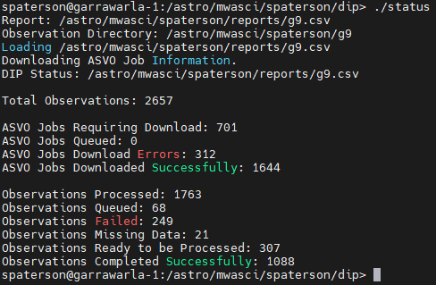
Steps
Setup the config file.
Place your obs IDs into the CSV template.
Run ./download <# of observations>
Run sbatch dip.sbatch
When ready to mosaic, run sbatch mosaic.sbatch
obsdir = '/astro/mwasci/user/observations'
mosaicdir = '/astro/mwasci/user/mosaic'
reportCsv = '/astro/mwasci/user/dip/dip_report.csv'
briggs = '0.3'
tukey = '875'
ra = '135'
dec = '0.5'
mosaicSample = 0
The status can viewed at any time by running: ./status

Slide 5
dip.sbatch
Symlinks to measurement sets created in the observations directory.
Nextflow schedules individual SLURM jobs.
Each observation is processed concurrently.
Calibrate
(MWA-Reduce)
Image
(WSCLEAN)
Post Image 0000
Post Image 0002
Post Image 0001
Post Image MFS
Post Image 0003

Slide 6
Calibration
Modified aocal_plot.py from MWA-Calplots (Hancock 2023).

Slide 7
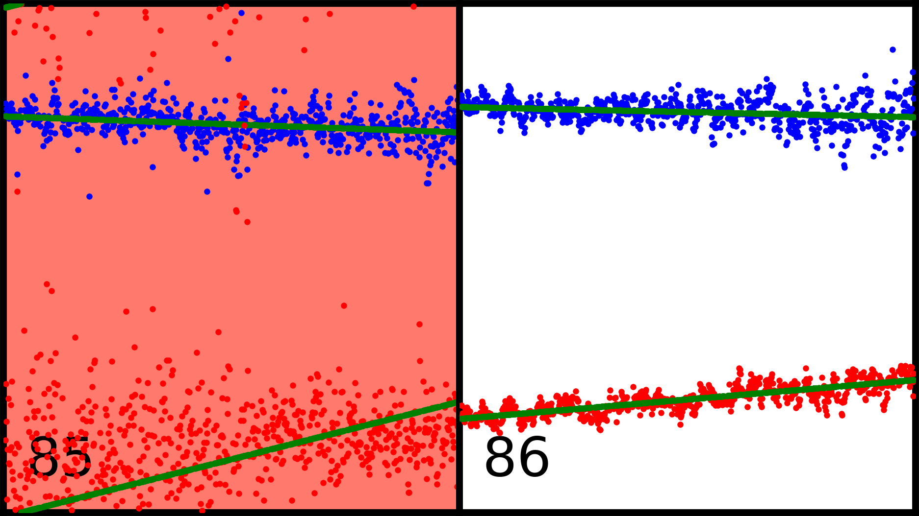
Calibration
Antenna RMSE
85 | 86
11.68 | 9.30
67.37 | 6.24
Cut-Off Value
20
Modified aocal_plot.py from MWA-Calplots (Hancock 2023).

Slide 8
Imaging

Slide 9
Imaging

Slide 10
Imaging

Slide 11
Imaging
Clean linear polarizations separately with WSCLEAN (Offringa et al. 2014).
W-Stacking > W-Gridding (~2.5x Quicker)
Image Size: 8000 x 8000px > 10000 x 10000px
Mgain (Peak reduction per major iteration): 0.85 > 0.75
Nmiter (Maximum # of major iterations): 5 > 10

Slide 12
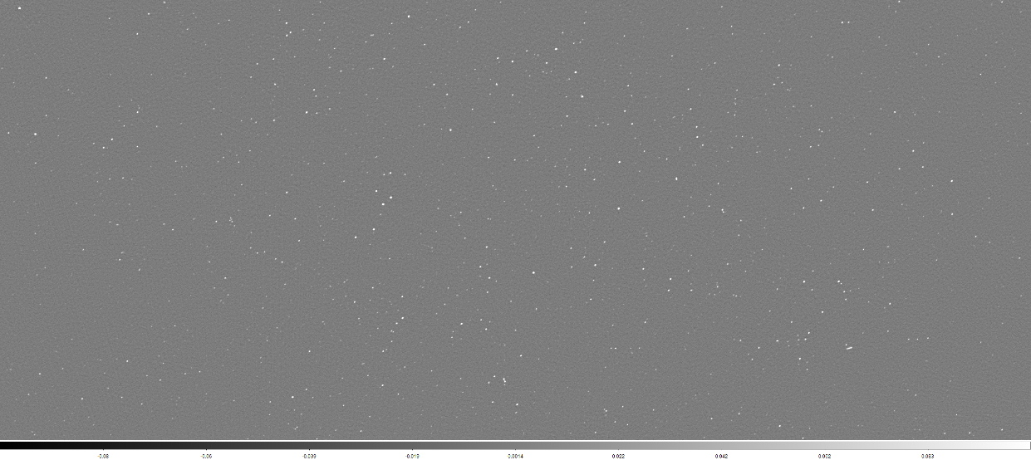
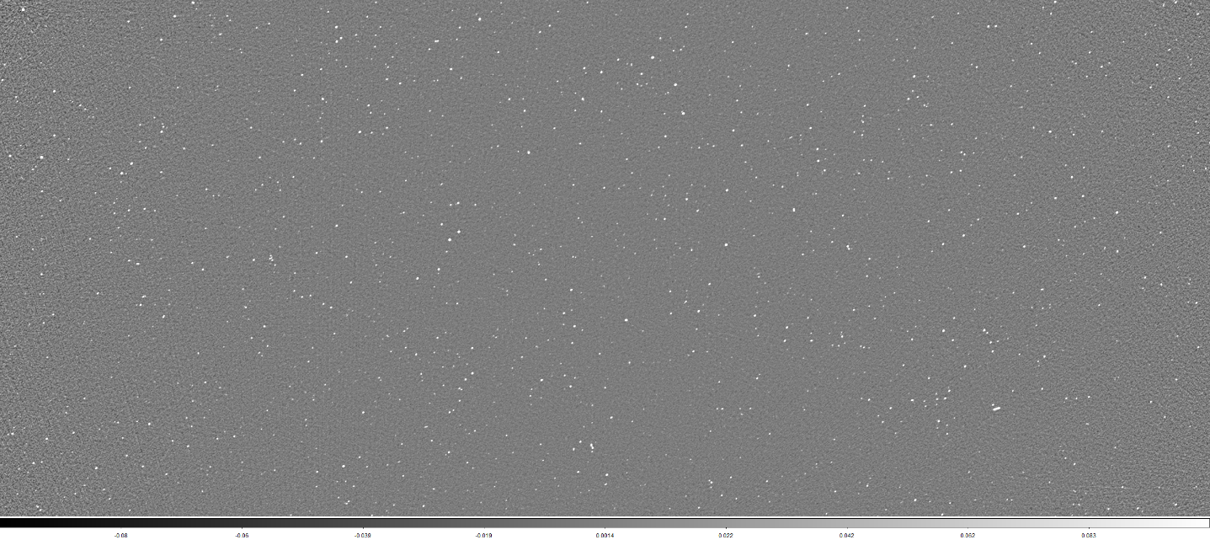
Post Image - Stokes I
$I_{I}\left(l\right)=\frac{\sum_{p}{\left.A\left(p\right)B(l,p)I(l,p)/{σ^{2}}(p\right)}}{\sum_{p}{\left.A^{2}\left(p\right)B^{2}(l,p)/{σ^{2}}(p\right)}}$
(Morgan, Chhetri, and Ekers 2022)
Matched to the GLEAM catalogue (Hurley-Walker et al. 2016).
Flux_warp (Duchesne et al. 2020): Using 2-D linear radial basis function interpolation.

Slide 13
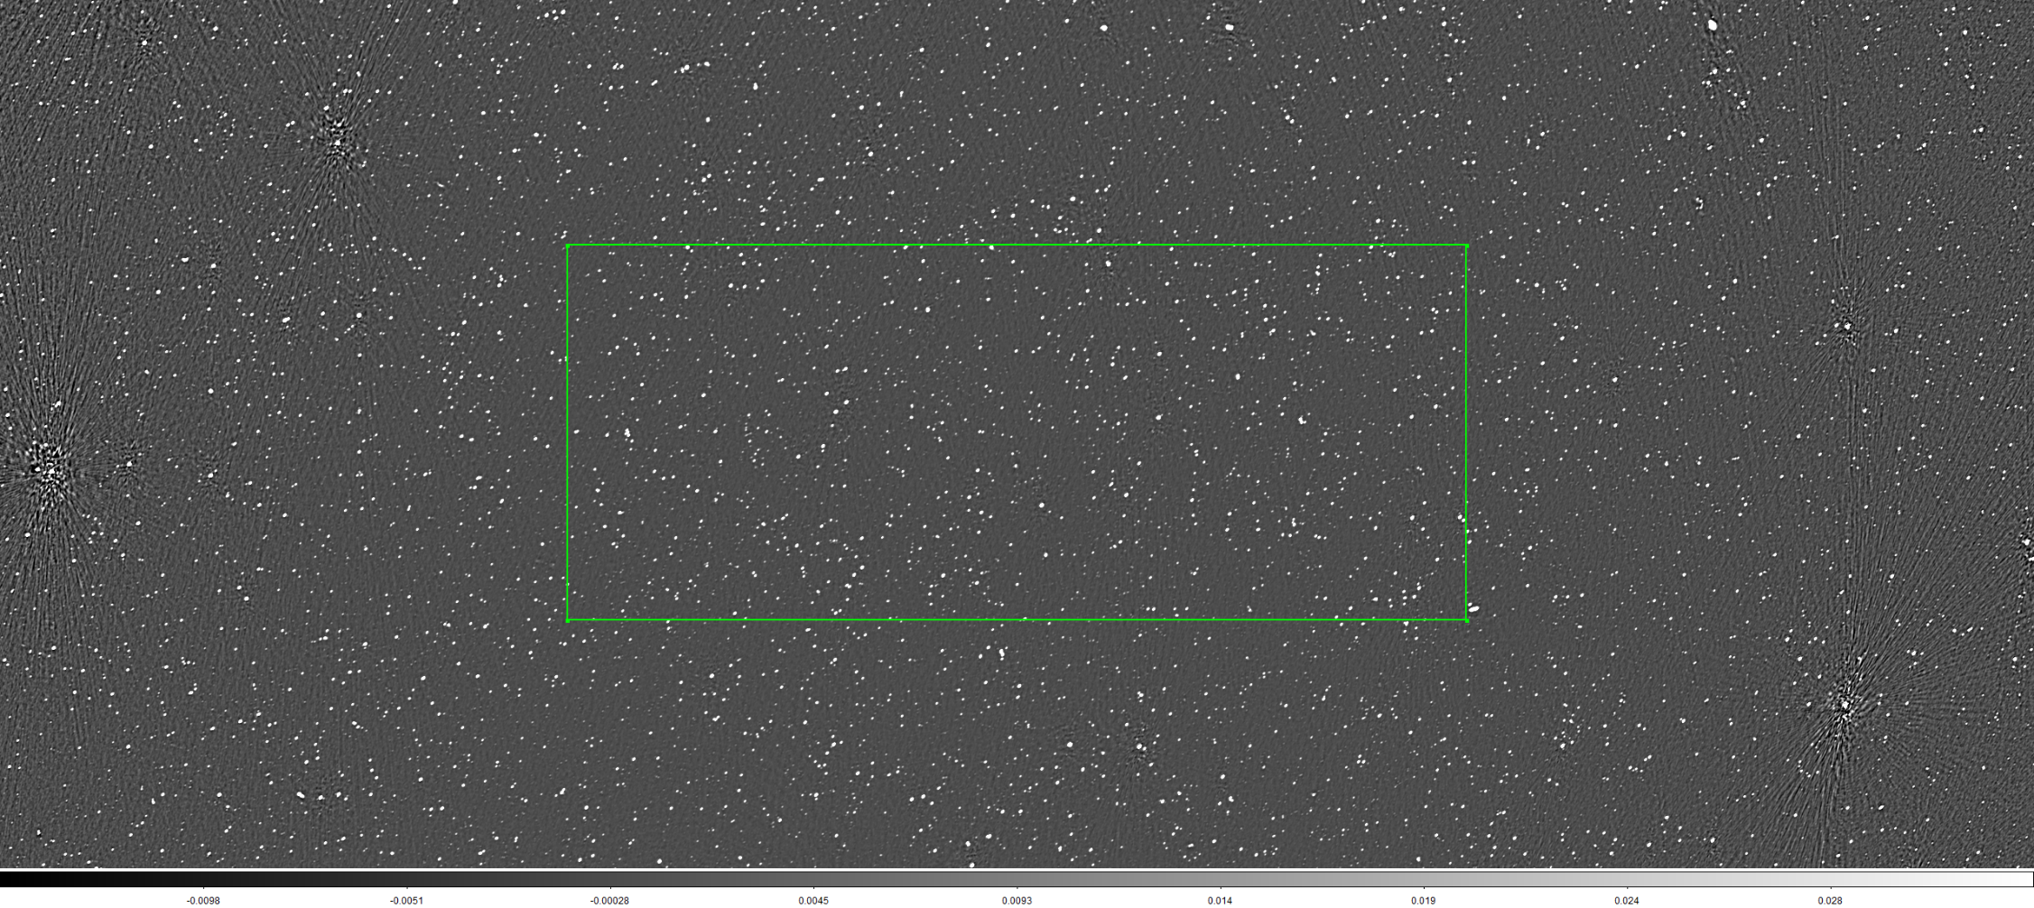
Mosaicking
Convolve observations to common beam using RACS-Tools (Thomson 2023).
Mosaic with SWARP (Bertin et al. 2002).
Currently investigating optimum observation selection.
959 observations
Central RMS: ~900 μJy/beam
https://github.com/sjpaterson/dip

Slide 14
References
Bertin, Emmanuel, Yannick Mellier, Mario Radovich, Gilles Missonnier, Pierre Didelon, and Bertrand Morin. 2002. “The TERAPIX Pipeline.” Astronomical Data Analysis Software and Systems XI 281 (January): 228.
Di Tommaso, Paolo, Maria Chatzou, Paolo Di Tommaso, Pablo Prieto Barja, Emilio Palumbo, and Cedric Notredame. 2017. “Nextflow Enables Reproducible Computational Workflows.” Nature Biotechnology 35 (4): 316–19. https://doi.org/10.1038/nbt.3820.
Duchesne, S. W., Melanie Johnston-Hollitt, Zi-Qiang Zhu, Randall B. Wayth, and J. L. B. Line. 2020. “Murchison Widefield Array Detection of Steep-Spectrum, Diffuse, Non-Thermal Radio Emission within Abell 1127.” Publications of the Astronomical Society of Australia 37 (January). https://doi.org/10.1017/pasa.2020.29.
Hancock, Paul. 2023. “GitHub - MWATelescope/Mwa-Calplots: Provide Aocal Library and Aocal_plot Script.” GitHub. 2023. https://github.com/MWATelescope/mwa-calplots.
Hurley-Walker, N., J. R. Callingham, P. J. Hancock, T. M. O. Franzen, L. Hindson, A. D. Kapińska, John S. Morgan, et al. 2016. “GaLactic and Extragalactic All-Sky Murchison Widefield Array (GLEAM) Survey – I. A Low-Frequency Extragalactic Catalogue.” Monthly Notices of the Royal Astronomical Society 464 (1): 1146–67. https://doi.org/10.1093/mnras/stw2337.
Hurley-Walker, N., Tim J. Galvin, S. W. Duchesne, X. Zhang, John S. Morgan, P. J. Hancock, Tao An, et al. 2022. “GaLactic and Extragalactic All-Sky Murchison Widefield Array Survey EXtended (GLEAM-X) I: Survey Description and Initial Data Release.” Publications of the Astronomical Society of Australia 39 (January). https://doi.org/10.1017/pasa.2022.17.
Morgan, John, Rajan Chhetri, and Ron Ekers. 2022. “A Census of Compact Sources at 162 MHz: First Data Release from the MWA Phase II IPS Survey.” Publications of the Astronomical Society of Australia 39 (January). https://doi.org/10.1017/pasa.2022.56.
Offringa, A. R., Benjamin McKinley, Natasha Hurley-Walker, Frank H. Briggs, Randall B. Wayth, David L. Kaplan, M. G. Bell, et al. 2014. “Wsclean: An Implementation of a Fast, Generic Wide-Field Imager for Radio Astronomy.” Monthly Notices of the Royal Astronomical Society 444 (1): 606–19. https://doi.org/10.1093/mnras/stu1368.
Thomson, Alec. 2023. “GitHub - AlecThomson/RACS-Tools: Useful Scripts for RACS.” GitHub. 2023. https://github.com/AlecThomson/RACS-tools.

