Slide 1




Ten years of Pulsars and Fast Transients with the MWA
Ramesh Bhat
The Pulsars & Fast Transients SWG
The MWA 10-year celebration Meeting, 25-28 July 2023

Slide 2
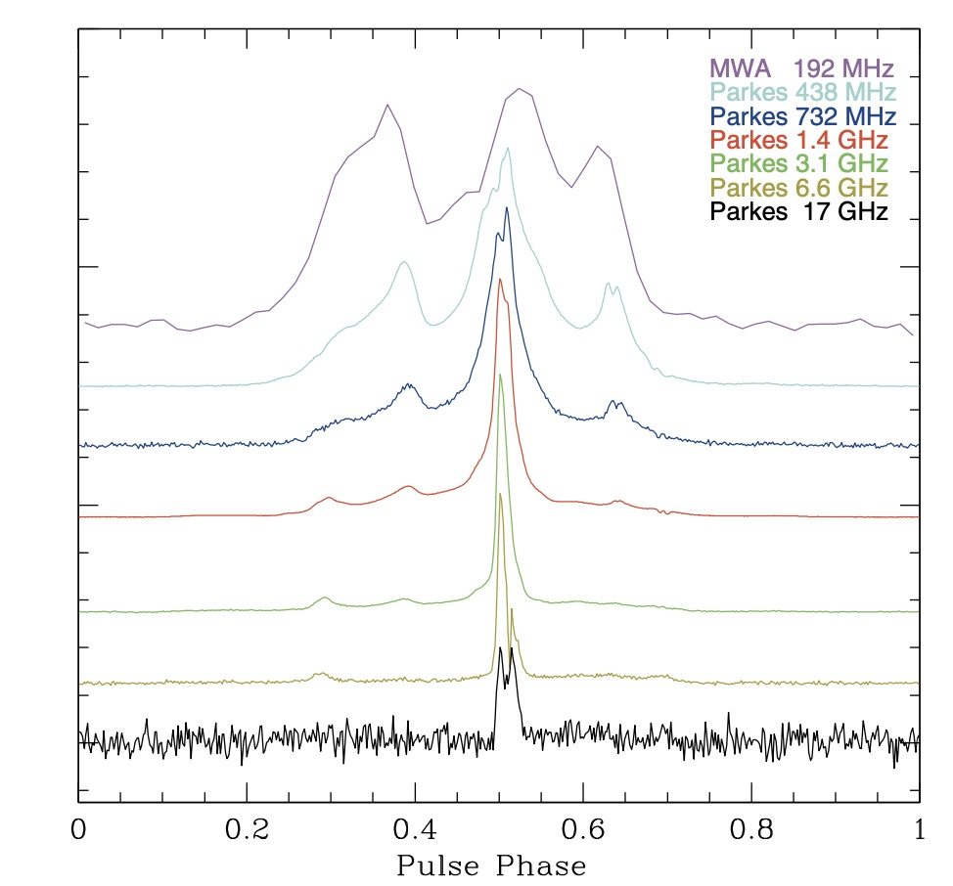
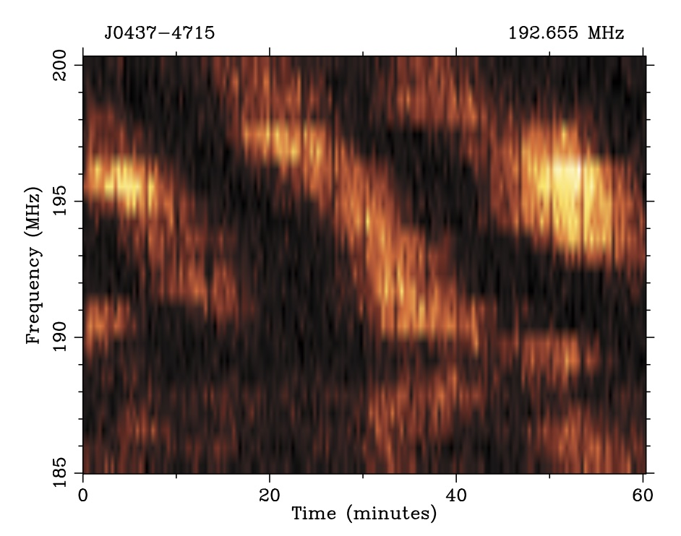
10 years of Pulsars & Fast Transients
Bhat et al. (2014), ApJ Letters, 791, 32
  Pulsars and Fast Transients (PFT) is relatively new SWG
      Formalised by mid-2021, and SWG policy endorsed in mid-2022
      Science using VCS + software subsystems
      Pulsars, FRBs, cosmic rays, passive radar, etc.
  Pulsar science started much earlier, soon after the commissioning of the array (for imaging) in 2013
  First pulsar science publication in 2014 (MSP J0437-4715 scintillation & profile evolution), using the “VCS mode” observations made in September 2013
    “Incoherent addition” of 126 tiles, 12 coarse channels, ~5% of the full array sensitivity in coherent beam
  VCS was not commissioned until around 2015 (Tremblay et al. 2015)

Slide 3
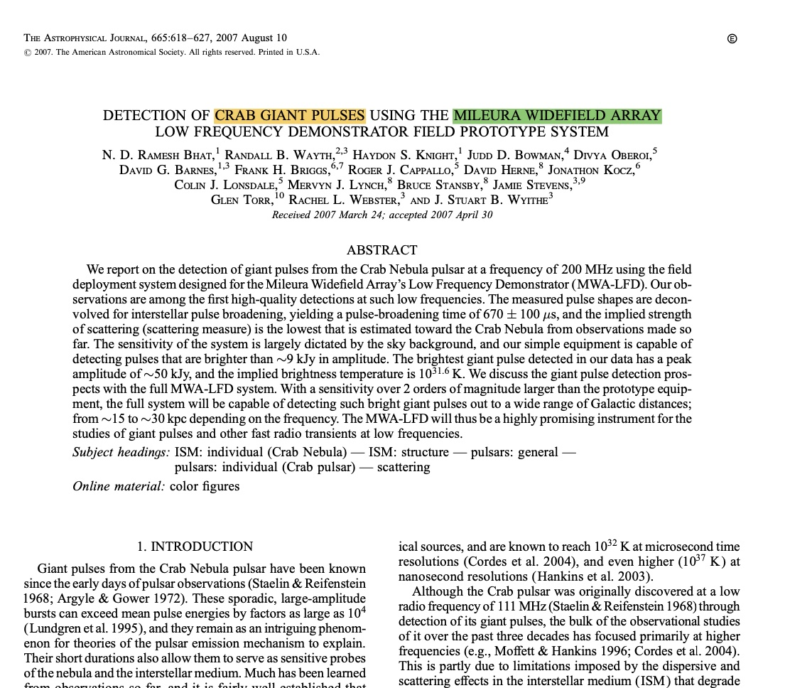
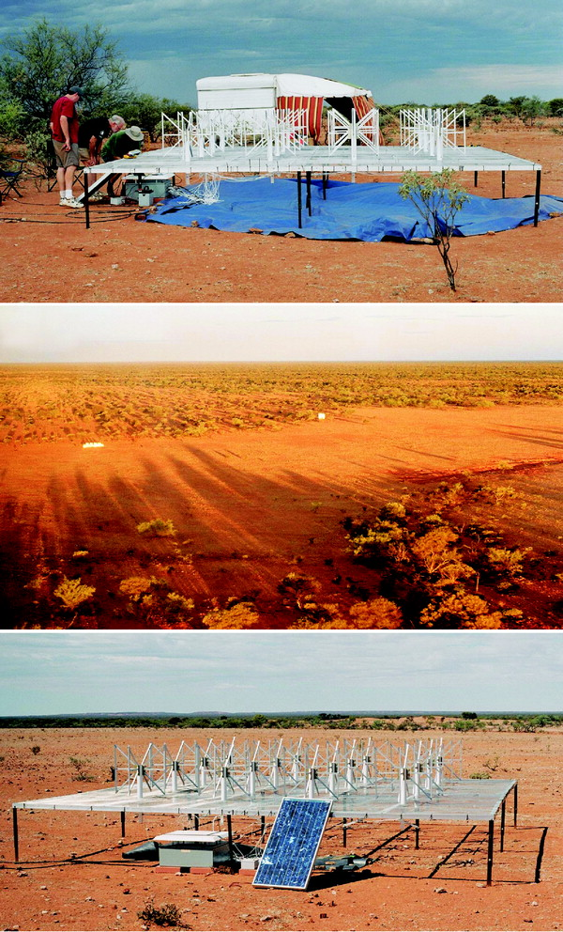
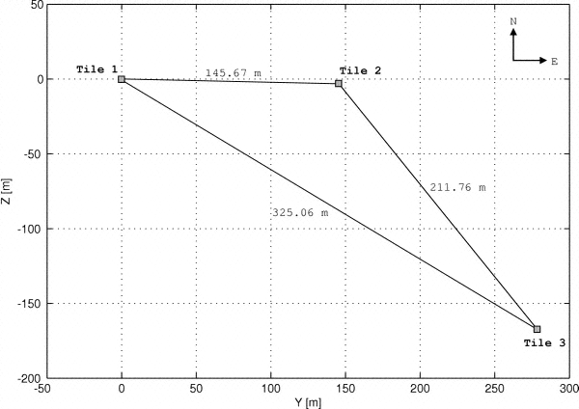
Crab giants from “3T MWA”
3
Notes:
7/25/23
3
3

Slide 4
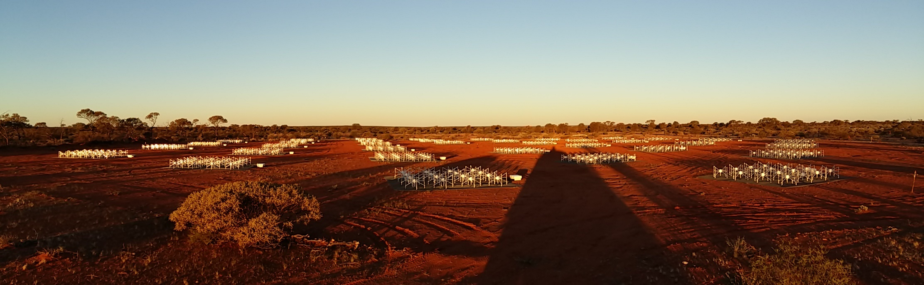
From “3T MWA” to “128T MWA”
3T “MWA LFD”
The Phase II compact/extended array
Early prototype (3 tiles)
Crab giant pulses
> 9 kJy pulses
< 0.2 TB/hour
0.6 TB of data
The full array of 128 (144) tiles
SMART for pulsars + discoveries
down to ~10 mJy (at 150 MHz)
56 (64) TB/hour (MWAX VCS)
Several PB of data!
4
Notes:
7/25/23
4
4

Slide 5
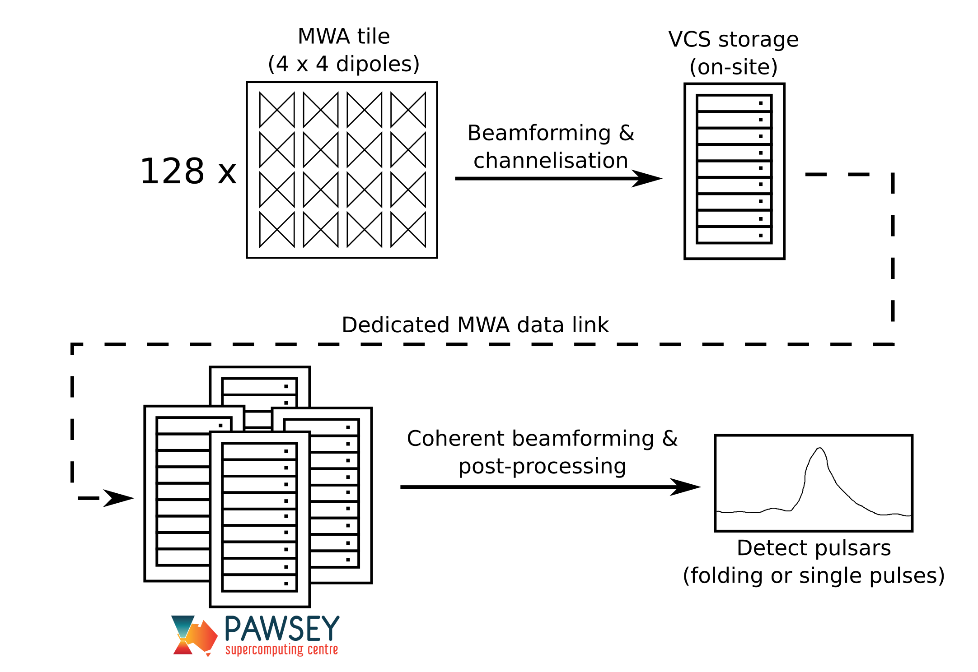
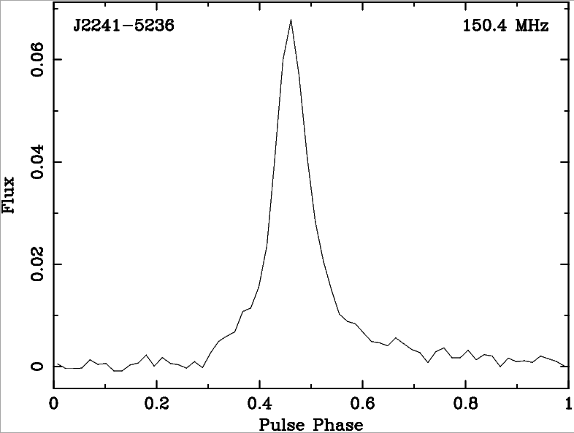
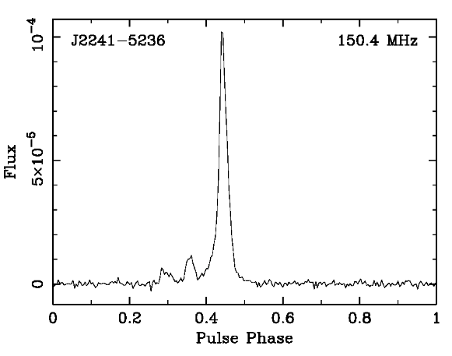
Pulsar (PFT) “observing mode” of the MWA
MWA’s Pulsar signal path
(Tremblay et al., 2015)
10 kHz 100 μs
@ Tile level for pointing
30 TB/hr
100 μs
PSRFITS
(Ord et al., 2019)
Full Coherent beamform
∼0.8 μs
vdif
(McSweeney et al, 2020)

Slide 6
VCS Data Processing
From the 2017 Project meeting
Arrange into
coarse channels
Incoherent
Beam
Record
(MRO)
Archive
(Pawsey)
Coherent
Beam
Correlate
~28 TB of
data/hour
‘Recombine’
within archive
‘Galaxy’ cluster
at Pawsey
Science:
Pulsars, Fast Transients, FRBs, spectral lines, SETI, passive radar. etc.
Notes:
Once we get hold of these data – you can process them in different ways
The simplest is incoherent sum – detect powers and sum them – preserves the FoV but gives a sens improvement only sqrt(N) – for MWA that is only 10% of the max achivable sensitivity
That is our quick check – form an incoherent beam and look at every detectable pulsars

Slide 7
VCS Data Processing
From the 2017 Project meeting
Arrange into
coarse channels
Incoherent
Beam
Record
(MRO)
Archive
(Pawsey)
Coherent
Beam
Correlate
~28 TB of
data/hour
‘Recombine’
within archive
‘Galaxy’ cluster
at Pawsey
Science:
Pulsars, Fast Transients, FRBs, spectral lines, SETI, passive radar. etc.
Notes:
Once we get hold of these data – you can process them in different ways
The simplest is incoherent sum – detect powers and sum them – preserves the FoV but gives a sens improvement only sqrt(N) – for MWA that is only 10% of the max achivable sensitivity
That is our quick check – form an incoherent beam and look at every detectable pulsars

Slide 8
PFT (VCS) science with the MWA
Pulsars
Cosmic ray detection
Janagal et al. (2023a), MNRAS, 523, 5934, “Single-pulse analysis and average emission characteristics of PSR J1820-0427 from observations made with the MWA and uGMRT”
McSweeney et al. (2023), ApJ, 952, 73, “Testing the circularity of PSR B0818-41’s carousel”
Bhat et al. (2023a), PASA, 40, e021, “The Southern-sky MWA Rapid Two-metre (SMART) pulsar survey – I. Survey design and processing pipeline”
Bhat et al. (2023b), PASA, 40, e020, “The Southern-sky MWA Rapid Two-metre (SMART) pulsar survey – II. Survey status, pulsar census and first pulsar discoveries”
Sett et al. (2023), PASA, 40, e003, “Image-based searches for pulsar candidates using MWA VCS data”
Tian et al. (2023), MNRAS, 518, 4278, “A targeted search for repeating fast radio bursts with the MWA”
Swainston et al. (2022b), PASA, 39, e056, “pulsar_spectra: A pulsar flux density catalogue and spectrum fitting repository”
Swainston et al. (2022a), 39, e020, PASA, “MWA tied-array processing IV: A multi-pixel beamformer for pulsar surveys and ionospheric corrected localization”
Tian et al. (2022), MNRAS, 514, 2756, “High time resolution search for prompt radio emission from the long GRB 210419A with the Murchison Widefield Array”
Kaur, et al. (2022), ApJ Letters, 930, L27, “Detection of frequency-dependent dispersion measure toward the millisecond pulsar J2241-5236 from contemporaneous wideband observations”
McSweeney et al. (2022), ApJ, 933, 210, “Independent discovery of a nulling pulsar with unusual subpulse drifting properties with the Murchison Widefield Array”
Swainston et al. (2021), ApJ Letters, 911, L26, “Discovery of a steep-spectrum low-luminosity pulsar with the Murchison Widefield Array”
Williamson et al. (2021), JAI, 10, 2150003, “An ultra-high time resolution cosmic-ray detection mode for the Murchison Widefield Array”
McSweeney et al. (2020), 37, e034, “MWA tied-array processing III: Microsecond time resolution via a polyphase synthesis filter”
McSweeney et al. (2019b), 883, 28, “The frequency-dependent behavior of subpulse drifting. I. Carousel geometry and emission heights of PSR B0031-07”
McSweeney et al. (2019a), ApJ, 870, 48, “On the geometry of curvature radiation and implications for subpulse drifting ”
Meyers et al. (2019), PASA, 36, e034, “The emission and scintillation properties of RRAT J2325-0530 at 154 MHz and 1.4 GHz”
Kaur et al. (2019), 882, 133, “A high time resolution study of the millisecond pulsar J2241-4236 at frequencies below 300 MHz”
Xue et al. (2019), PASA, 36, e025, “MWA tied-array processing II. Polarimetric verification and analysis of two bright southern pulsars”
Ord et al. (2019), PASA, 36, e030, “MWA tied-array processing I. calibration and beamformation”
Kirsten et al. (2019), ApJ, 874, 179, “Probing pulsar scattering between 120 and 280 MHz with the MWA”
Meyers et al. (2018), ApJ, 869, 134, “Hunting for low-frequency emission from the intermittent pulsar J1107-5907 at low frequencies”
Bhat et al. (2018), ApJS, 238, 1, “Observations of low-frequency emission from millisecond pulsars and multipath propagation in the interstellar medium”
Xue et al. (2017), PASA, 34, e070, “A census of southern pulsars at 185 MHz”
Meyers et al. (2017), ApJ, 851, 20, “Spectral flattening at low frequencies in Crab giant pulses”
McSweeney et al. (2017), ApJ, 836, 224, “Low-frequency observations of the sub-pulse drifter PSR J0034-0721 with the MWA”
Bhat et al. (2016), ApJ, 818, 86, “Scintillation arcs in low-frequency observations of the millisecond pulsar J0437-4715”
Oronsaye et al. (2015), ApJ, 809, 51, “Simultaneous observations of giant pulses from the Crab, with the MWA and Parkes: implications for giant-pulse emission mechanism”
Tremblay et al. (2015), PASA, 32, e005, “The high time and frequency resolution capabilities of the MWA”
Bhat et al. (2014), ApJ, 791, L32, “The low-frequency characteristics of PSR J0437-4715 observed with the MWA”
Bhat et al. (2007), ApJ, 665, 618, “Detection of Crab giant pulses using the Mileura Widefield Array Low Frequency Demonstrator field prototype system”
James (2022), Physical Review D, 105, 023014, “Nature of radio-wave radiation from particle cascades”
Williamson, et al. (2021), Journal of Astronomical Instrumentation, 10, 2150003, “An ultra-high time resolution cosmic-ray detection mode for the Murchison Widefield Array
Bray et al. (2020), Nuclear Inst. And Methods in Physics Research, 973, 164168, “The SKA particle array prototype: The first particle detector at the Murchison Radio-astronomy Observatory”
Passive radar applications
Palmer et al. (2017), "Surveillance of Space using passive radar and the Murchison Widefield Array," 2017 IEEE Radar Conference (RadarConf), Seattle, WA, USA, 2017, pp. 1715-1720,
Hennessy et al. (2019), "Improved Techniques for the Surveillance of the Near Earth Space Environment with the Murchison Widefield Array," 2019 IEEE Radar Conference (RadarConf), Boston, MA, USA, 2019, pp. 1-6, doi: 10.1109/RADAR.2019.8835821.
Hennessy et al. (2021), "Uncued Detection and Initial Orbit Determination From Short Observations With the Murchison Widefield Array," in IEEE Aerospace and Electronic Systems Magazine, 36, no. 10, pp. 16-30,
Hennessy et al. (2022), “Establishing the Capabilities of the Murchison Widefield Array as a Passive Radar for the Surveillance of Space,” Remote Sens. 2022, 14, 2571
… and 8 PhD completions!
Notes:
Once we get hold of these data – you can process them in different ways
The simplest is incoherent sum – detect powers and sum them – preserves the FoV but gives a sens improvement only sqrt(N) – for MWA that is only 10% of the max achivable sensitivity
That is our quick check – form an incoherent beam and look at every detectable pulsars

Slide 9

The 10-yr journey of PFT MWA
2007
2016
2019
2021
2023
Crab giants with 3 Tile the early prototype
(Bhat et al. 2007)
9
Notes:
7/25/23
9
9

Slide 10
The 10-yr journey of PFT MWA
15
2007
2016
2019
2021
2023
Crab giants with 3 Tile the early prototype
(Bhat et al. 2007)
10
Notes:
7/25/23
10
10

Slide 11
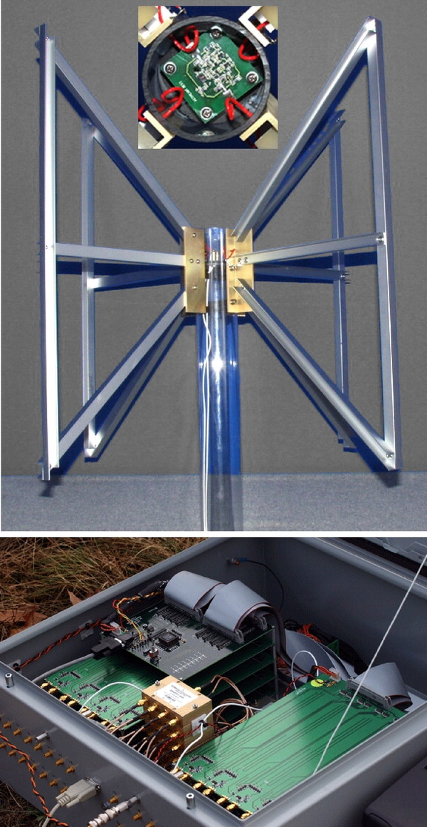
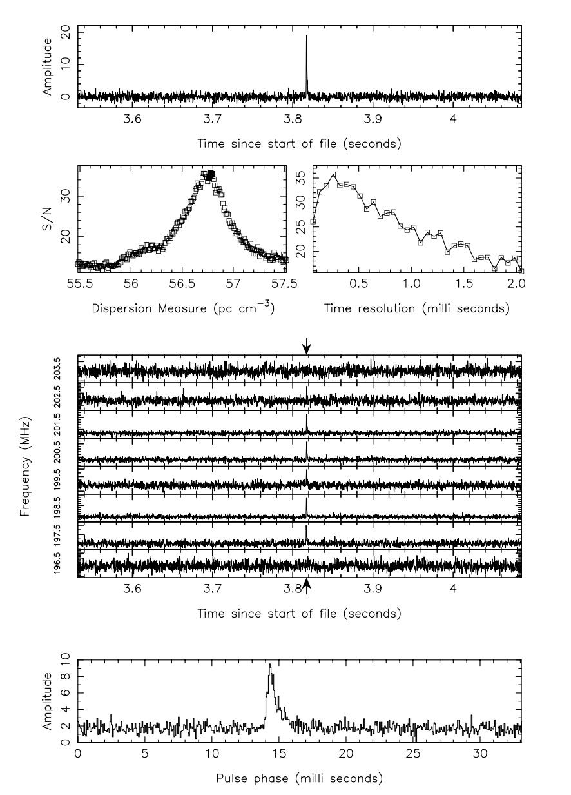
Crab giants from “3T MWA”
Bhat, Wayth, Knight, et al. (2007), ApJ, 665, 618
Only 4 independent data streams were recorded (effectively 2 tiles), 8 MHz bandwidth
ED correlator (Frank Briggs) + Randall’s “tied-array” beamformer
Data storage and access via Grangenet (10s files, 1000s of them!)
PSRDISP (and _not_ DSPSR!)
Multiple passes of incoherent filterbank, before forming a “coherent filterbank”
Fortuitious detection, thanks to the lowest degree of scattering (@ 200 MHz)
11
Notes:
7/25/23
11
11
Showed it to Steven, but he wans’t that excited…. (because he didn’t have much to do with MWA in those days…)
Showd it to Matthew, Q: ”is it coherently dedispersed”? (my first induction to the world of CD) ”your pulsar detection looks interesting… “ (MB)

Slide 12
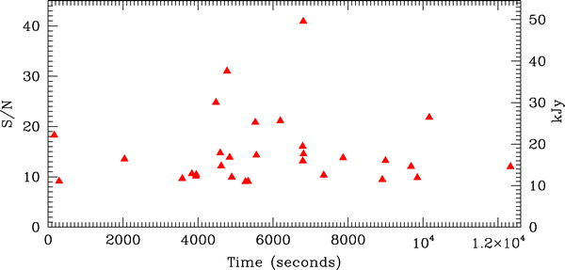
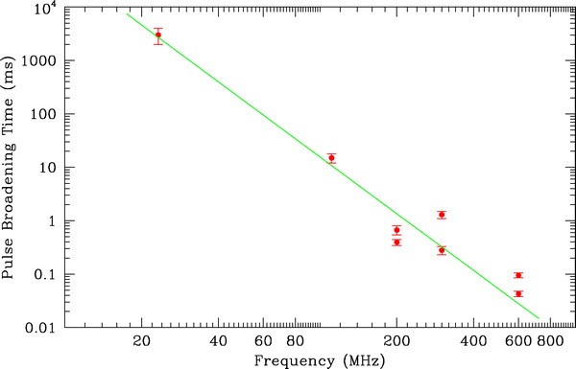
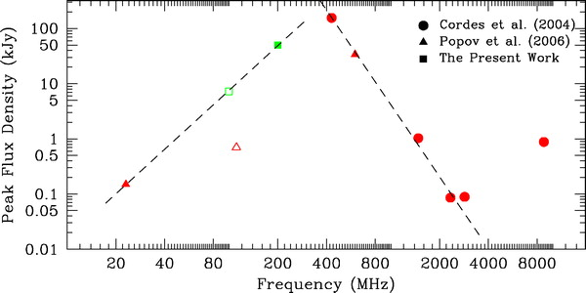
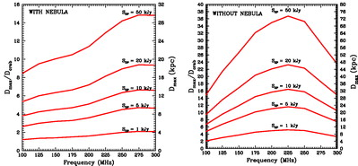
Crab giants from “3T MWA”
30+ pulses detected
Pulse broadening time
Brighest giant pulses
Detectabilty with a “512 Tile” MWA
Bhat, Wayth, et al. (2007), ApJ, 665, 618
12
Notes:
7/25/23
12
12

Slide 13
The 10-yr journey of PFT MWA
2007
2016
2019
2021
2023
Crab giants with 3 Tile the early prototype
(Bhat et al. 2007)
pulsar 0437 detection in full coherent beam
(Bhat et al. 2016)
13
Notes:
7/25/23
13
13

Slide 14
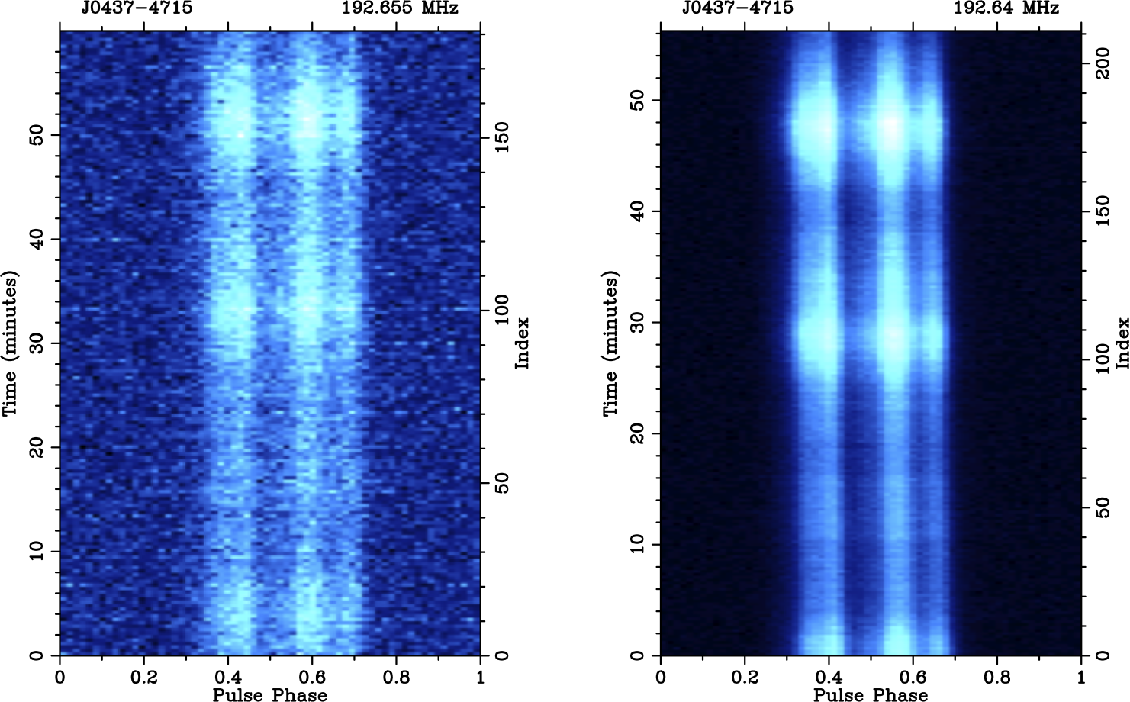
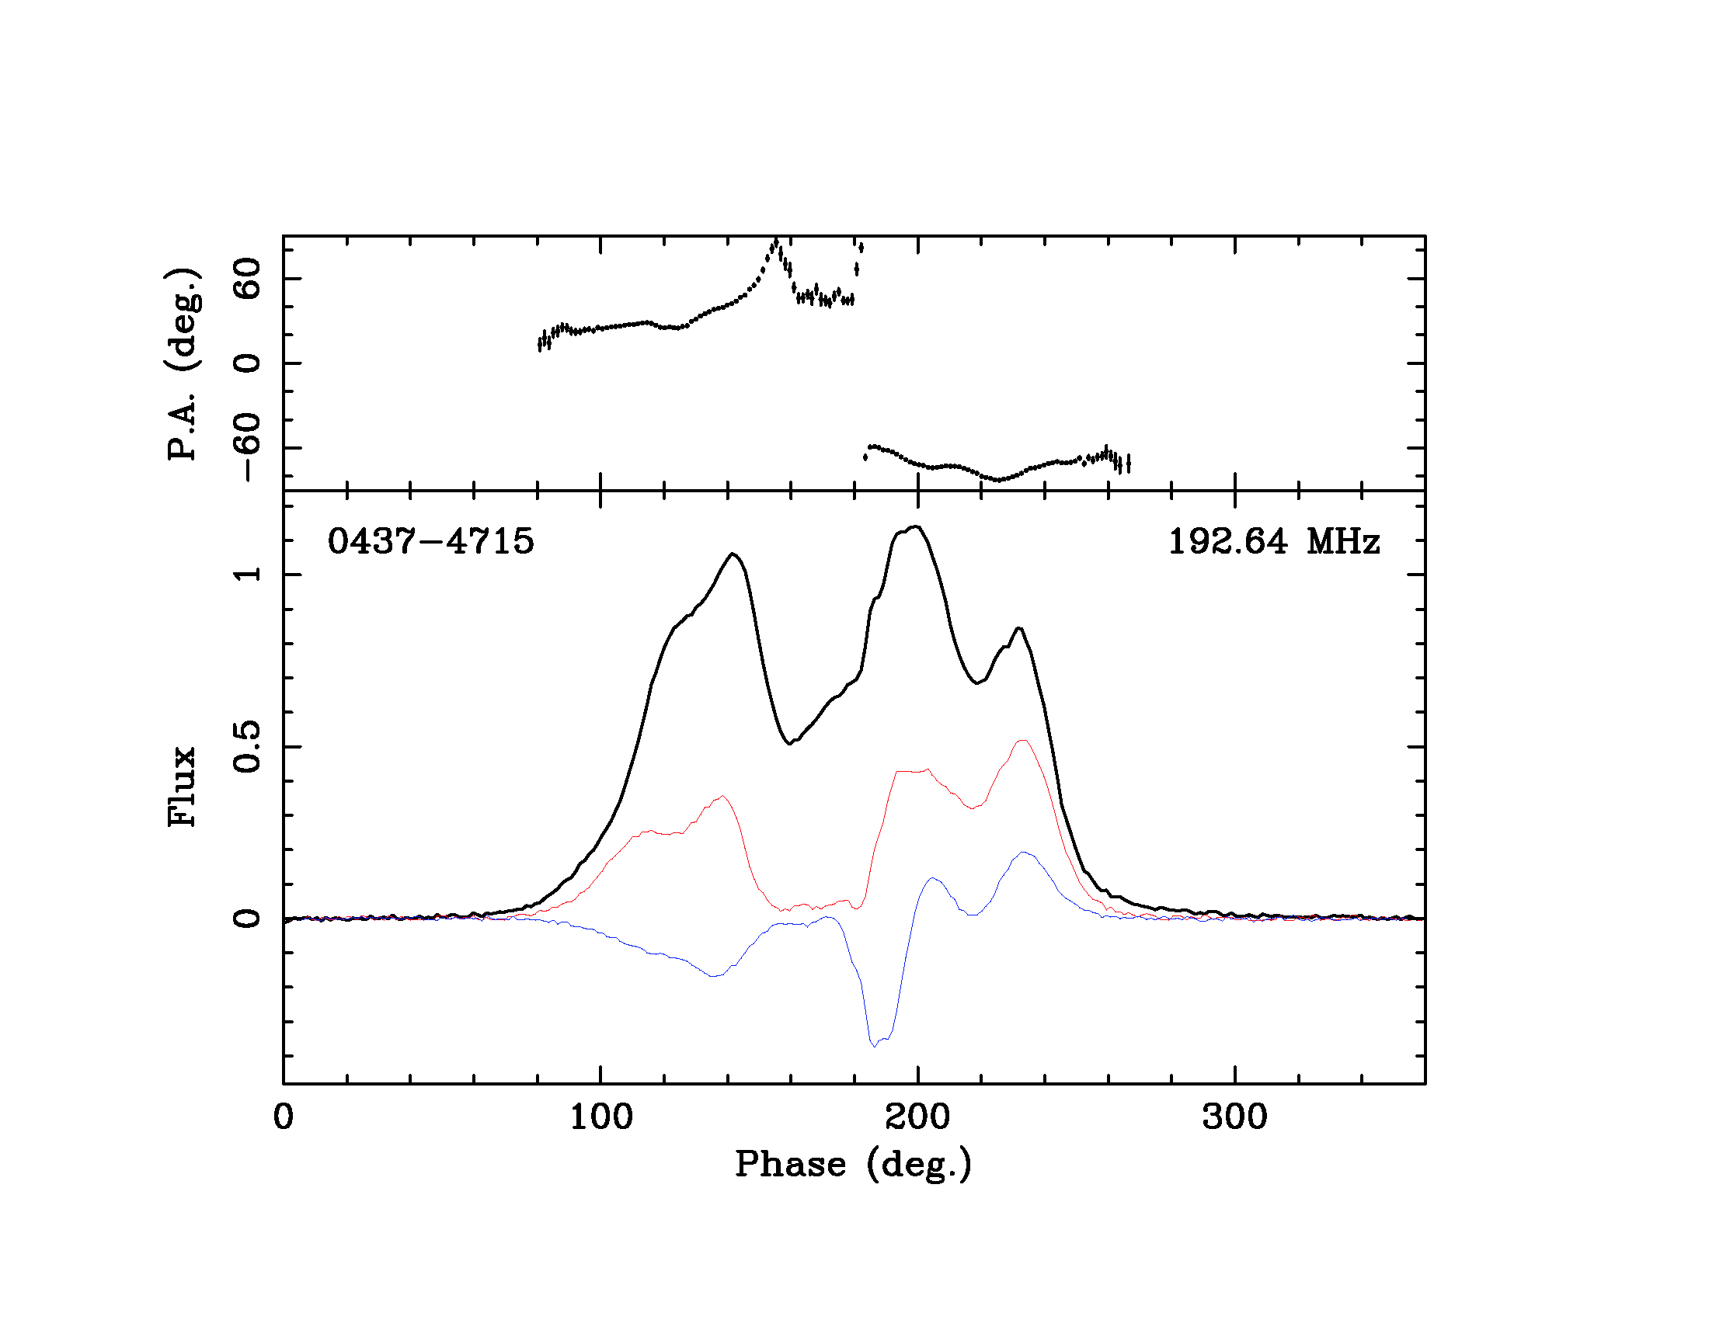
Coherent beam → 10 x improved sensitivity
PSR J0437-4715 @ MWA 200 MHz
And enables polarimetry
Ord et al. (2019)
Incoherent addition
Coherent addition
Bhat et al. (2016)

Slide 15
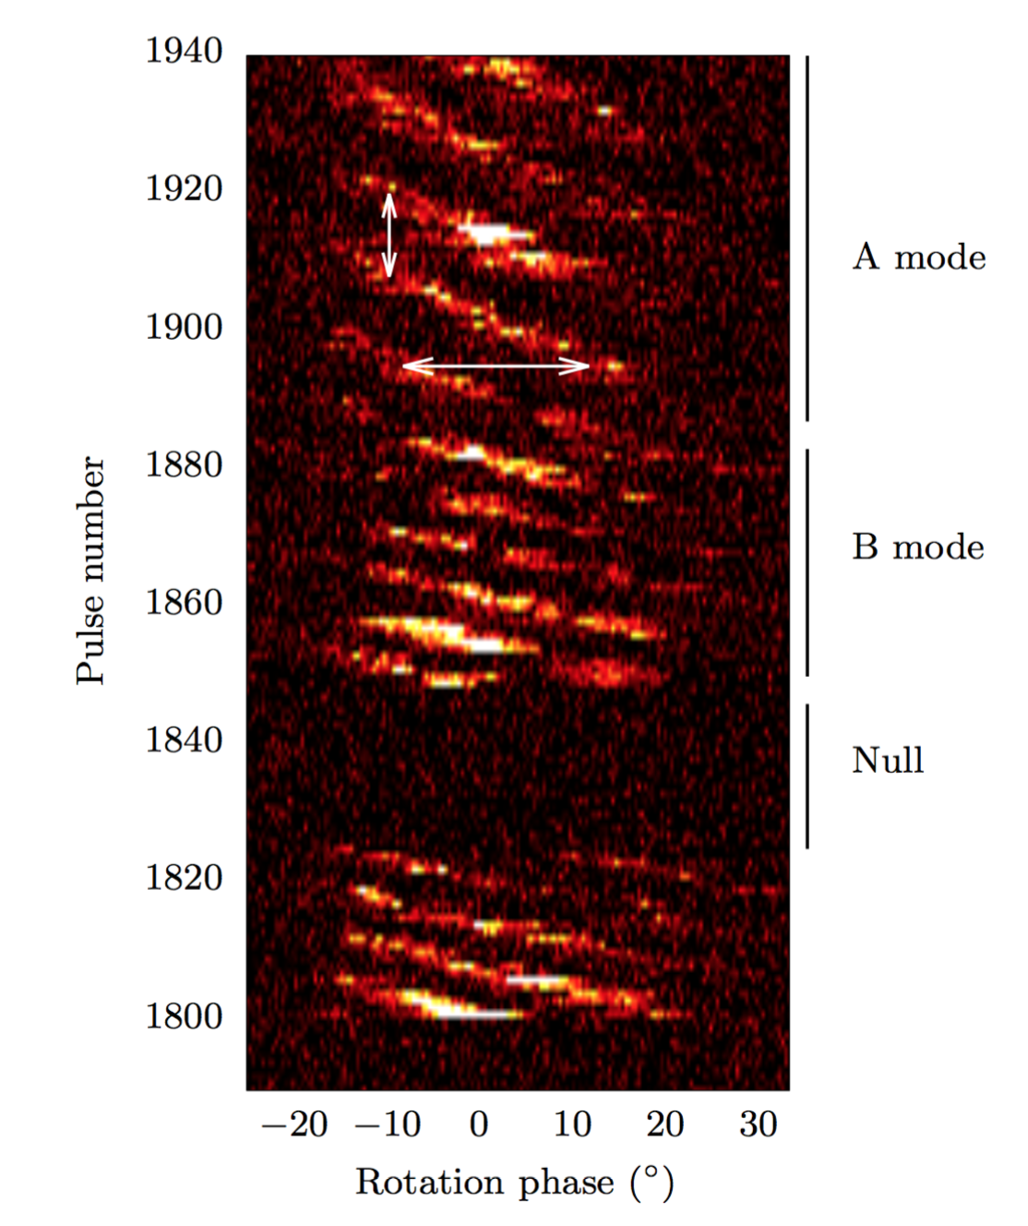
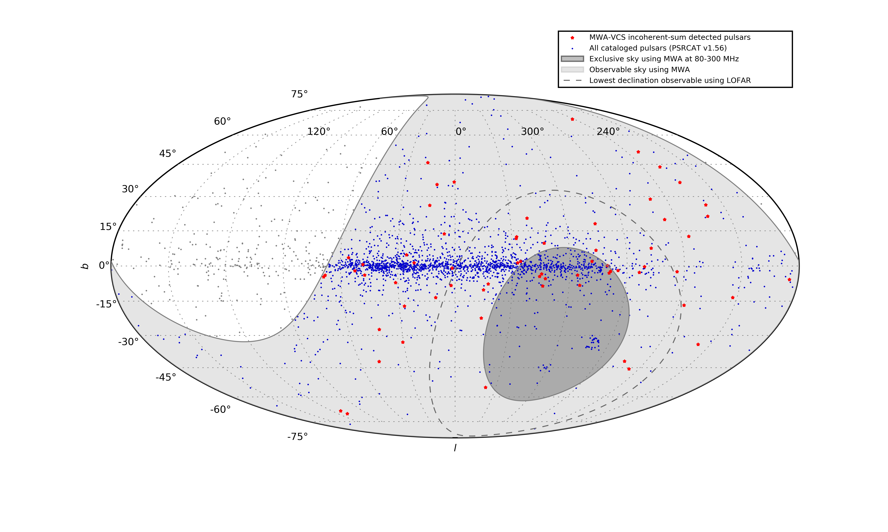
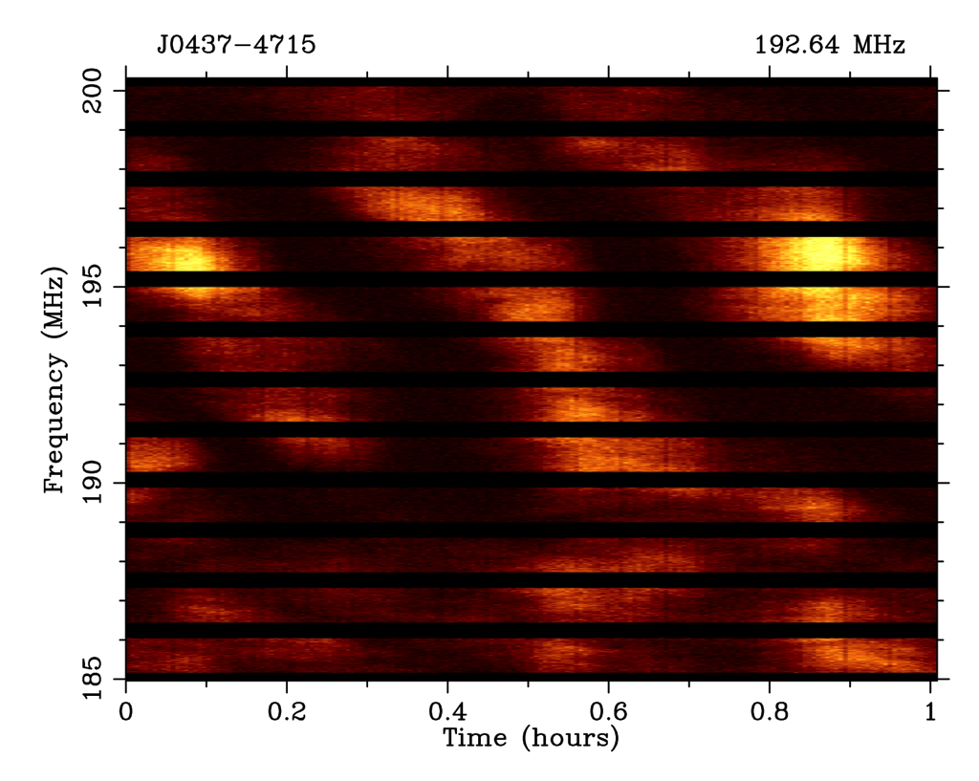
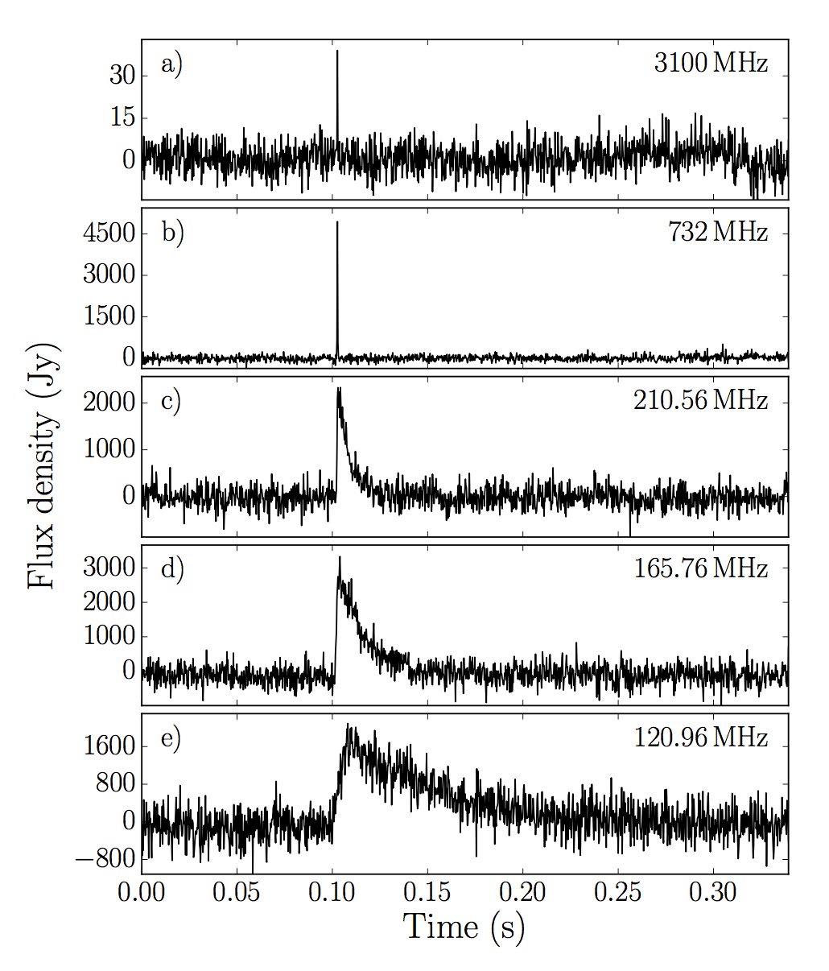
First paper splash on MWA Pulsars
60+ pulsar detections
Drifting of sub-pulses
J0034-0721
Xue et al. (2017), PASA, 34, e070
McSweeney et al. (2017), ApJ, 836, 224
Scintillation J0437-4715
Giant pulses from the Crab
Bhat et al. (2016), ApJ, 818, 86
Meyers et al. (2017), ApJ, 851, 1
Notes:
Once we get hold of these data – you can process them in different ways
The simplest is incoherent sum – detect powers and sum them – preserves the FoV but gives a sens improvement only sqrt(N) – for MWA that is only 10% of the max achivable sensitivity
That is our quick check – form an incoherent beam and look at every detectable pulsars

Slide 16
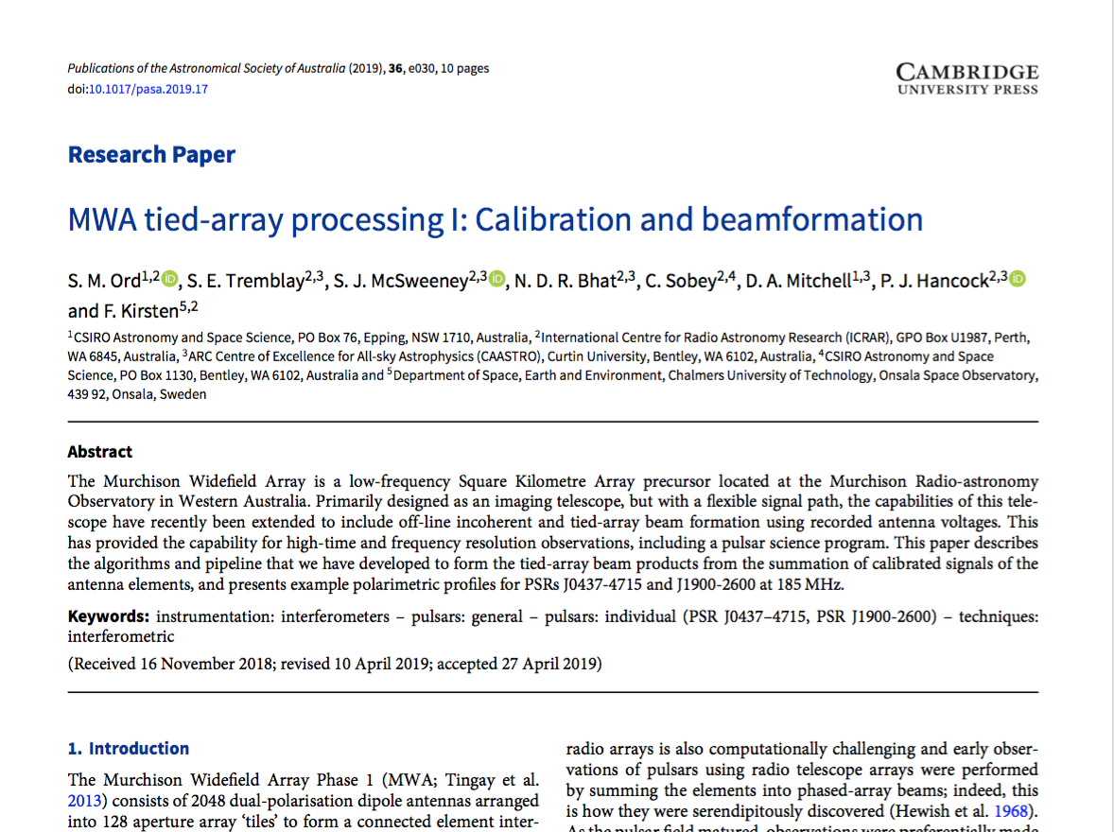

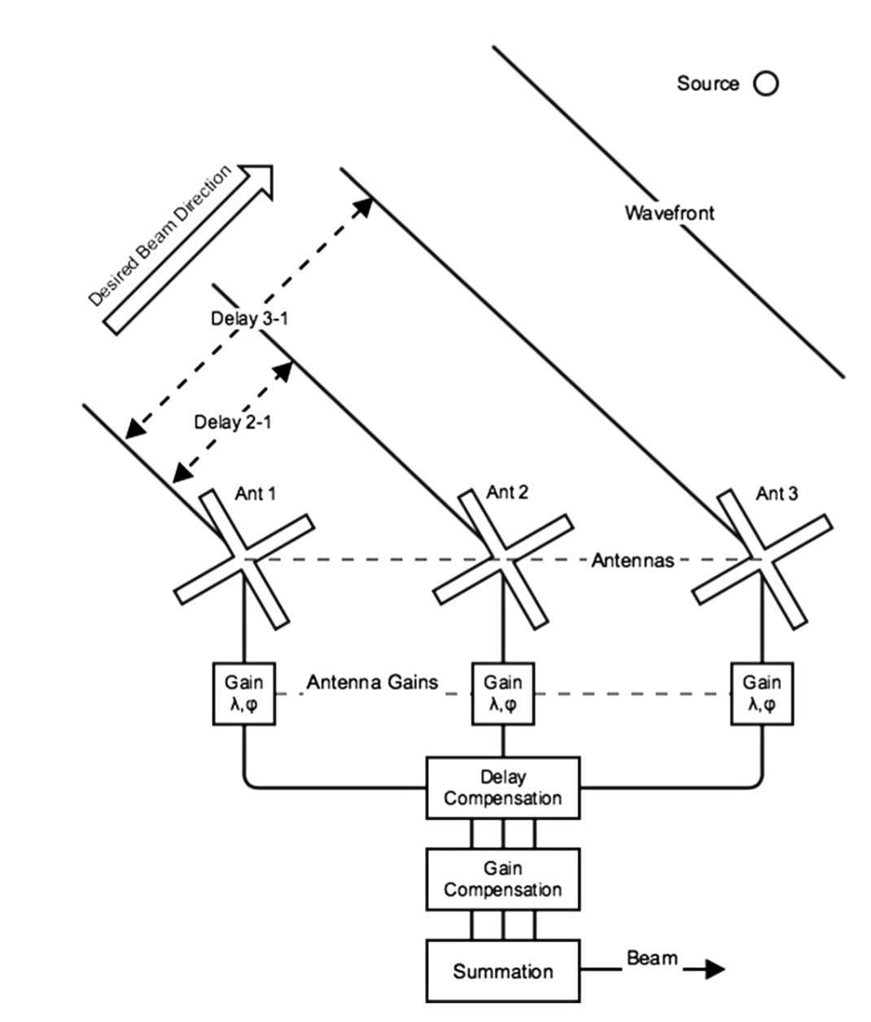


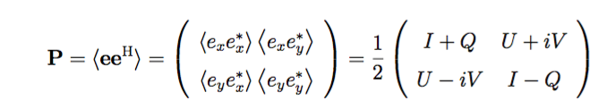
MWA tied-array beamformer
Instrumental response is modeled in terms of antenna-based Jones matrices formalism
Electric field vector
Ord et al. (2019)
Measured voltage
Jones matrix
Alignment matrix
Direction-independent Gain
Measured visibility:
Coherency matrix:

Slide 17
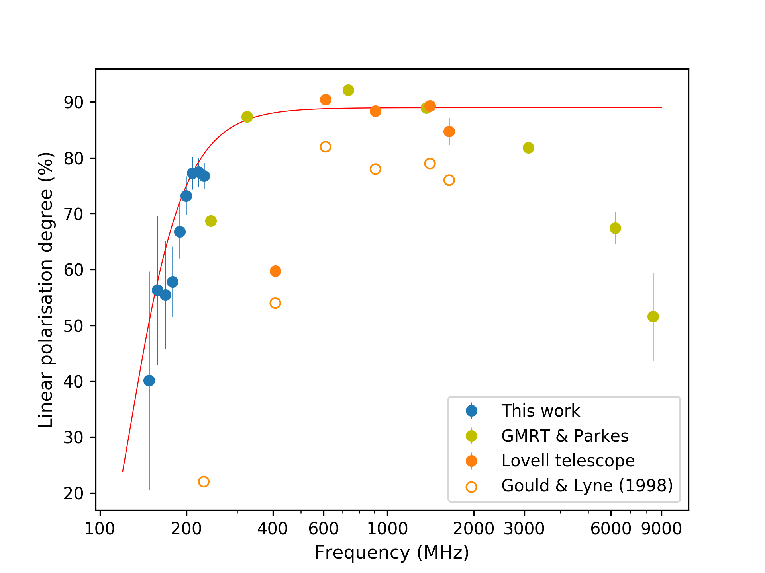
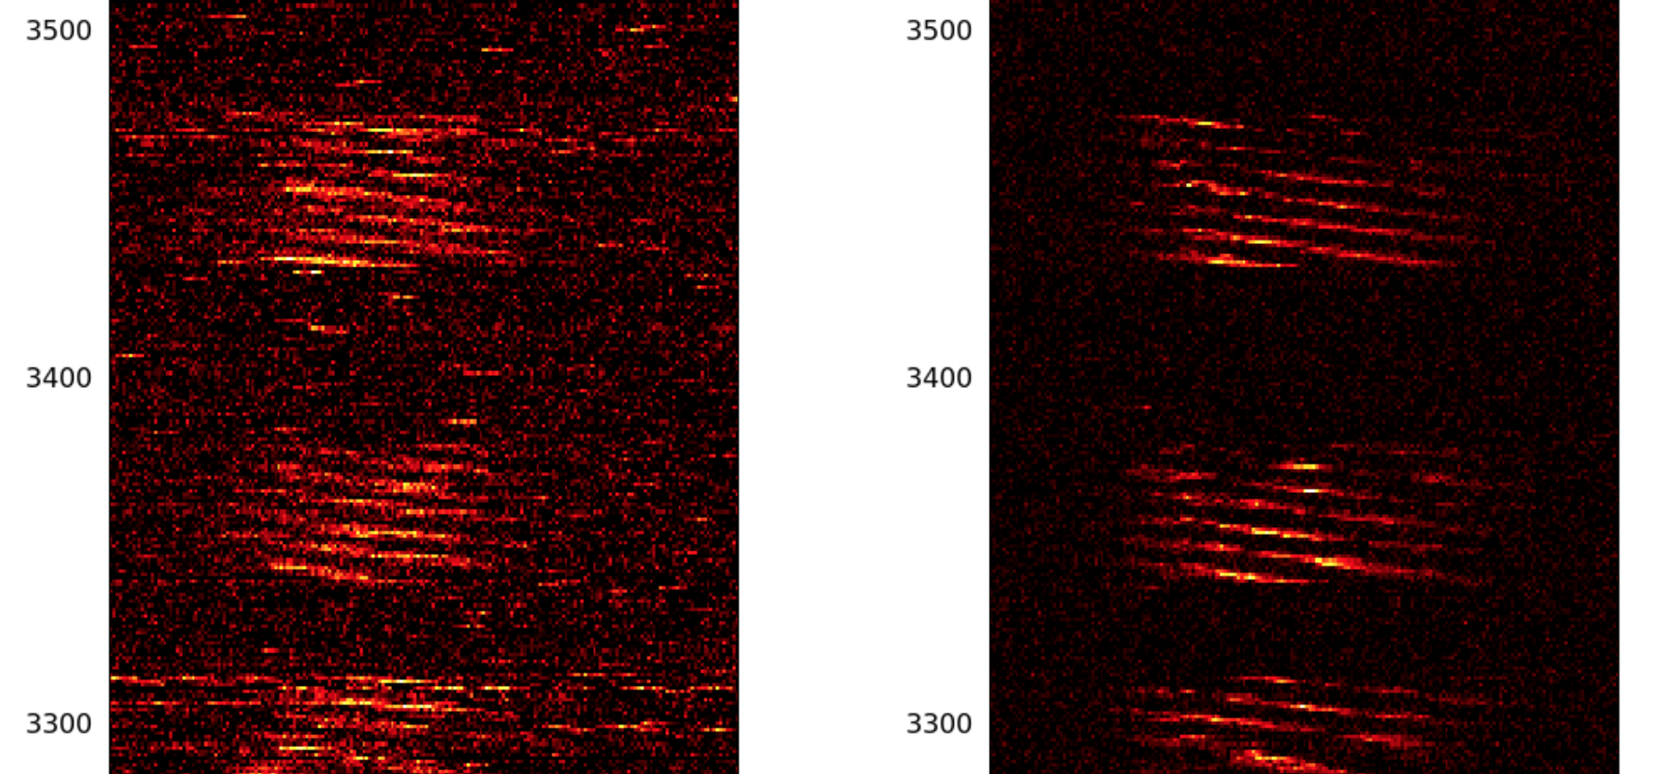
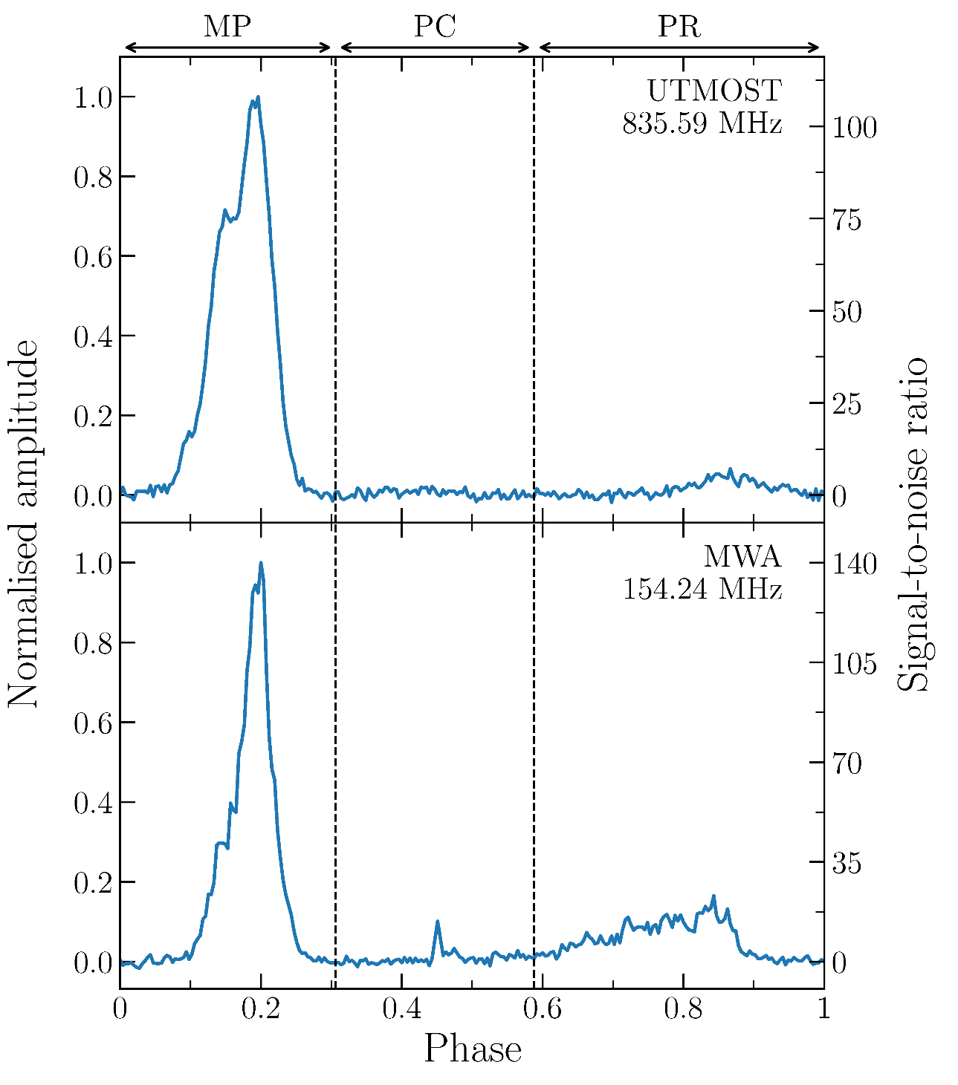
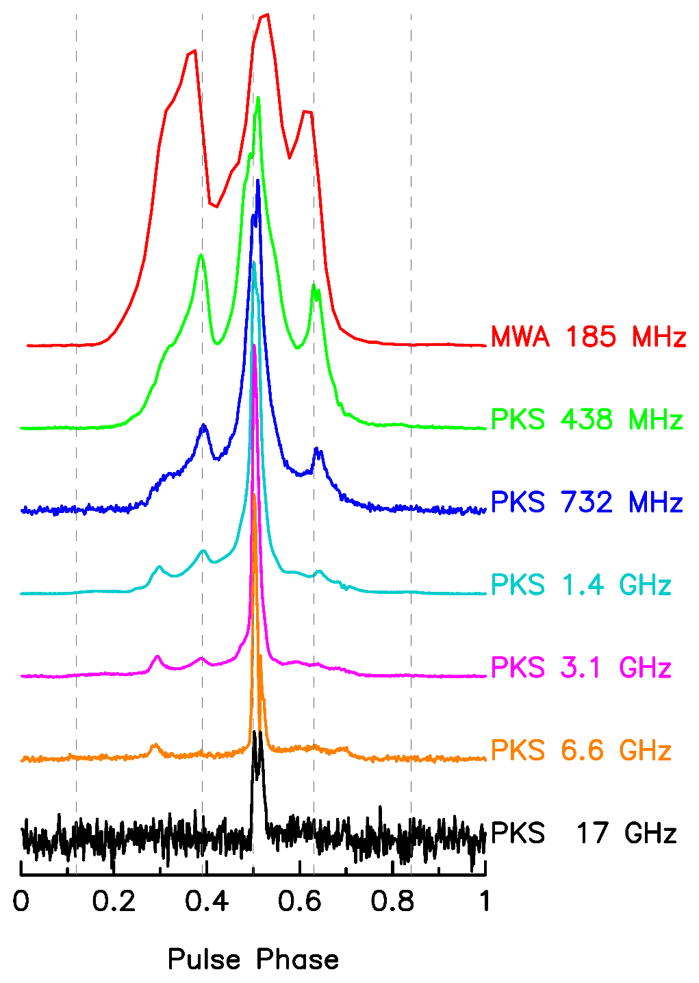
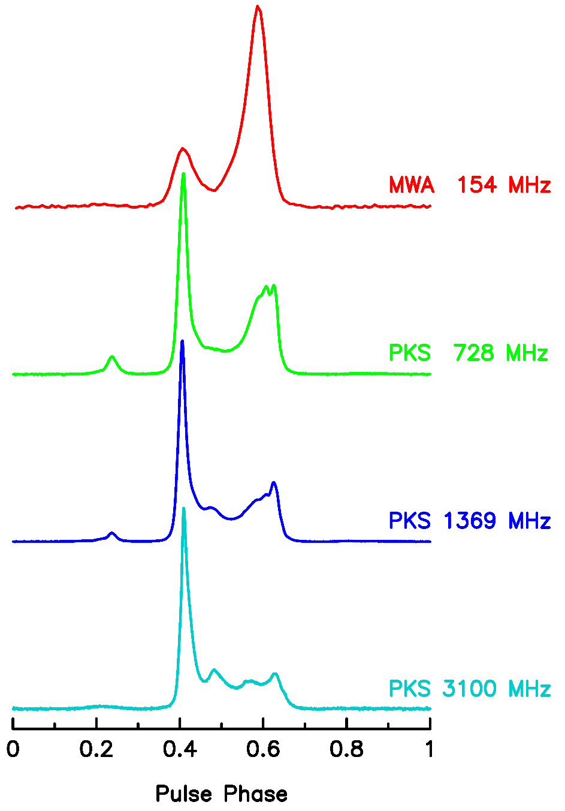
More Pulsar science from MWA
Emission heights from simultaneous MWA+GMRT obs of J0034-0721
Xue et al. (2019)
McSweeney et al. (2019b)
GMRT
MWA
Depolarisation at low frequencies for PSR J0742-2822
See Mengyao’s talk
Profile evolution of millisecond pulsars
Bhat et al. (2018), ApJS, 238, 1
Intermittent pulsar J1107 with the MWA and UTMOST
Meyers et al. (2018), ApJ, 869, 134
Notes:
Once we get hold of these data – you can process them in different ways
The simplest is incoherent sum – detect powers and sum them – preserves the FoV but gives a sens improvement only sqrt(N) – for MWA that is only 10% of the max achivable sensitivity
That is our quick check – form an incoherent beam and look at every detectable pulsars

Slide 18
The 10-yr journey of PFT MWA
2007
2016
2019
2021
2023
Crab giants with 3 Tile the early prototype
(Bhat et al. 2007)
First pulsar detection in coherent dedispersion
(Kaur et al. 2019)
pulsar 0437 detection in full coherent beam
(Bhat et al. 2016)
18
Notes:
7/25/23
18
18

Slide 19

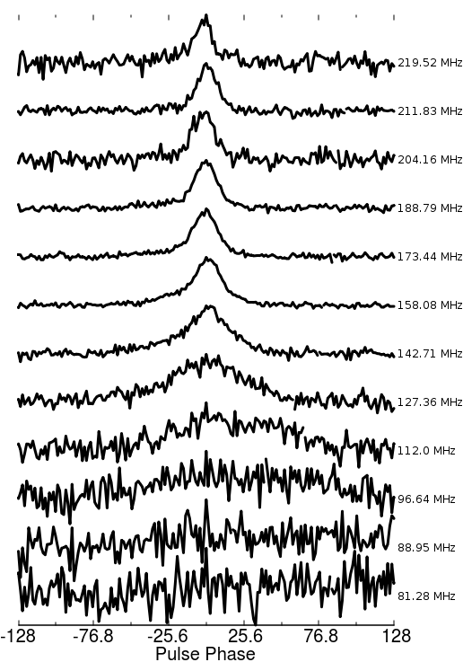
Coherent dedispersion and microsecond time resolution
MSP J2241-5236
P = 2.18 ms
W ~ 130 μs
DM = 11.41 pc cm⁻³
Dilpreet Kaur
Kaur et al. (2019)

Slide 20
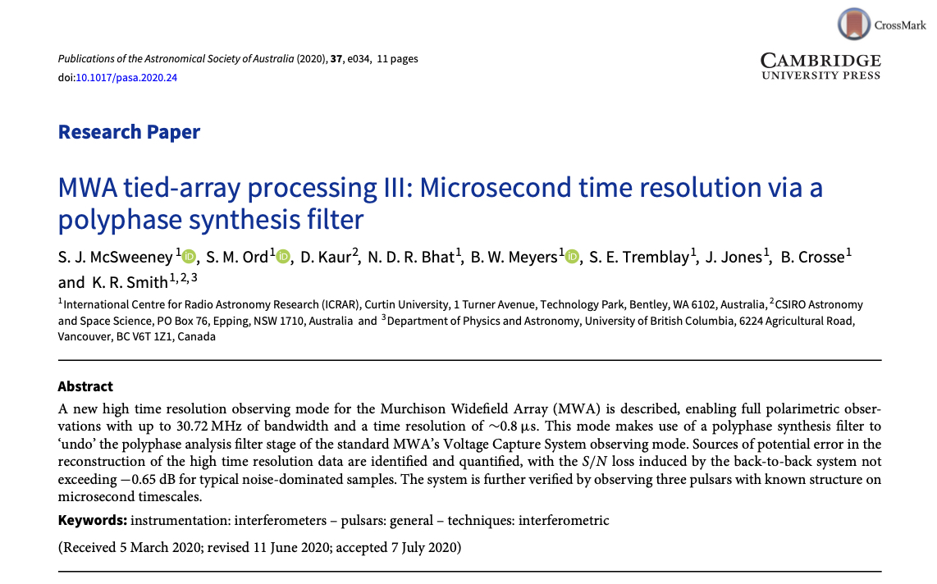

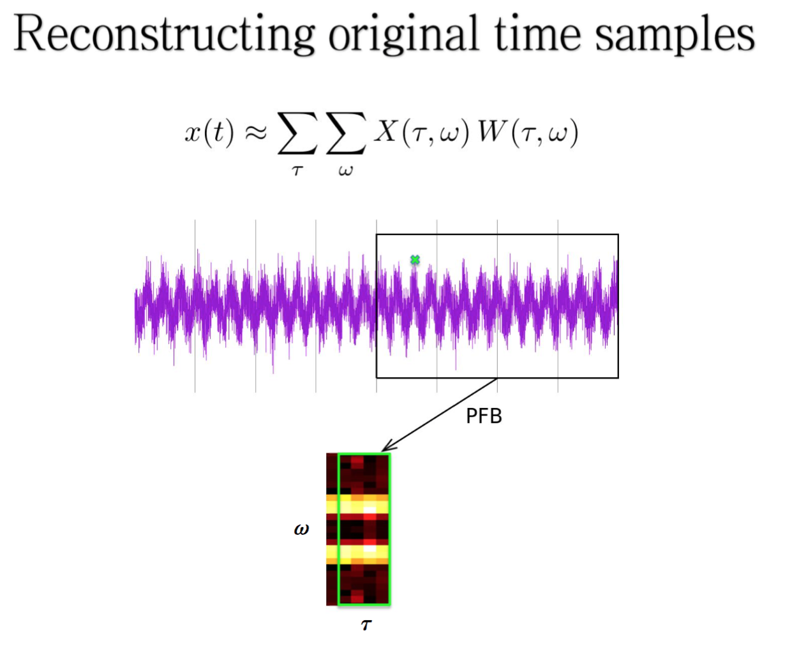
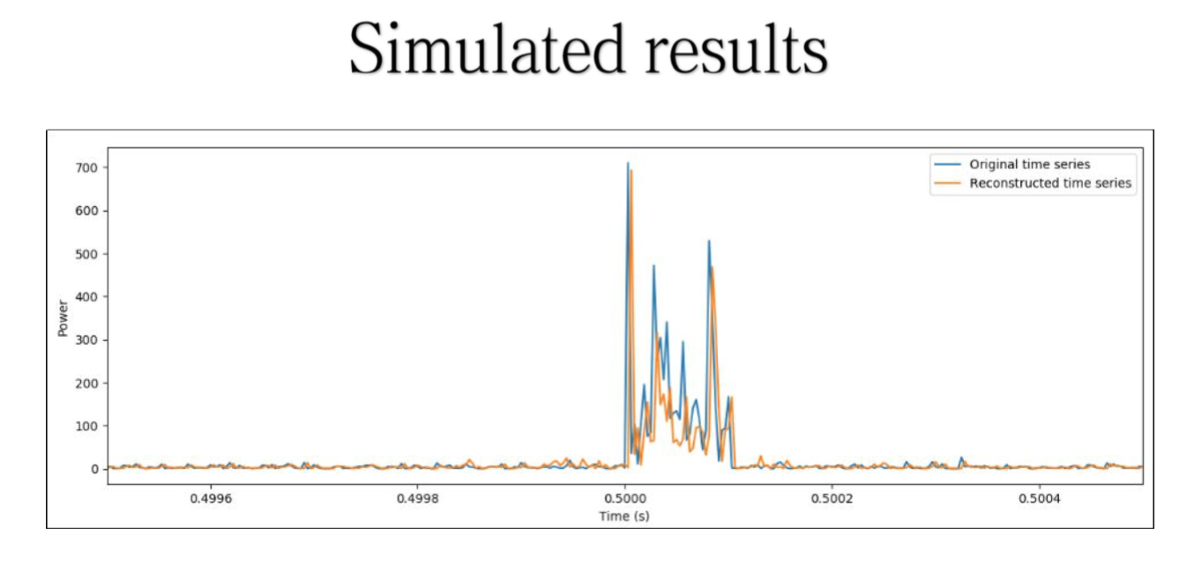
Squeezing time resolution
McSweeney et al. (2020)
Sammy McSweeney
(PhD student)
MWA VCS : 100 μs, 10 kHz
Reconstruct: 1 μs, 1.28 MHz
Re-synthesize pre-fine-PFB voltage samples for high time resolution (~1 μs) time series

Slide 21
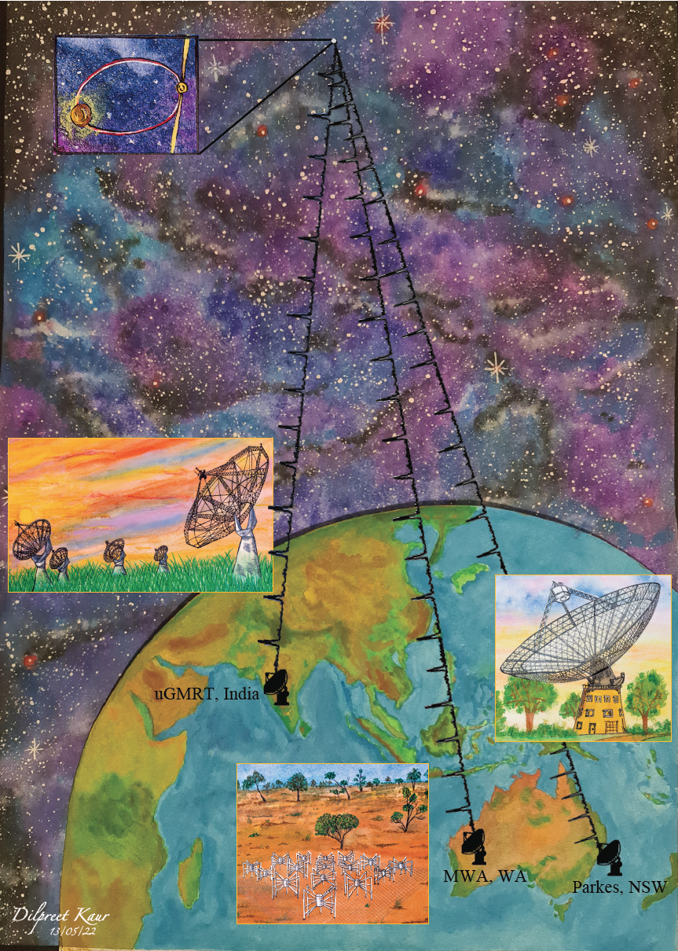
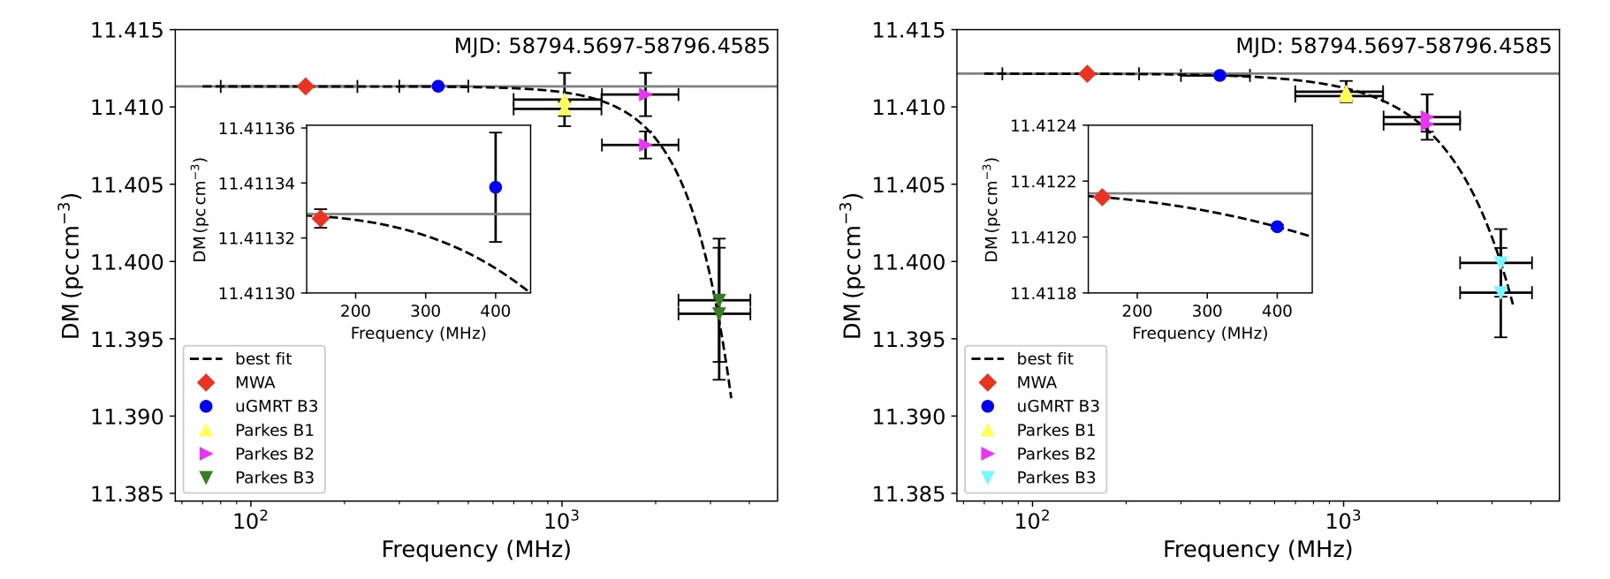
“Chromatic” DM in MSP J2241-5236
“Narrow-band” timing
“Wide-band” timing
Kaur, Bhat, et al. (2022), ApJ Letters
Predictions from Cordes et al. (2016)
Consequence of multipath propagation in the ISM
PSR J2241-5236
  Timing precision ~1 μs
  DM precision ~ 10⁻⁶ pc cm⁻³
Contemporaneous observations with MWA, uGMRT and Parkes
21
Notes:
7/25/23
21
21

Slide 22
The 10-yr journey of PFT MWA
2007
2016
2019
2021
2023
Crab giants with 3 Tile the early prototype
(Bhat et al. 2007)
First pulsar detection in coherent dedispersion
(Kaur et al. 2019)
pulsar 0437 detection in full coherent beam
(Bhat et al. 2016)
First new pulsar J0036 discovered with the MWA
(Swainston et al. 2021)
22
Notes:
7/25/23
22
22

Slide 23
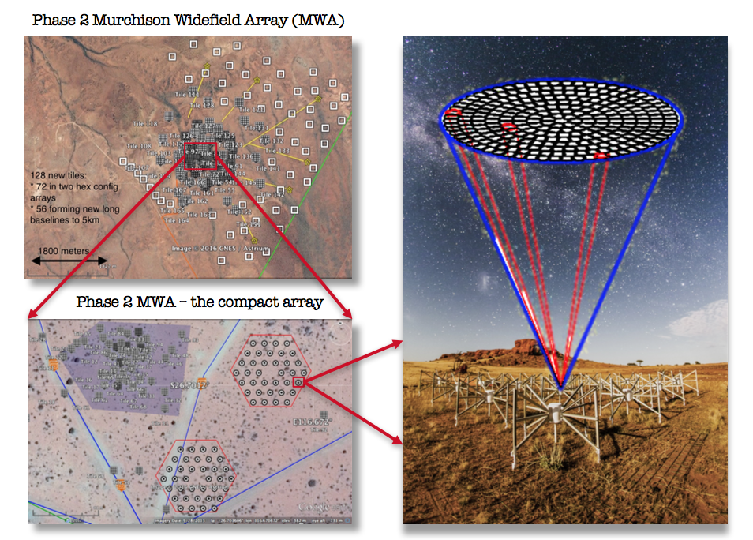
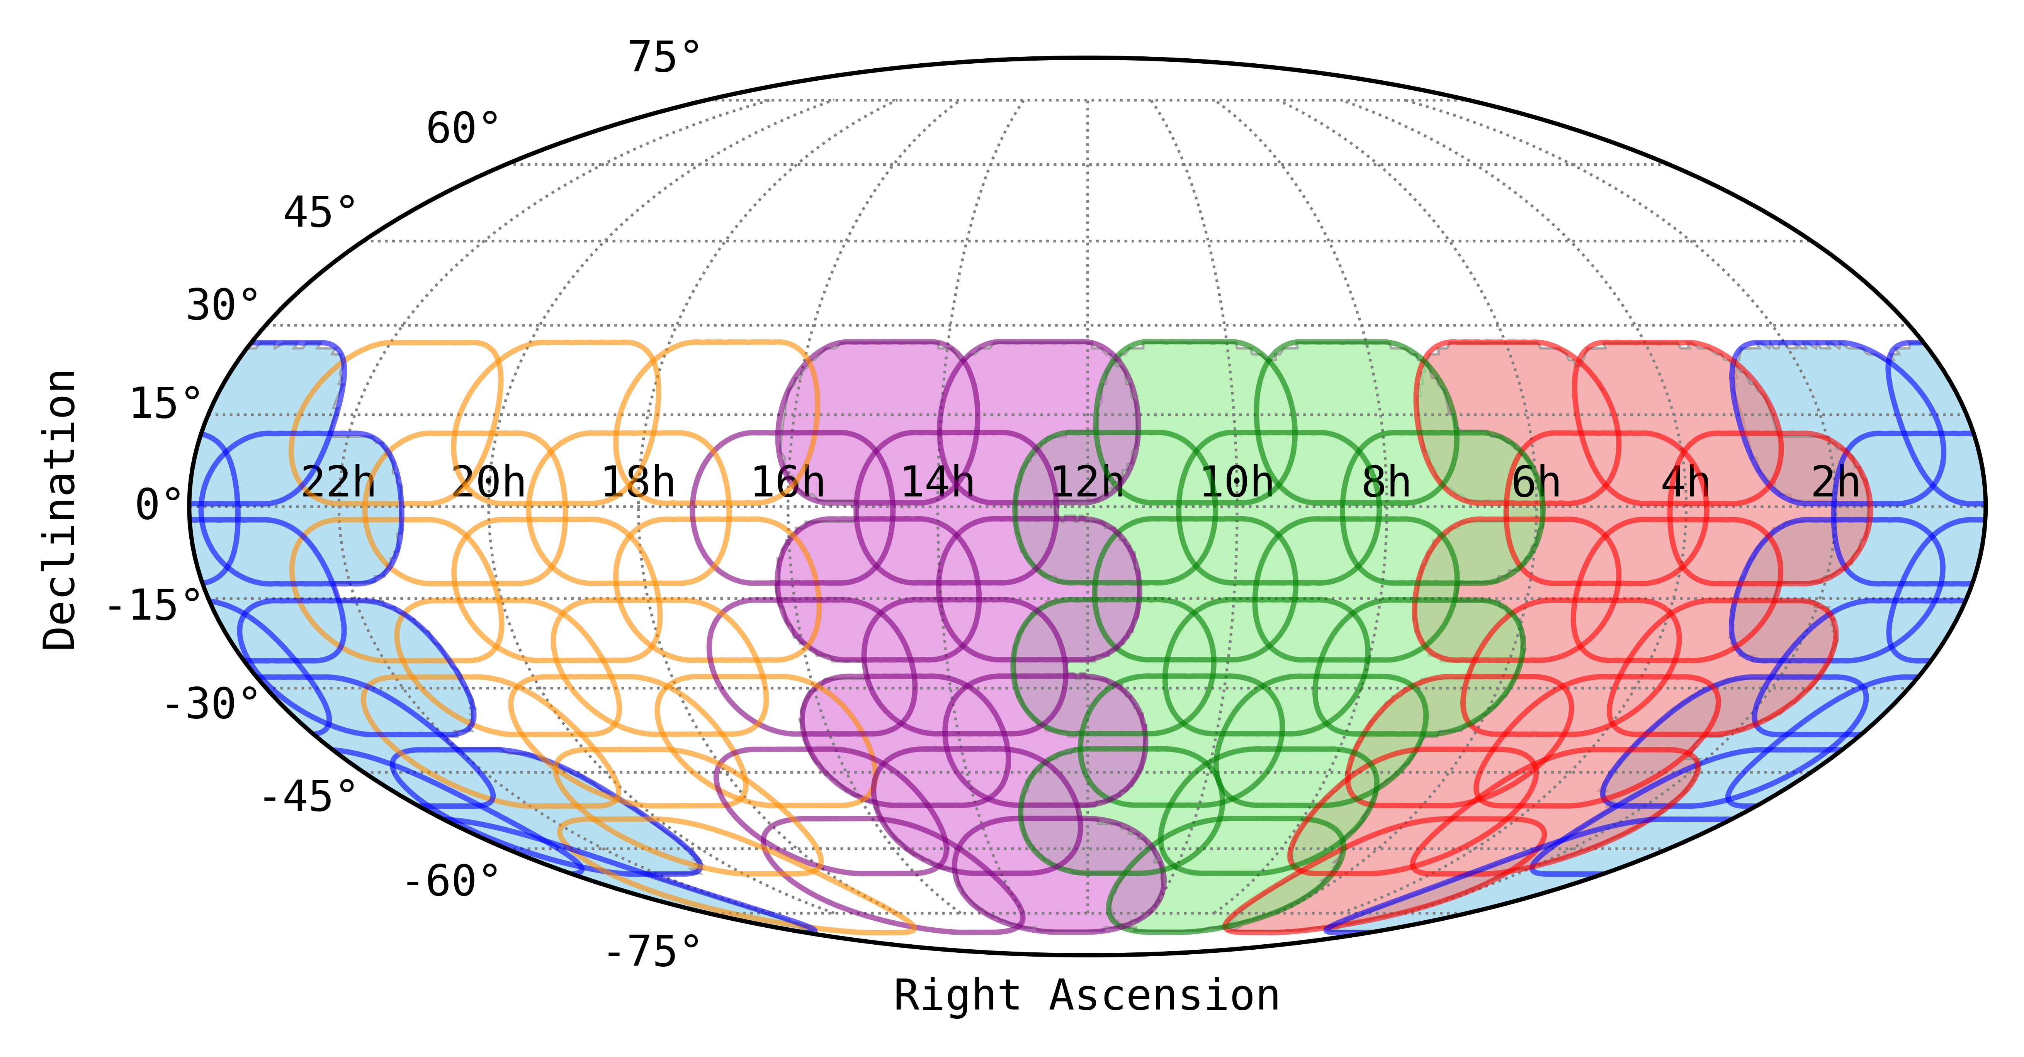
The Southern-sky MWA Rapid Two-metre (SMART) pulsar survey
An all-sky voltage-capture (VCS) pulsar survey with the Phase 2 compact MWA
See Bradley’s talk
Tied-array beam size ~23 arcminutes
Frequency band: 140-170 MHz
6000-8000 beams per each (4800 s) observation
100 hours for covering the full sky south of +30º declination
600,000 tied-array beams for the full survey
42 TB to process per VCS observation
Compact configuration of the MWA for 2-3 orders of magnitude saving in beamforming cost
Each tile sees ~610 deg² of the sky, recording in the Voltage Capture System (VCS) mode
100-μs / 10-kHz resolution data from 128 tiles in dual polarisation
Notes:
The SMART survey is an all-sky pulsar project that exploits several unique advantages of the MWA, like low frequencies, large field of view, compact configuraton after the upgrade, and most imprtantly a capability to record high time resolution voltage data from every single detector – we call it the voltage capture system or VCS. The compant config means orders of magnitude saving in beamforming cost which is incredibly important to make full scale searches tractable with interferometric like this. With the VCS slike system we essentially sample ~ 600 sq deg instantaneously in high time/freq resolution. Still we are talking about 1000s of tied-array / phased array beams per each observation, and that means over a half a million beams to cover the full southern sky. The combination brings astonishingly large survey speed (in terms of data collection) ~ 500 sq deg per hour, and hence Rapid, But that doesn’t undermine the fact that the processing cost are enormous at low frequencies and substantial processing needs for the full search processing.

Slide 24

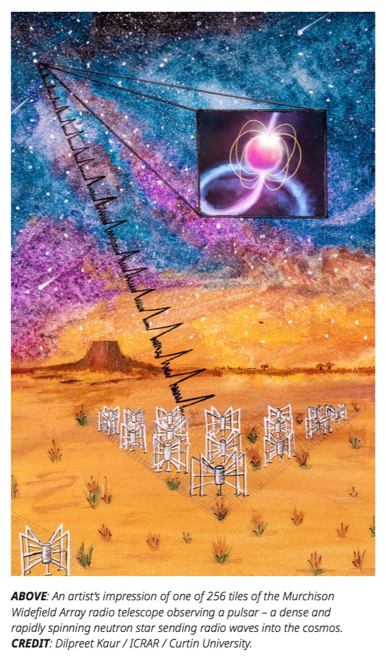
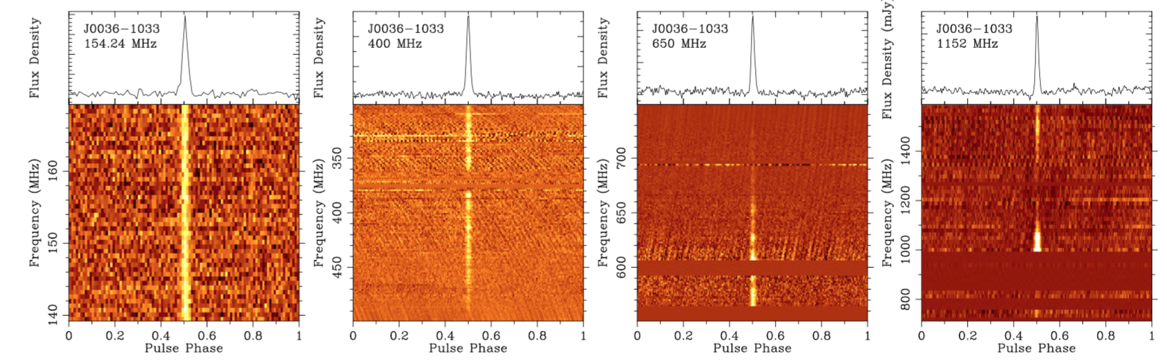
MWA PSR #1: J0036-1033
Swainston, et al. (2021), ApJ Letters, 911:L26
MWA
GMRT Band 3
GMRT Band 4
Parkes UWL
Period: 0.900009 s
DM: 23.123 pc cm⁻³
Pulse width: 18 ms
S/N: 10-30 @155 MHz
After processing ~1% of data, over a limited parameter space (DM up to 250 pc cm⁻³, in 2358 trial DMs)
Steep-spectrum, low-luminosity pulsar, in the lowermost ~2 percenitle of long-period pulsars
24
Notes:
7/25/23
24
24

Slide 25
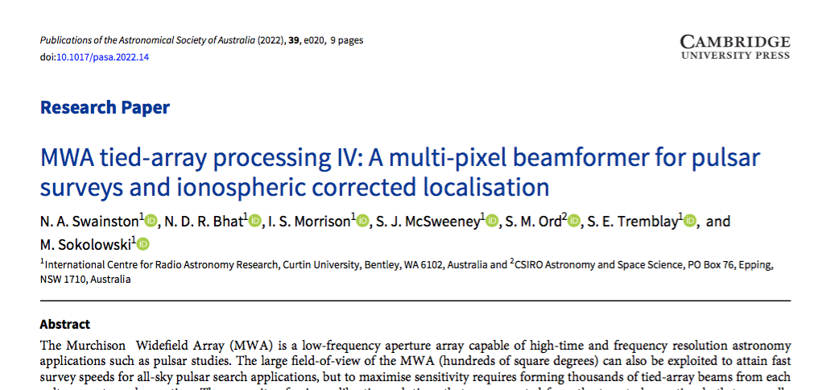
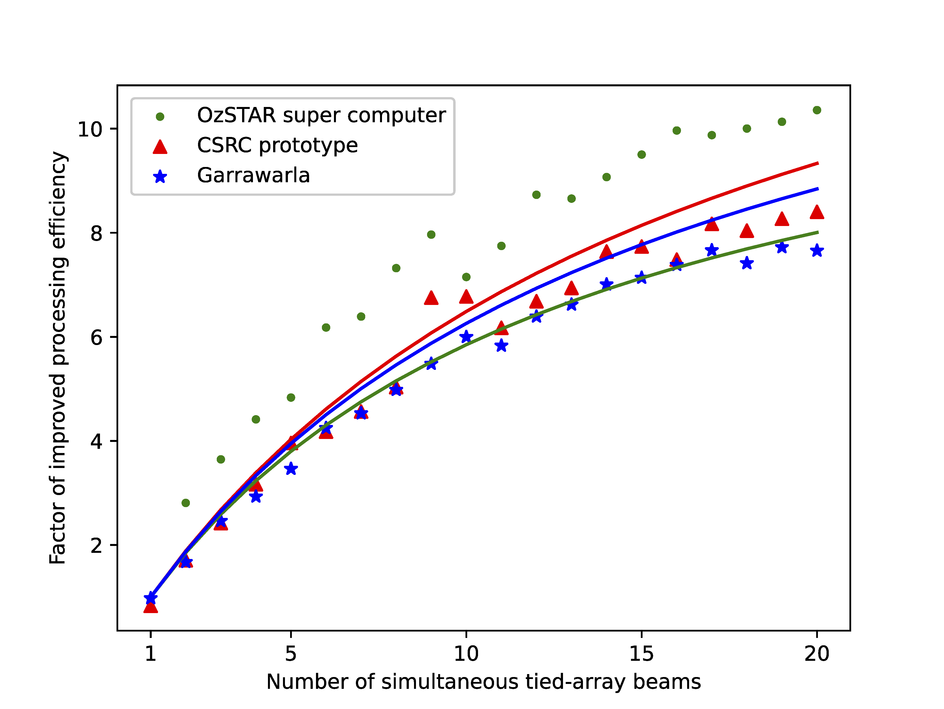
Beamformer for the SMART
Swainston et al. (2022)
Multi-pixel beamformer
Processing workflow
Benchmarks (relative to single-pixel beamformer)
Block READ (VCS observation, 100-us10-kHz data from 128 tiles, in dual polarisation)
CALC: apply calibration solutions (purple), delay compensation and tile summation (green)
WRITE: beam-formed output (up to ~120 data streams instantaneously)
25
Notes:
7/25/23
25
25

Slide 26
The 10-yr journey of PFT MWA
2007
2016
2019
2021
2023
?
Crab giants with 3 Tile the early prototype
(Bhat et al. 2007)
First pulsar detection in coherent dedispersion
(Kaur et al. 2019)
pulsar 0437 detection in full coherent beam
(Bhat et al. 2016)
First new pulsar J0036 discovered with the MWA
(Swainston et al. 2021)
26
Notes:
7/25/23
26
26

Slide 27
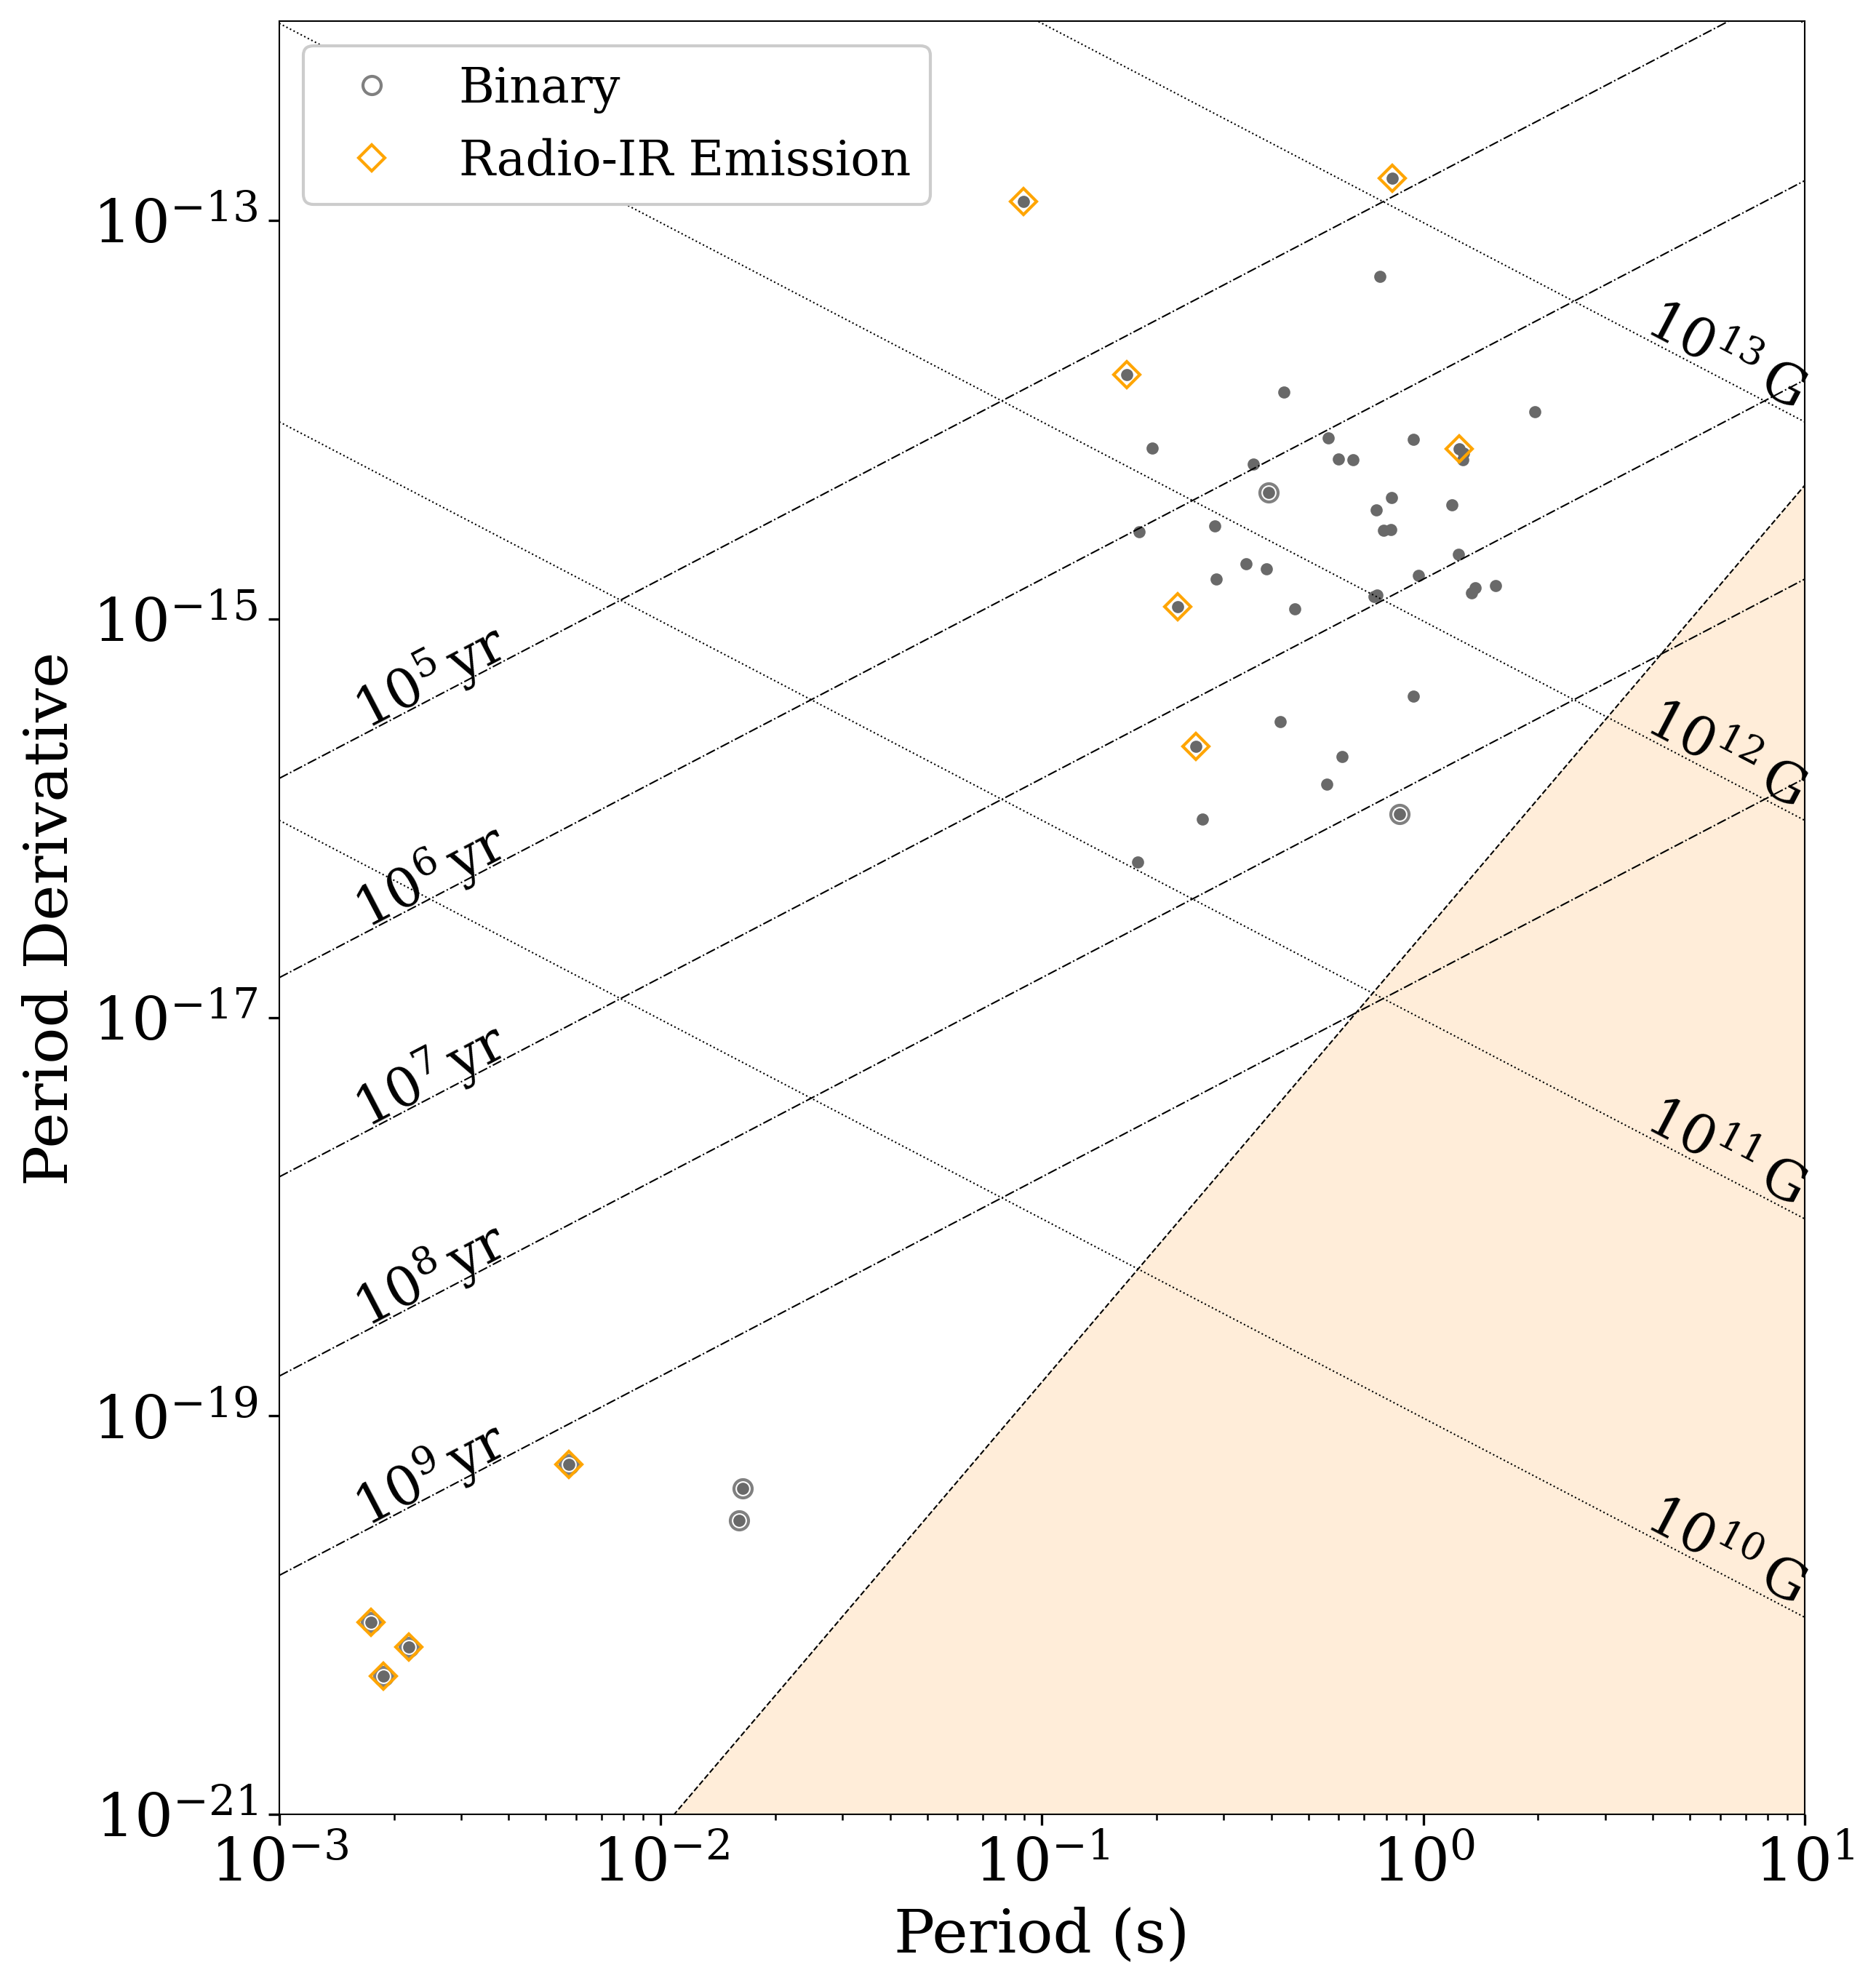
MWA PSRs in the P-Pdot diagram
Initial census: Xue et al. (2017)
50 pulsars (incoherent census)
Slide credit: Chris Lee
27
Notes:
7/25/23
27
27

Slide 28
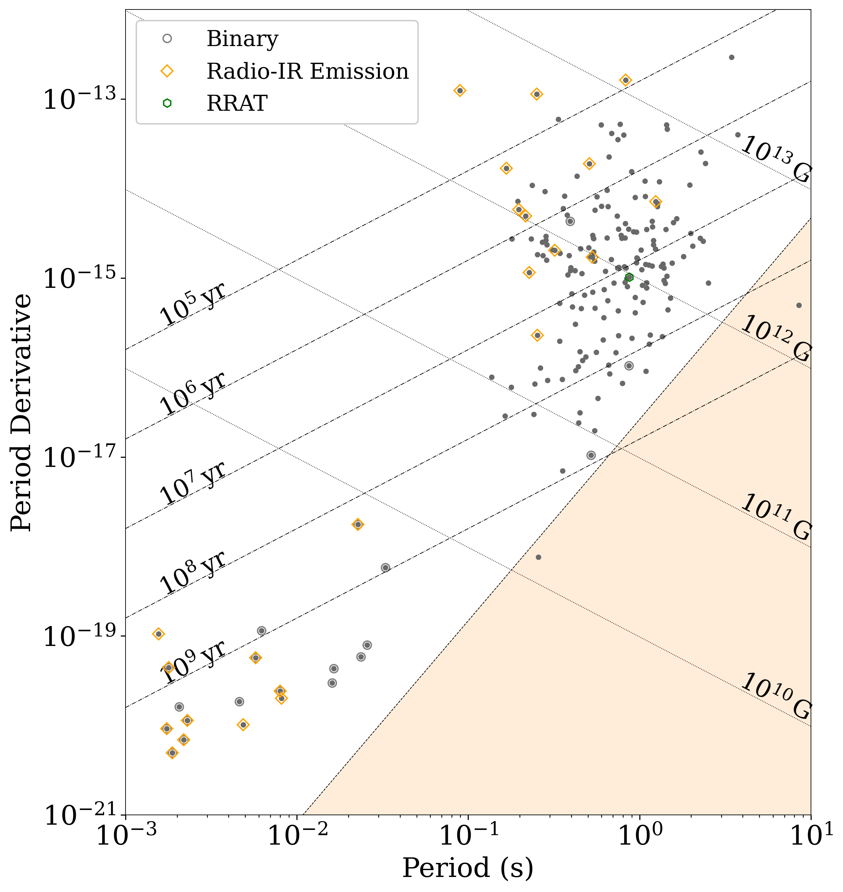
MWA PSRs in the P-Pdot diagram
Initial census: Xue et al. (2017)
50 pulsars (incoherent census)
updated SMART + 2017 census
200+ (inc 180 in Bhat et al. 2023b)
Slide credit: Chris Lee
28
Notes:
7/25/23
28
28

Slide 29
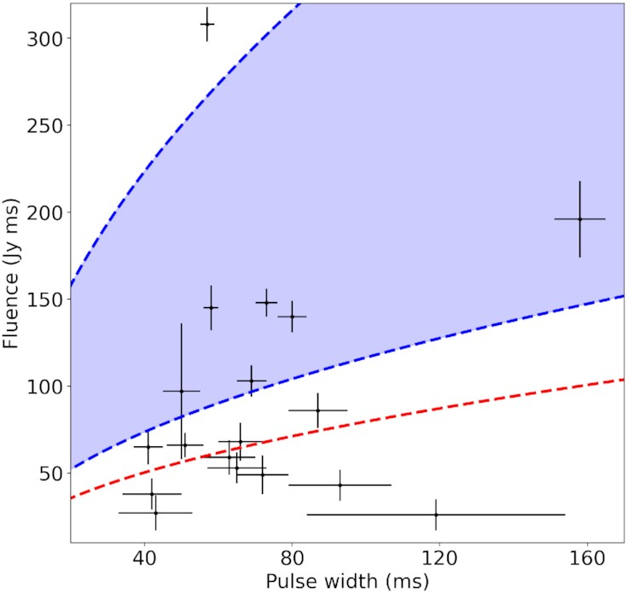

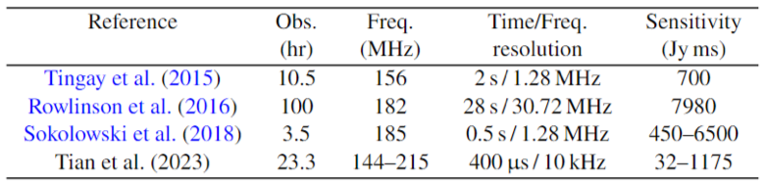
Fast Radio Bursts
Searched ~23 hours of VCS archival data toward 5 repeaters (4 from CHIME, 1 from ASKAP)
No detections
Most sensitive FRB search (to date) with the MWA
Sensitivity sufficient to detect repeat bursts from the northern FRB 20180916B (Pleunis et al. 2021)
Plans to continue searches from repeaters as more discovered
Image-domain searches are also in progress
Jun et al. (2023)
See Gemma’s talk
29
Notes:
7/25/23
29
29

Slide 30
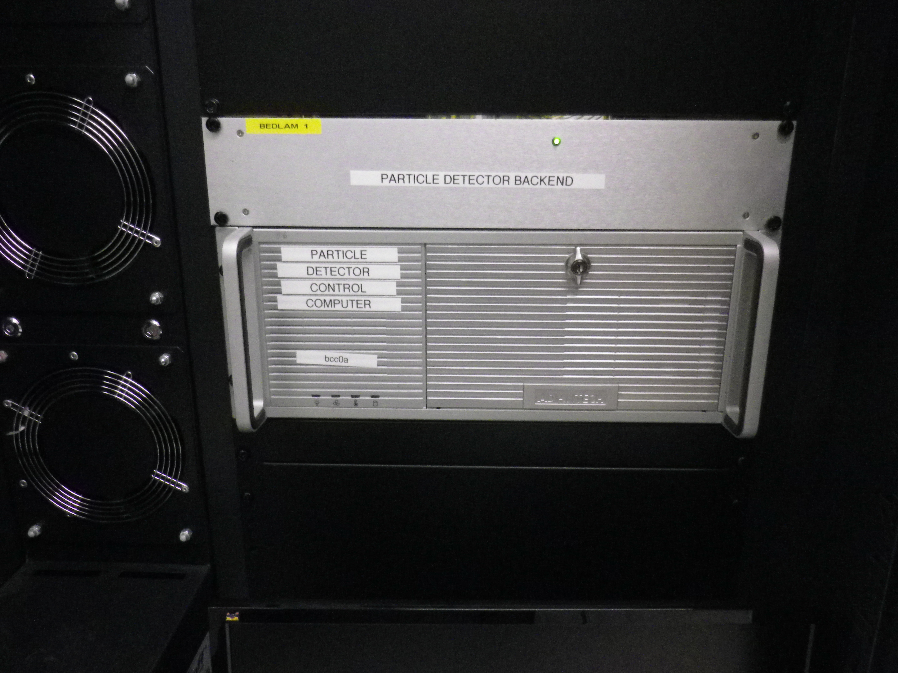
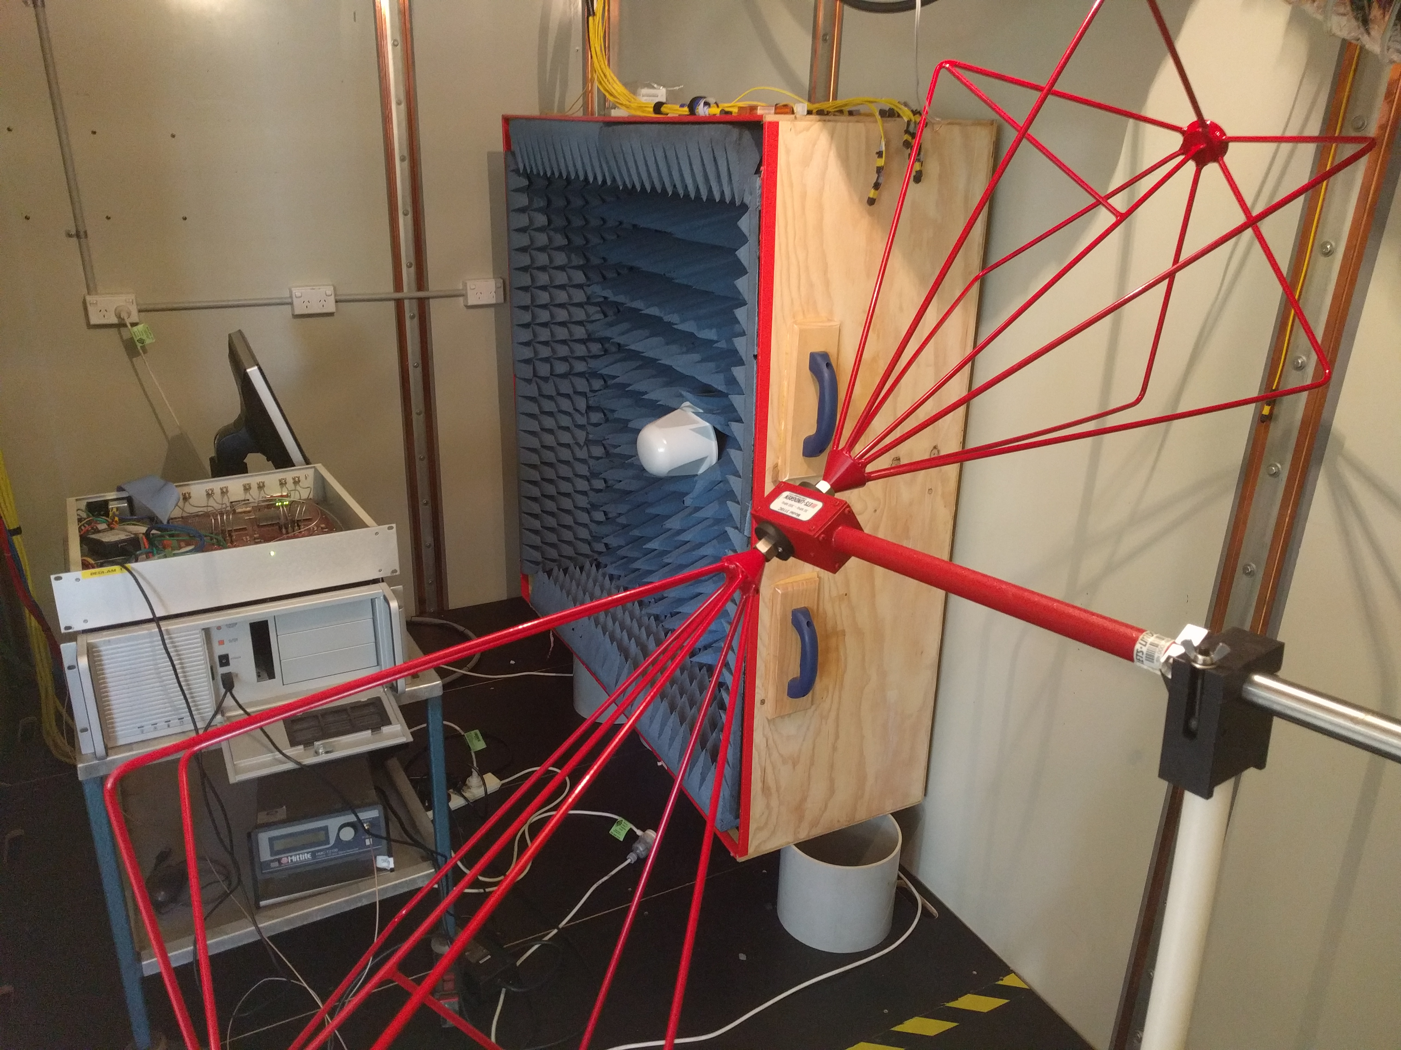
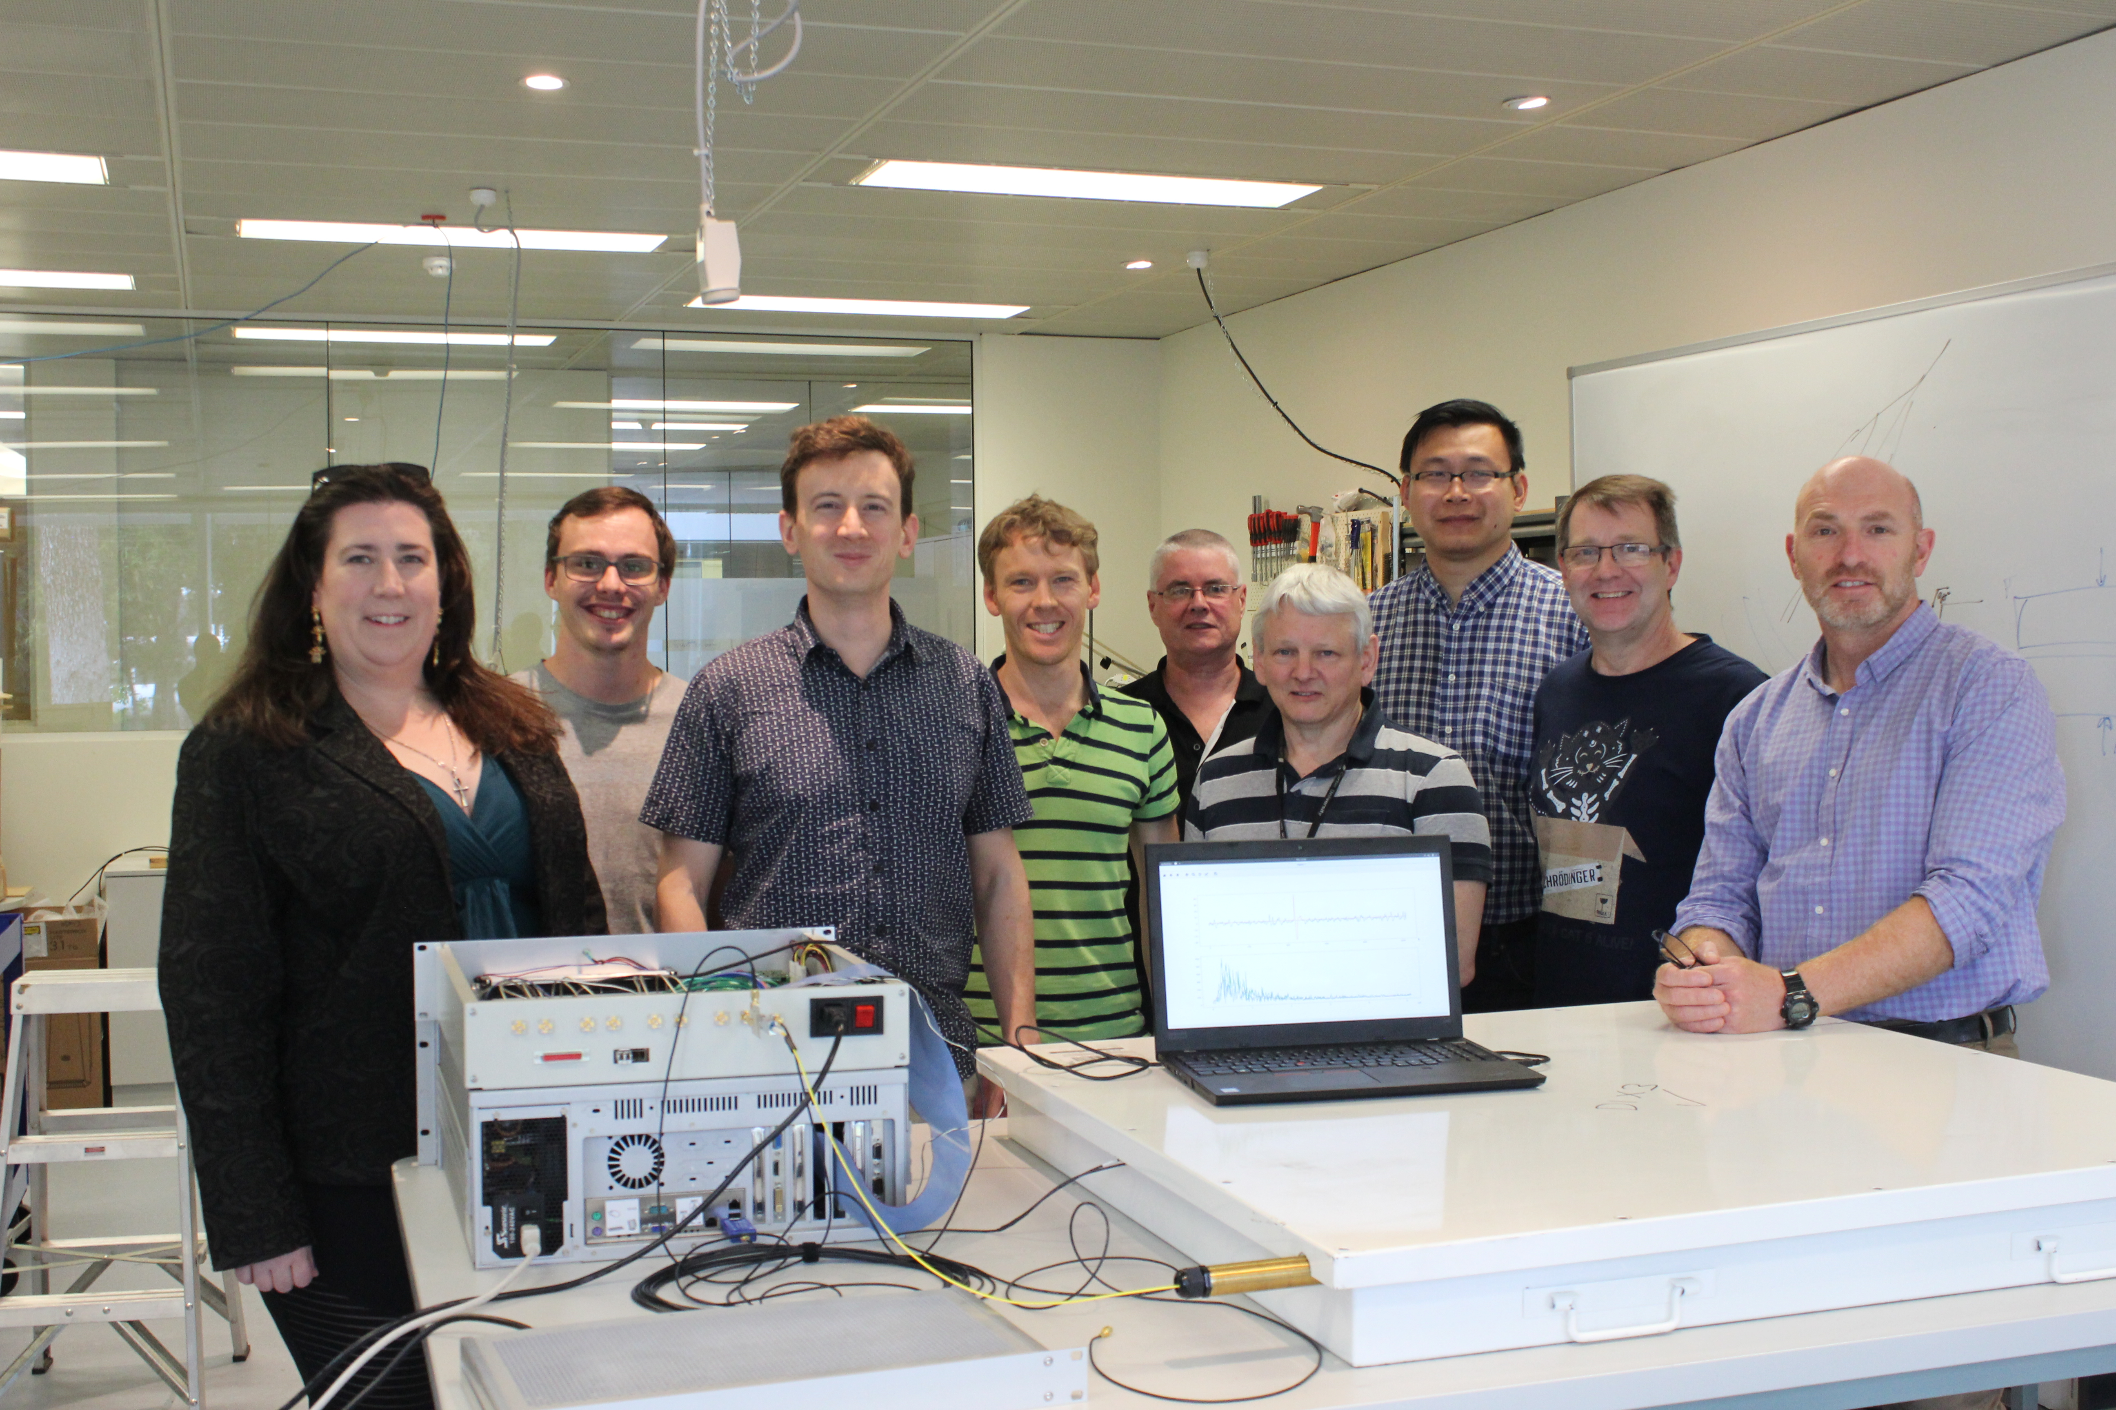
Cosmic Ray detection
~2012: Original suggestion of performing cosmic ray detection with the MWA: (Steven Tingay, Justin Bray)
2015: SKA high energy particle working group forms. Clancy James, Justin Bray co-leads.
2016: Justin Bray, Ralph Spencer (Manchester) begins work on SKA prototype detector.
2018: Alexander Williamson starts his PhD on cosmic ray detection with MWA (offline analysis of VCS data - gets a rate of ~1/hour, but one week to process each observation)
Summer 2018: Prototype deployed at the MWA site. Performs well! Stays on-site for ~1 year before turns off.
2019: Developed ultra-high-time resolution mode for MWA: voltage buffers + polyphase filterbank inversion
End 2019: ARC funding (2 grants; O~600k) for an 8-detector array
2022: SKA High Energy Cosmic Particles made a science working group
2023: 8-detector prototype almost complete, shipping in August, deployment some time this year
See Clancy’s talk
Slide courtesy: Clancy James

Slide 31
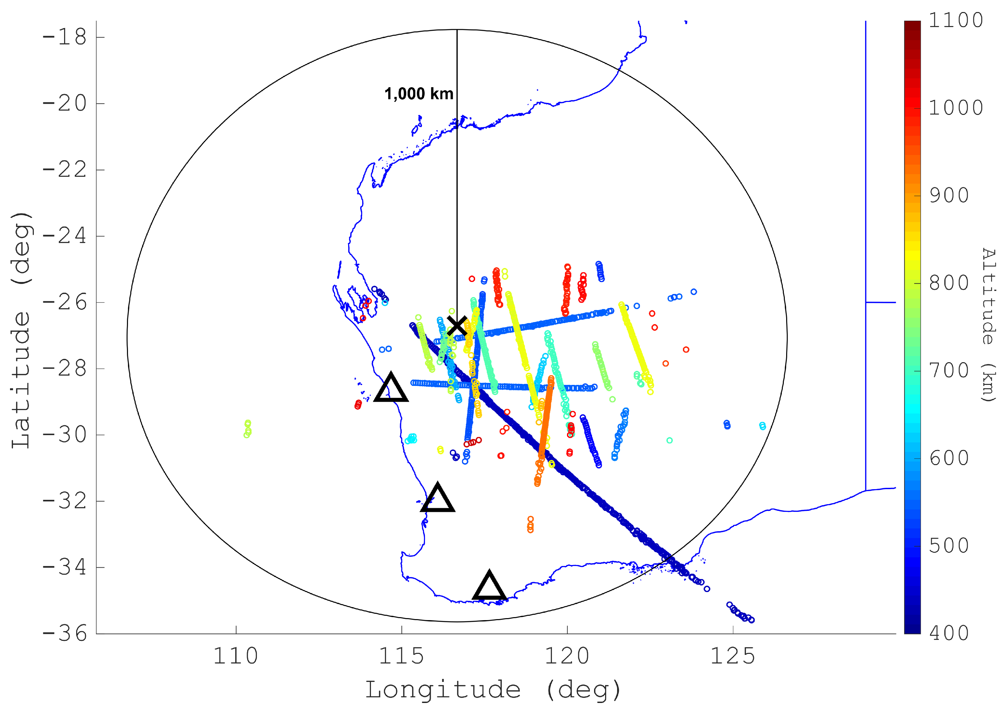
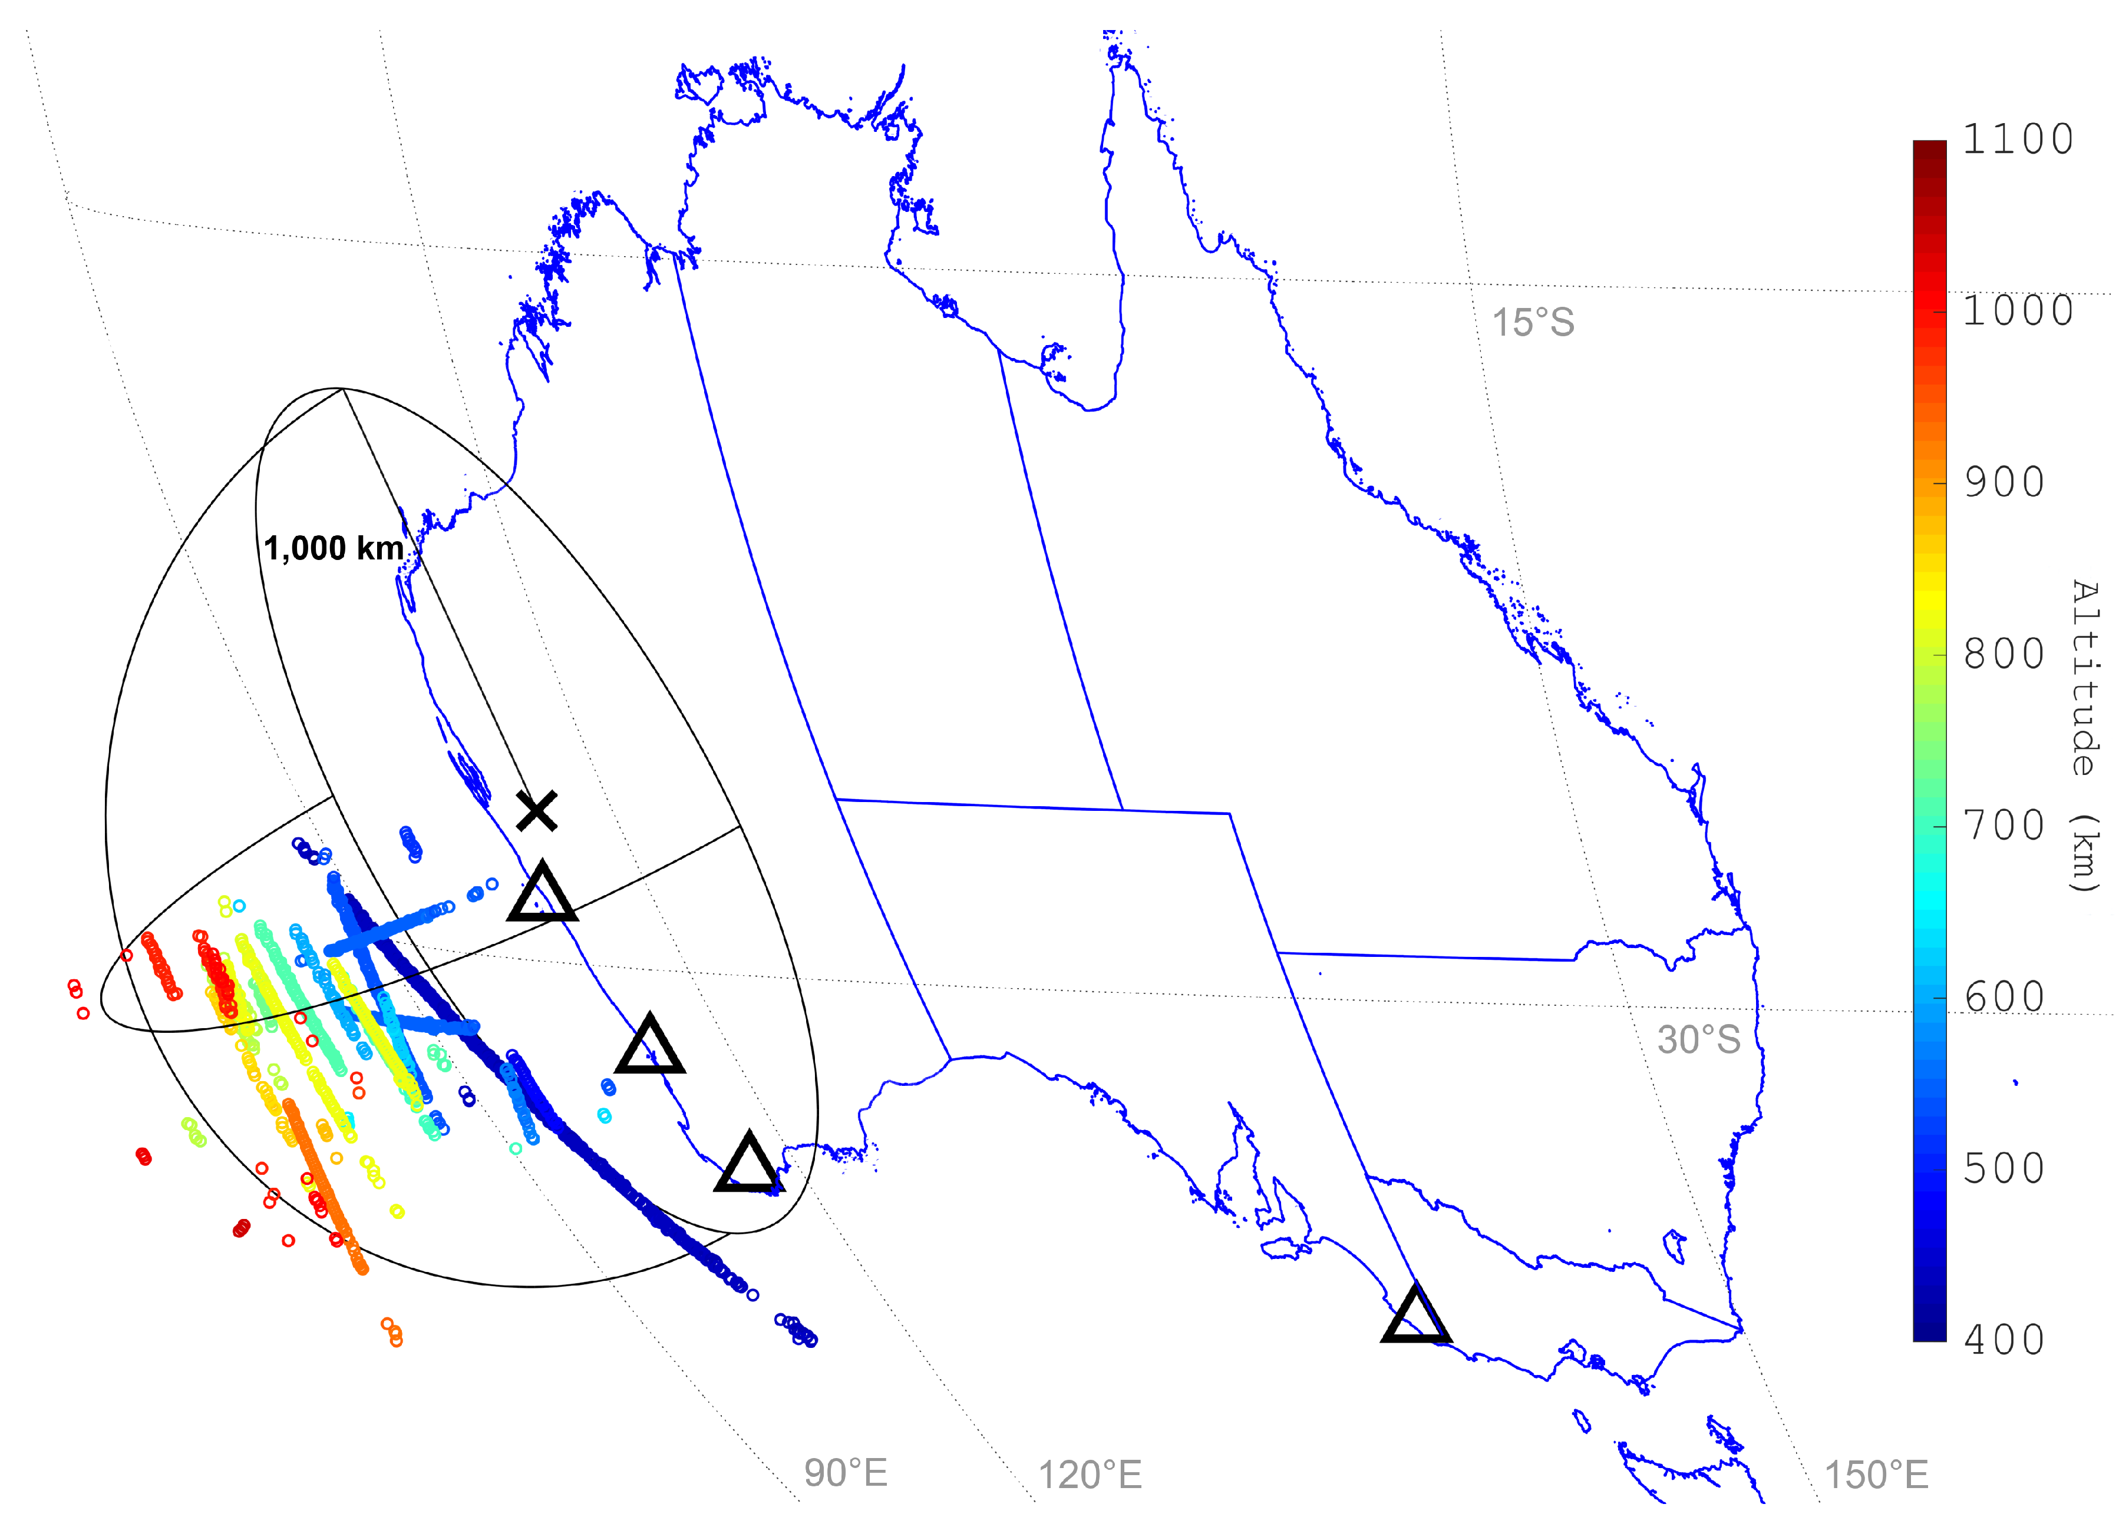


Passive Radar applications
Terrestrial transmission (e.g., broadcast television and radio) can be used, with the MWA, as part of a passive radar to detect satellites and debris.
The VCS allows for direct matched-filter processing between MWA timeseries signals and radio/television reference signals.
Detections of space targets can be used to accurately estimate their orbits and predict future positions.
The MWA has been used as a radar receiver as part of a continent-spanning multi-static radar network.
Hennessy et al. (2021, 2022)
Slide courtesy: Brendan Hennessy
31
Notes:
7/25/23
31
31
- Terrestrial transmission (such as broadcast television and radio) can be used, with the MWA, as part of a passive radar to detect satellites and debris.
- The voltage capture system allows for direct matched-filter processing between MWA timeseries signals and radio/television reference signals.
- Detections of space targets can be used to accurately estimate their orbits and predict future positions.
- The MWA has been used as a radar receiver as part of a continent-spanning multistatic radar network.

Slide 32






Recent Pulsar publications
Image-domain searches for pulsar candidates
GMRT follow-up of SMART PSR #2 J0026-1955
Sett et al. (2023)
Janagal et al. (2023b)
32
Notes:
7/25/23
32
32

Slide 33




SMART survey description
Bhat et al. (2023a), PASA, 40, e020
Bhat et al. (2023b), PASA, 40, e021
33
Notes:
7/25/23
33
33

Slide 34




PSR J1820-0427: MWA + GMRT
Janagal et al. (2023a)
Bhat et al. (2023b), PASA, 40, e021
Parul Janagal
PhD candidate (IIT, Indore)
High-sensitivity single-pulse analysis (GMRT), spectral and profile evolution (multi-path scattering) using MWA+ GMRT, polarimetry etc.
34
Notes:
7/25/23
34
34

Slide 35




Testing the circularity of B0818-41’s carousel
PSR B0818-41 (aka J0820-4114) sub-pulse drifter with two nested carousels
uGMRT observations at 300 - 500 MHz (Band 3)
MWA observations 170-200 MHz
Frequency dependence of single pulses and the average profiles used to test the circularity of the (outer) carousel
Started as ICRAR summer project (Lisa Smith)
McSweeney, Smith, Bhat, Wright (2023)
Lisa Smith
35
Notes:
7/25/23
35
35

Slide 36


PhD completions
Congratulations on Submission!
Congratulations on Submission!
36
Notes:
7/25/23
36
36

Slide 37









8 PhD completions so far
37
Notes:
7/25/23
37
37

Slide 38


Looking Forward
  A decade of productive science; however VCS recording + processing poses major limitations in viable scientific opportunities (64 TB/hr with MWAX VCS)
  Real-time processing (beamforming) capability will open up yet-untapped science potential with wide-ranging science opportunities
  Scientific niche:
    Monitoring pulsar timing array targets, contribute toward PTA goals
    Rich ISM science
    Targeted searches (GCs, Fermi-LAT targets, etc)
    FRB monitoring (e.g. repeaters)
  Importantly, developing “self-reliance” for timing of SMART pulsars
    More demanding constraints as we transition to the 2nd phase in terms of cadence, sensitivity
CHIME monitoring of PTA MSP J2145-0750
Courtesy: Bradley Meyers
MWA detections of SMART PSR #1
Swainston et al. (2021)
38
Notes:
7/25/23
38
38

Slide 39

Summary
  MWA presents a fantastic opportunity for Pulsars and Fast Transients
  An amazing range of science, and opportunities for skill developments, and student training
  A productive decade of scientific and technical accomplishments: 35+ VCS publications, 8 PhD completions
  Low freq. detections of 200+ pulsars, 5 discoveries, 6 PhD completions, notwithstanding VCS data and processing challenges
  Extending beyond pulsars; e.g. FRBs, cosmic ray detection and passive radar applications
  Bright and promising future ahead (VCS archives + SMART + real-time processing/beamformer)

Slide 40

















PFT SWG members & friends
Thank you

