Slide 1
Interplanetary Scintillation with the MWA
John Morgan
Rajan Chhetri Angelica Waszewski
Ron Ekers
MWA Project meeting
July 2023

Slide 2
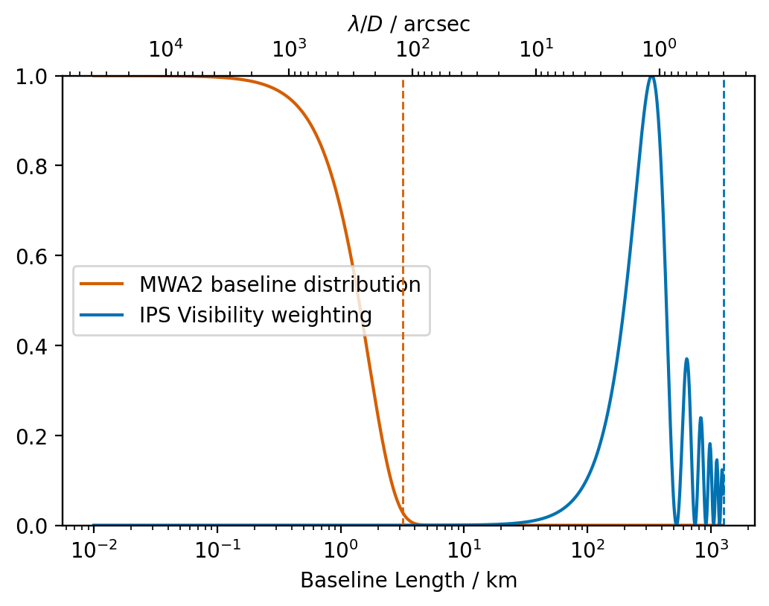
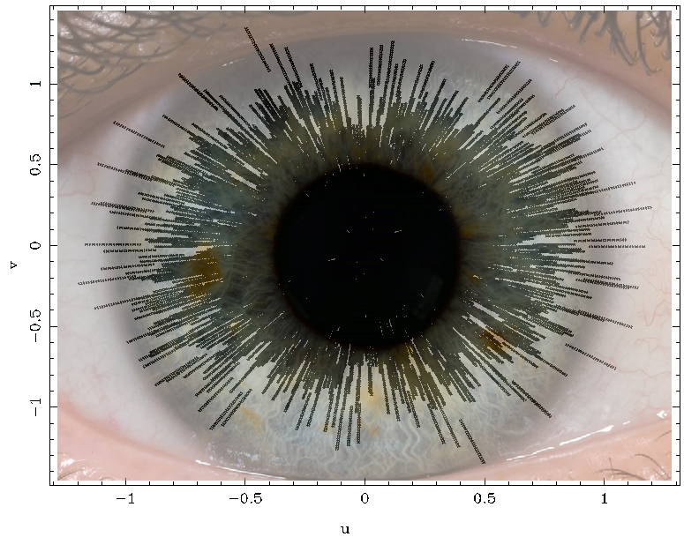
What is IPS and what does it measure?
NSI is Ratio of
Source visibility weighted by blue line
Source visibility weighted by orange line
NSI<1 implies structure on scales > 0.3”
<0.3” -- NSI=1
0.6” -- NSI~0.5

Slide 3
Ten Years Ago
I had done a PhD and 1 postdoc in Widefield VLBI
I shifted over to the MWA, nominally to work on SHI, but mostly working on the MWA Commissioning Survey
In 2015 Iver Cairns suggested I schedule some IPS observations
Was a long-anticipated MWA project
Was always assumed that beamforming would be used
Observations were scheduled using VCS
As an afterthought, I decided to flank the VCS observations with standard observations, to make some easy check images.
IPS experts told me it wasn’t worth doing without 10ms sampling!

Slide 4
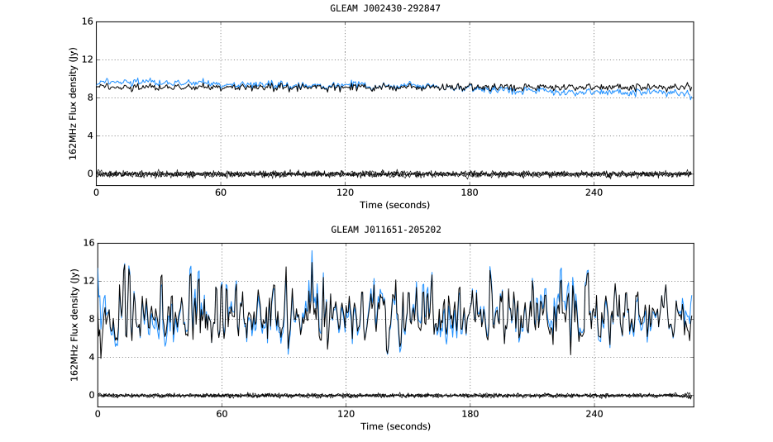
Rajan Chhetri

Slide 5
Initial Skepticism
IPS community didn’t really understand the observations
Bill Coles thought it was ionospheric scintillation
Quite a hostile reaction to Kaplan, Tingay et al. “Serendipitous detection”
Eventually we were able to convince people that our results were real, and that widefield IPS was game-changing
In late 2015 I was encouraged by Randall to schedule more observations
Ended up producing 5 papers from 2x5-minute observations

Slide 6
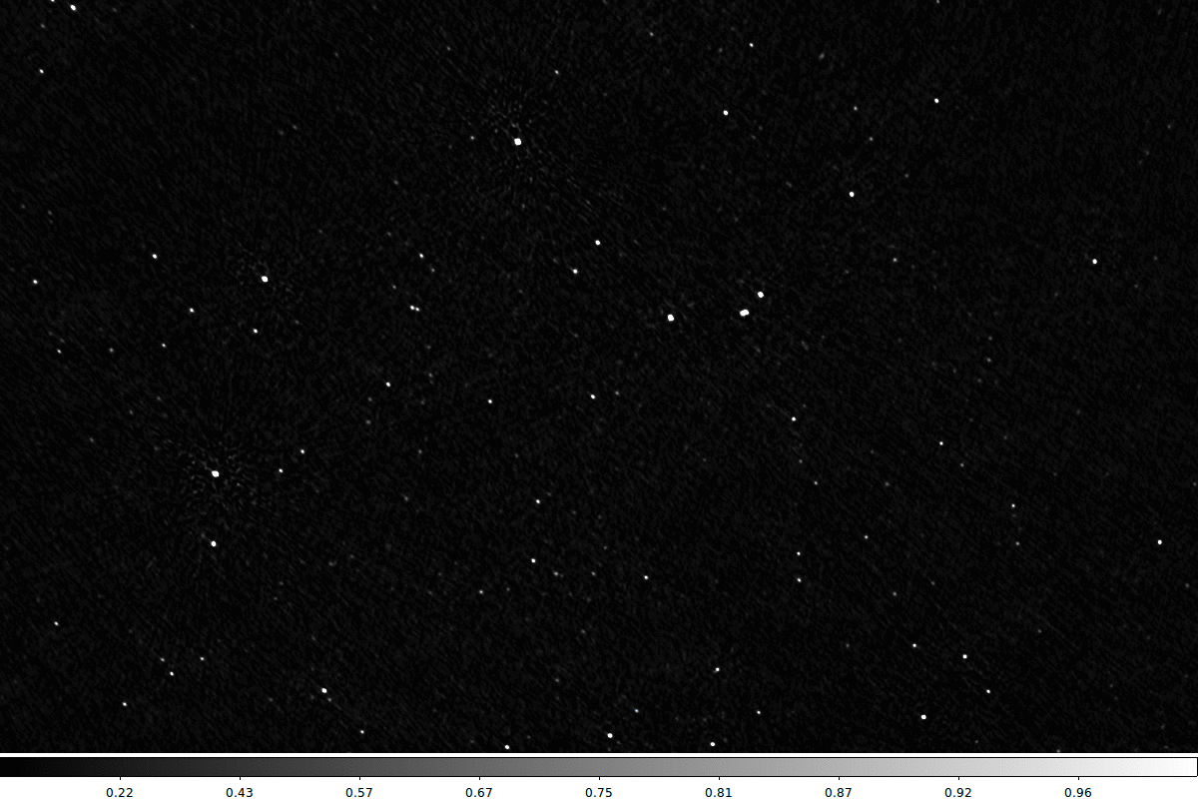
Mean vs RMS
of
time-
series

Slide 7
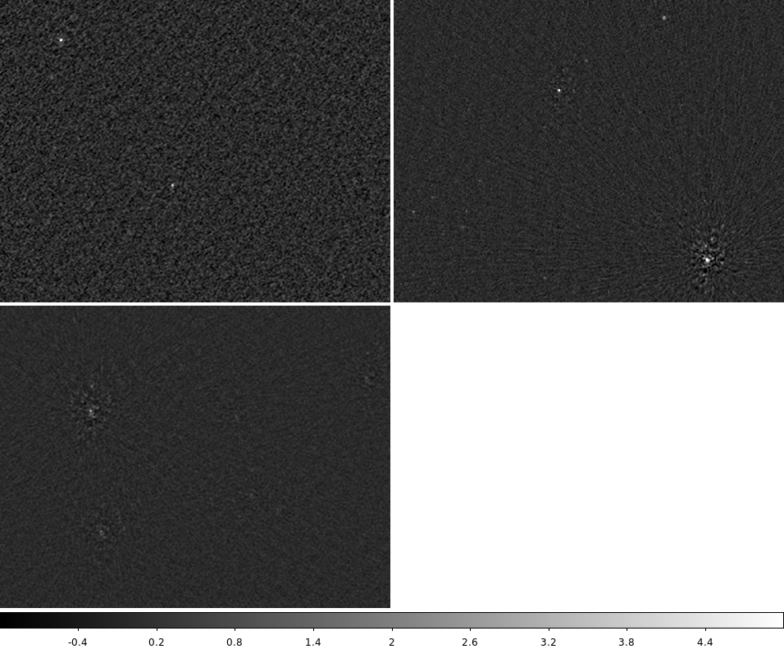
IPS observations in December 2015 motivated tents for receivers
Reference Calibrator from ~hours ago no longer works!

Slide 8
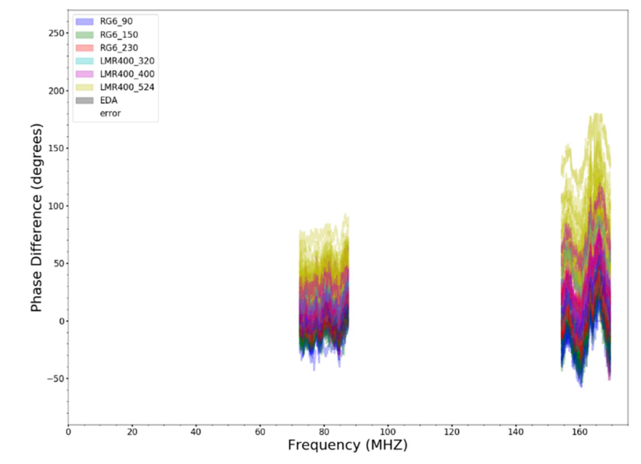
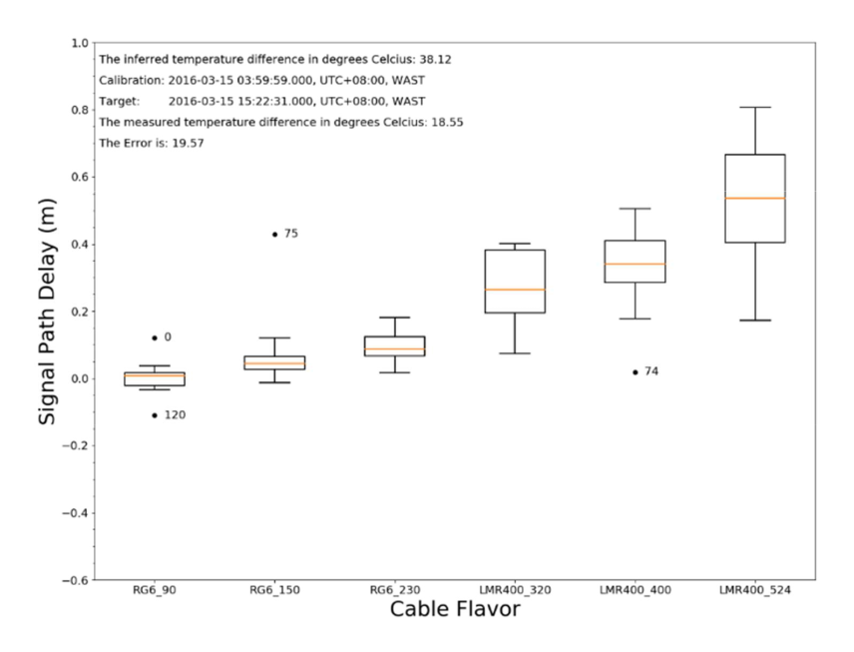
Chris Jordan, Jay Oliver

Slide 9
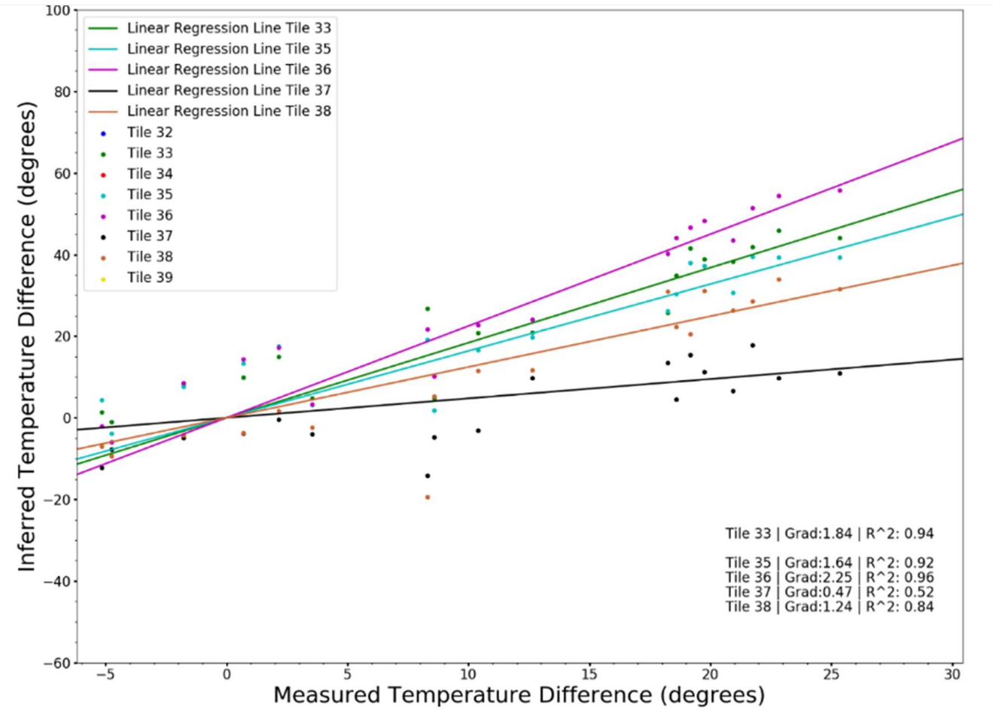
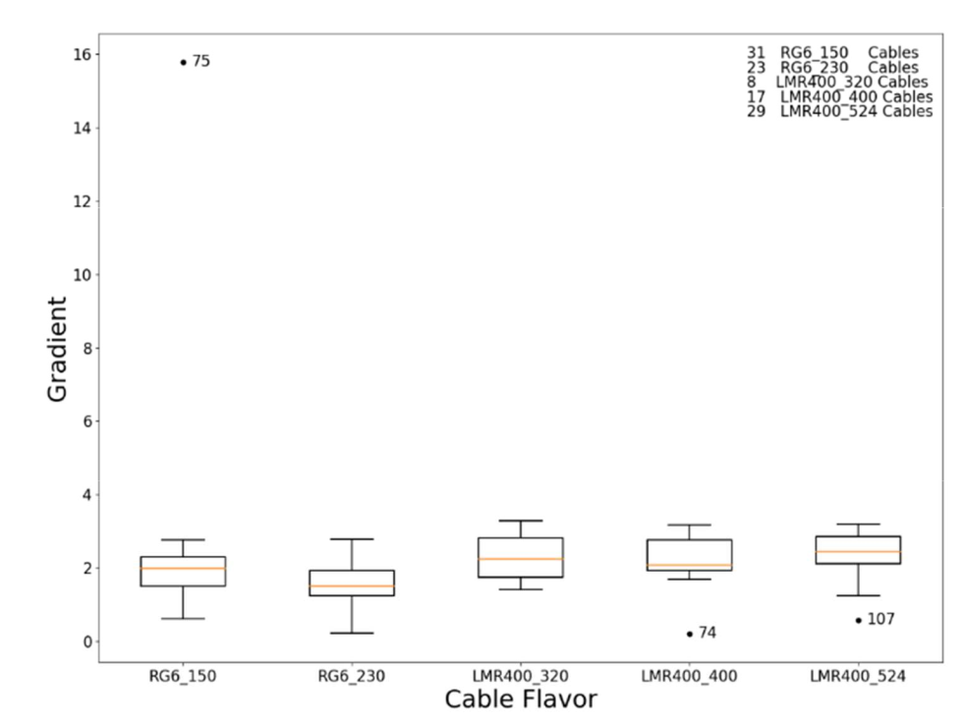

Slide 10
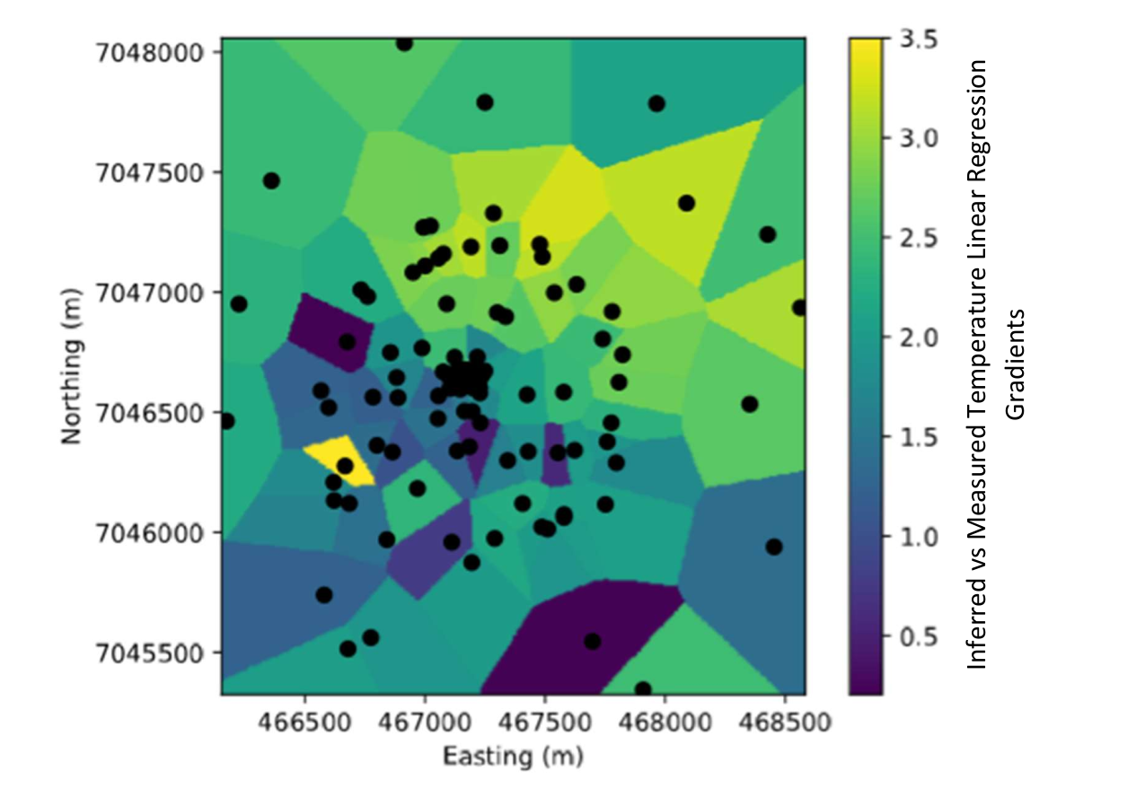
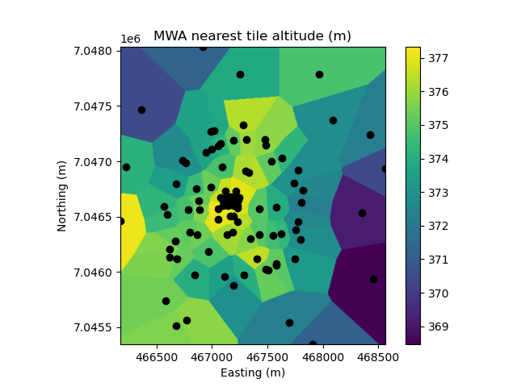

Slide 11
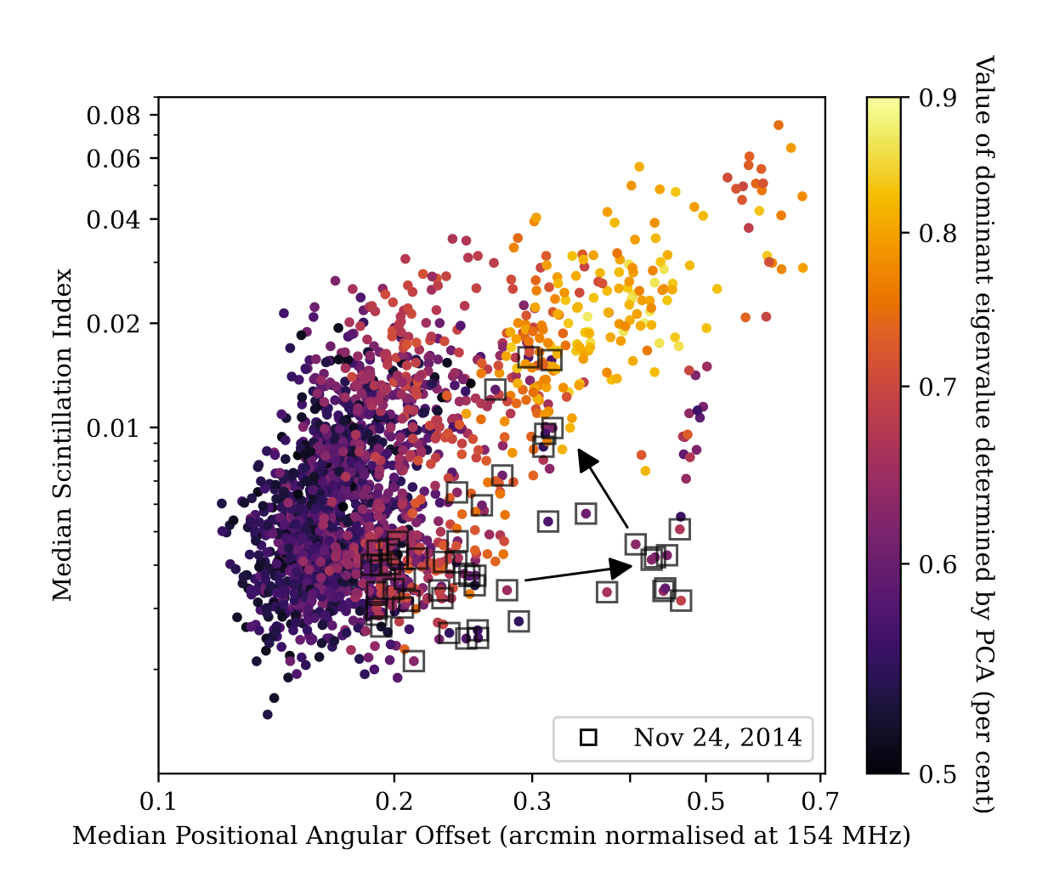
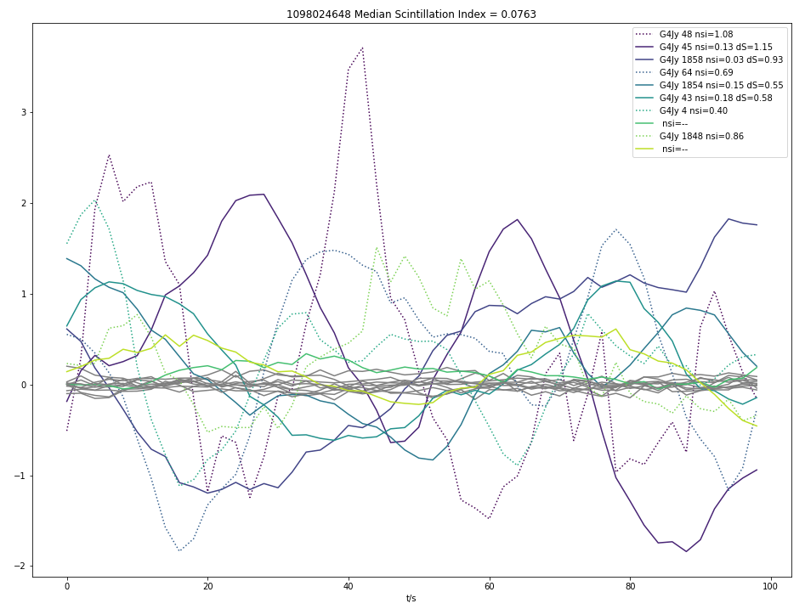
Ionospheric scintillation in Phase I EoR data
Angie Waszewski, Chris Jordan

Slide 12
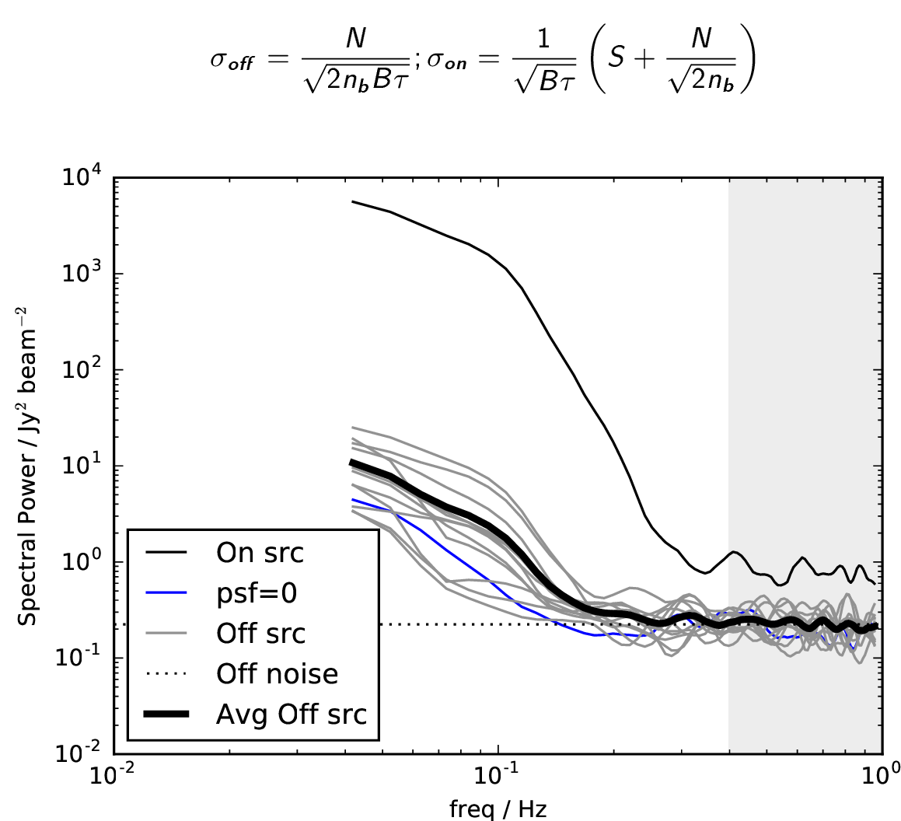
Source Noise
Power of Virgo A is 1% of sky noise (power detected across the array same as sky noise of a single tile)
Demonstrate existence of “Source Noise” placing fundamental limits on interferometer performance.
Important also as an extra observable for (e.g.) fast transient studies.

Slide 13
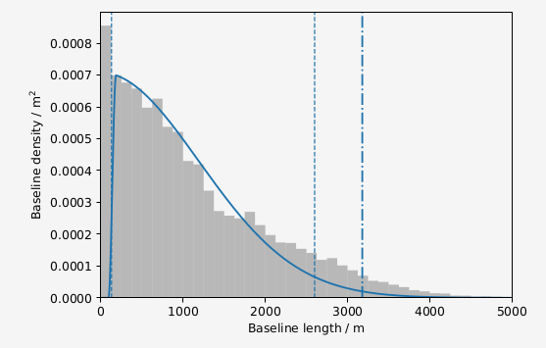
Onto Phase II MWA!
Far superior array for this work (Beardsley+ 2019)
Gaussian PSF with only 10% sensitivity loss
Vastly improved survey design and scheduling

Slide 14
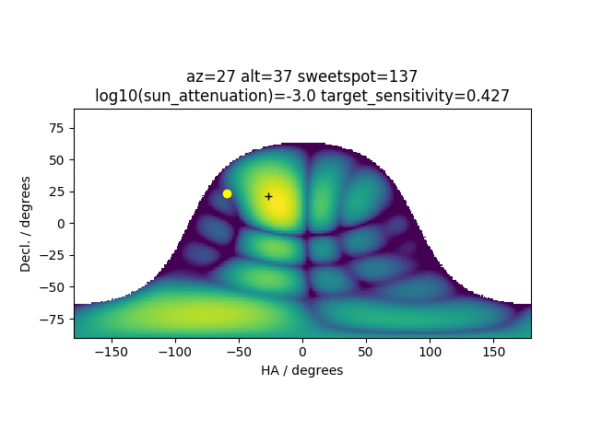

Slide 15
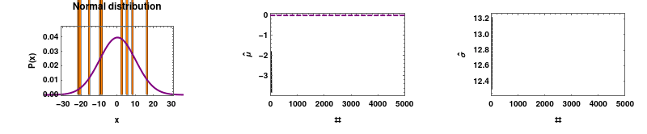
A new regime of variability detection
Most measurements (in astronomy) are measuring a source brightness. Detection of a source means a statistically significant (positive) measurement above zero.
Estimate mean brightness in presence of variance (due to noise)
Draw more samples (longer integration time) and S/N goes up with sqrt(N)
We make a map of the standard deviation of the time series
Estimate variance in the presence of another variance!

Slide 16
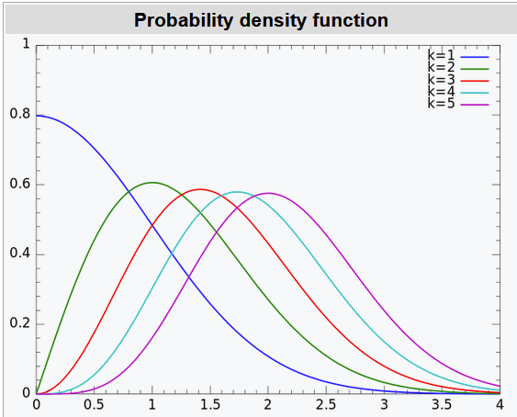
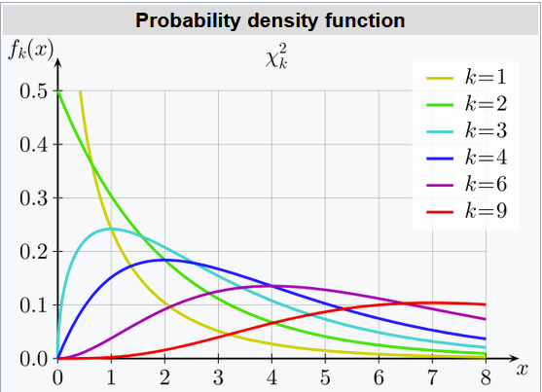
Statistics of variability detection
Standard deviation is ꭕ distributed
Converges to Gaussian much quicker than more familiar ꭕ-square (for variance)
30 d.o.f. – only 50% excess of 5-sigma sources compared to true Gaussian
This means we can use standard source finding tools (e.g. Aegean)
Downside is that we then have to subtract the noise in quadrature.

Slide 17
Debiased modulation index
Small uncertainty in measurement can lead to large uncertainty in modulation index close to detection limit
Point measurement in rms map
Signal absent rms (i.e. thermal noise) – background of rms map
Modulation due to IPS desired quantity
RMS map measurement errors go down with square root of observing time
For our observing parameters, fractional error in rms map is around 1/30
Therefore for us (or any reasonable observation time many times scintillation timescale)
rms of an IPS sources at the detection limit << rms due to thermal noise
Detection limit actually goes down with fourth root of observing time

Slide 18
Big difference from previous work:
Multiple measurements per source
Can exploit this to get more accurate NSI
(and maybe go a bit deeper, but it takes 40 2-sigma detections to get to 5-sigma!)
Biased if we don’t include all measurements

Slide 19
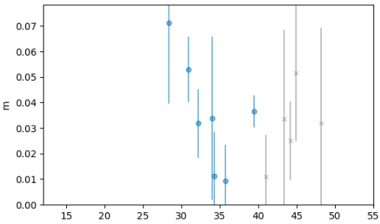
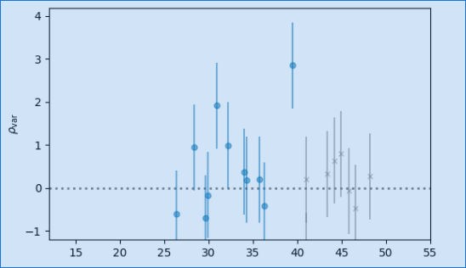
Is this a detection??
Scintillation Index
S/N in variability image
Solar Elongation

Slide 20
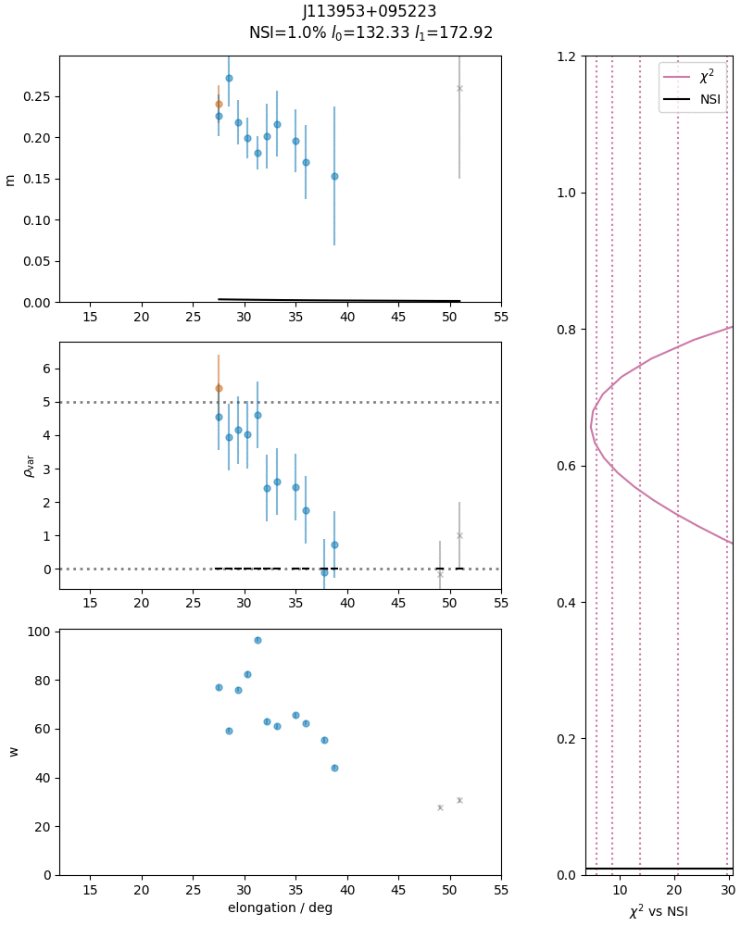
Combining ~250 observations
into one catalogue
For each source
Calculate scintillation index for each observation (top panel)
Find the NSI which minimises the residuals in the variability image detections (middle panel)
Weight by ratio of continuum measurement to thermal noise (bottom panel)
Sum of squares of residuals shown in side panel

Slide 21
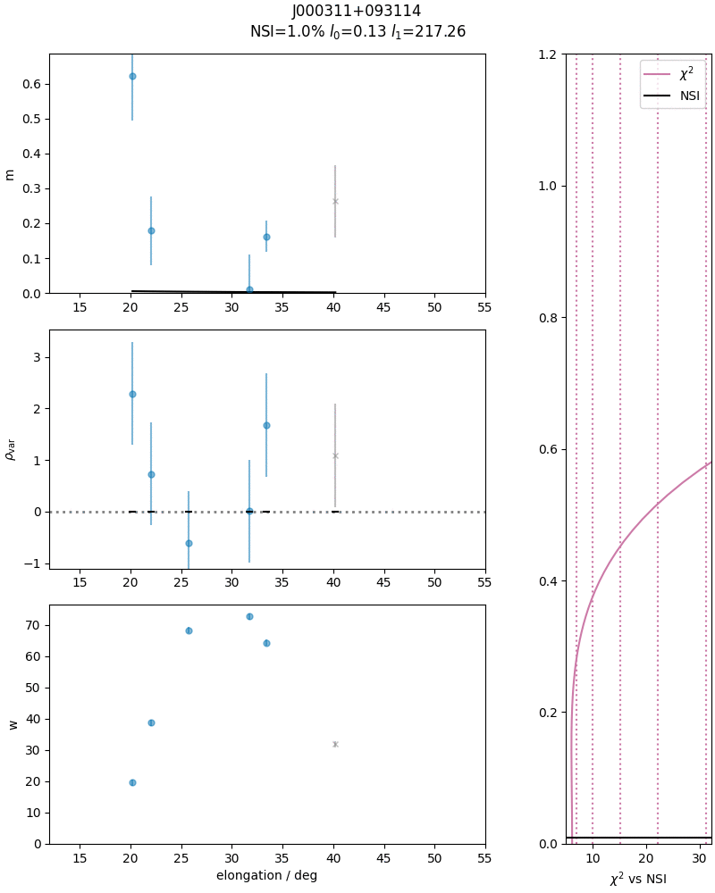
Combining ~250 observations
into one catalogue
Lots of upper limits!
Non-linear relationship really noticeable below 1-sigma
Negative measurements really important!
dSNR/dNSI=0 at 0 for *all sources*
Range of plausible NSIs at the bottom end
*steeper* than quadratic log likelihood function.

Slide 22
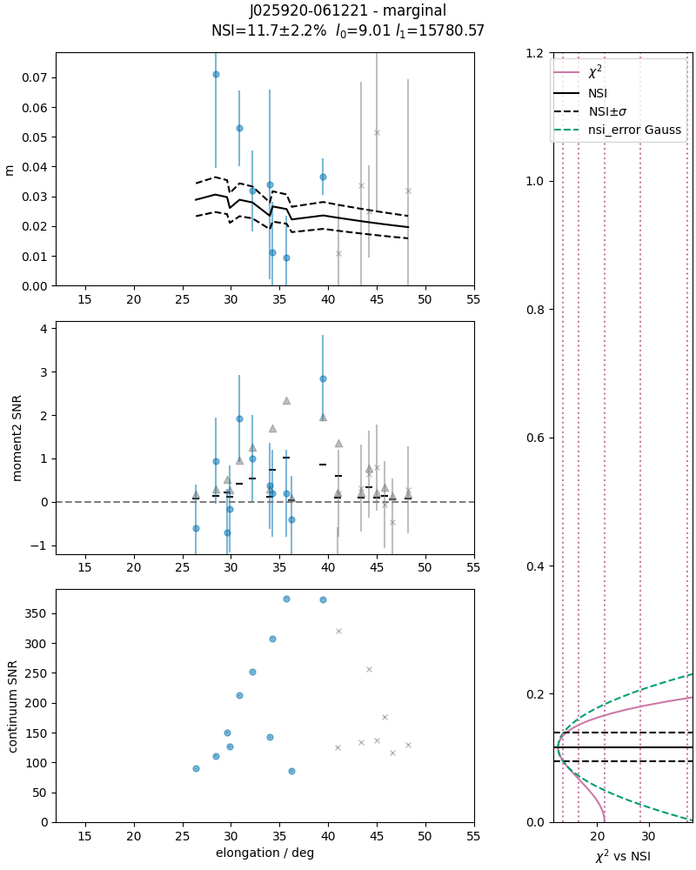
Back to our original
“Detection”
“Marginal” detection (approx 3-sigma)

Slide 23
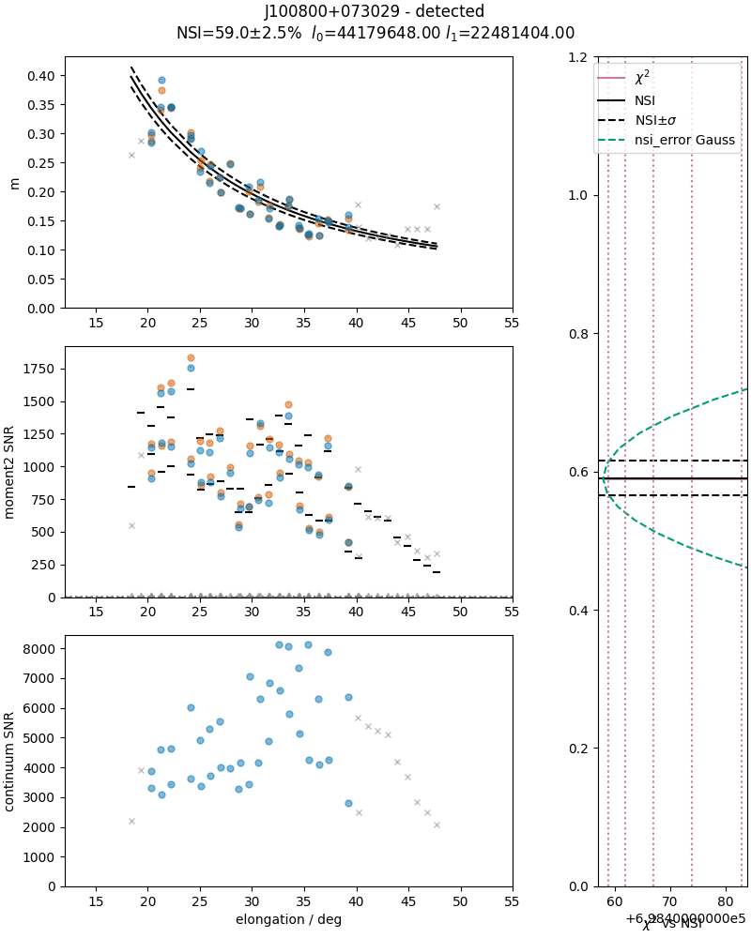
For strongest detections, uncertainty is dominated by “space weather” fractional error of ~25%
25% / √N_{eff}
Combined in quadrature with fitting error.
This “error” encodes valuable information about the solar wind!

Slide 24
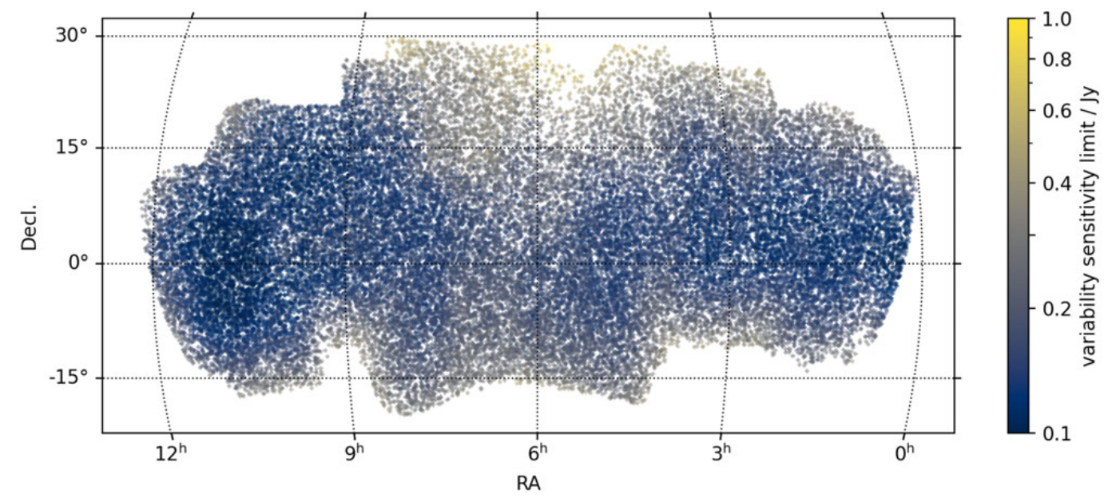
Data Release 1
41035 GLEAM sources in survey area (essentially complete)
7837 IPS detections (NSI not zero at 5-sigma significance level)
29672 Upper limit (Not in IPS detection set and NSI not 1 (3-sigma significance))
3526 Unconstrained (not IPS detection and not Upper limit)

Slide 25
Science so far
Comparison with Lofar long-baseline calibrator survey
IPS properties of HzRGs
Space Weather: Detection of moving Heliosphere Transient (submitted)
Galactic Scattering (in prep)
FLASH (HI absorption; in prep)

Slide 26
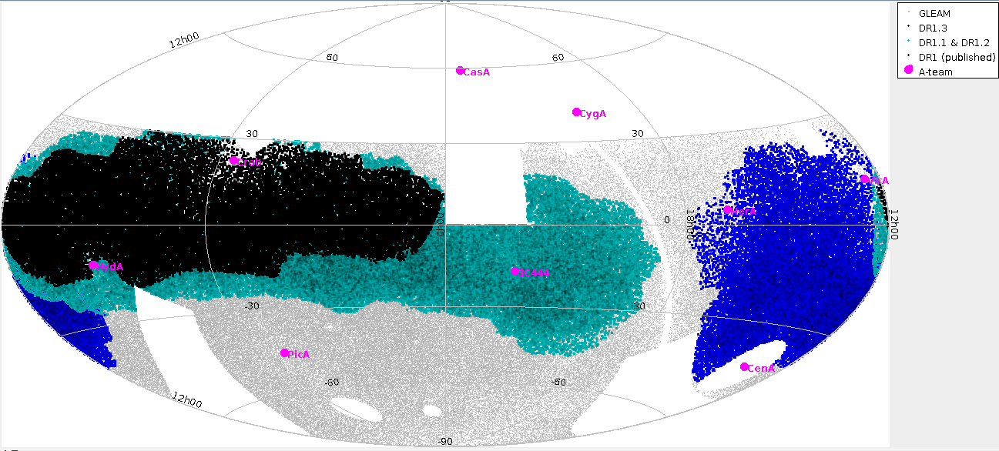
Data Release 2 (in prep)

Slide 27
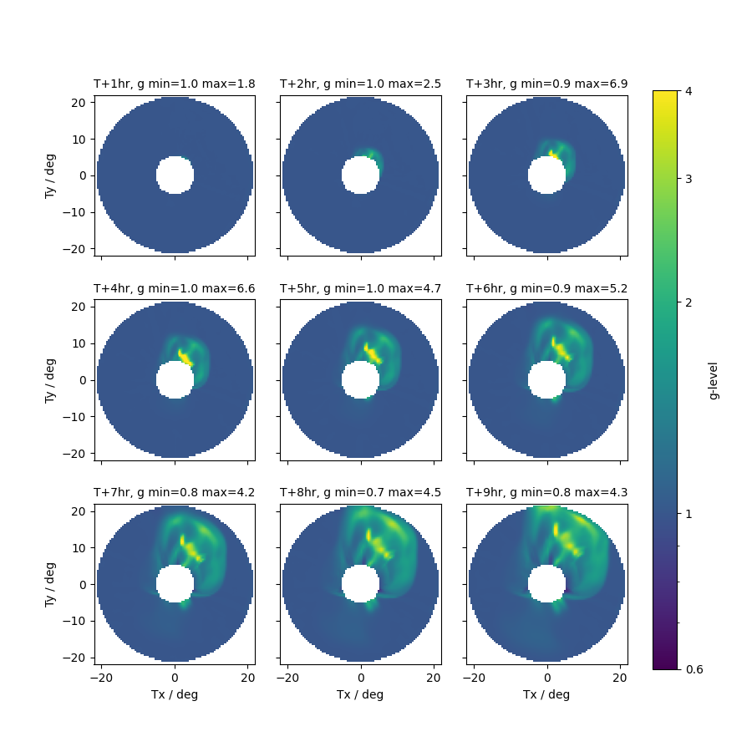
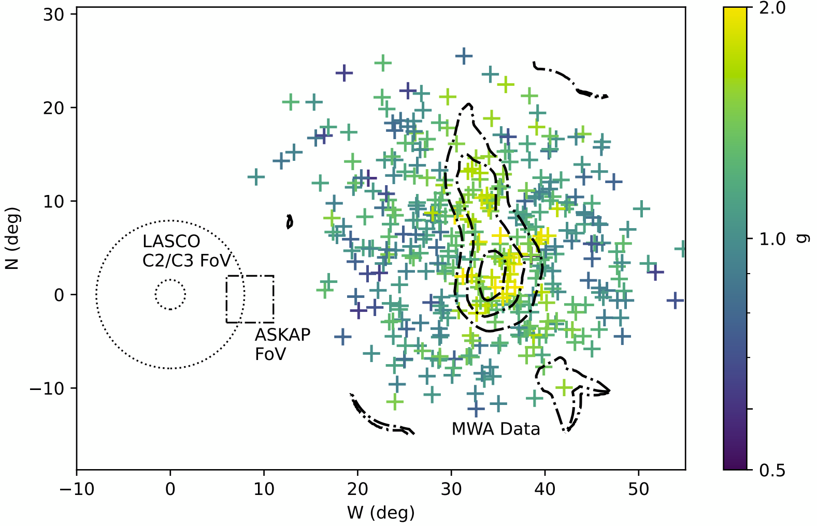
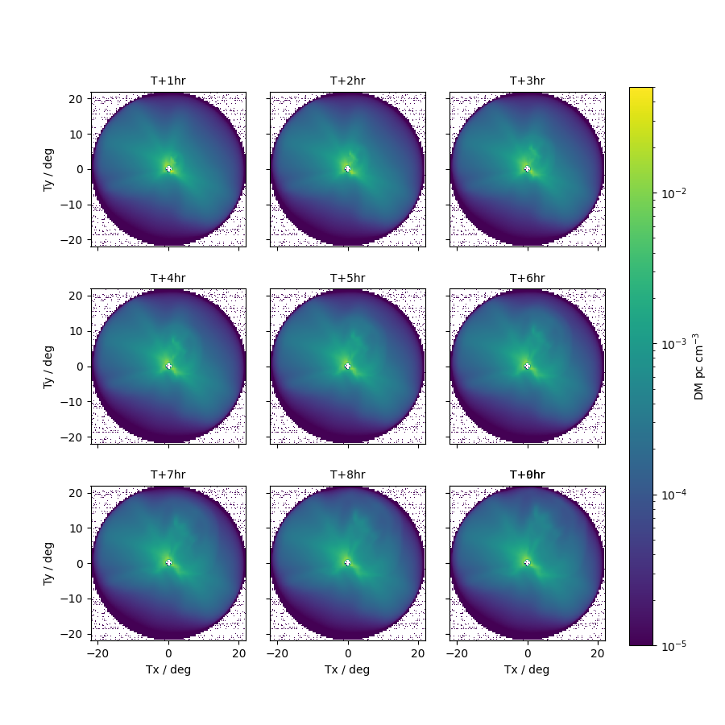
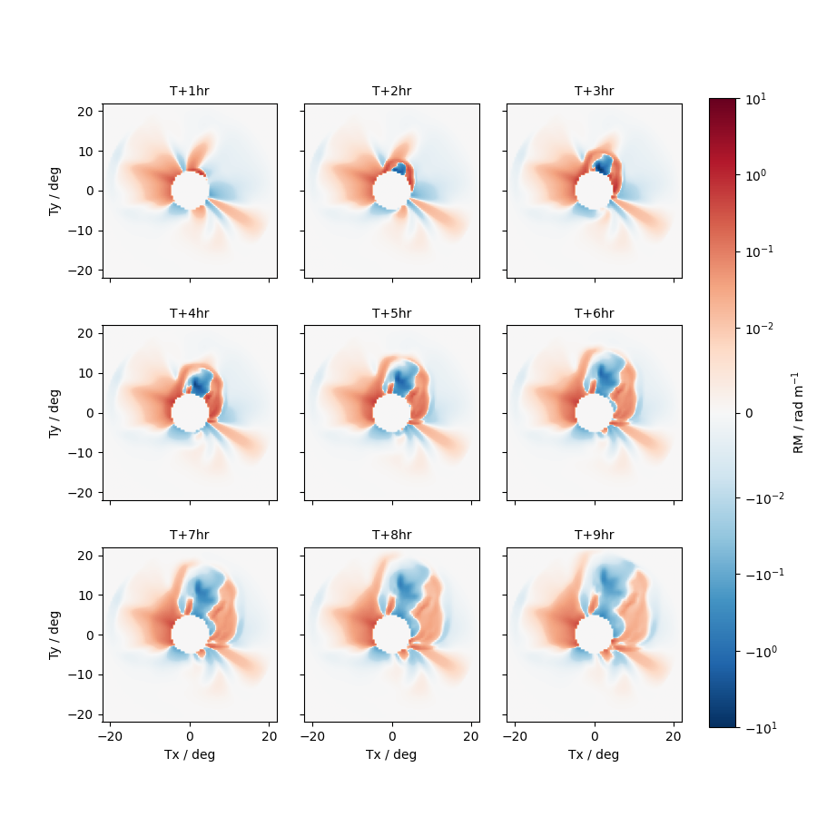
The future
Is bright!
Still plenty more work to be done with MWA IPS
Increasing focus on Space Weather
Shift towards more instruments and other techniques to probe the Heliosphere

