Slide 1

The fifth pulsar discovered with the SMART survey
Garvit Grover
Supervisors:
Dr. Ramesh Bhat & Dr. Sam McSweeney

Slide 2
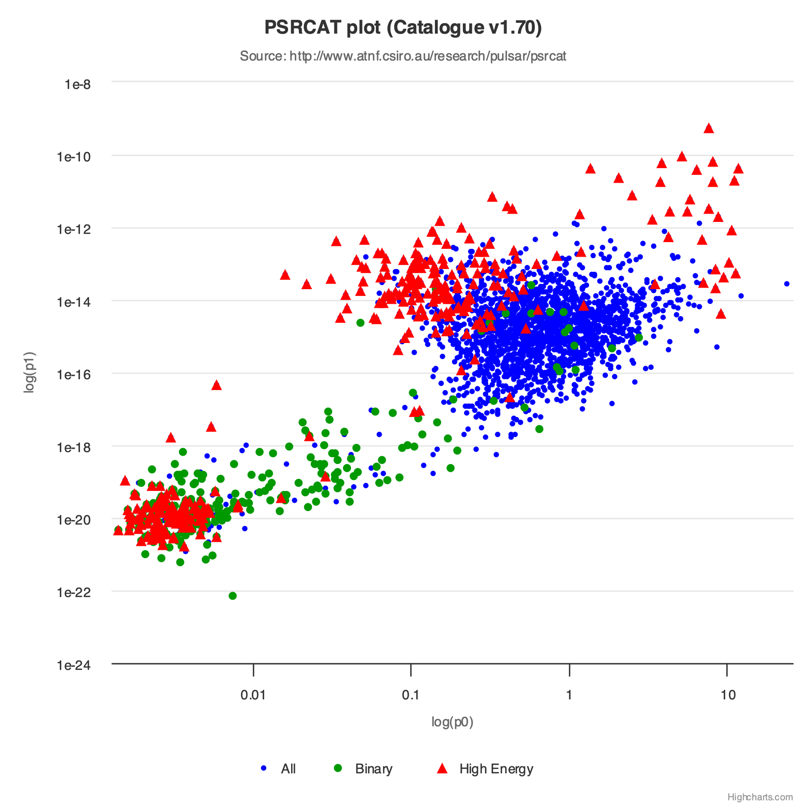
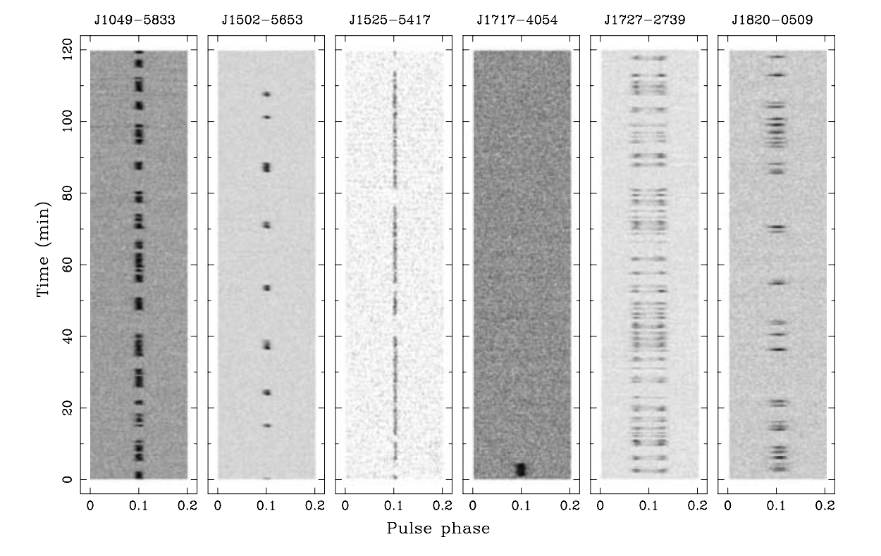
The pulsar mystery
Emission mechanism is unknown
They must “die” with age
Recently finding many long-period transients
Majority of these objects also show nulling
SMART survey is sensitive to such objects due to long duration observations
Credit: Wang et al. (2007)
Notes:
- We see them but we don’t know why – long-period pulsars are dead – nulling – SMART

Slide 3
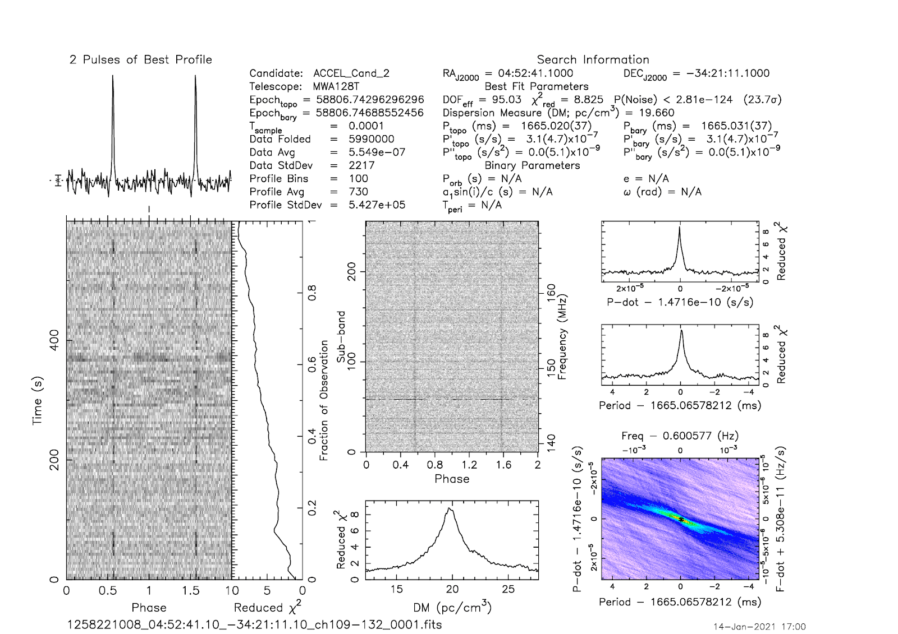
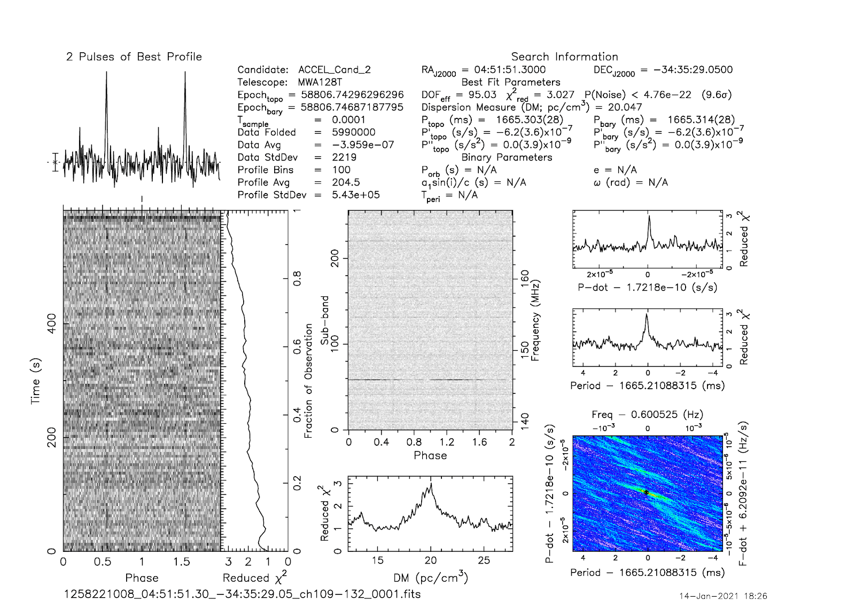
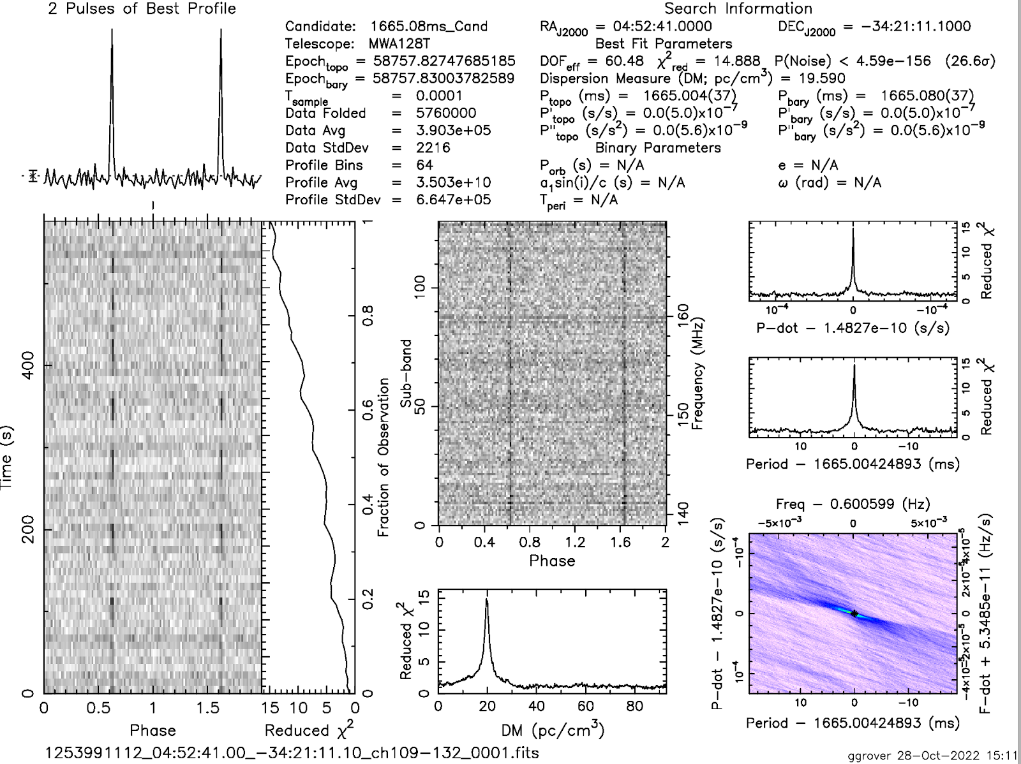
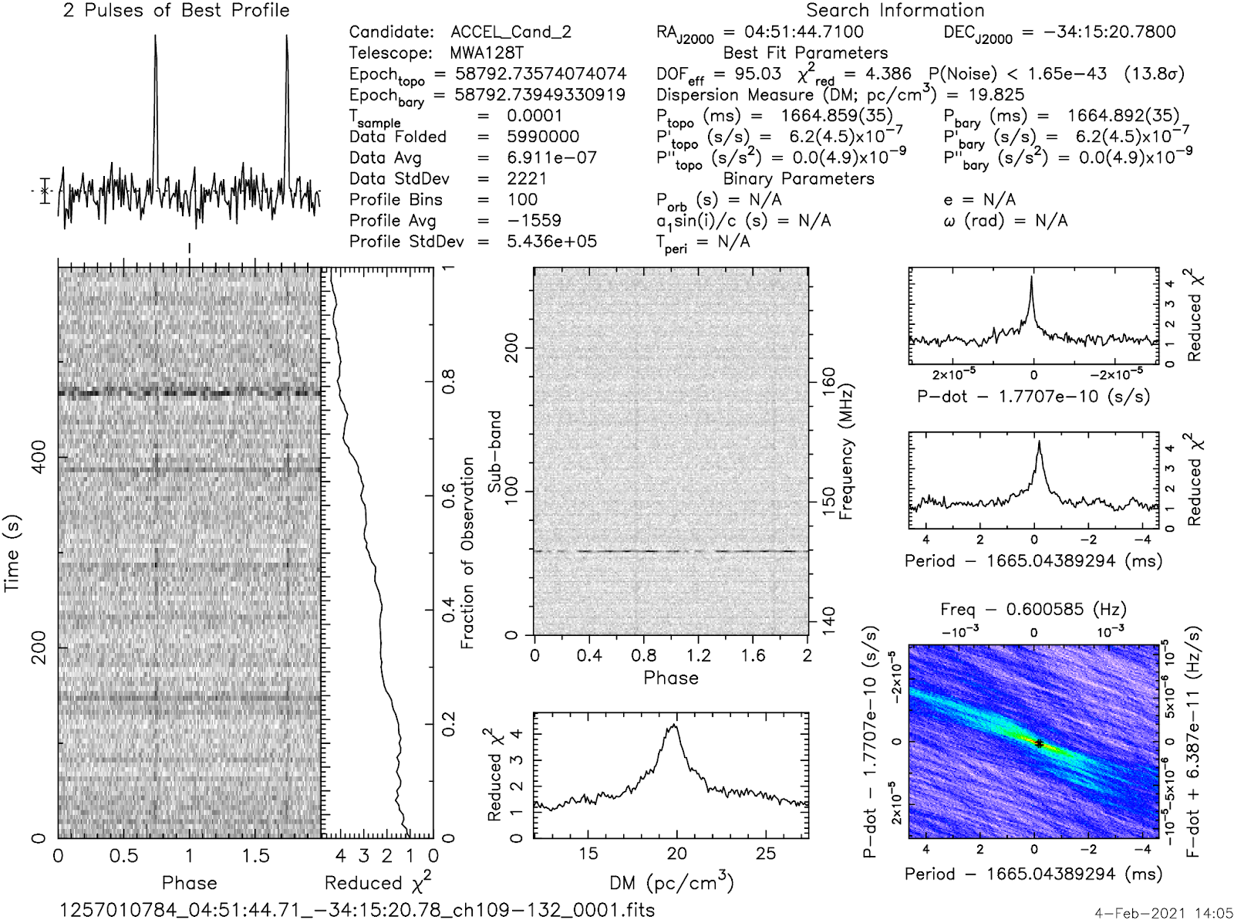

Discovery
Name: J0452-3418
Period: 1.665… s
DM: 19 pc cm⁻³
Shows nulling

Slide 4
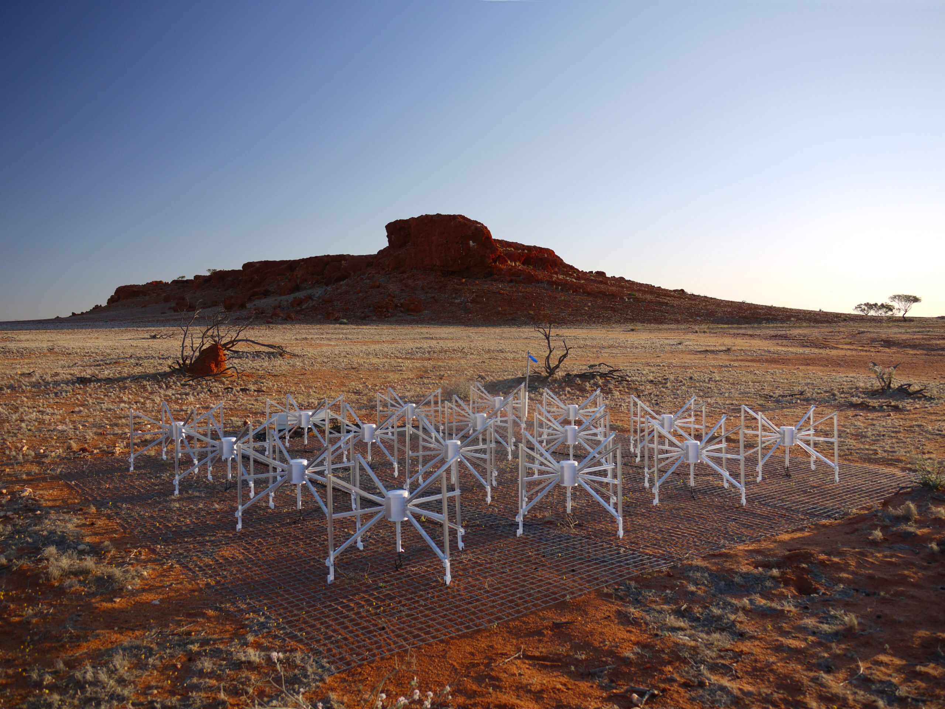
Advantages of MWA Pulsar Processing
Large field of view
Low RFI
Pulsars are brighter at low frequencies
Store voltages
Offline beamform
Credit: Natasha Hurley-Walker

Slide 5
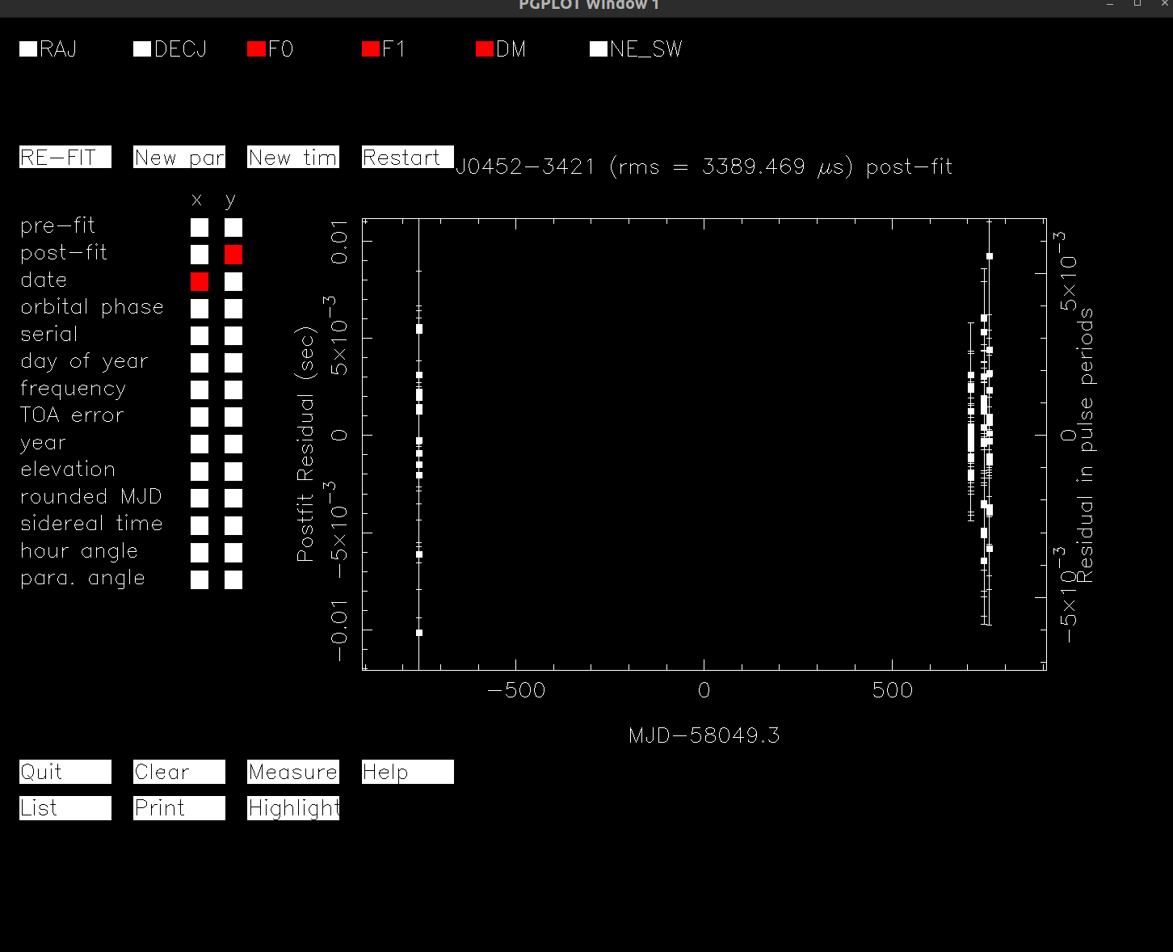

Timing
Timing the arrival of each pulse
Past discoveries used other telescopes for timing (Parkes, GMRT)
We only used MWA observation
3 SMART observations + 1 past observation
Better constrain the Period
&
$$\dot{P}≈6∗{10}^{−14}$$
Notes:
Exaplin timing ”when you fit model, you ideally want residuals to be small and near 0” – past discoveries used GMRT and Parkes – with only MWA obs, we time pulsar

Slide 6
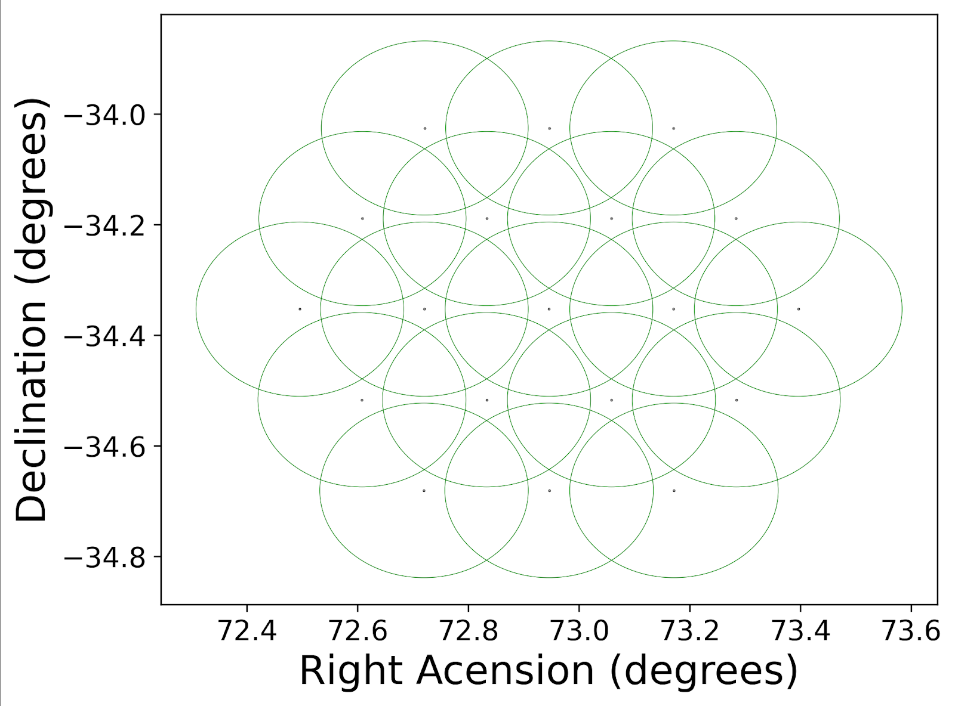
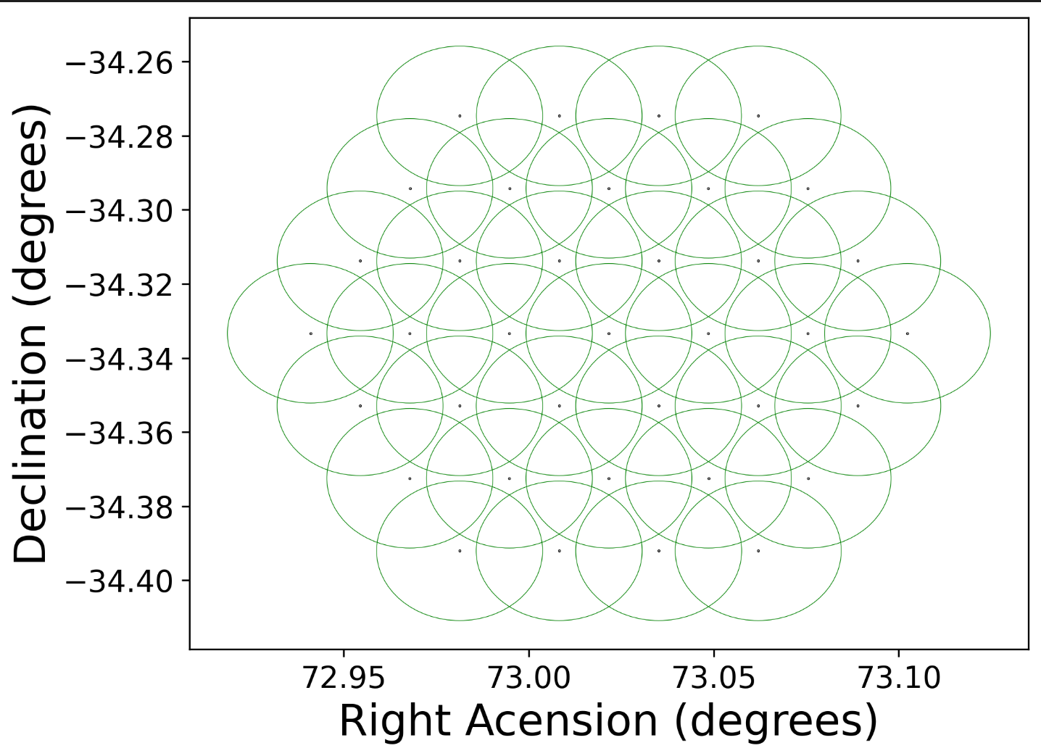
Localisation
SMART Obs (Phase 2 Compact)
Phase 1

Slide 7
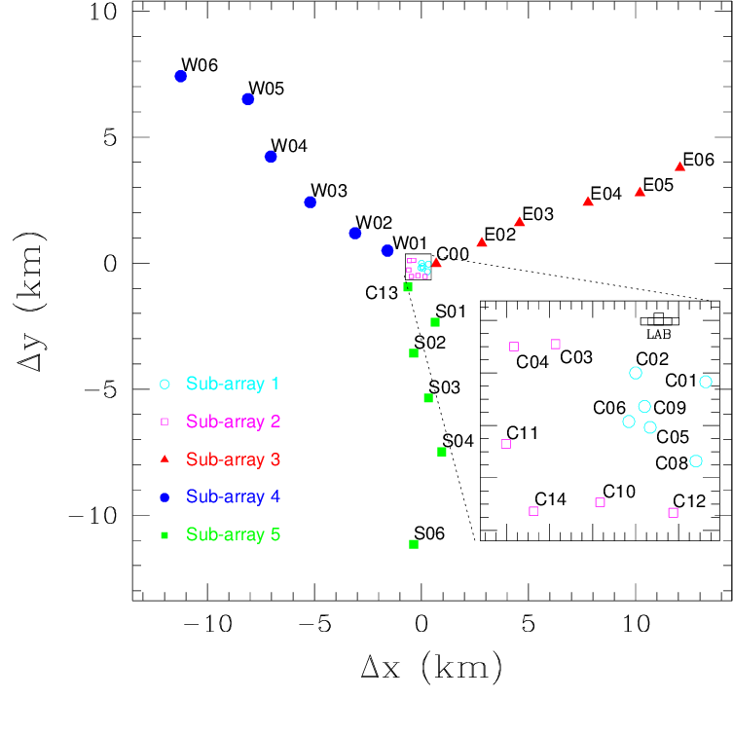
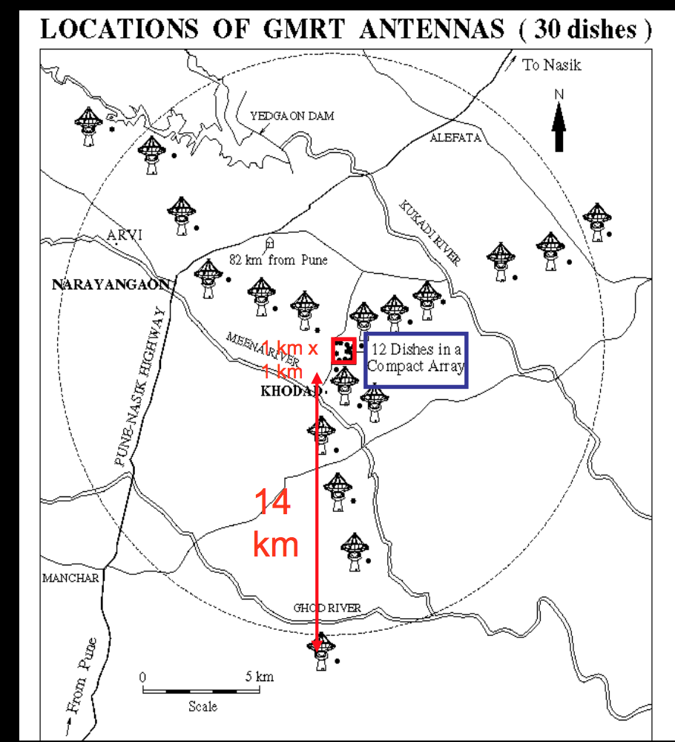
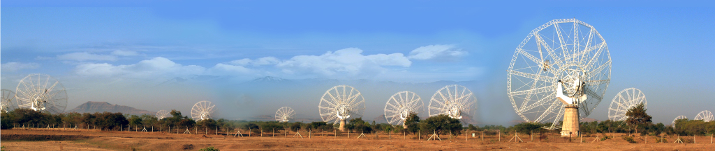
GMRT
Credit: Ramesh Bhat
Multiple sub-arrays
Collect beamformed and correlated data

Slide 8
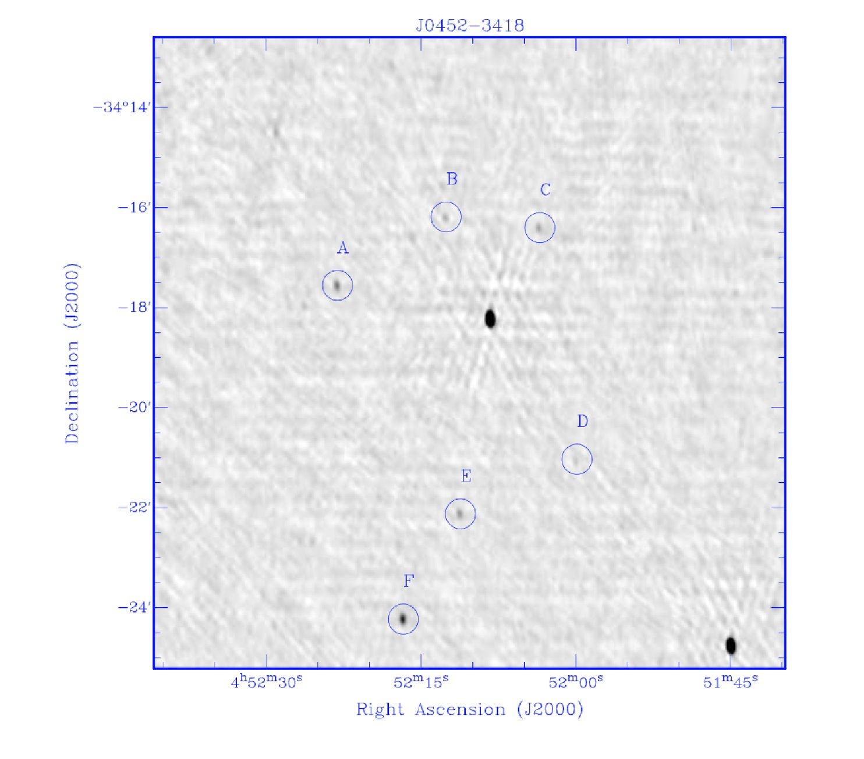
GMRT Follow up
Source A
Source B
Source C
Source D
Source E
Source F

Slide 9
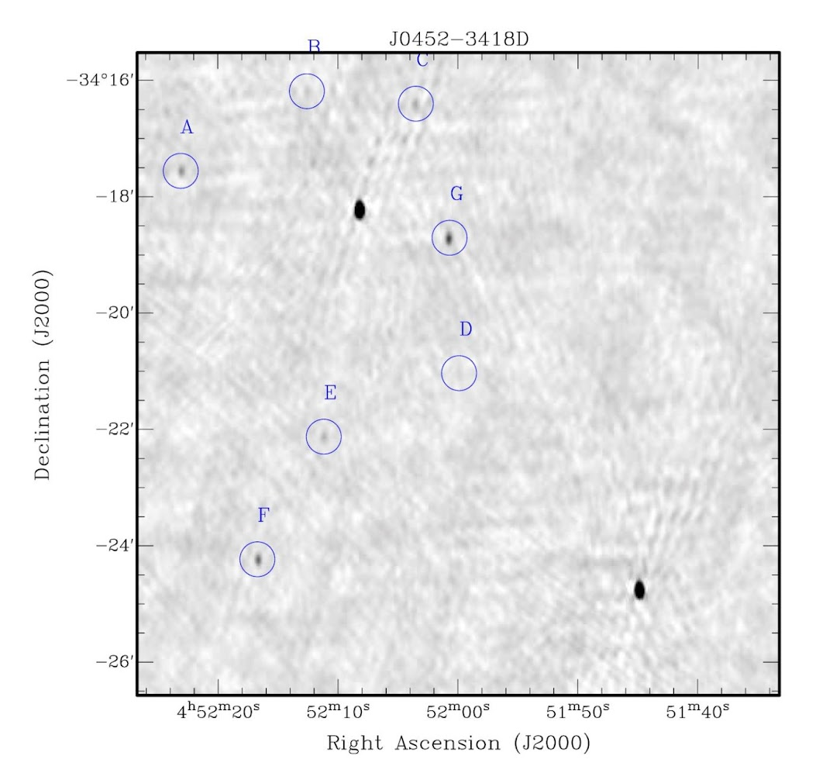
GMRT Follow up
Source A
Source B
Source C
Source D
Source E
Source F
None of the above

Slide 10
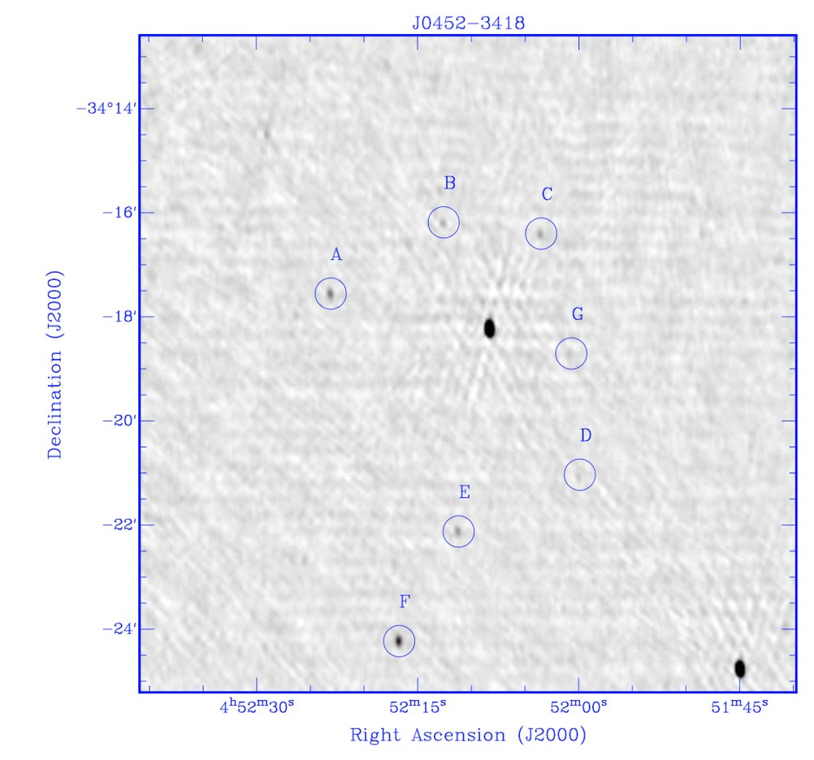
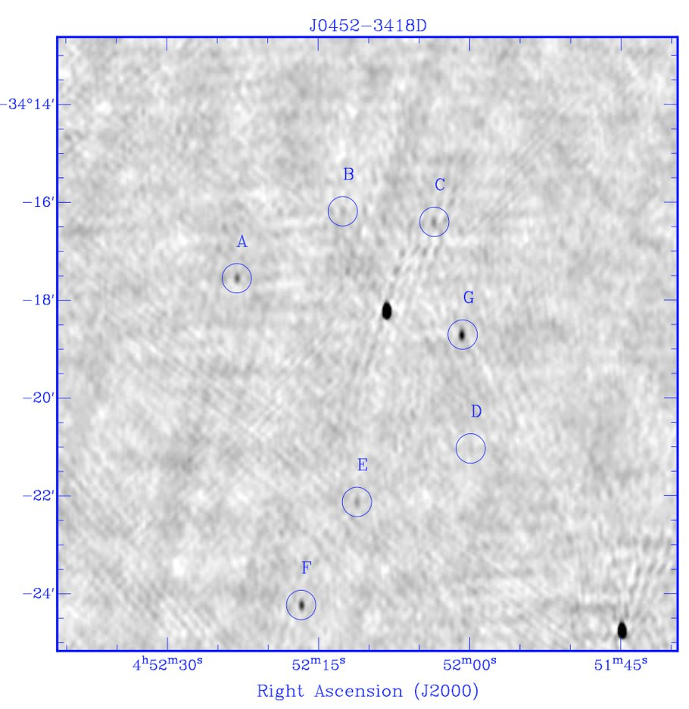
Notes:
30min long data

Slide 11
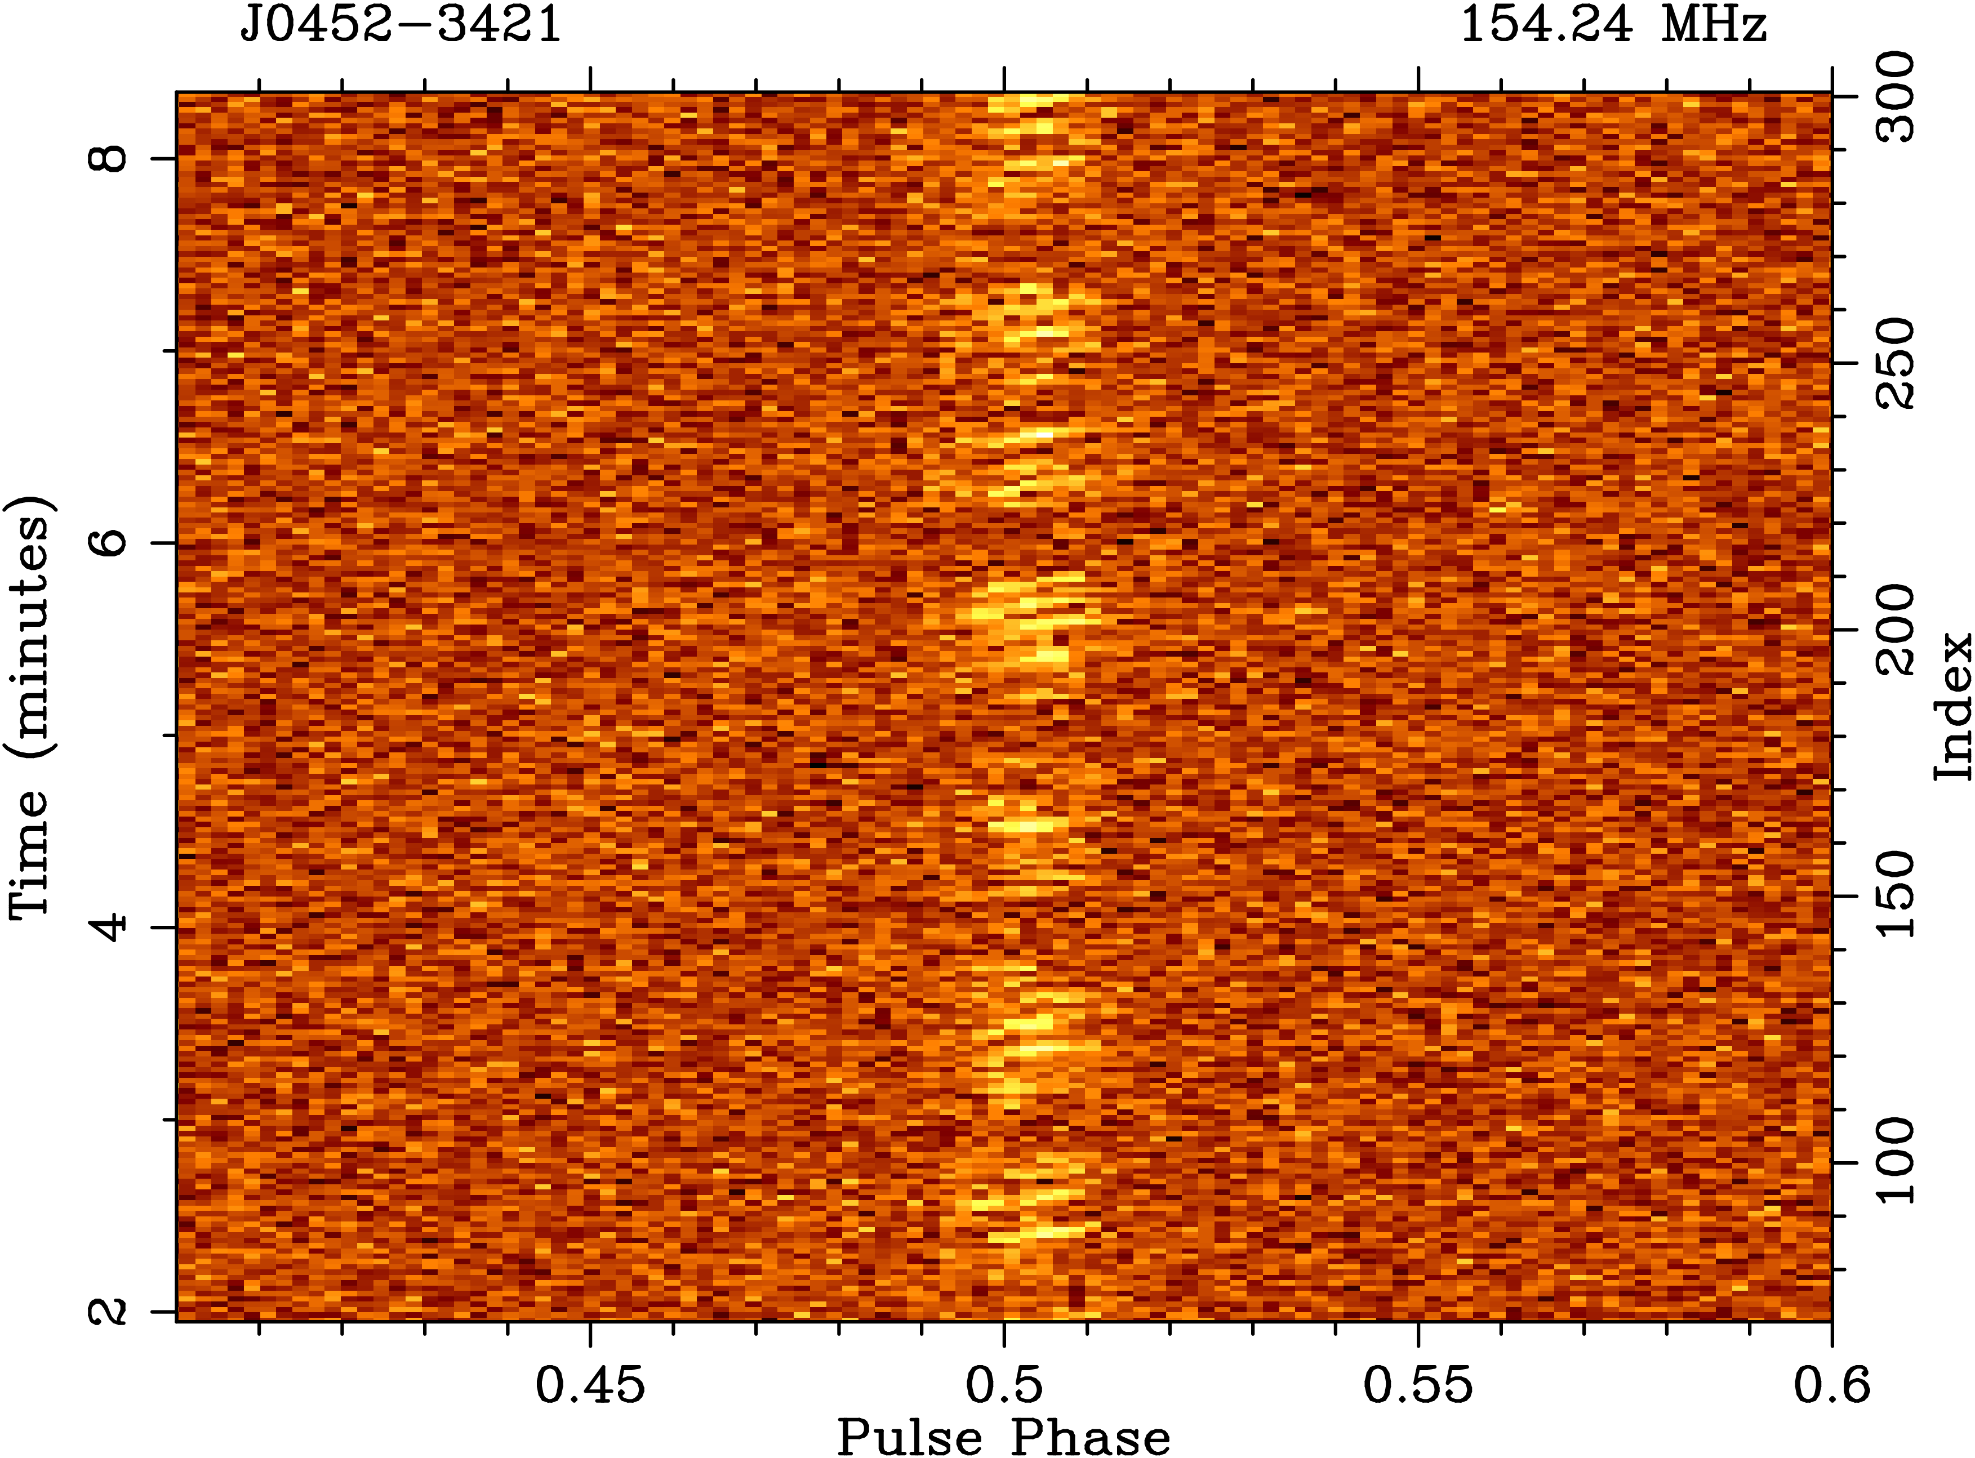
Single Pulse Analysis
Nulling and sub-pulse drifting
Similar to Pulsar #2 (McSweeney+2022)
Stable drift rate?
Stable nulling?

Slide 12
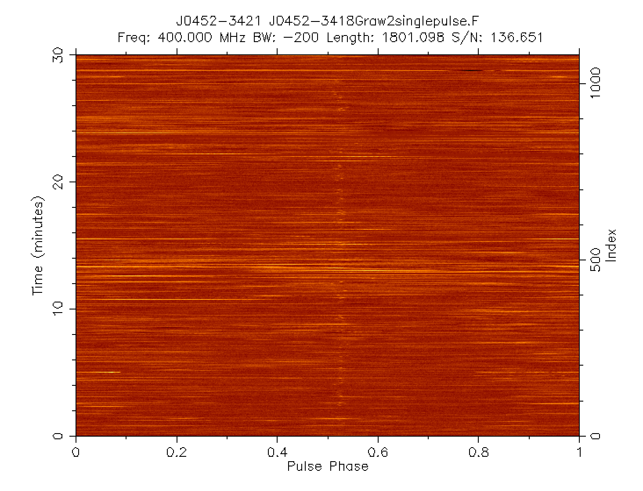
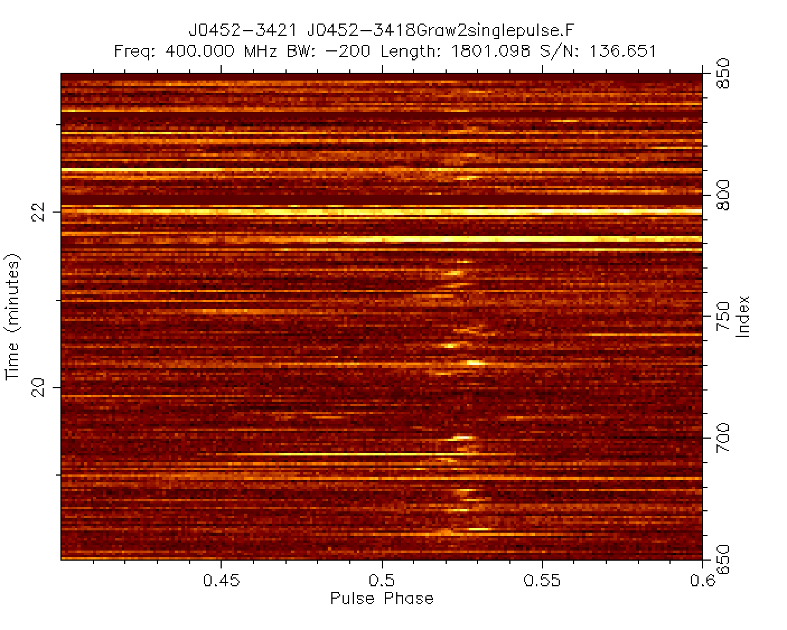
GMRT DATA

Slide 13
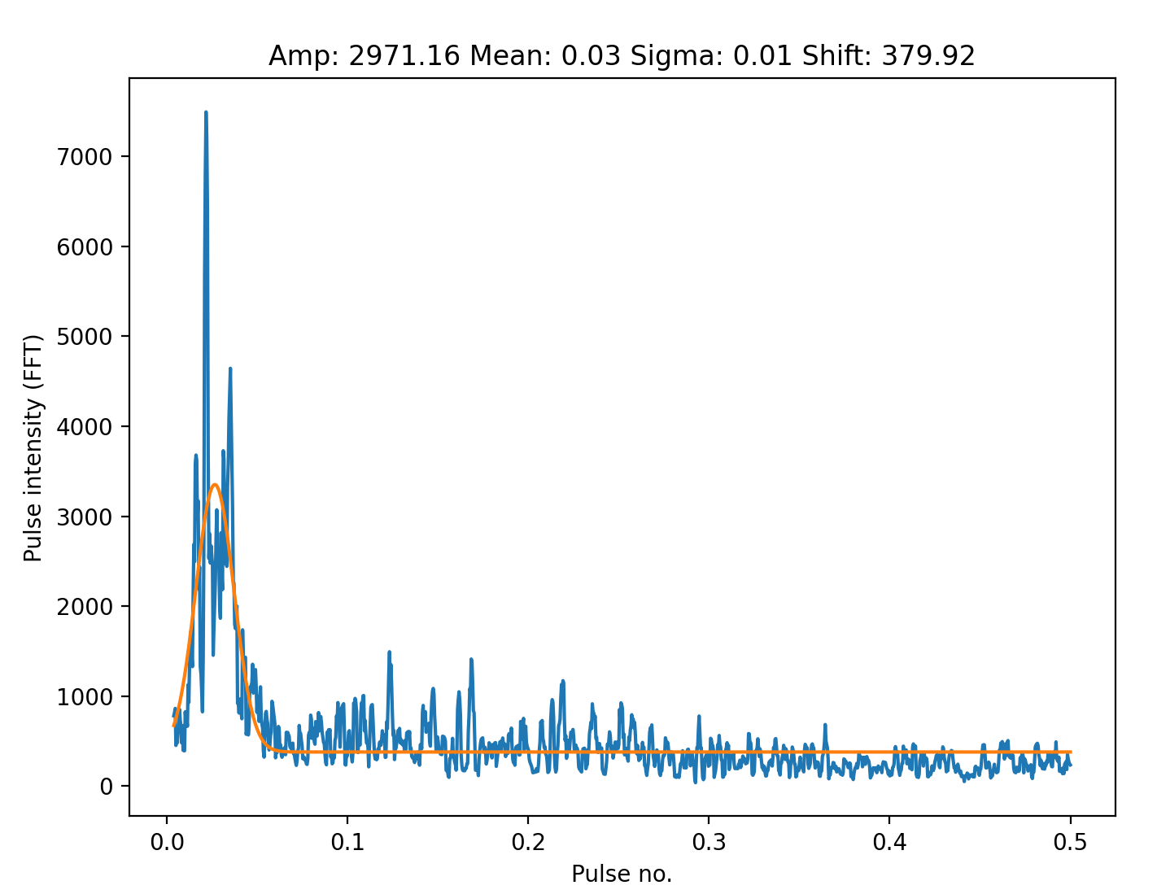
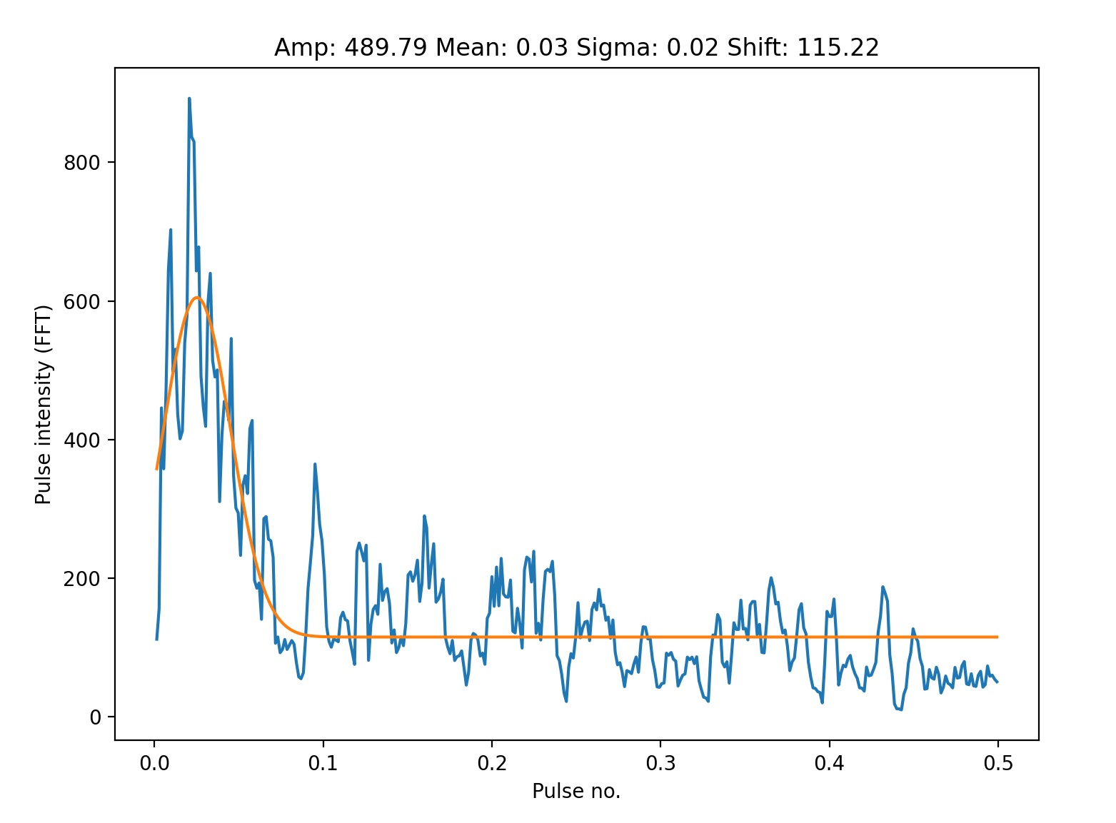
Nulling Analysis
Use 2 bright SMART observations
Nulling fraction 50%-70%
Preform FFT of a single bin
Fit Gaussian
Nulling periodicity approx. 50 pulses

Slide 14
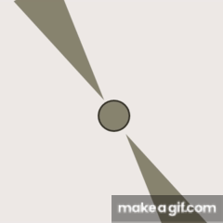
Summary
5th pulsar with the SMART survey
Single pulse analysis revealed sub-pulse drifting
2nd nulling and sub-pulse drifting pulsar found by SMART
Timed entirely and reasonably localised by MWA data
Future work to study this object deeper
Notes:
Highlight future possibilities with MWA

