Slide 1
The History of Discoveries made (and missed) using radio frequency interferometers on our path to the MWA
10 years of MWA operations:
a celebration of international collaboration in radio astronomy
Ron Ekers
28 July 2023, Perth
CSIRO Space & ASTRONOMY
Notes:
The history of discoveries made (and missed) using interferometers (Jansky-galaxy, Bolton-AGN, Jennison-double sources, Burke-Jupiter bursts, Ryle-evolution, Bell–pulsars, VLBI-superluminal motion, SgrA* and EHT, etc. I would try to go behind the scene to understand how the mostly serendipitous discoveries were made. This has some overlap with the Pawsey book and with the new Kellerman book on discoveries in radio astronomy.
For MWA10 could also cut aperture synthesis image and phase switch.

Slide 2
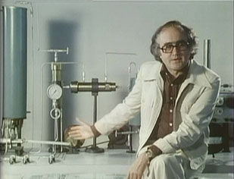
Connections
TV series on the history of science
James Burke1990s
One cannot consider the development of any particular piece of the modern world in isolation.
Rather, it is the result of a web of interconnected events.
Each event is conducted with no concept of the final, modern result.
The interplay of the results of these isolated events is what drives history and innovation
https://en.wikipedia.org/wiki/Connections_(British_TV_series)

Slide 3
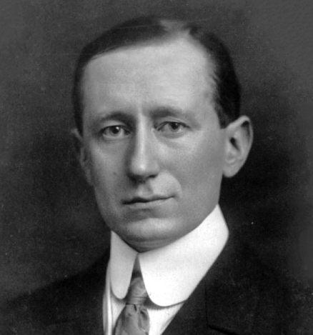
1910 - Guglielmo Marconi transmits radio signals across the Atlantic
Wealthy amateurs could take risk
  physicist Oliver Lodge had predicted the maximum
  transmission distance would be a half mile.
In 1901 Marconi famously transmitted a radio signal from Poldhu, Cornwall, in Great Britain, to Newfoundland, Canada.
How did the signal propagate around the curved earth?
  Multiple diffraction by surface features
    A prized theory because of its elegance.
    All anomalous data was ignored (skip zones, day v night…..)
  Multiple reflections from a hypothetical reflecting layer in the upper atmosphere
    Oliver Heaviside a practical man who invented and patented the coaxial cable.
    Largely ignored for the next decade
    A new discovery or unnecessary complexity (Occam)?

Slide 4
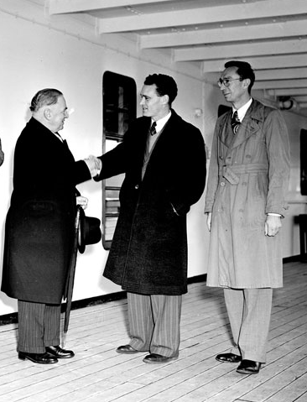
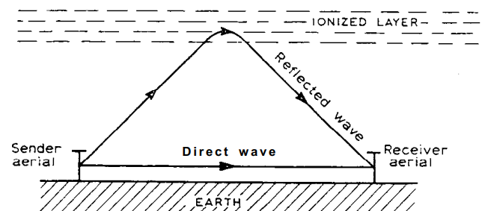
1924 – Edward Appleton
Conclusive evidence for the existence of an ionosphere
Measured the interference between the ground and reflected wave while sweeping frequency.
  Separates delay and phase – measured height of ionosphere
  Used powerful radio broadcast transmitters.
1947 - Nobel prize
Appleton got the name and the Nobel prize
  Cambridge academic physicist advantage?
URSI 1952 Sydney
Appleton
Bowen
Pawsey
Notes:
Pawsey’s colleague Payne-Scott would also later use the swept-frequency technique in interferometry to measure positions of short duration solar bursts

Slide 5
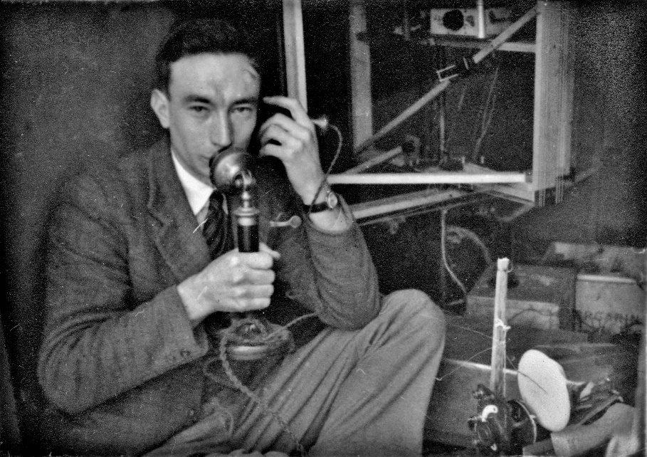
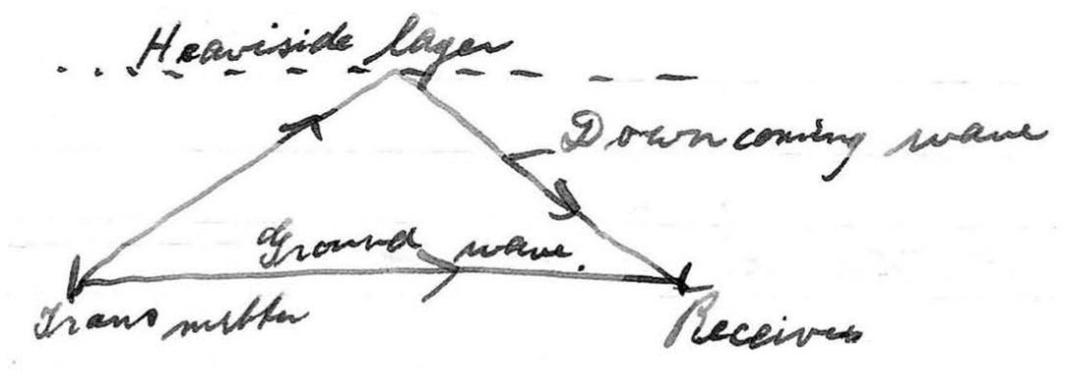
1931 – Pawsey PhD in Cambridge
Appleton’s research provided the context for Pawsey’s PhD project in Cambridge.
Using interference between direct and reflected radio waves to measure structure and motion in the ionosphere
Notes:
Pawsey’s colleague Payne-Scott would also later use the swept-frequency technique in interferometry to measure positions of short duration solar bursts

Slide 6
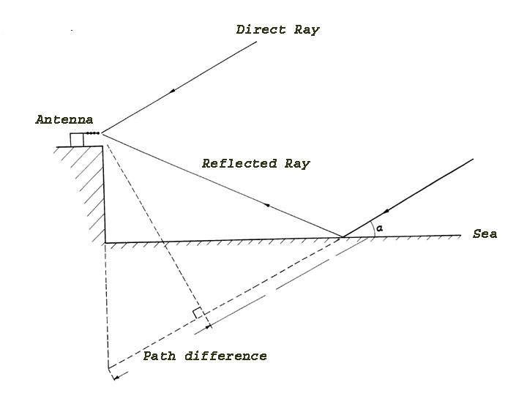
1947 – Connections!
Collaroy Plateau and Dover Heights
How to measure the structure of a radio source?
Cliff interferometer concept
One receiver
No phase stability problems
Notes:
also used in WWII by naval radar operators

Slide 7
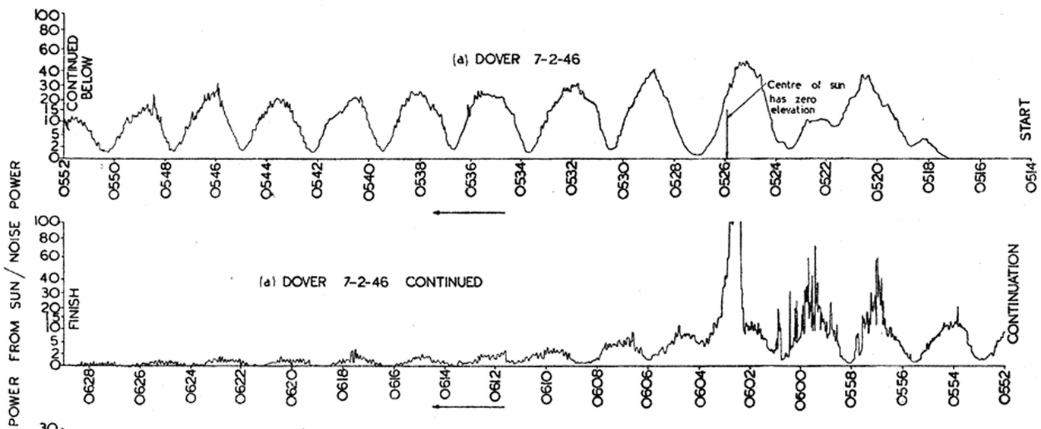
First radio astronomy interferometer fringes
The sun, Dover Heights, 7 Feb 1946

Slide 8
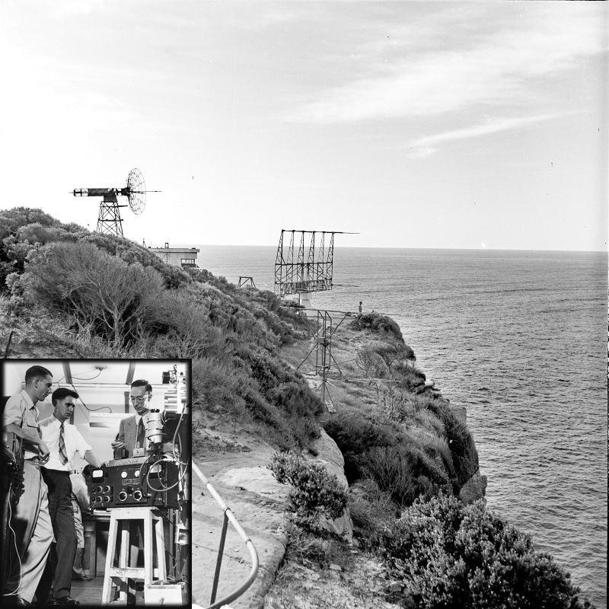
Cliff Interferometer
Dover Heights, 1950
Notes:
The first radio astronomy interferometer

Slide 9
At the end of WWII the discrete radio sources were assumed to be stars
Clever but incorrect application of Occam's razor
  The Galaxy had been detected (Jansky)
  The sun had been detected (Hey),
  would not expect multiple different mechanisms and since the galaxy is full of stars the galactic emission must be the sum of all the stars like the sun
  Hence the discrete sources will be stars.
Strong evidence against this interpretation was ignored
  not enough stars to explain the galactic emission if they are like the sun
    easily fixed, special bright stars
  Evidence for extended emission ignored

Slide 10
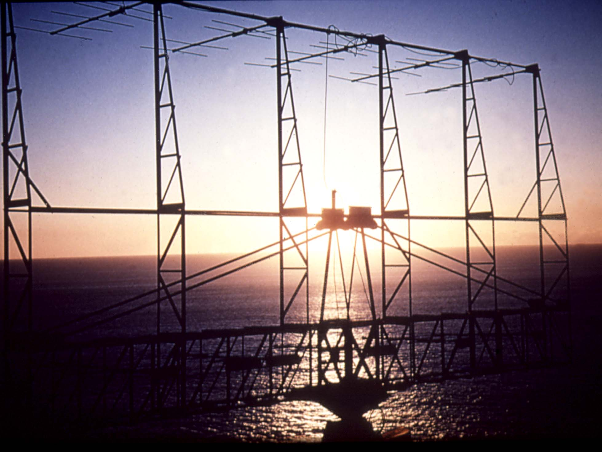
Cliff Interferometer
Cliff interferometer CSIRO, Australia (1948)
  Built to identify the radio stars (John Bolton)
  Discovery of extragalactic radio sources at great distances
    Centaurus A , Virgo A, Cygnus A, Fornax A
    None were stars and two were extragalactic.
Sydney, Australia 1948
Needed more accurate positions to identify the sources of radio emission
Notes:
Remove: Idea from multiple path interference in ship borne radar
Remove: Had to hedge on extragalactic origin to get paper published
Loyds mirror – use setting sun to explain
Perhaps the most spectacular discovery was made at Dover Heights where a telescope had been constructed on the cliff to measure the interference between the direct waves and those reflected by the sea (a Loyds mirror). Bolton and his colleges were able to use it to measure positions accurately enough to identify three of the strongest of the mysterious discrete sources of radio emission which were thought to be radio stars.
One was the Crab nebula, the remnant of a star that the Chinese had seen explode 900 years ago. The other two were an even greater surprise. They were both galaxies, far outside our own milkyway but undergoing such a violent explosion that they were among the brightest objects in the radio sky. This discovery, with some help from the now very enthusiastic optical astronomers at Mt Palomar in the US, lead to the identification of the strongest of all the radio sources. It was found to be a very faint galaxy so incredibly distant that it was immediately obvious that these new radio telescopes were probing the most distant reaches of the universe. A new field of astronomy was born.

Slide 11
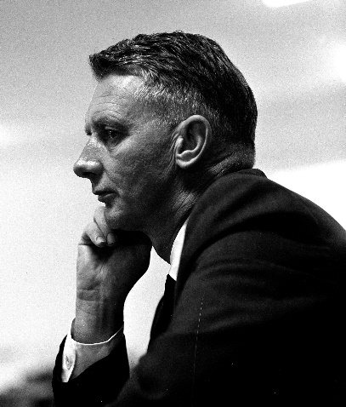
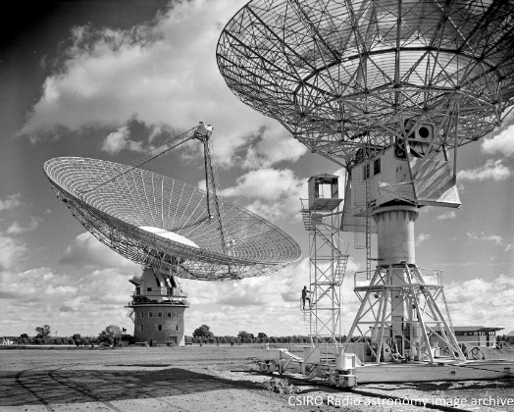
Did this discovery make an impact?
Bolton wrote a paper on these new class of radio sources assuming he would be famous for this discovery
  mostly ignored by the Australian group who were busy observing the sun
  had to fight with Ruby Payne-Scott to get telescope time.
Bolton was transferred out of the radio astronomy group
  too disruptive
Bolton later moved to Caltech and became acknowledged as one of the worlds top astronomers.
Returned to Australia in 1960 to run the new
Parkes Radio Telescope
  the dish master
  Insisted on having an interferometer – the 60’ with variable baselines

Slide 12
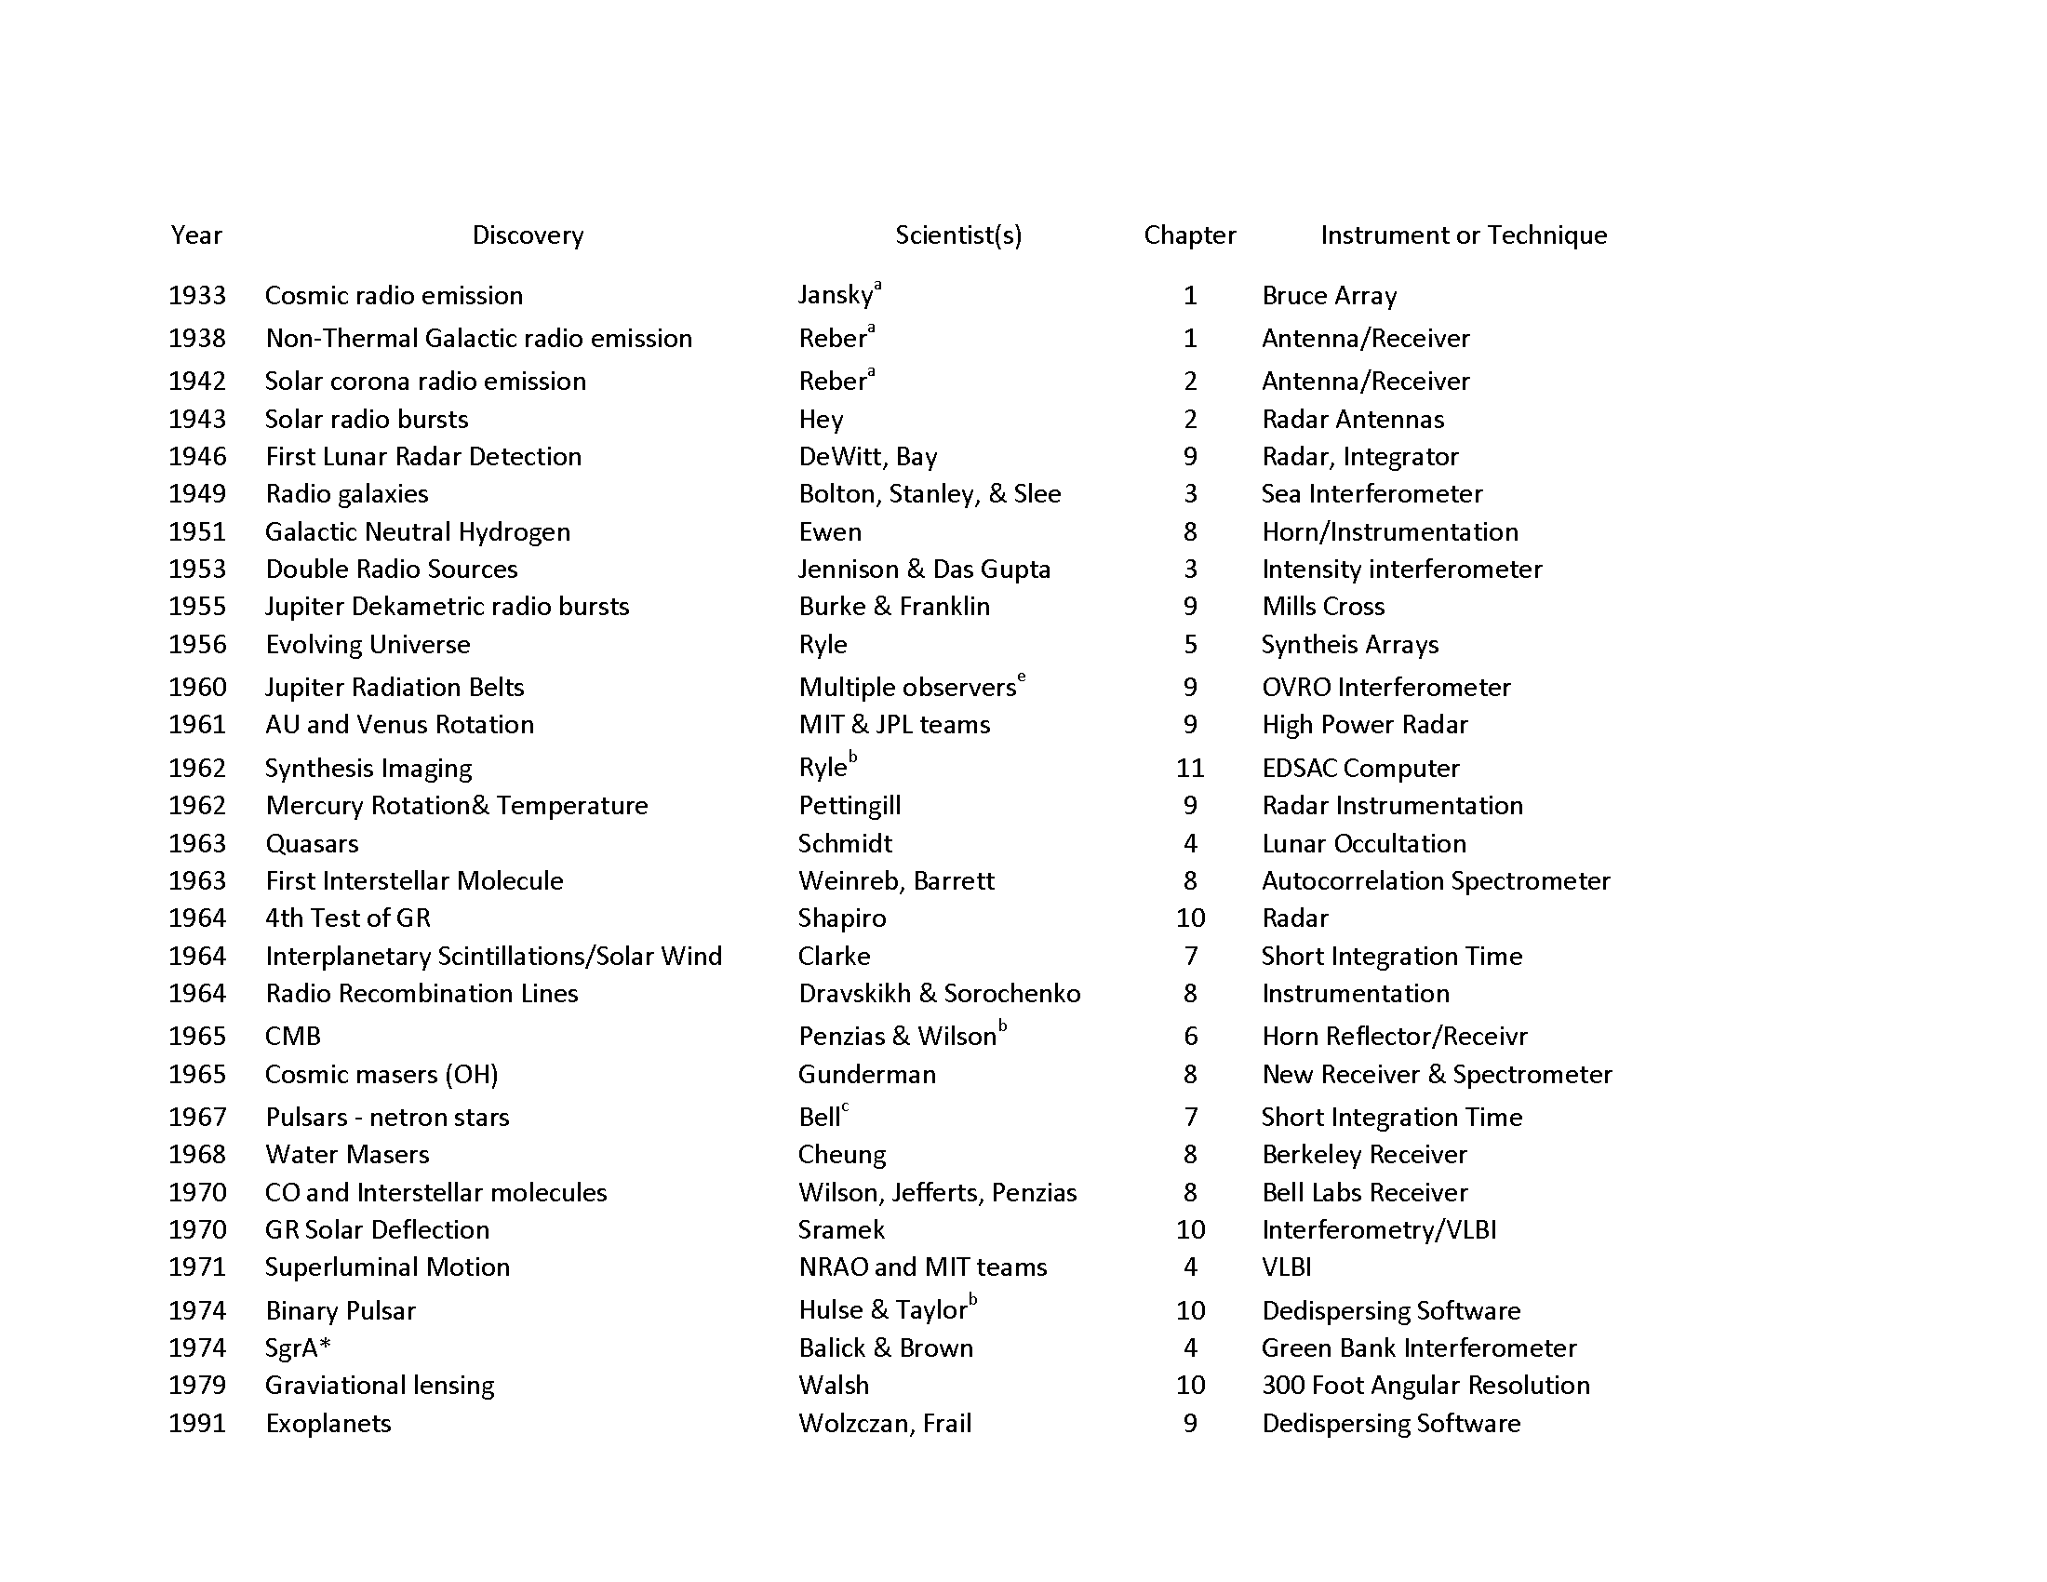
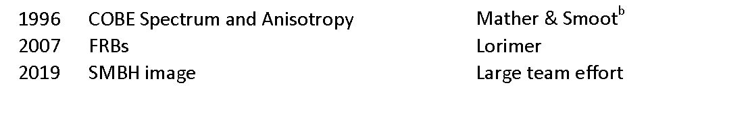
Discoveries
Kellerman and Bouton, Star Noise, 2023
Harwit’s definition
  Named, conference, …..
  Consensus (Ekers, Kellermann, Lazio, Cordes), but clearly subjective
  Discoveries may not be a single event or a single scientist
  Doesn’t include sub-categories. Eg radio galaxies but not tail sources….
Notes:
SgrA is a series of discoveries over 70 years, culminating in the EHT result.

Slide 13
Discoveries using Interferometers

Kellerman and Bouton, Star Noise, 2023
Harwit’s definition
  Named, conference, …..
  Consensus (Ekers, Kellermann, Lazio, Cordes), but clearly subjective
  Discoveries may not be a single event or a single scientist
  Doesn’t include sub-categories. Eg radio galaxies but not tail sources….




Notes:
SgrA is a series of discoveries over 70 years, culminating in the EHT result.

Slide 14
Star Noise
Foreword by Ron Ekers

Slide 15
McCready, Pawsey & Payne-Scott 1947
Proc Roy Soc, Aug 1947 - received July 1946!
Used the phase of the sea interferometer fringes (lobes) to co-locate solar emission with sunspots
15
Notes:
15
Added Pawsey and Payne-Scott

Slide 16
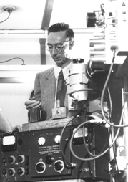
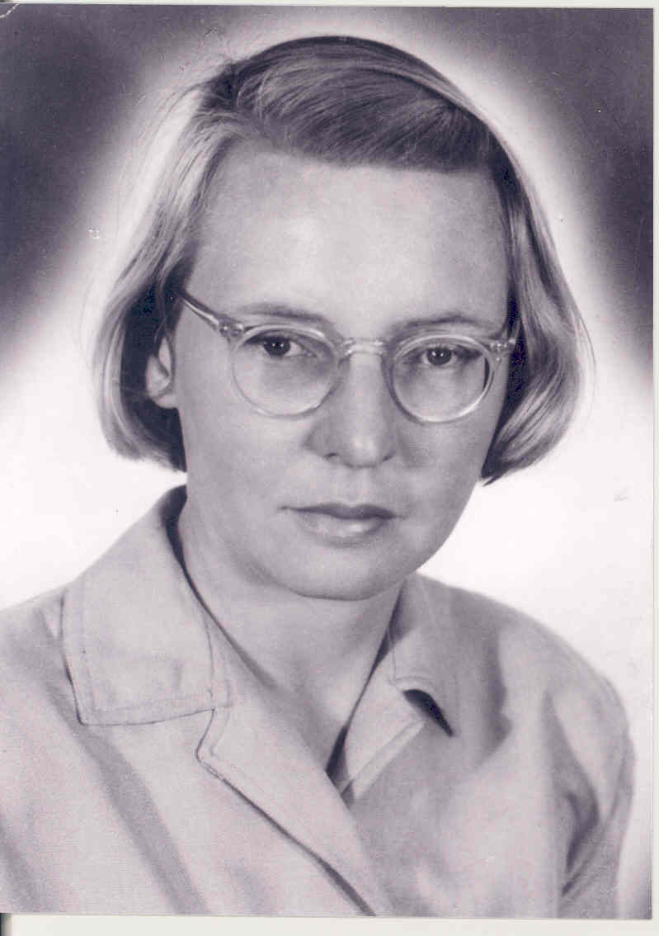
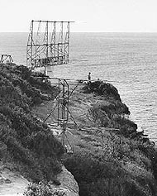
McCready, Pawsey & Payne-Scott 1947
Proc Roy Soc, Aug 1947 - received July 1946!
Used the phase of the sea interferometer fringes (lobes) to co-locate solar emission with sunspots
Joe Pawsey
Dover Heights
Ruby Payne-Scott
16
Notes:
16
Split for .pdf

Slide 17
McCready, Pawsey & Payne-Scott 1947
It’s possible in principal to determine the actual distribution by Fourier synthesis using the phase and amplitude at a range of height or wavelength.
Using wavelength as a suitable variable is unwise since the solar bursts are likely to have frequency dependent structure.
Getting a range of cliff height is clumsy, a different interference method would be more practical.
Paper is well cited BUT only by solar astronomers.
  The Fourier synthesis concept was buried and almost lost
  Ryles first notebook entry on Fourier synthesis follows receipt of this paper
  Ryle cites McCready et al BUT only in his early papers
17
Notes:
17
Added Pawsey and Payne-Scott
Added citations and Ryle

Slide 18
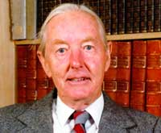
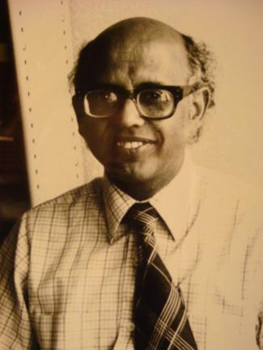
Christiansen and Warburton earth rotation synthesis (1955)
EW array makes analogue fan beams which rotate on sun
Chris takes the 1D FT of each strip distribution & then does a 2D Fourier synthesis using all strips
  The way in which a 2D radio brightness distribution may be derived from a number of 1D scans is not obvious. However rather similar 2D problems have arisen in crystallography and solutions for these problems, using methods of Fourier synthesis have been found.
Cites O'Brian (Cambridge) for earth rotation
Swarup calculates the Fourier Transforms
  More than 1 month with electronic calculator
18
Notes:
Add Swarup and fan beam

Slide 19
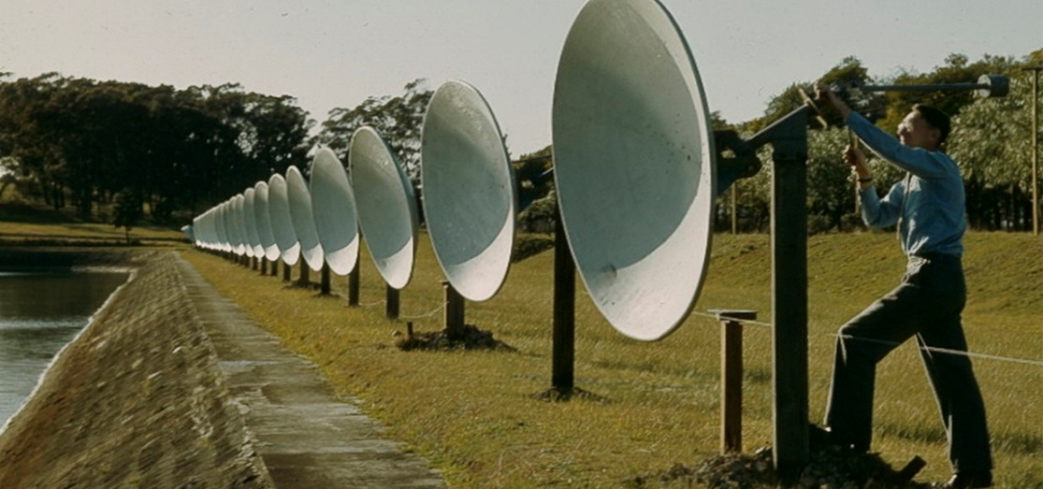
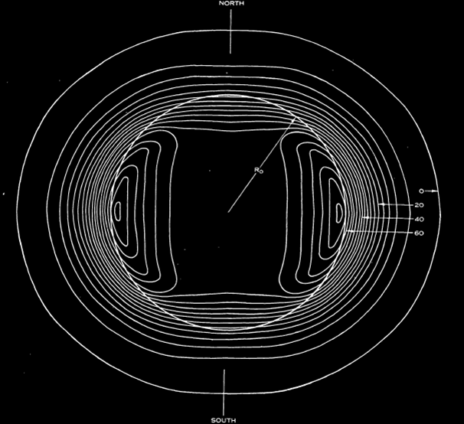
First earth rotation aperture synthesis image The Sun at 21cm
Potts Hill Reservoir 1955
32 6’ dishes
First aperture synthesis image
Christiansen and Warburton,
Aust J Phys 8, 474 (1955)
Notes:
Christiansen and Warburton, Aust J Phys 8, 474 (1955)
Amended version from Pune talk
Note this is a 2D transform of smoothed visibility contours – so no noise
Forced radial symetry

Slide 20
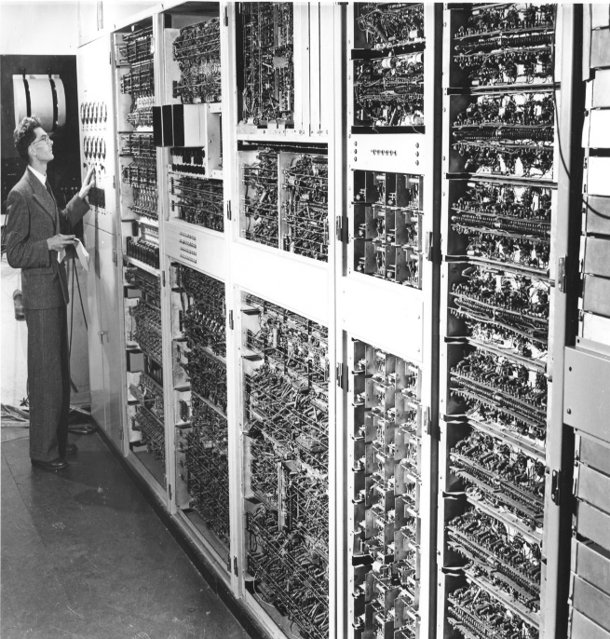
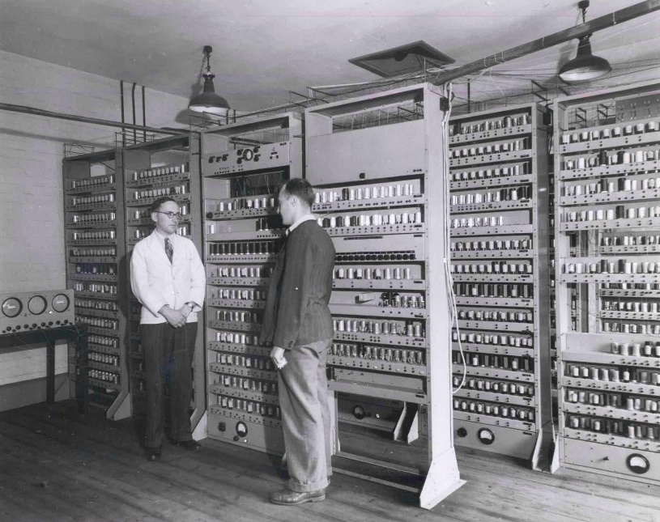
Impact of Digital Computing
After Christiansen it was two decades before another synthesis image was computed in Australia!
  Brouw (FST) and Schwartz (Parkes interferometer)
Australia's first digital computer, CSIRAC, was operating in the same building at this time but the radio astronomers took no advantage of the new computer age.
Cambridge went on to exploit aperture synthesis using digital electronic computers
CSIRAC
EDSAC

Slide 21
Why did the Australians loose the way?
Bracewell: “it never occurred to us that the arcane art of machine language programming and punching holes in paper tape would have any relevance for the radio telescopes.”
Mills: “The only way to perform Fourier transforms in a reasonable time was to use digital computers which are still under development and hardly to be considered as an essential part of an observing program.”
The X-ray crystallographers and mathematicians at the Cavendish introduced the Cambridge radio astronomers to the digital computer and this symbiosis made the jump possible.
Notes:
Bracewell quote – R. Ekers, private communication
Mills quote -

Slide 22
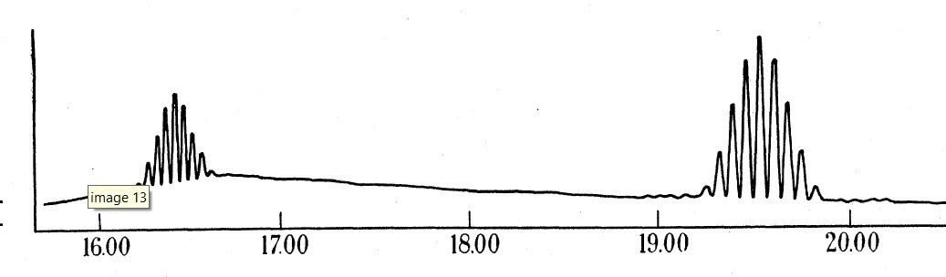
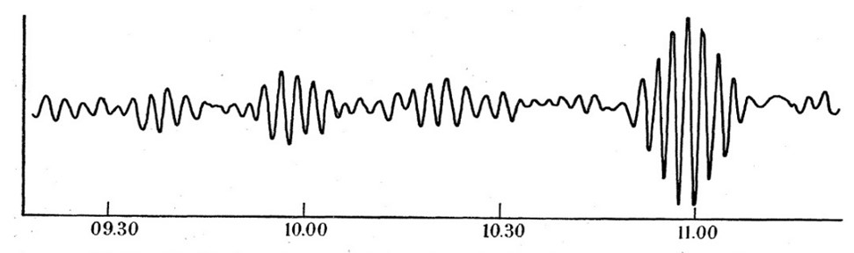
Phase Switch invented by Martin Ryle (1952) independently invented in Sydney by B.Y. Mills
Consider two antennas A and B: two voltage outputs can be formed: first A+B, then by switching the phase of B by 180 degrees, A-B is measured.
If the phase is switched continuously, the difference between the two power outputs can be synchronously detected:
(A+B)² - (A-B)² → A.B
In this way the product of the two voltages (A.B) can be measured without the contribution of the two much larger total power signals (A² and B²).
Makes the interferometer a powerful tool compared with the single dish
(A+B)²
A.B

Slide 23
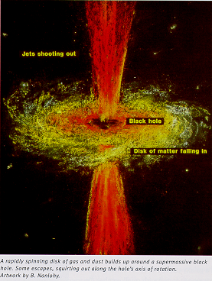
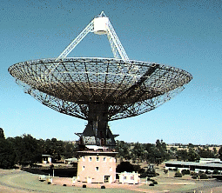
Discovery of Quasars (1963)
Hanbury Brown invents the intensity interferometer
A group of small diameter radio sources identified with stars
    These weird stars known to have variable light so “couldn’t be extragalactic”
3C273 lunar occultation observed at Parkes
  Schmidt interprets the spectrum of 3C273 as due to huge redshift
    Flash of insight - Schmidt's thumb
Observational Cosmology is born
Gravitational Collapse and Relativistic Astrophysics
  Dallas, Texas 1963
  only a black hole could provide the energy
Notes:
Ken says check if the black hole energy argument was already made in 1963
Modified version to include the intensity interferometer

Slide 24
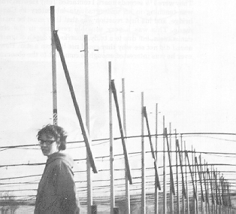
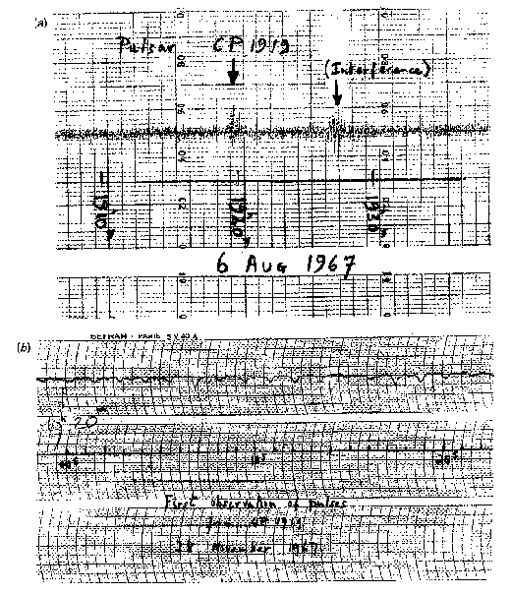
Pulsar discovery: 1967
Jocelyn Bell & Tony Hewish
Cambridge 1967
Telescope built for IPS survey
Short time constant for IPS

Slide 25
Pulsating White Dwarfs or
Rotating Neutron Stars?
First reaction – alien signals (little green men)
  Excluded for wrong reason – not from an orbiting planet
  But a binary pulsar was found later
Initial explanation was pulsating white dwarfs
Pacini and Gold (1966) had already calculated the rate of energy loss from a obliquely magnetised rotating neutron star
  They suggested that this was the power source for the crab nebula
  They did not predict pulses of radio emission
Rotating neutron star explanation (Gold) was initially resisted
There is a confirmed pre-discovery from Military radar
  Initial discovery missed because of Defence security issues
Notes:
Remove: Prediction had no impact on discovery

Slide 26
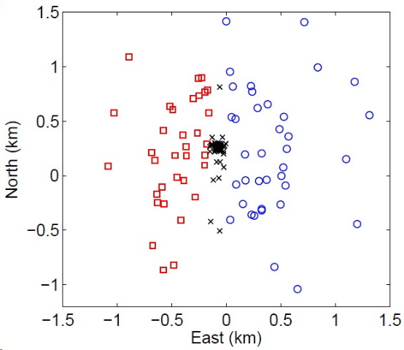
MWA discoveries
Shyeh Tjing Loi (Cleo) and Tara Murphey
Transient search leading to the discovery of ionospheric ducts
Cleo split the MWA to make a parallax measurement
Serendipitous discovery but an earlier model found

Slide 27
MWA discoveries
Night-time interplanetary scintillation (IPS)
  Tingay doing an FRB search in 2014 led to the detection
  Publication result in 2015
    Referee “not possible so must be an instrumental error”
  FRB search -> night time IPS -> IPS surveys -> peaked spectrum sources -> high redshift galaxies.
  MWA still hasn’t detected an FRB!

Slide 28
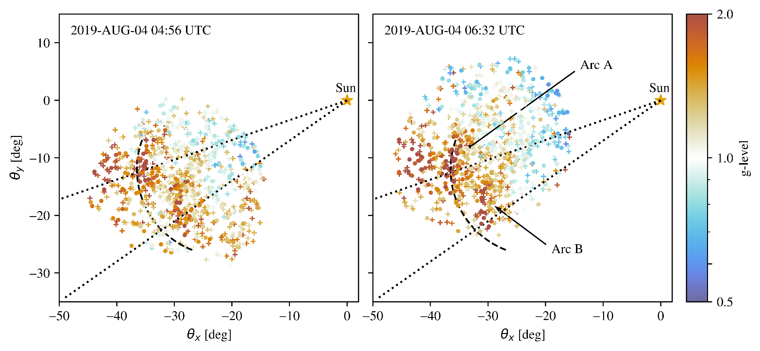
MWA discoveries
Space weather features in MWA IPS data
  John Morgan, Angie Waszewski
  Wide FoV essential
  Innovative implementation of known phenomena
    NB discovery of pulsars was also a by product of IPS
    Cross disciplinary

Slide 29
MWA discoveries
Natasha’s team and galactic transients.
  Natasha is talking later in this session
  Includes all the aspects of the Serendipity pattern
  Two really important impacts of technology
    Wide FoV dominates discovery space for high S/N events
    Single dishes are dominated by total power – too much red noise
    Interferometer correlation removes total power [phase switch]
    Wide FoV interferometers will have a huge impact for transient searching, including SETI.

Slide 30
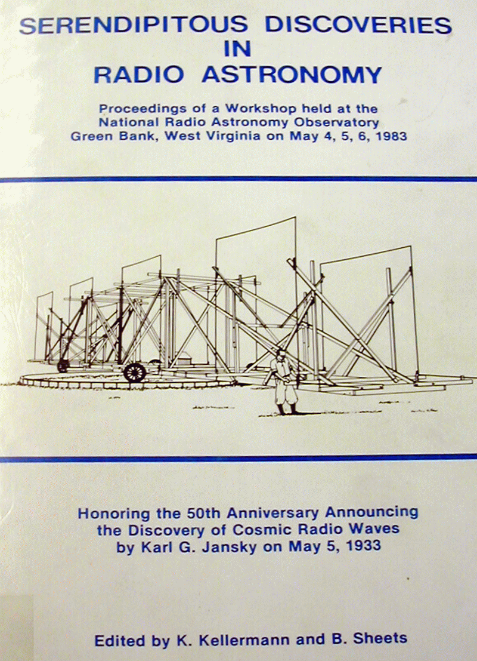
Jansky Workshop
1983 (50th anniversary)
Identified a common pattern
  Technology driven
  Unanticipated
  Understand instrument
  Curiosity & persistence
  Flash of insight
  Right time
Serendipity pattern

Slide 31

The Travels & Adventures of Serendipity
Horace Walpole (1754)
As the three princess of Serendip traveled, they were always making discoveries, by accidents and sagacity, of things they were not in quest of.
Western Science is usually stripped of stories
  This is a story following our indigenous community tradition of story telling
Merton identified the Serendipity pattern
Notes:
Acceptance cycles with time: Not used again until 1830
Applied to science 1874, Science use strong 1930-1960
In Rayfest link to Krystal Napoli

Slide 32
Why are Discoveries Missed?
We found a clear serendipity pattern for radio astronomy discoveries, but do the missed discoveries show a similar pattern?
Missed discoveries may help us understand how discoveries are made or missed.
  However, it is much more difficult to obtain this information.
Researching the Pawsey book provided detailed context for Australia in the 1950 period.
  We were able to compile the following reasonably complete list.

Slide 33
Missed Discoveries – Australia 1950s
1950 Ionospheric scintillation
  discovered using multiple cliff interferometers
  Uncorrelated variability so not intrinsic
  published a year later by Cambridge and Manchester ignoring a collaboration agreement
  Are unpublished discoveries still discoveries?
1951 (Shain) decametric bursts from Jupiter using a low frequency cross array.
  dismissed as rfi
  independent discovered by Burke and Franklin in 1955 with a similar (copy) of the low frequency cross.
1952 Mills cross invention meant the use of electronic computers had been missed
  quote from Mills – see earlier slide
1953 evolution of radio sources dismissed because of a conceptual error
  Bolton assumed the steep source counts were a luminosity function effect
1953 Polarization of galactic emission
  missed in 1953 because no understanding of depolarization due to Faraday rotation.
  Held up acceptance of synchrotron theory for many years
  The Australians “knew too much” and assumed no polarization meant no synchrotron.

Slide 34
Why are Discoveries Missed?
We found a clear serendipity pattern for radio astronomy discoveries, but do the missed discoveries show a similar pattern?
Missed discoveries may help us understand how discoveries are made or missed.
  However, it is much more difficult to obtain this information.
Researching the Pawsey book provided detailed context for Australia in the 1950 period.
  We were able to compile the following reasonably complete list.
These discoveries were missed for many different reasons, and no clear pattern emerges.
  Communication failure
  Risk averse
  Misconceptions

Slide 35
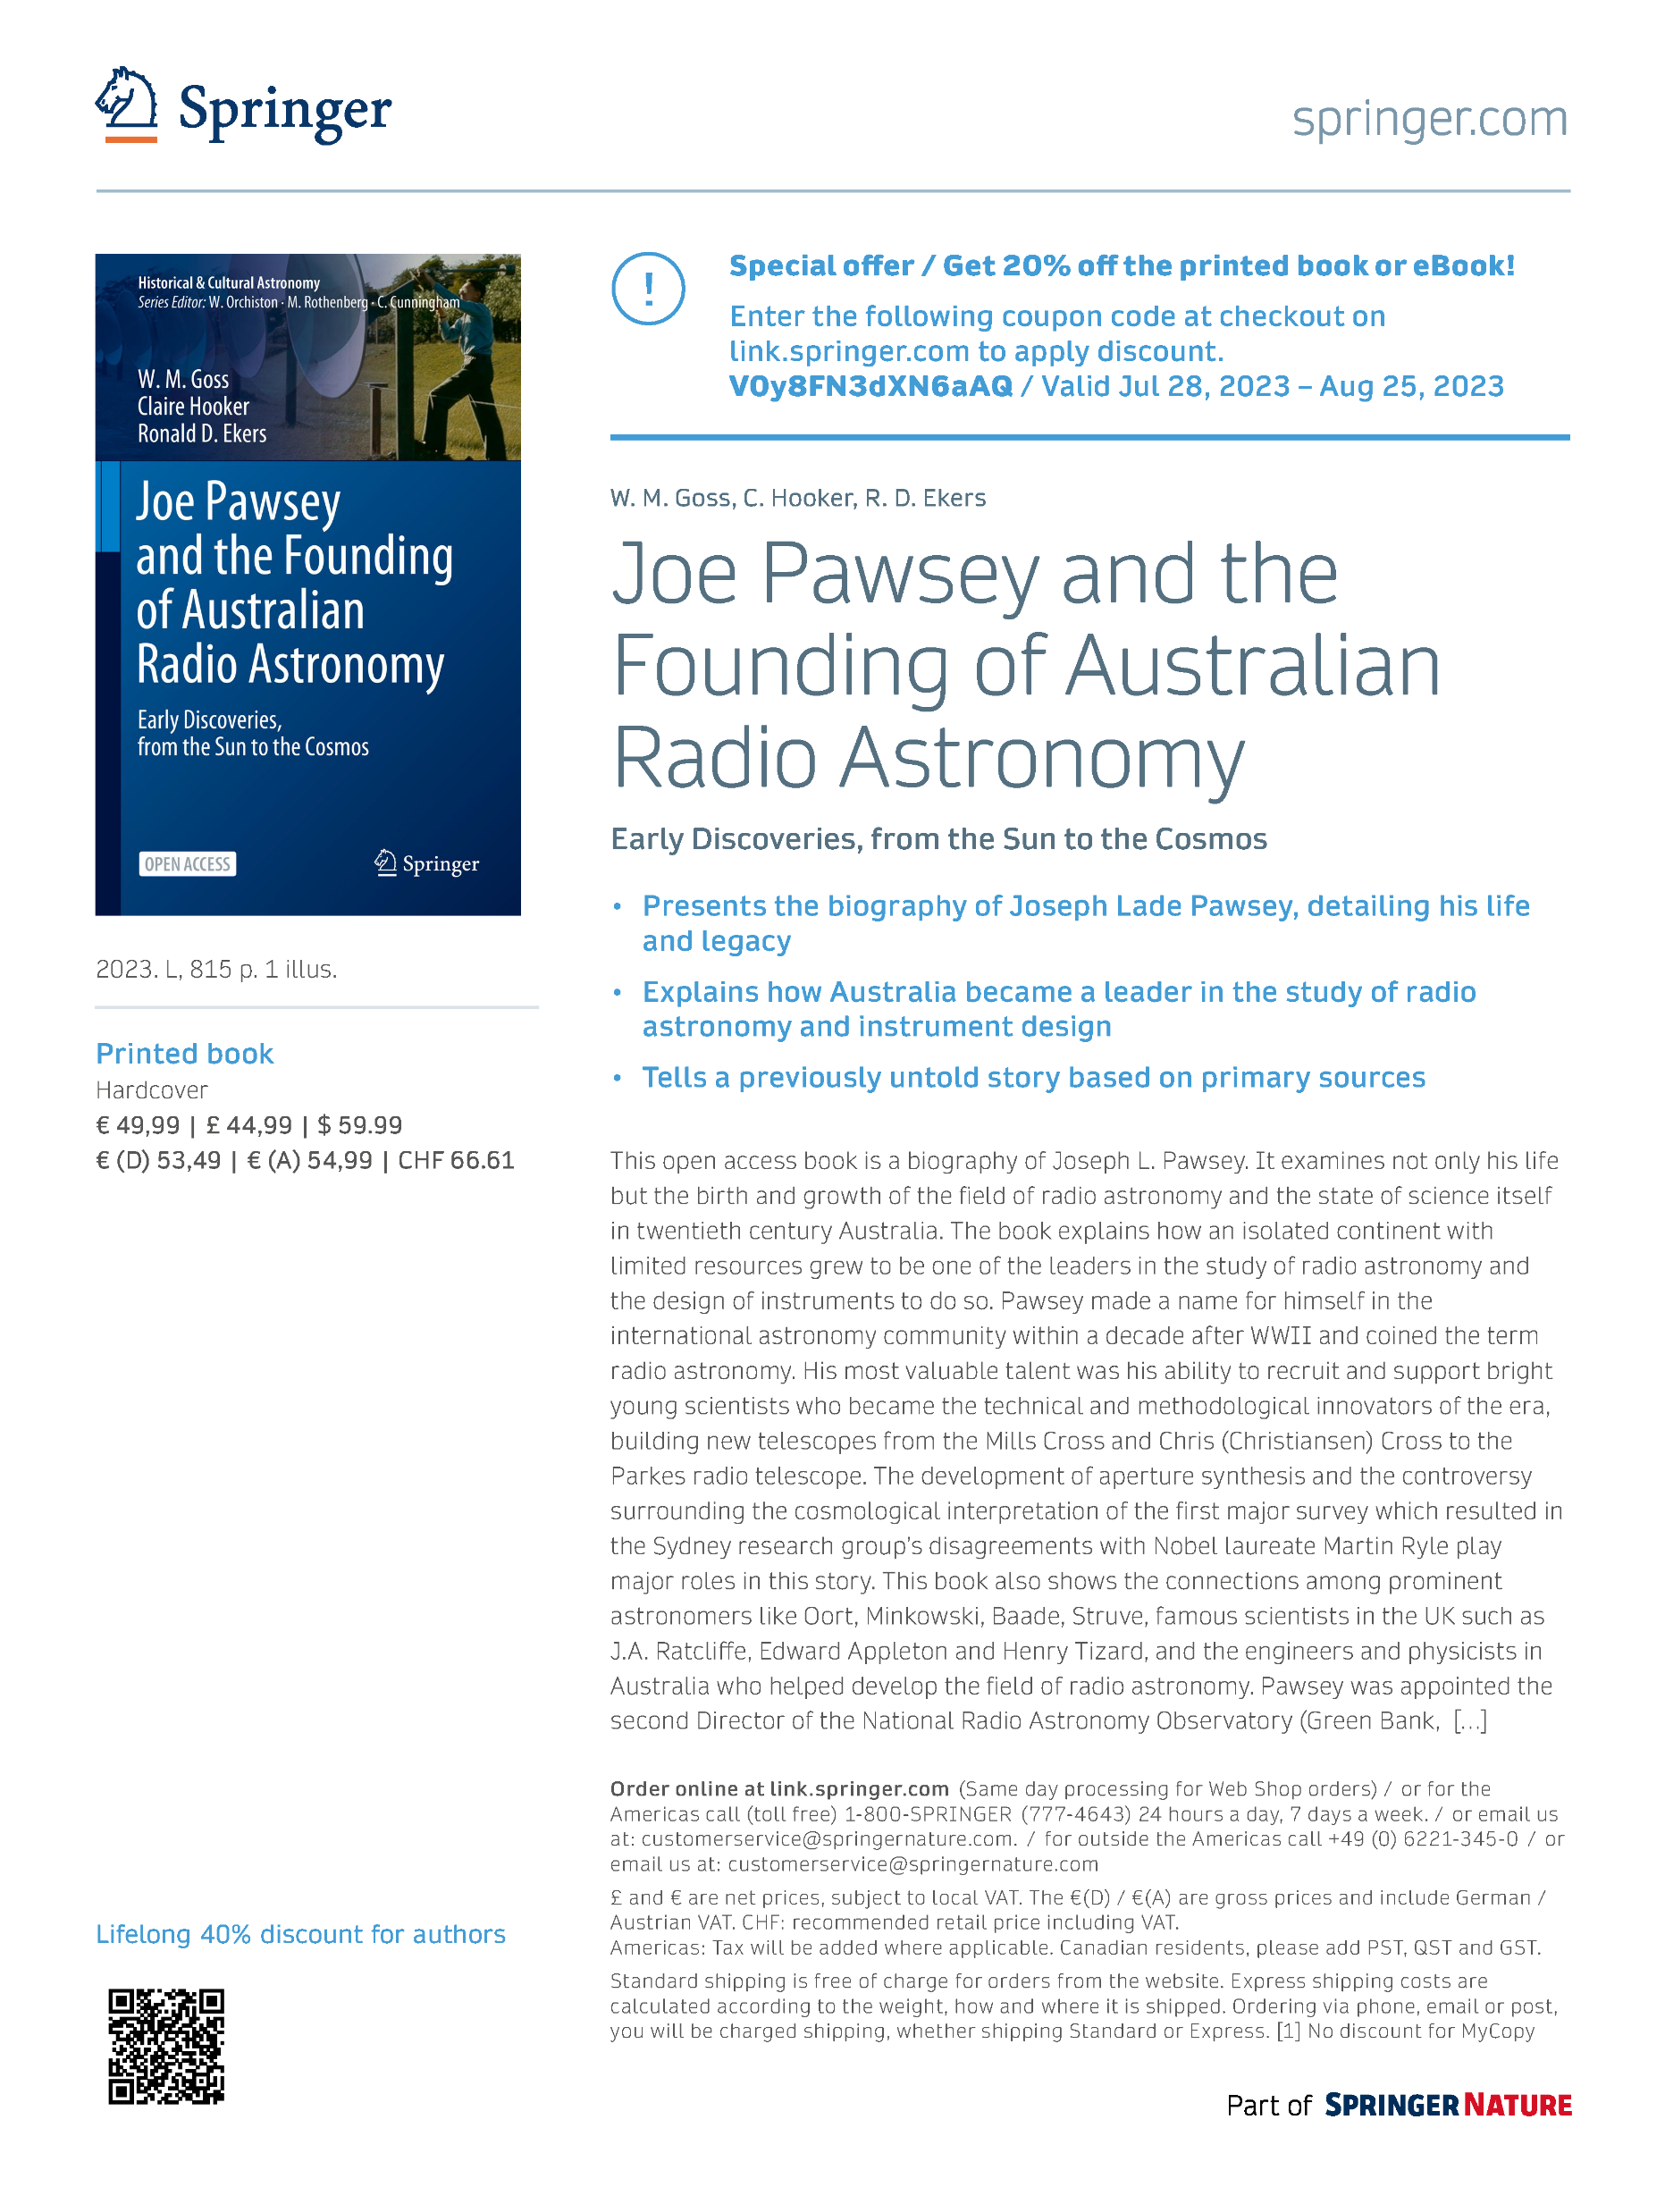
Joe Pawsey and the Founding of Australian Radio Astronomy
Book access
Open access funded by CSIRO
https://link.springer.com/book/10.1007/978-3-031-07916-0

