Slide 1
MWA Archive Update & Retrospective
27th July 2023, MWA Project Meeting
10th Anniversary of the MWA!
Greg Sleap – MWA Data Manager
Notes:
Hi everyone!
I’m really sorry I cannot be there in person! MWA Cupcakes
I have really enjoyed hearing all of the love the archive has been getting at this project meeting.
The amazing science that comes out of all this data is one of the reasons I love this job and being part of the MWA so much!
Also apologies in advance if I cough

Slide 2
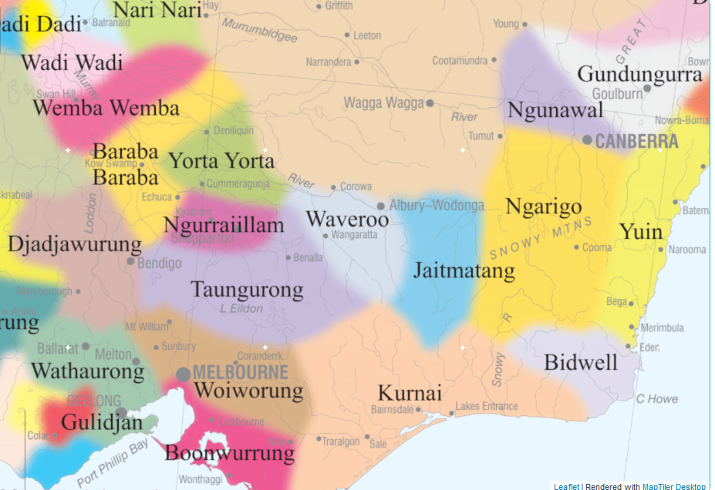
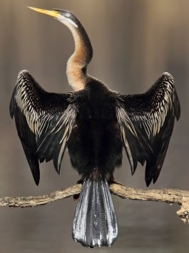
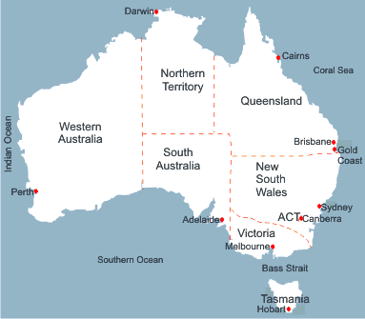
Partner Institutions
Acknowledgement of Country
Image: Chris Tzaros (Birds Bush and Beyond)
Map: Gold Coast Australia Travel Tips.com
I am here (just a few km south of Wangaratta)
Notes:
I’d like to start by acknowledging the Traditional Owners of the land on which I am presenting to you today, the Bpangerang people and pay my respects to Elders past and present.
The name “Wangaratta” means “Long Necked Cormorant” in Bpangerang Language

Slide 3
Partner Institutions
MWA Archive Update & Retrospective
New Starters
MWA Archive Volume Update
MWA Archive Timeline
Data Retention Update
MWA ASVO & System Updates

Slide 4
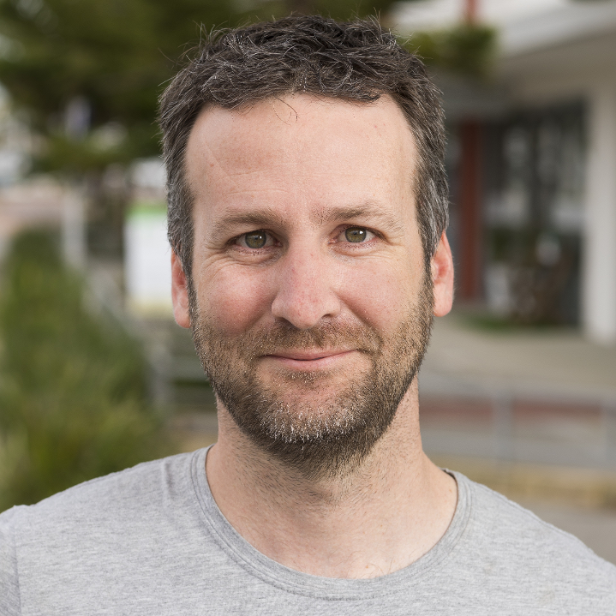
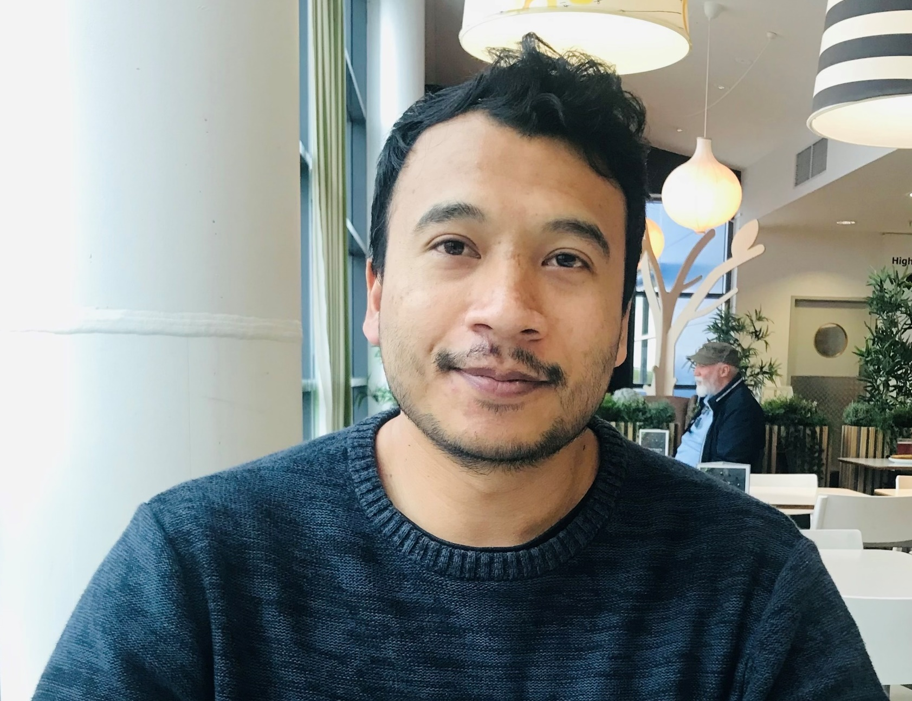
Partner Institutions
New Starters!
Greg Sleap
Team lead
MWAX archiving/data Mgt
Sysadmin
Mouriyan Rajendran
Chitru Shrestha
Andrew Williams
MWA/MRO M&C
Web services
Sysadmin
Dev Null
AusSRC
EoR pipeline/quality
Calibration
Birli/Hyperdrive
Luke Williams
MWAX UDP
MWAX correlator
MWAX beamforming
Notes:
Two decades of professional experience between them

Slide 5
Partner Institutions
ARDC Data Collections
“Collections of National Significance” project complete:
EoR Raw Data (2014 - 2015) ~0.6 PB
GLEAM Survey Raw Data (2013-2015) ~0.9 PB
SMART Survey Raw Data (2018-2019) ~ 1.0 PB
SMART Survey Raw Data (2020-2021) ~ 1.0 PB
Galactic Plane data (2013-2022) ~3.0 PB (-11° to +11 ° Gal. lat.)
https://asvo.mwatelescope.org/collections
Pawsey has added ~6.5PB on Acacia for Collections
Collections are “ring-fenced” storage (not considered for deletions)
Notes:
Thanks to ARDC, Pawsey and Mia and Aoife

Slide 6
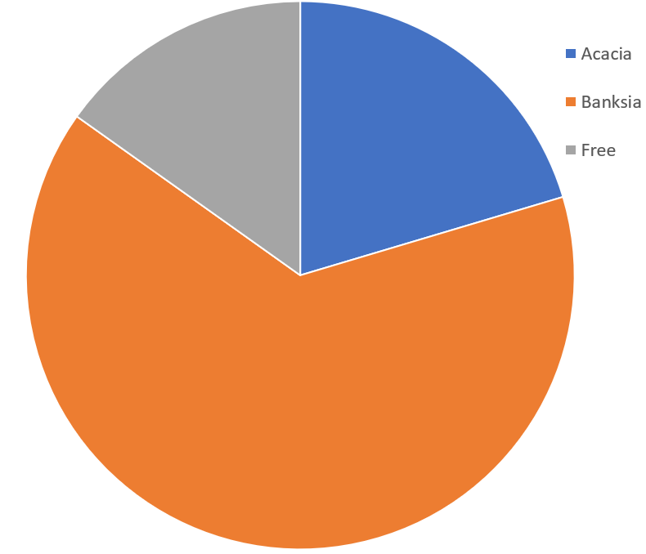
Partner Institutions
Archive Volume Update
48.7 PB / 57.4 PB
(+7.4 PB from ARDC Collections)
Acacia: 11.7 / 17.4 PB
Banksia: 37.0 / 40.0 PB
Remaining: 8.7 PB ~15%
611K+ observations in
148 Projects
Free
Acacia
(Disk)
Banksia
(Tape)
Notes:
Thanks for all of the archive love at this project meeting!

Slide 7
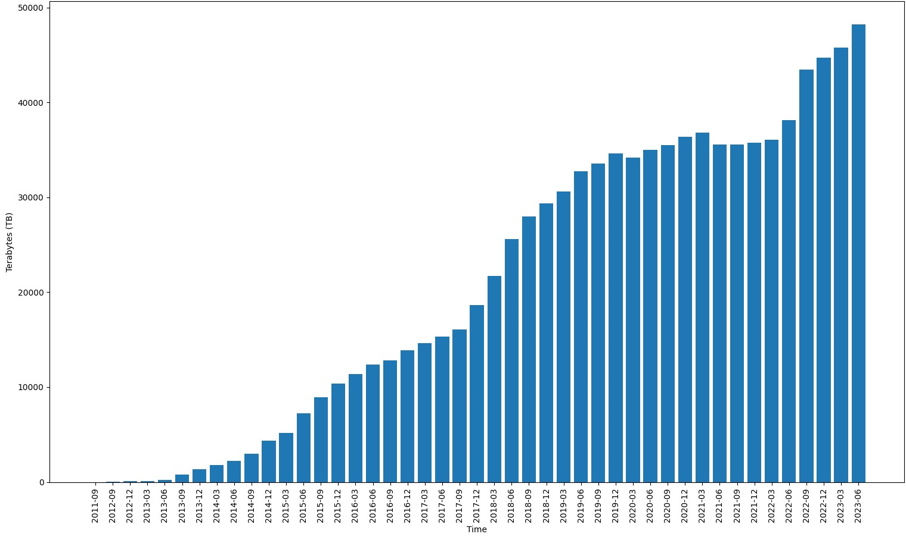
Partner Institutions
Archive Volume (all time)
48.7 PB
MWAX
Phase 2
Notes:
If you count data which has been deleted, then we have ingested 61.9 PB!

Slide 8
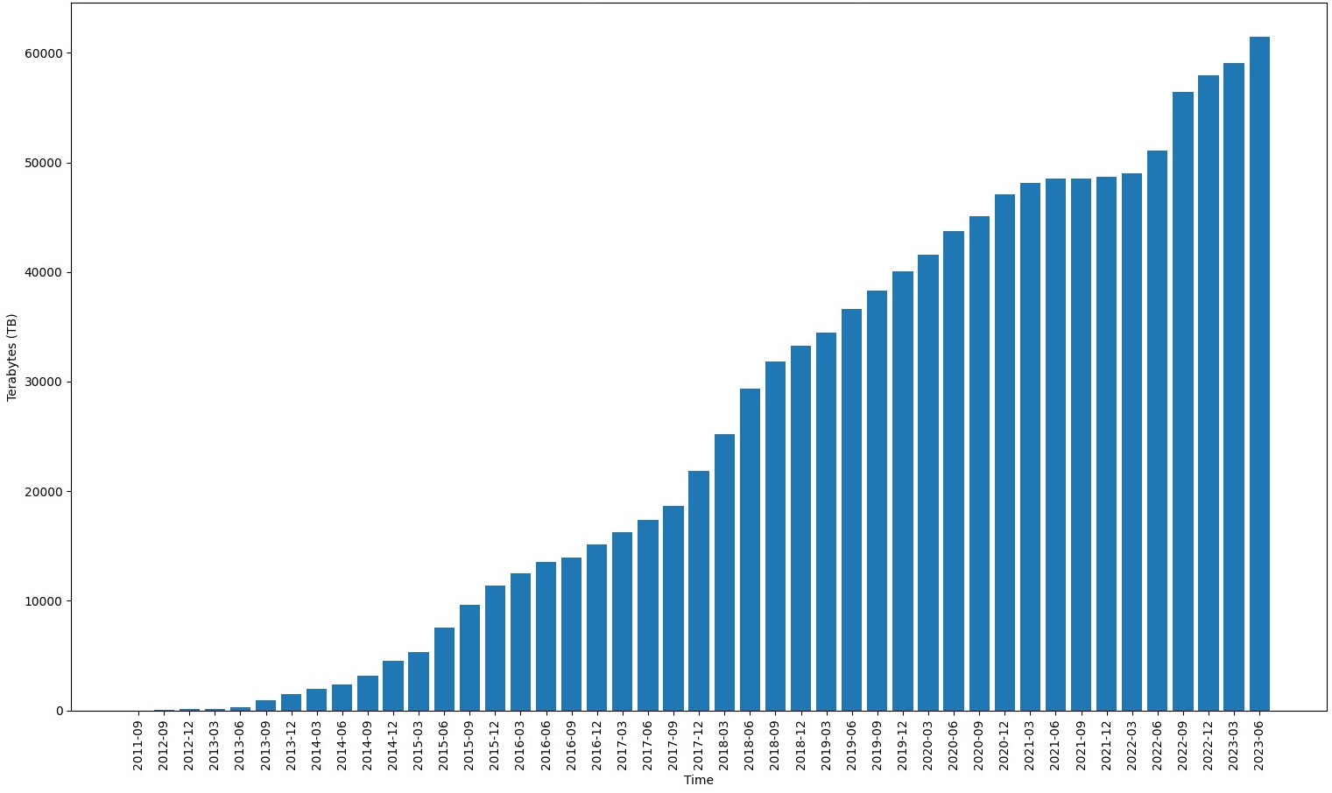
Partner Institutions
Archive Ingest (all time)
61.9 PB

Slide 9
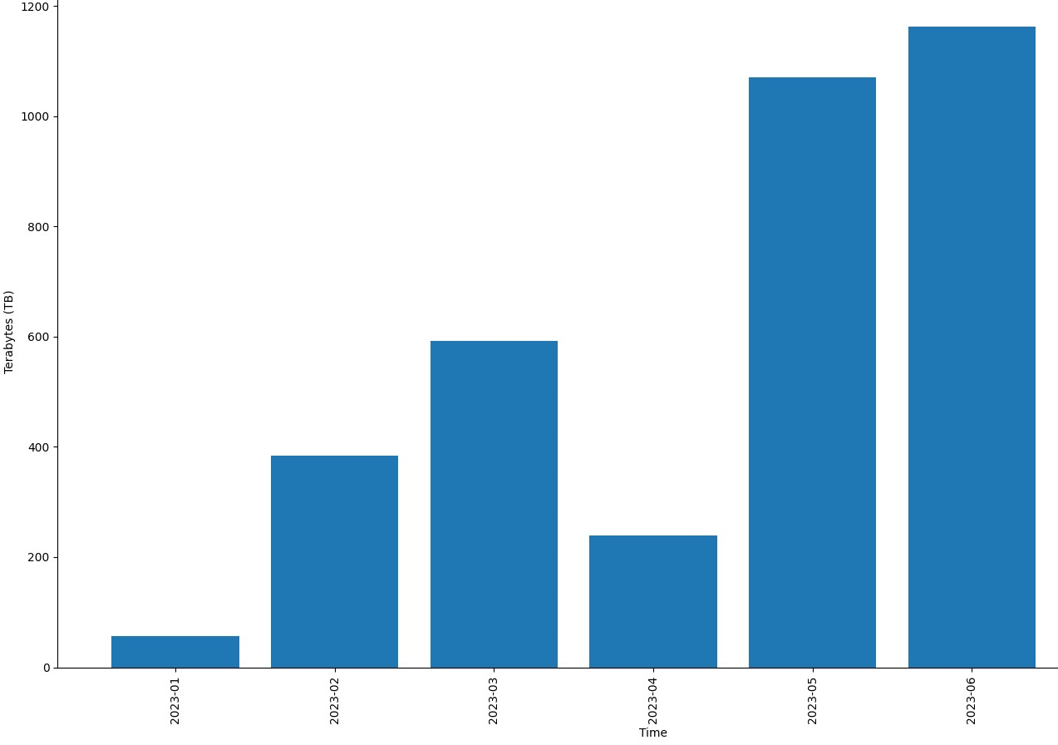
Partner Institutions
Archive Volume (last 6 months)

Slide 10
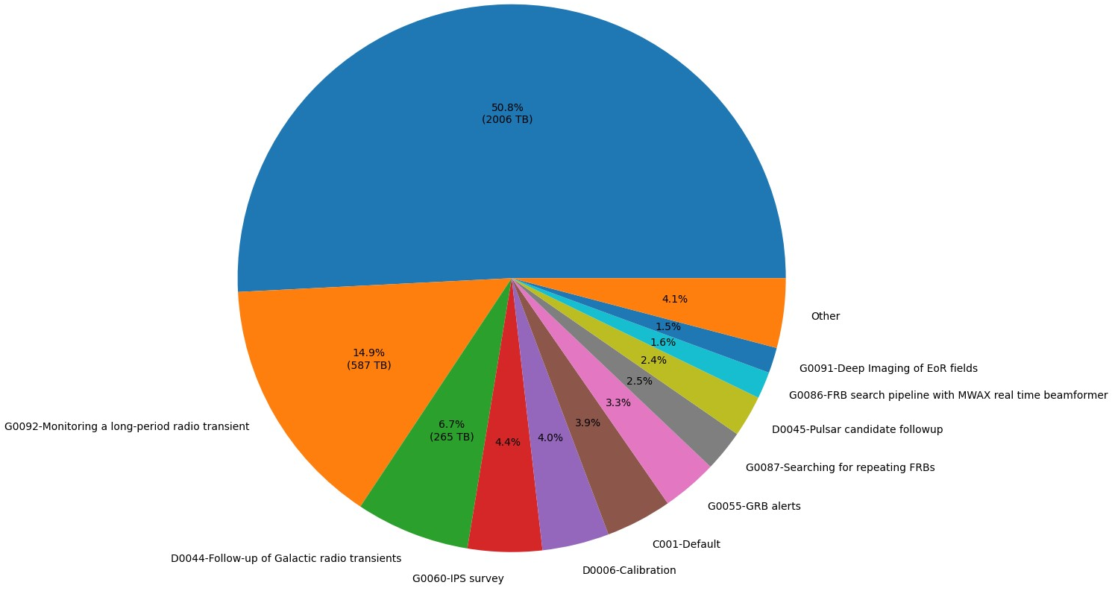
Partner Institutions
Archive Volume (last 6 months)

Slide 11
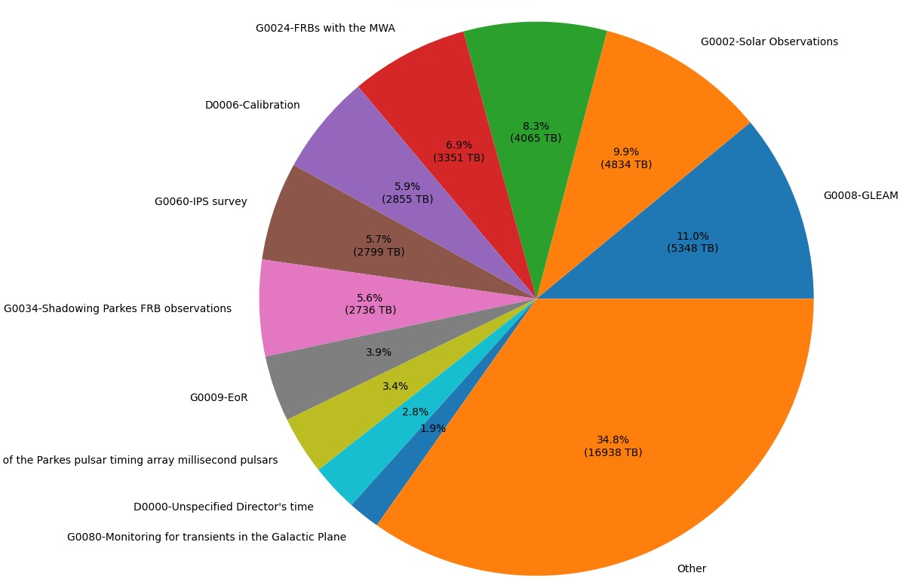
Partner Institutions
Archive Volume (all time)
G0021 Low-frequency investigations

Slide 12
Partner Institutions
MWA Archive & Systems timeline

Slide 13
<2013

Slide 14
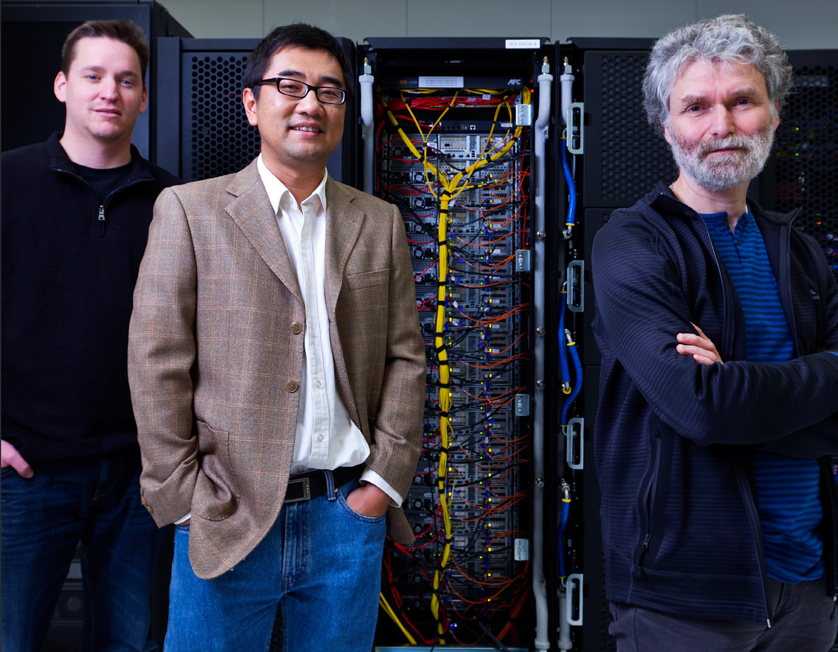
Partner Institutions
<2013
32T
Andrew Williams
ICRAR UWA DIA team + Curtin start
early NGAS testing / Benchmarking
Sneaker-net!
Notes:
Bob Goeke

Slide 15
2013

Slide 16
Partner Institutions
2013
Phase 1
128T
Science starts!
NGAS & Pawsey archive deployed
Galaxy supercomputer commissioned
VCS Testing
1PB

Slide 17
2014

Slide 18
Partner Institutions
2014
Obsdownload.py developed (MWA_Tools)
NGAS mirrors established:
MIT Haystack (USA)
University of Melbourne (Aus)
Victoria University of Wellington (NZ)
Cotter pre-processor developed by André Offringa
10G link to Pawsey(?)
4PB

Slide 19
2015

Slide 20
Partner Institutions
2015
voltdownload.py developed
Obviously, everyone was busy sciencing
10PB

Slide 21
2016

Slide 22
Partner Institutions
2016
Greg Sleap
MWA ASVO design study
MWA Collaboration management design
14PB

Slide 23
2017

Slide 24
Partner Institutions
2017
Phase 2
6 New arch boxes deployed at MRO
100G link commissioned
10 mwacache boxes deployed for testing
MRO VM cluster & SAN commissioned
MWA ASVO v1 launched (data available to public)
MWA VO services launched
19PB
Notes:
Higher data rates due to long baselines

Slide 25
2018

Slide 26
Partner Institutions
2018
Hasan Rayan
MRO M&C network upgrade
MWA ASVO v2 (calibration feature, SSO)
MWA Collaboration/Identity Management went live (SSO, Registry, Wiki, Mailman, MWA ASVO)
SKA Data Workshop at SHAO
30PB
Notes:
Calibrated MWA data for the masses!

Slide 27
2019

Slide 28
Partner Institutions
2019
AWS deployment for web and DB servers
Pawsey $70M refresh
MWAX & archiving design
Large-scale transfer of GLEAM public data to INAF (Trieste, Italy)
35PB

Slide 29
2020

Slide 30
Partner Institutions
2020
Harrison Barlow
Garrawarla supercomputer commissioned
Redundant VCS/bad data deletion
Large-scale Transfer of GLEAM public data to SHAO
36PB

Slide 31
2021

Slide 32
Partner Institutions
2021
Dev Null
Birli development begins
MWAX commissioning
New archive system: mwax_mover replaced NGAS
Use of 100G link
Use of mwacache servers as a 3PB buffer
35PB

Slide 33
2022

Slide 34
Partner Institutions
2022
Luke Williams
Birli reaches feature parity with Cotter
MWA ASVO v3 (HPC migration/VCS downloads/LTS)
Pawsey LTS replaced old DMF tape system
136T
42PB

Slide 35
2023

Slide 36
Partner Institutions
2023
Chitru Shrestha
Mouriyan Rajendran
MWAX Fringe Stopping
144T
48PB

Slide 37
Partner Institutions
MWA ASVO Stats (Dec 2017-Jul 2023)
 | MWA Members | External | Total
Total number of Users | 178 | 397 | 575
Active Users | 126 | 125 | 249
 | Jobs | Downloaded** (TB)
All jobs | 399,923 | 14,095
..Download jobs | 240,091 | 8,701
..Conversion jobs | 131,215 | 1,954
..Voltage jobs | 340 | 3,439
..Metadata jobs | 28,277 | < 1
Top 3 MWA ASVO Users
 | Jobs
Dev Null | 12,473
Theodora Kunicki | 9,093
Stefan Duchesne | 8,769

Slide 38
Partner Institutions
MWA ASVO Stats (Dec 2017-Jul 2023)
Most Requested Data Type

Slide 39
Partner Institutions
Data Retention Update
First (small <1PB) delete cycle will start very soon!
PI’s may nominate bad/useless data for deletion at any time
Data is deleted as required to make room for upcoming season
Delete list is based on age and utility (PSs decide)
Collections & calibrators are automatically exempt
MWA Collaboration notified with summary of delete list
MWA Members have 4-week consultation period
MWA Members may apply to Director for temp. retention
At end of review period, data is deleted (except retained data)

Slide 40
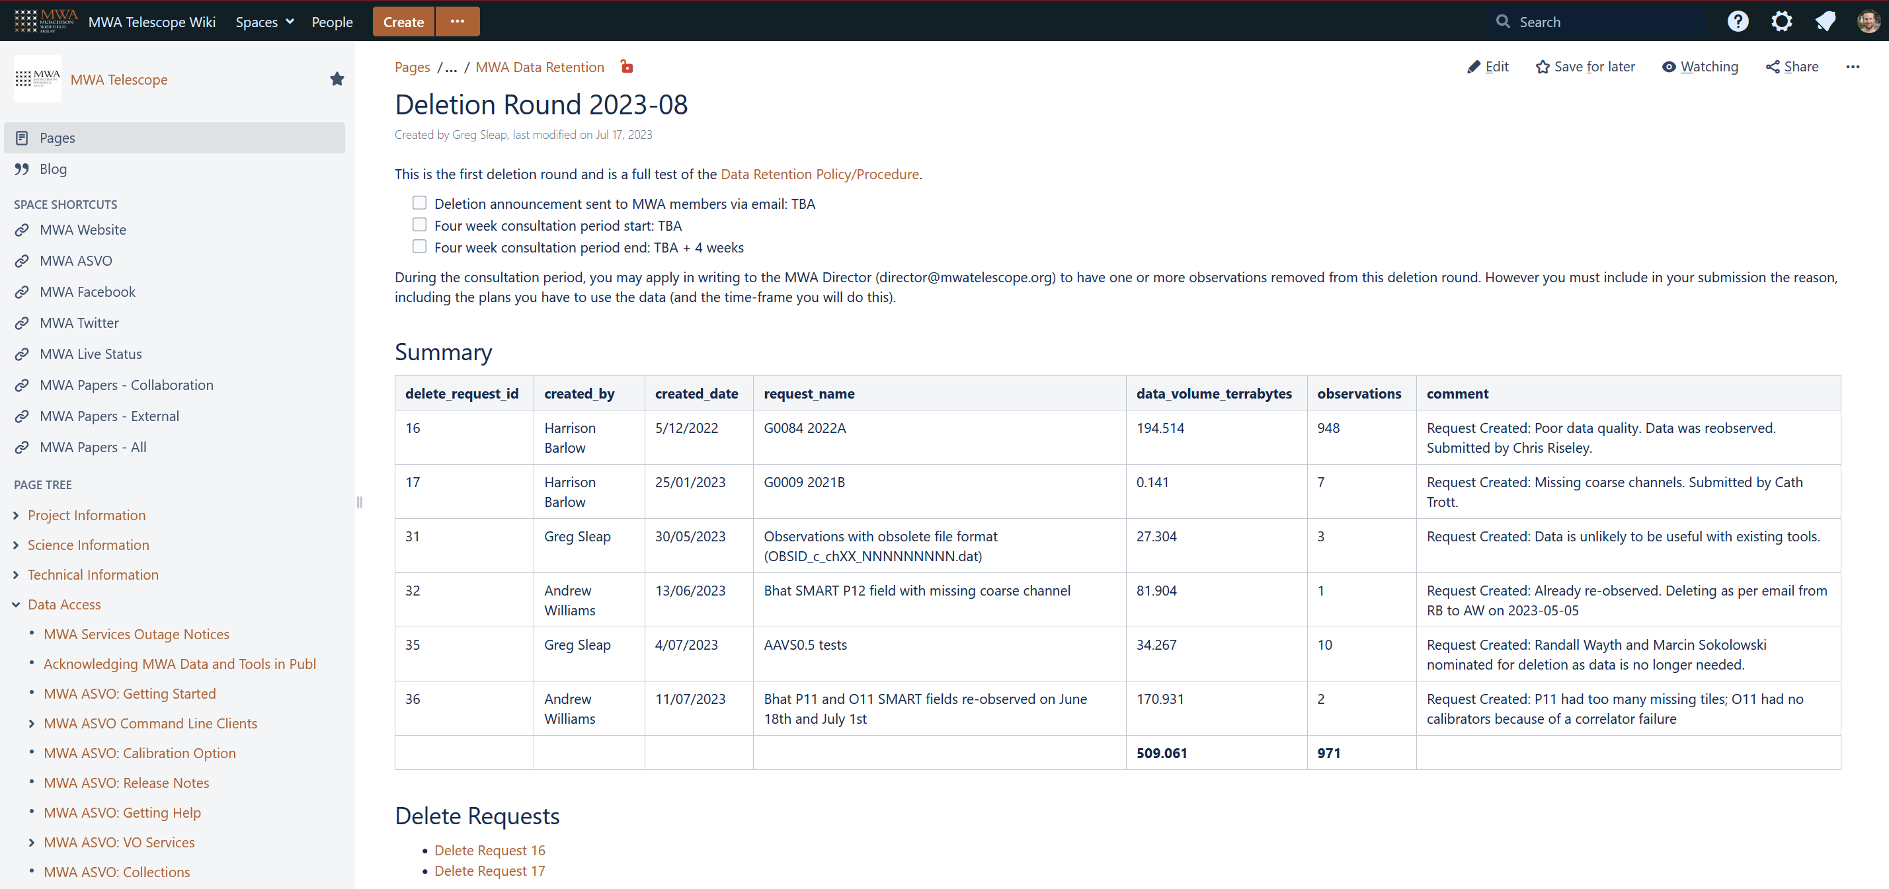
Partner Institutions
Data Retention Info
Summary
Detail

Slide 41
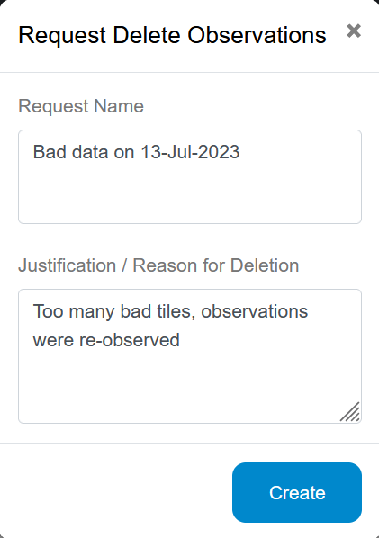
Partner Institutions
Data Retention MWA ASVO UI for PIs
Request Deletion button available to PIs
Or email asvo_support@mwatelescope.org !
Notes:
Very basic interface initially- not ideal for large, scattered requests- contact us instead!

Slide 42
Partner Institutions
MWA ASVO & System Updates
Upcoming Pawsey changes affecting MWA ASVO:
Garrawarla and /astro end of life (EOL):
October: Addition of delivery to Setonix /scratch
December: Removal of delivery to /astro (/astro EOL)
Late 2023/Early 2024: Migration of MWA ASVO from Garrawarla to Setonix
June 2024: Garrawarla EOL
New/Upcoming Features:
Additional resilience to failures
Better support for MWA Buffer Dumps
More search options, UI improvements
Many minor enhancements and bug fixes
Got some feature suggestions? Let us know!
Wiki migration to Cloud (Late August):
New URL will be https://mwatelescope.atlassian.net/wiki

Slide 43
Partner Institutions
Systems Update
MWA Wiki migration to Cloud Hosted
Tentatively scheduled for late August
Main change is URL: https://mwatelescope.atlassian.net/wiki
Log in via Atlassian account
MWA Mailing Lists
Software stack integration with MWA SSO isn’t supported ☹
Assessing options for migration later in 2023
Core Infrastructure
MRO VMWare upgrades
MRO OS Upgrades
AWS refresh

Slide 44
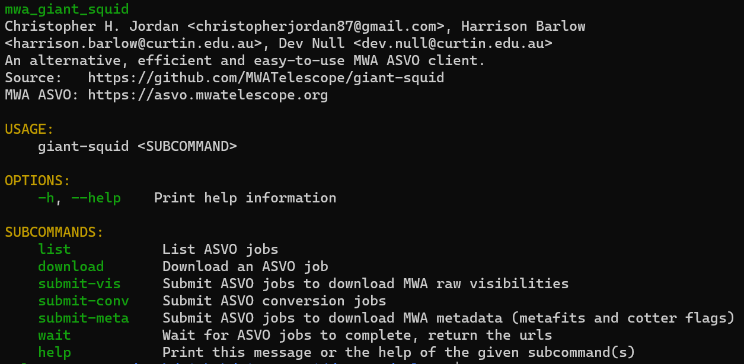
Partner Institutions
Spotlight on giant-squid
CLI Client for MWA ASVO built in Rust by Chris Jordan, Harrison Barlow and Dev Null
https://github.com/MWATelescope/giant-squid
Feature parity with manta-ray-client (recently added voltage download option)
Easy to use and install (use binary, build it yourself or use Docker/Singularity)
Streams downloads so you don’t have to download then extract tar file
Automatically checks the hash of the download
Example of submitting a conversion job:

Slide 45
Partner Institutions
Invaluable Continuing Partners (archive/data)
Digital & Technology Solutions
Notes:
30 PB more or less (14 PB since Dec 2017)

Slide 46
Partner Institutions
Thank You!
Questions?
Contact me any time!:
greg.sleap@curtin.edu.au
MWA Users Slack: @Greg Sleap
MWA ASVO status updates/support/feedback:
asvo_support@mwatelescope.org
Twitter/X/whatever the heck it’s called now: @mwa_asvo
MWA Users Slack: #mwa-asvo-status
Wiki: https://wiki.mwatelescope.org
Notes:
30 PB more or less (14 PB since Dec 2017)

