Slide 1
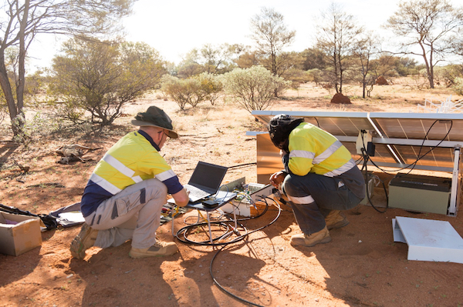
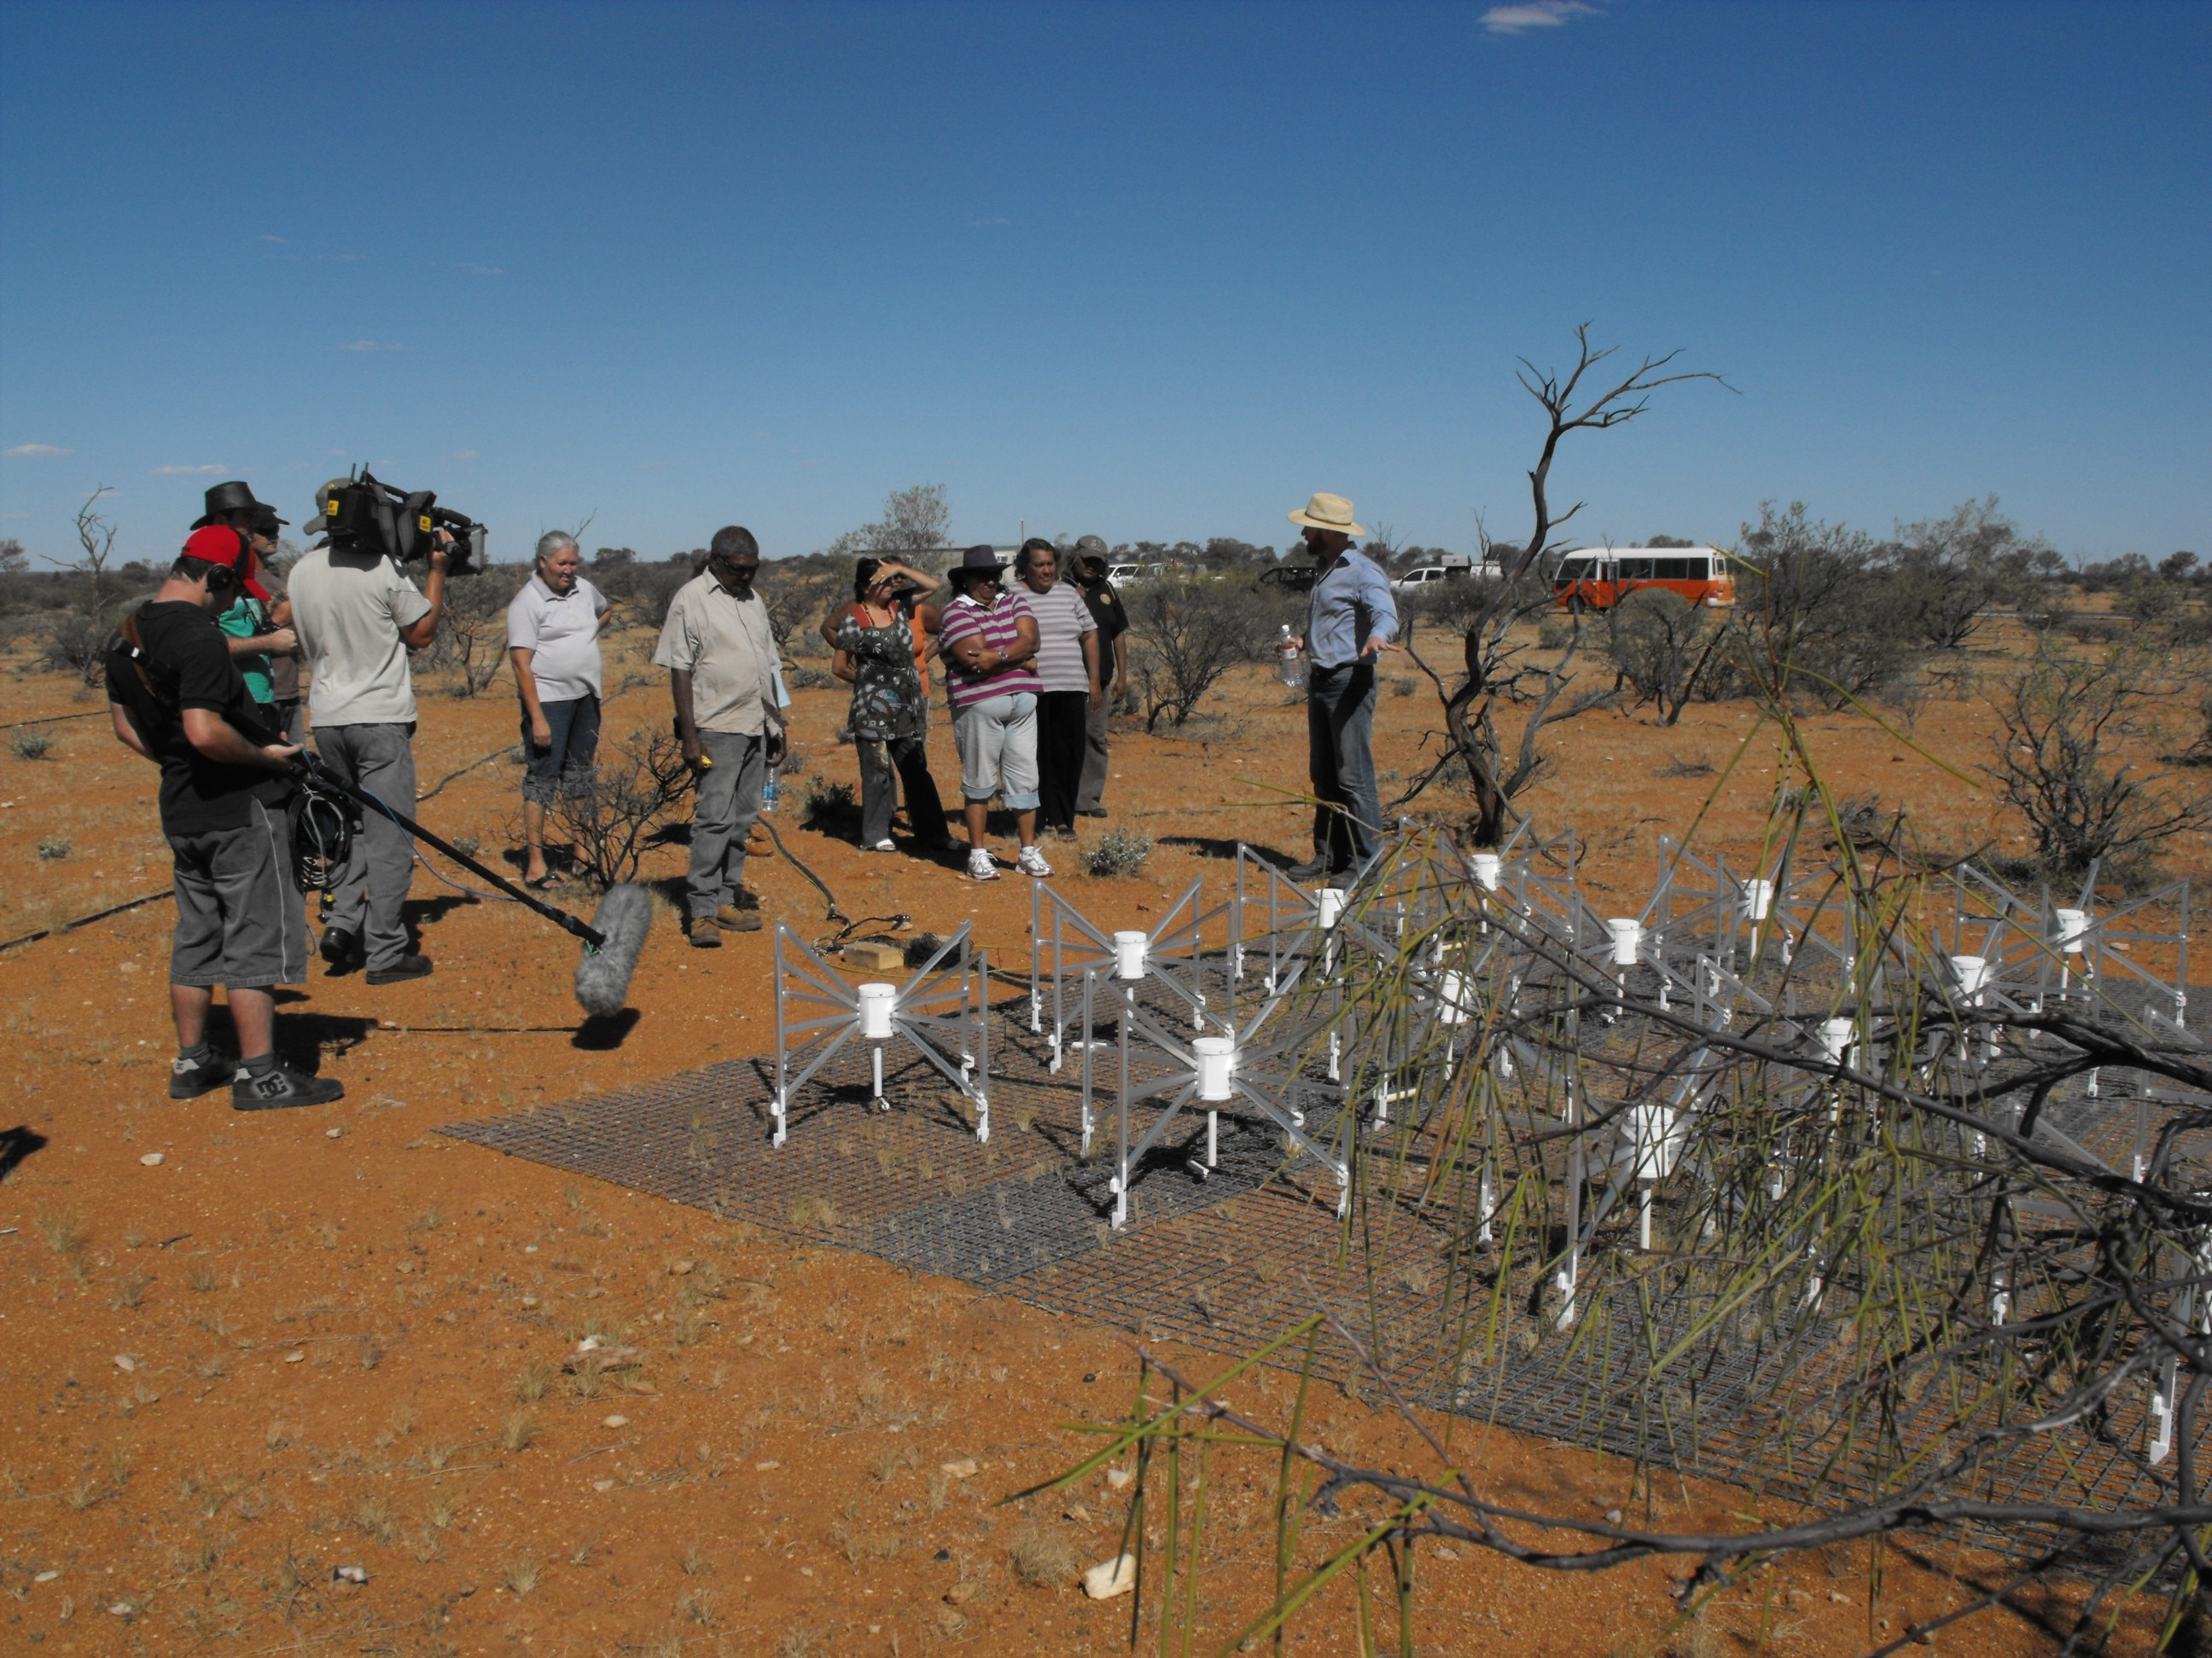
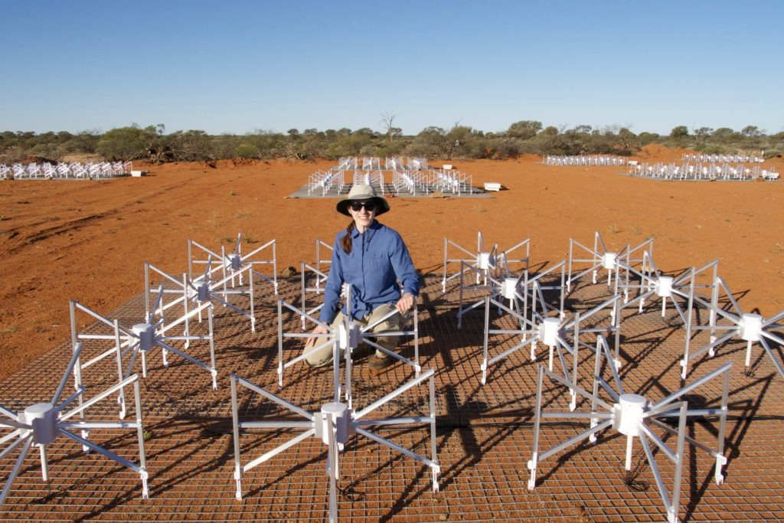
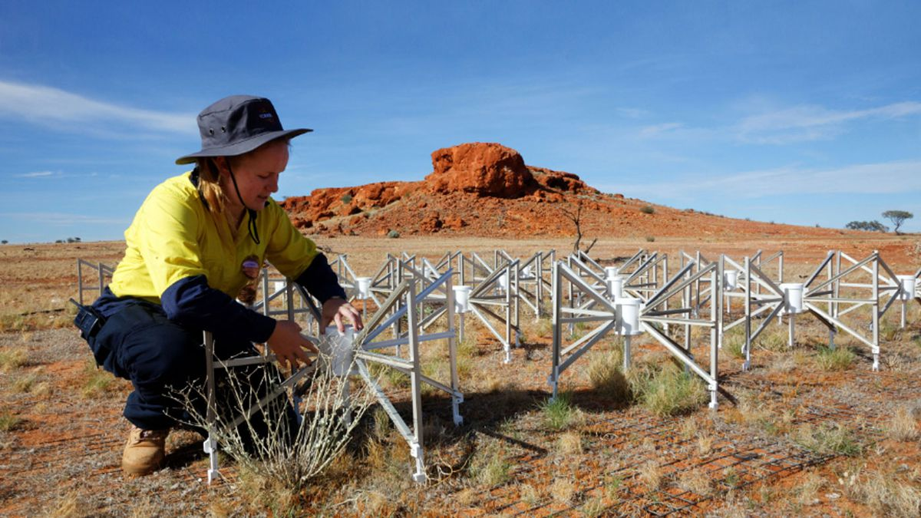
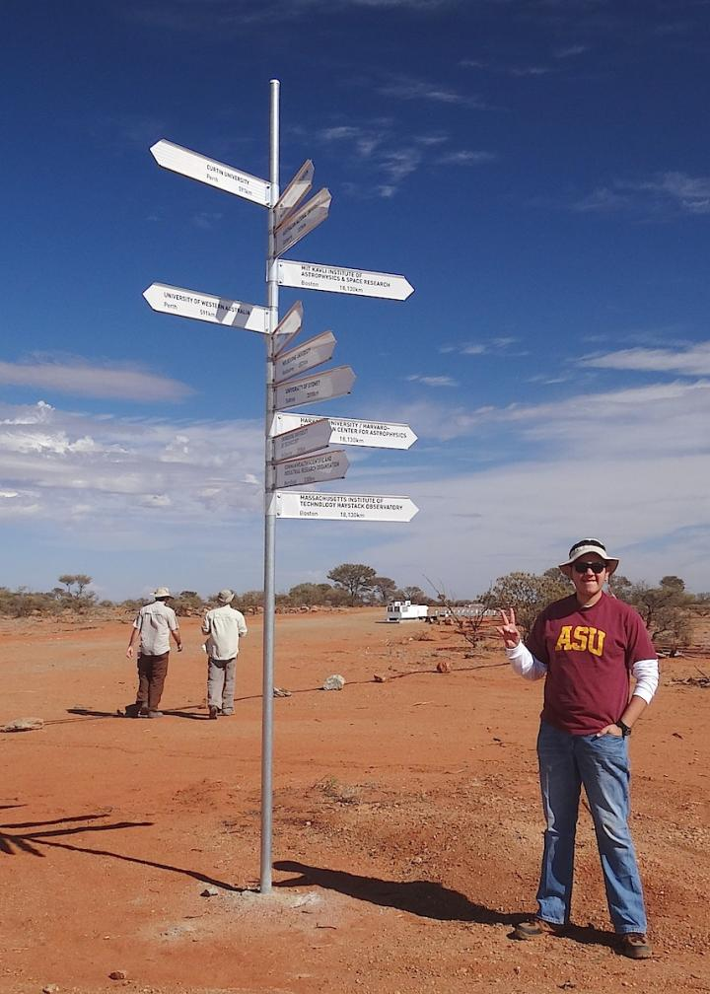

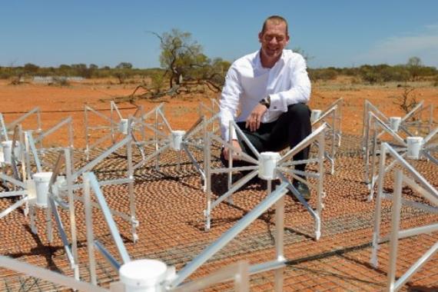
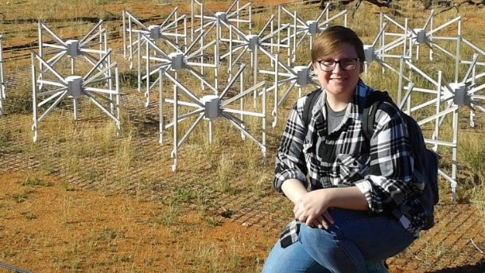
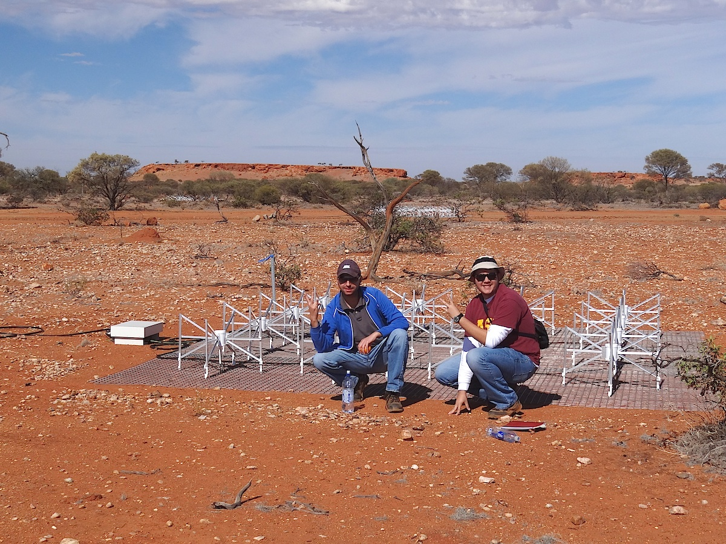
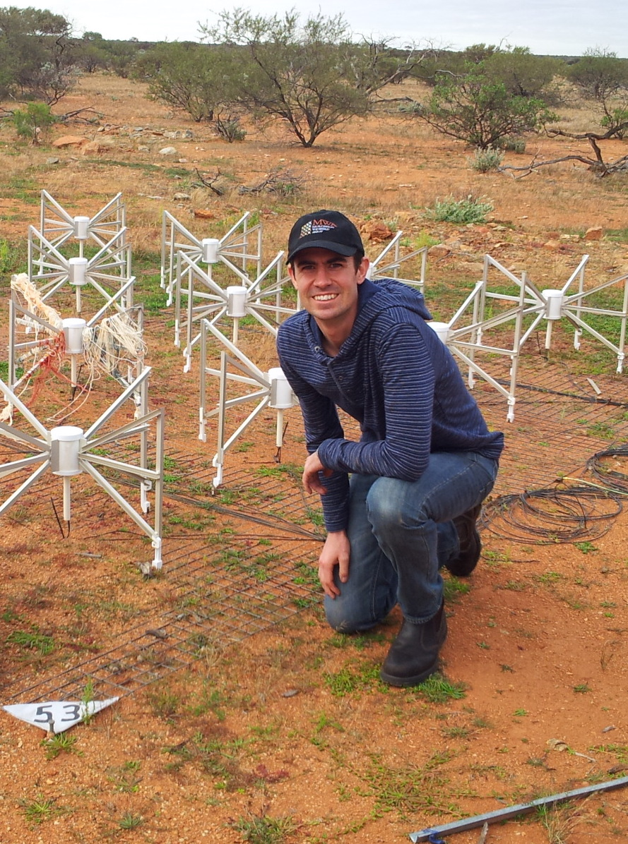
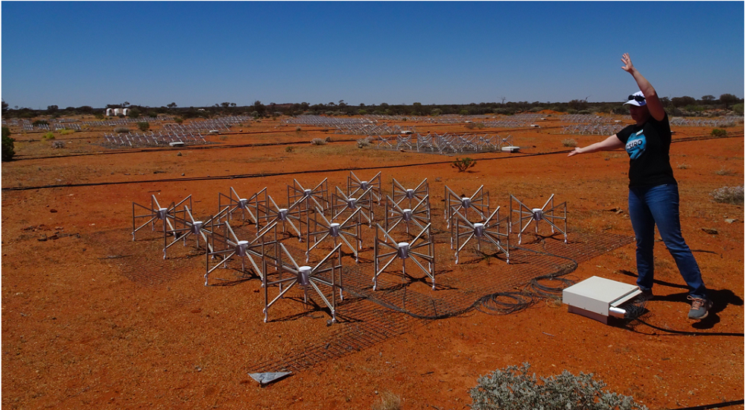
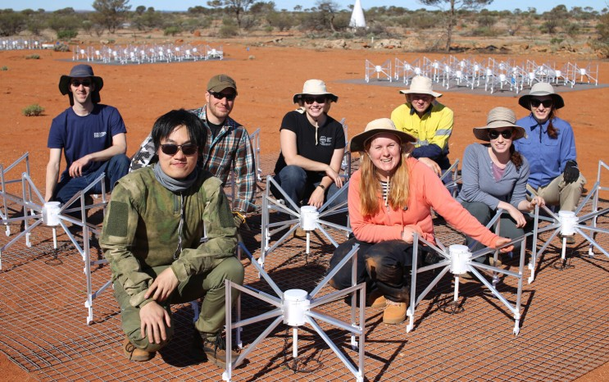
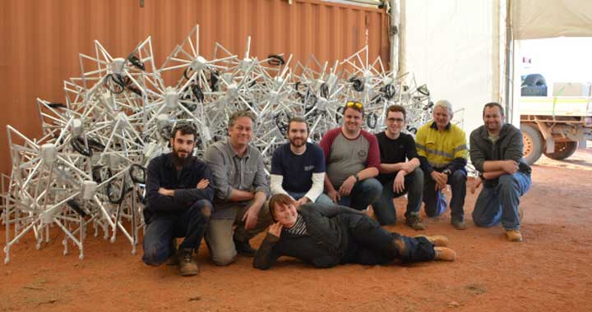


MWA Director’s Report
10 Year Anniversary Edition!
Prof. Steven Tingay
ICRAR/Curtin University

Slide 2

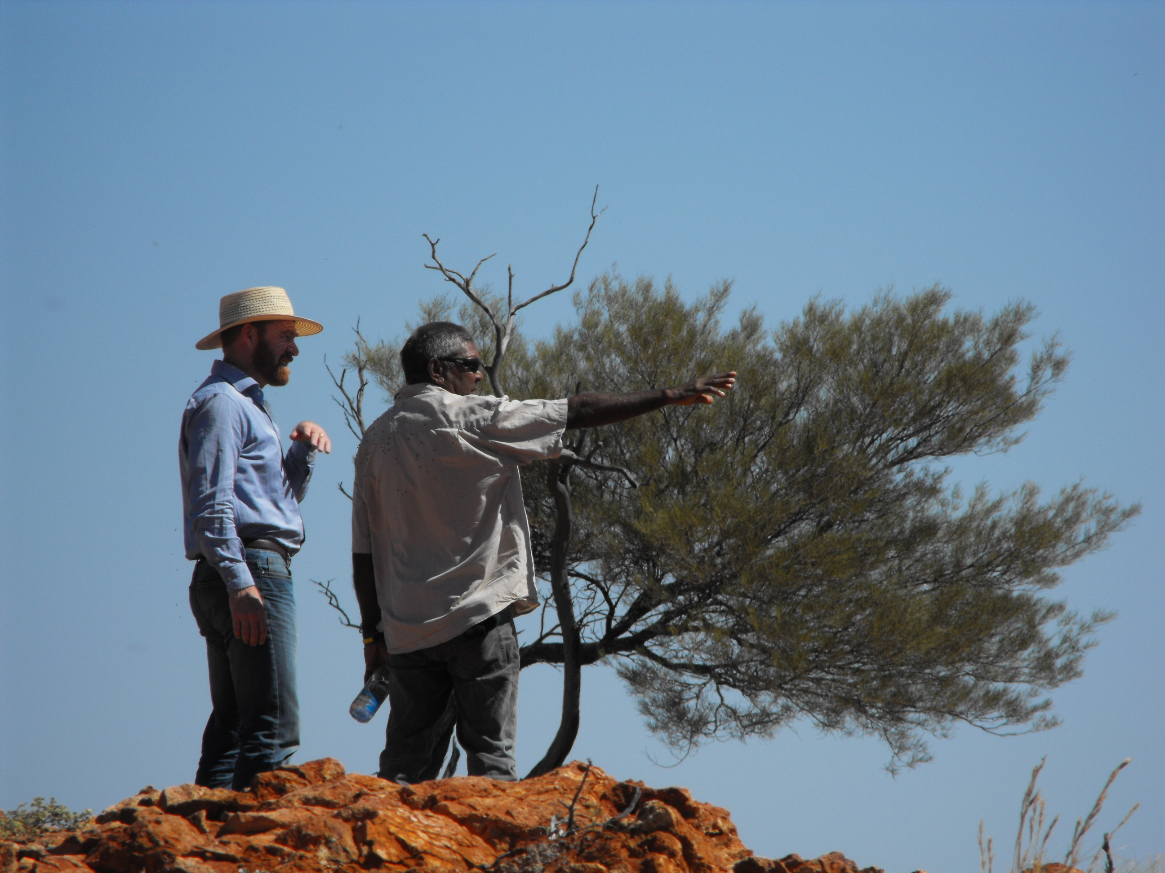
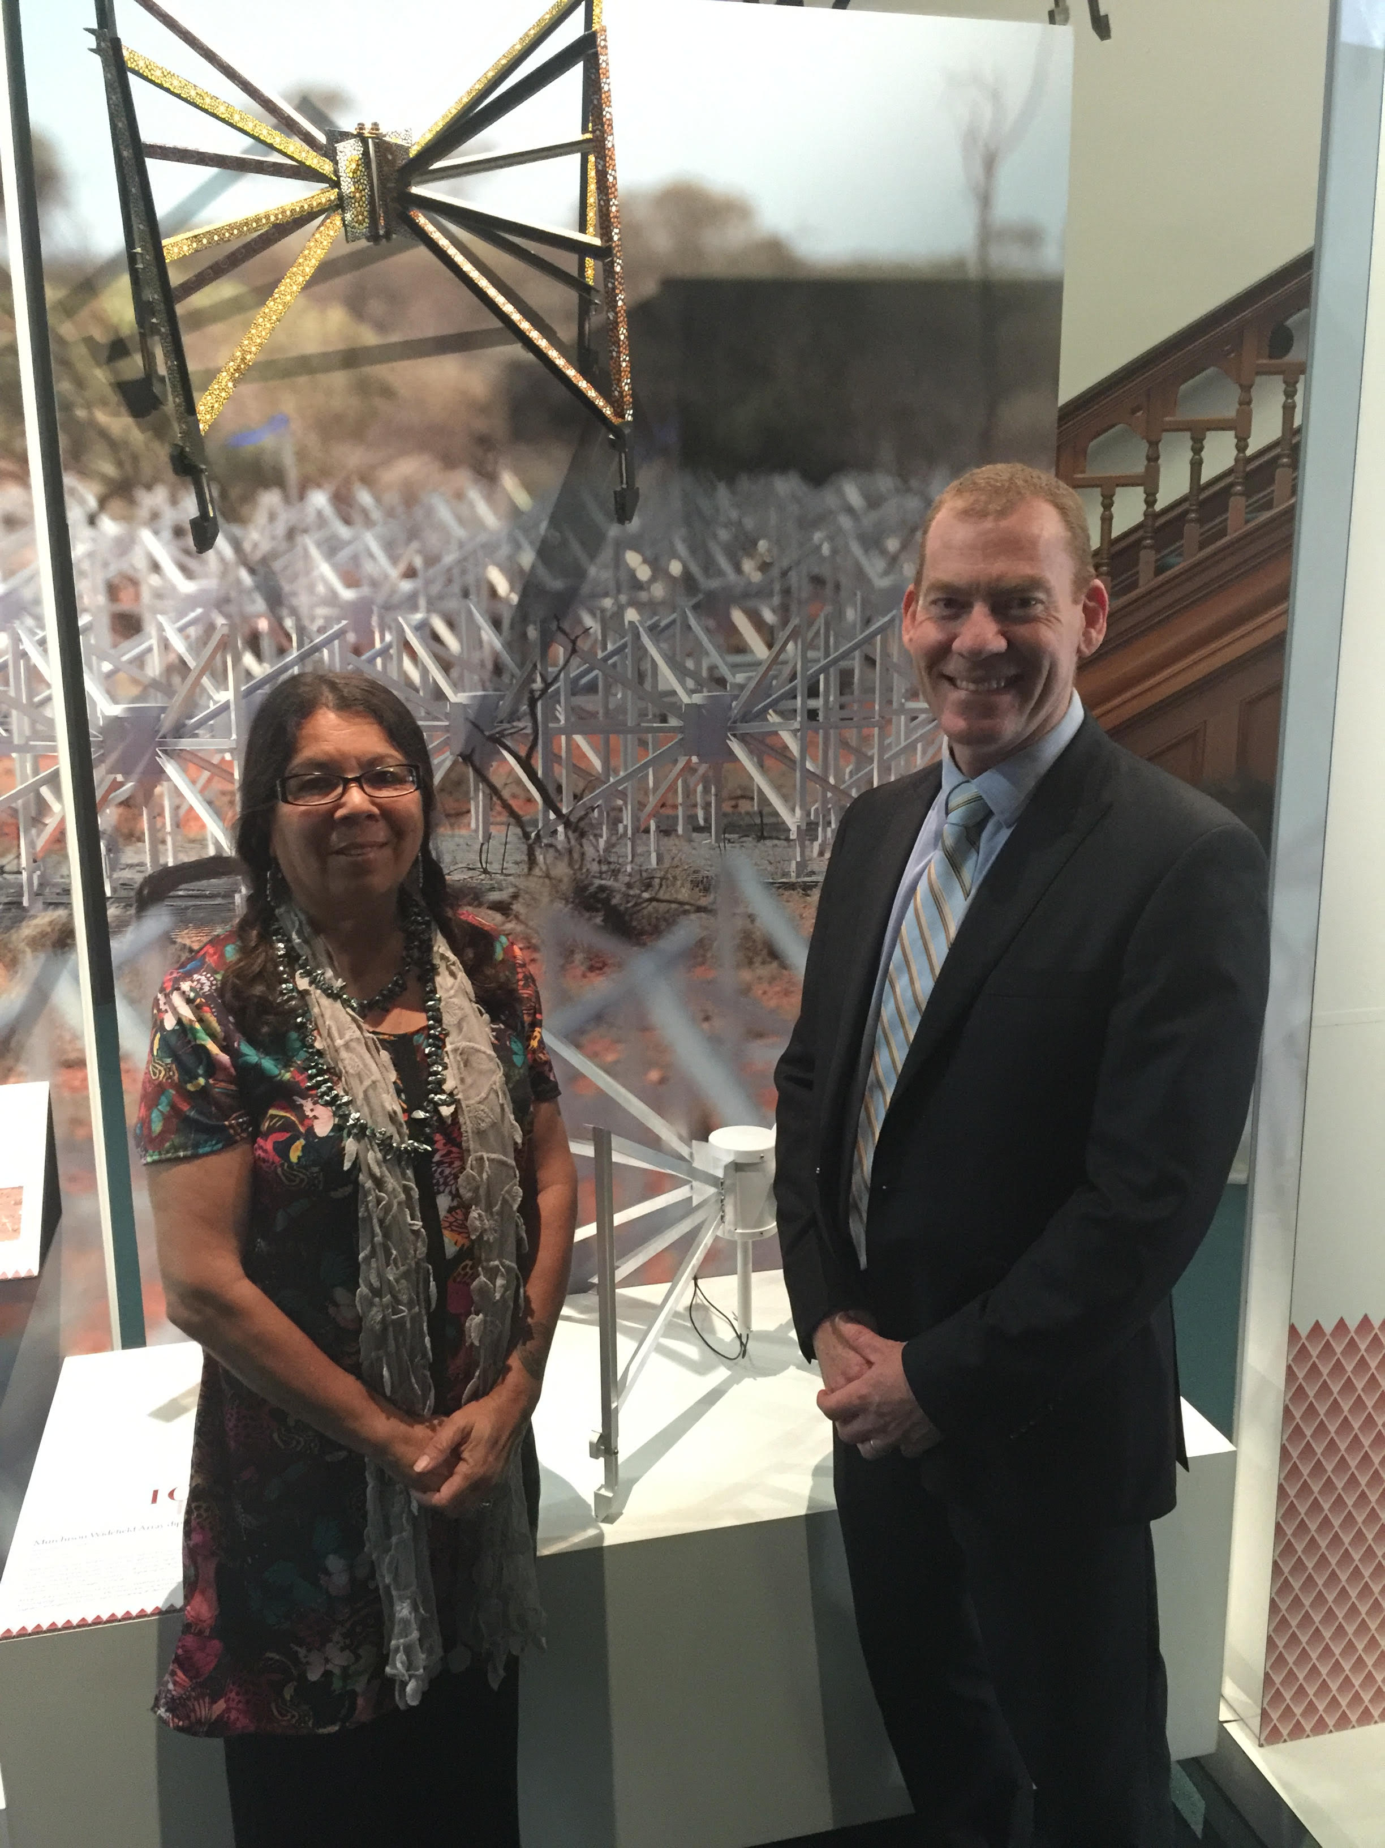
Acknowledgement to Country
We wish to acknowledge the Traditional Owners of the Land on which we meet today, the Whadjuk people of the Noongar Nation and pay my respect to their Elders past, present and emerging.
And we pay our respects to the Wajarri Yamatji, the traditional owners of the land from which we are exploring the Universe.
Notes:
Acknowledge Board Chairs present: Phil Edwards, Stuart Wyithe, George Heald, Rachel Webster, Melanie Johnston-Hollitt.

Slide 3





















Slide 4
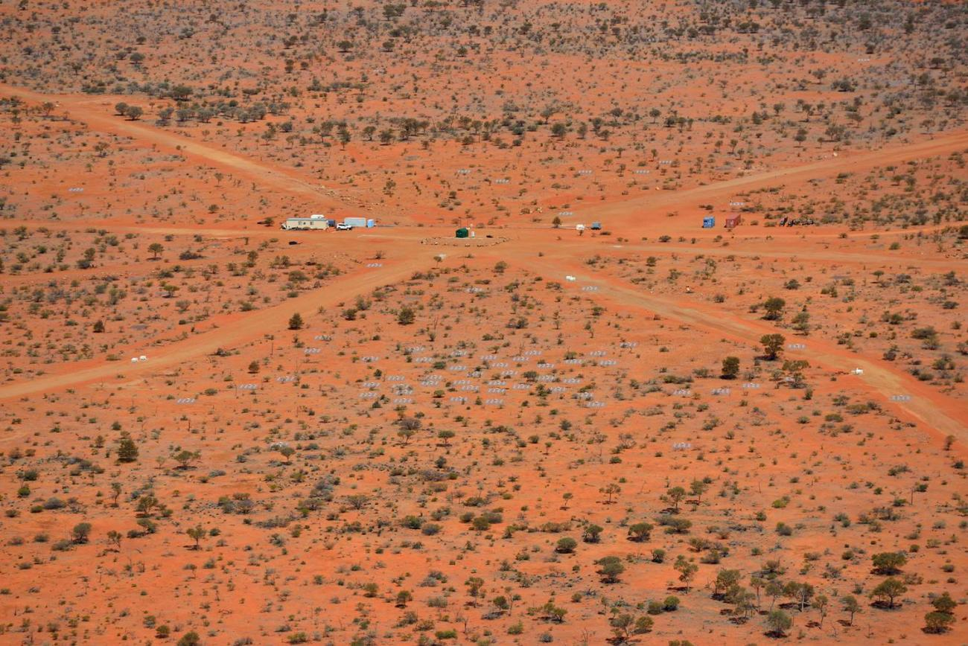
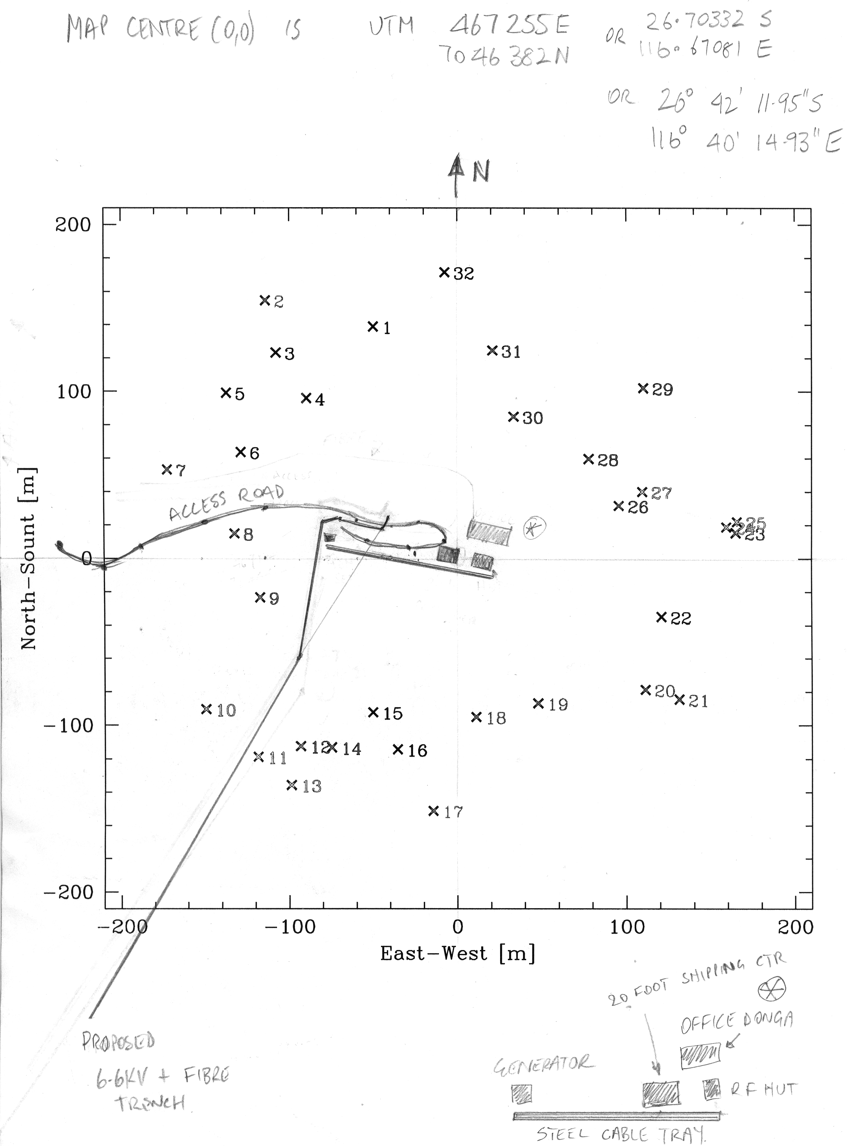
How (on Earth) did we get here?
Preparation (~2006 - 2012): Directors – Lonsdale, Whitney, Tingay
Concept: 512 tiles, Real Time System
Background technologies:
  Antennas, correlator, receiver;
  Real-time data processing concepts.
Design iterations:
  FPGA correlator -> software correlator. Ord, Johnston-Hollitt
32T (show me the money):
  AAL: McAuley, Sadler;
  MWA: Arcus, Booler, Goeke
Reality: 128 tiles. Preserve infrastructure. Store visibilities!
NCRIS ($4.7M), EIF (thanks to the GFC, $3.05M), ARC Super Science Fellows (Hurley-Walker, Morgan);
Infrastructure. Hadley.
https://wiki.mwatelescope.org/display/MP/
Telescope+Configurations

Slide 5
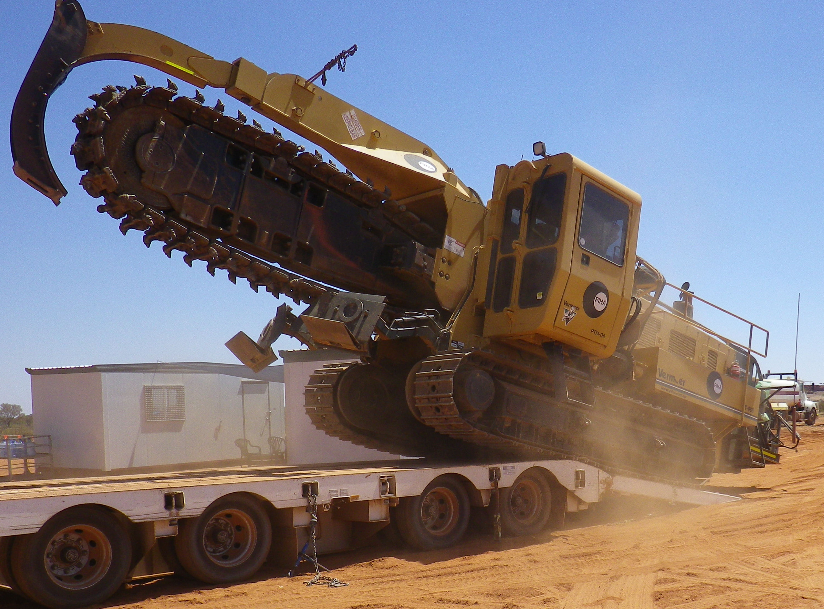
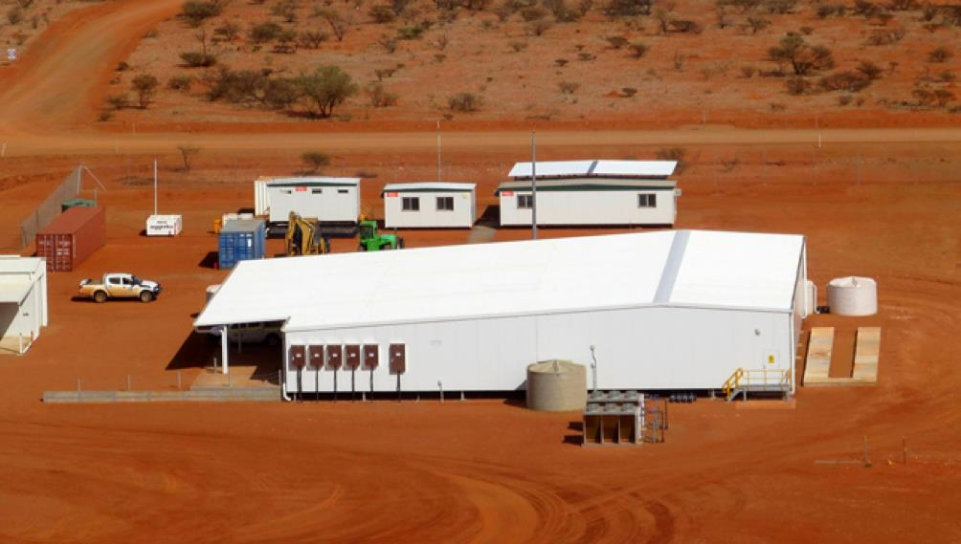
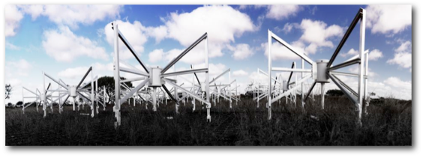
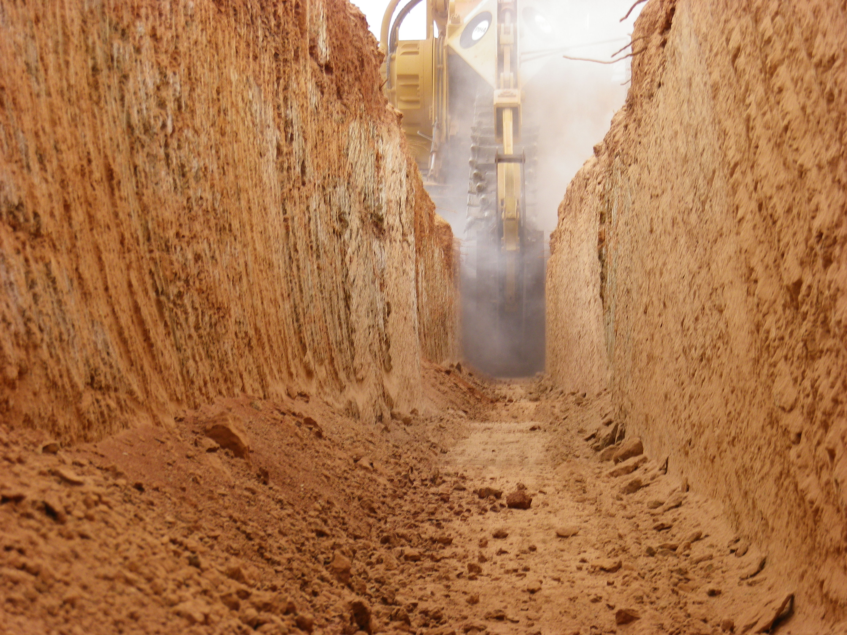
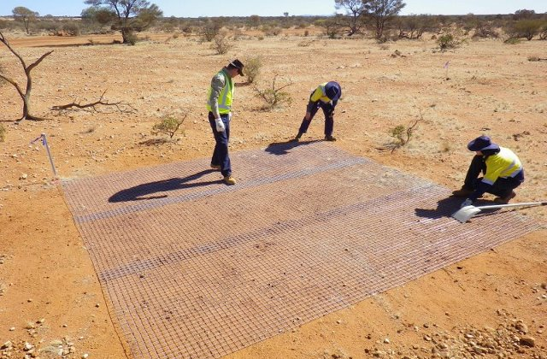
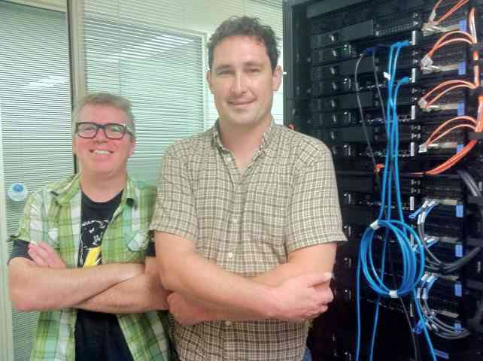
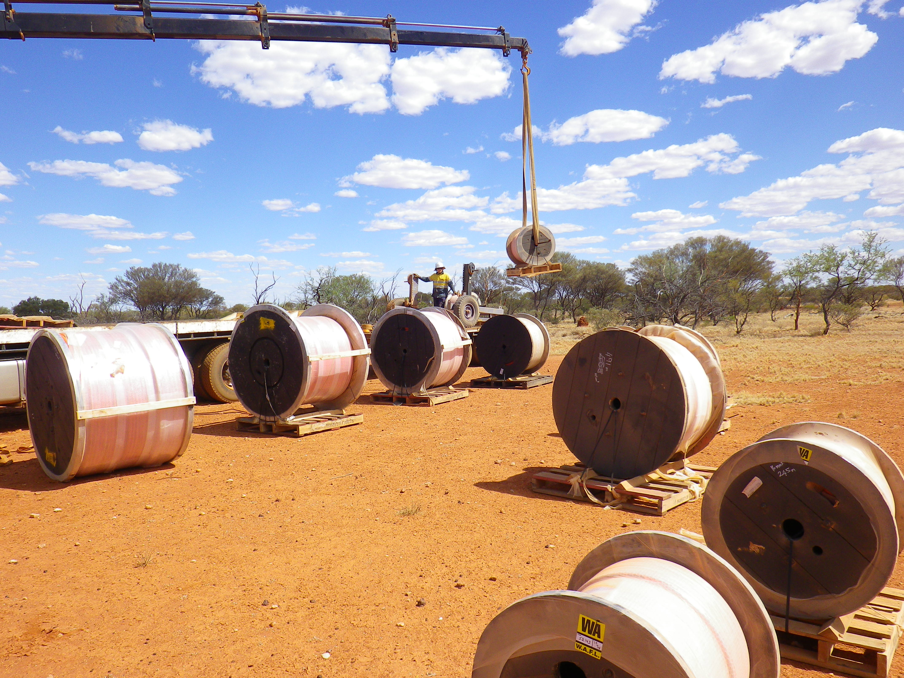
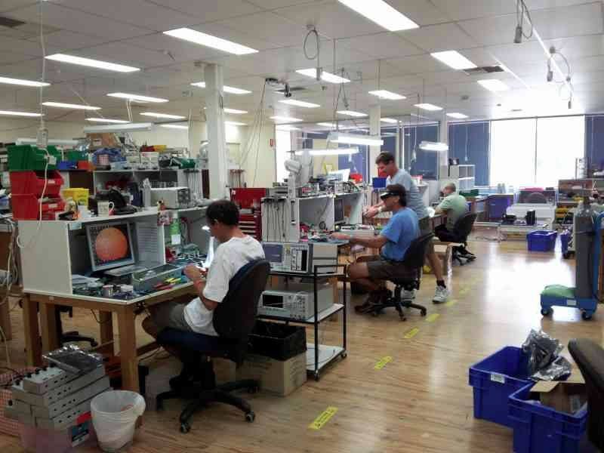
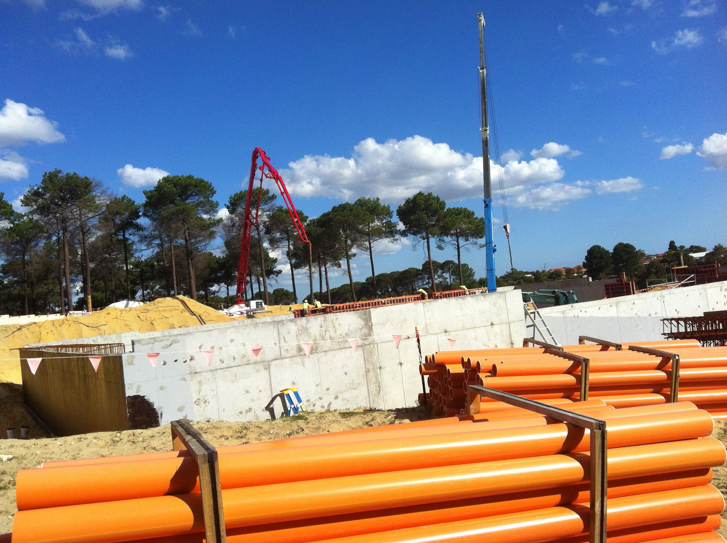
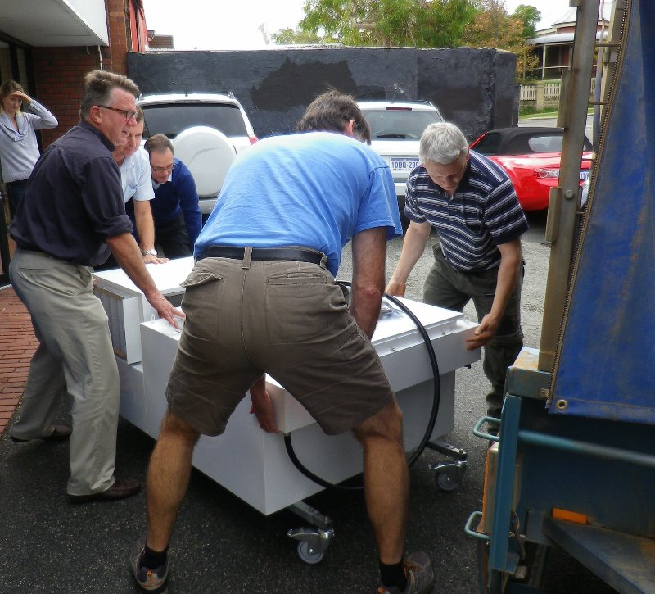
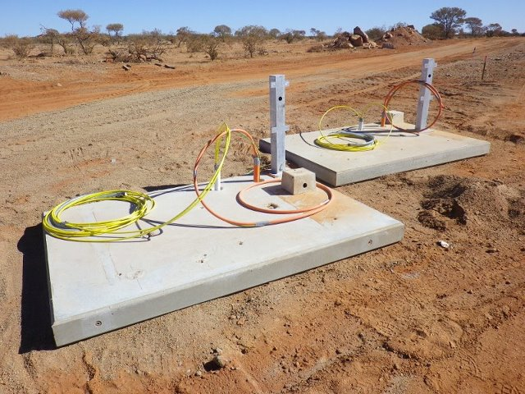
Progress in final construction phase
INFRASTRUCTURE
INSTRUMENT
DATA PROCESSING

Slide 6
Commissioning:
Practical completion: November/December 2012 (holding!)
Commissioning
commences: August/September 2012
Early operations: Mid 2013
Science Commissioning Team appointed by MWA Board:
19 individuals (led by Dr Randall Wayth at ICRAR – Curtin University);
10 institutions;
3 countries.
Repeated all-sky survey (supporting GEG) will be a major deliverable of Science Commissioning (see commissioning sessions this week). Also, focus on EoR (during season), SHI (during days), and accommodating transients.

Slide 7
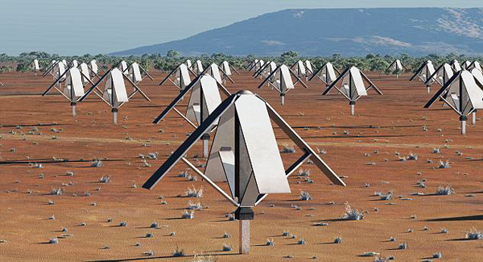
Connection to SKA:
Recent SKA site decision places SKA Phase 1 and 2 low frequency aperture array at the MRO (HERA++ scale);
MWA is the only low frequency SKA Precursor (pathfinder technology on SKA site);
Additional MWA infrastructure we have built at the MRO can assist the SKA low consortium execute its pre-construction plan.
Power/fibre in field -> rack space in central building -> network to Pawsey Centre.
SKA pre-construction phase opportunity

Slide 8
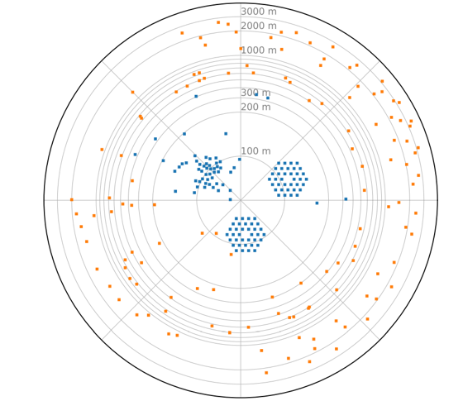
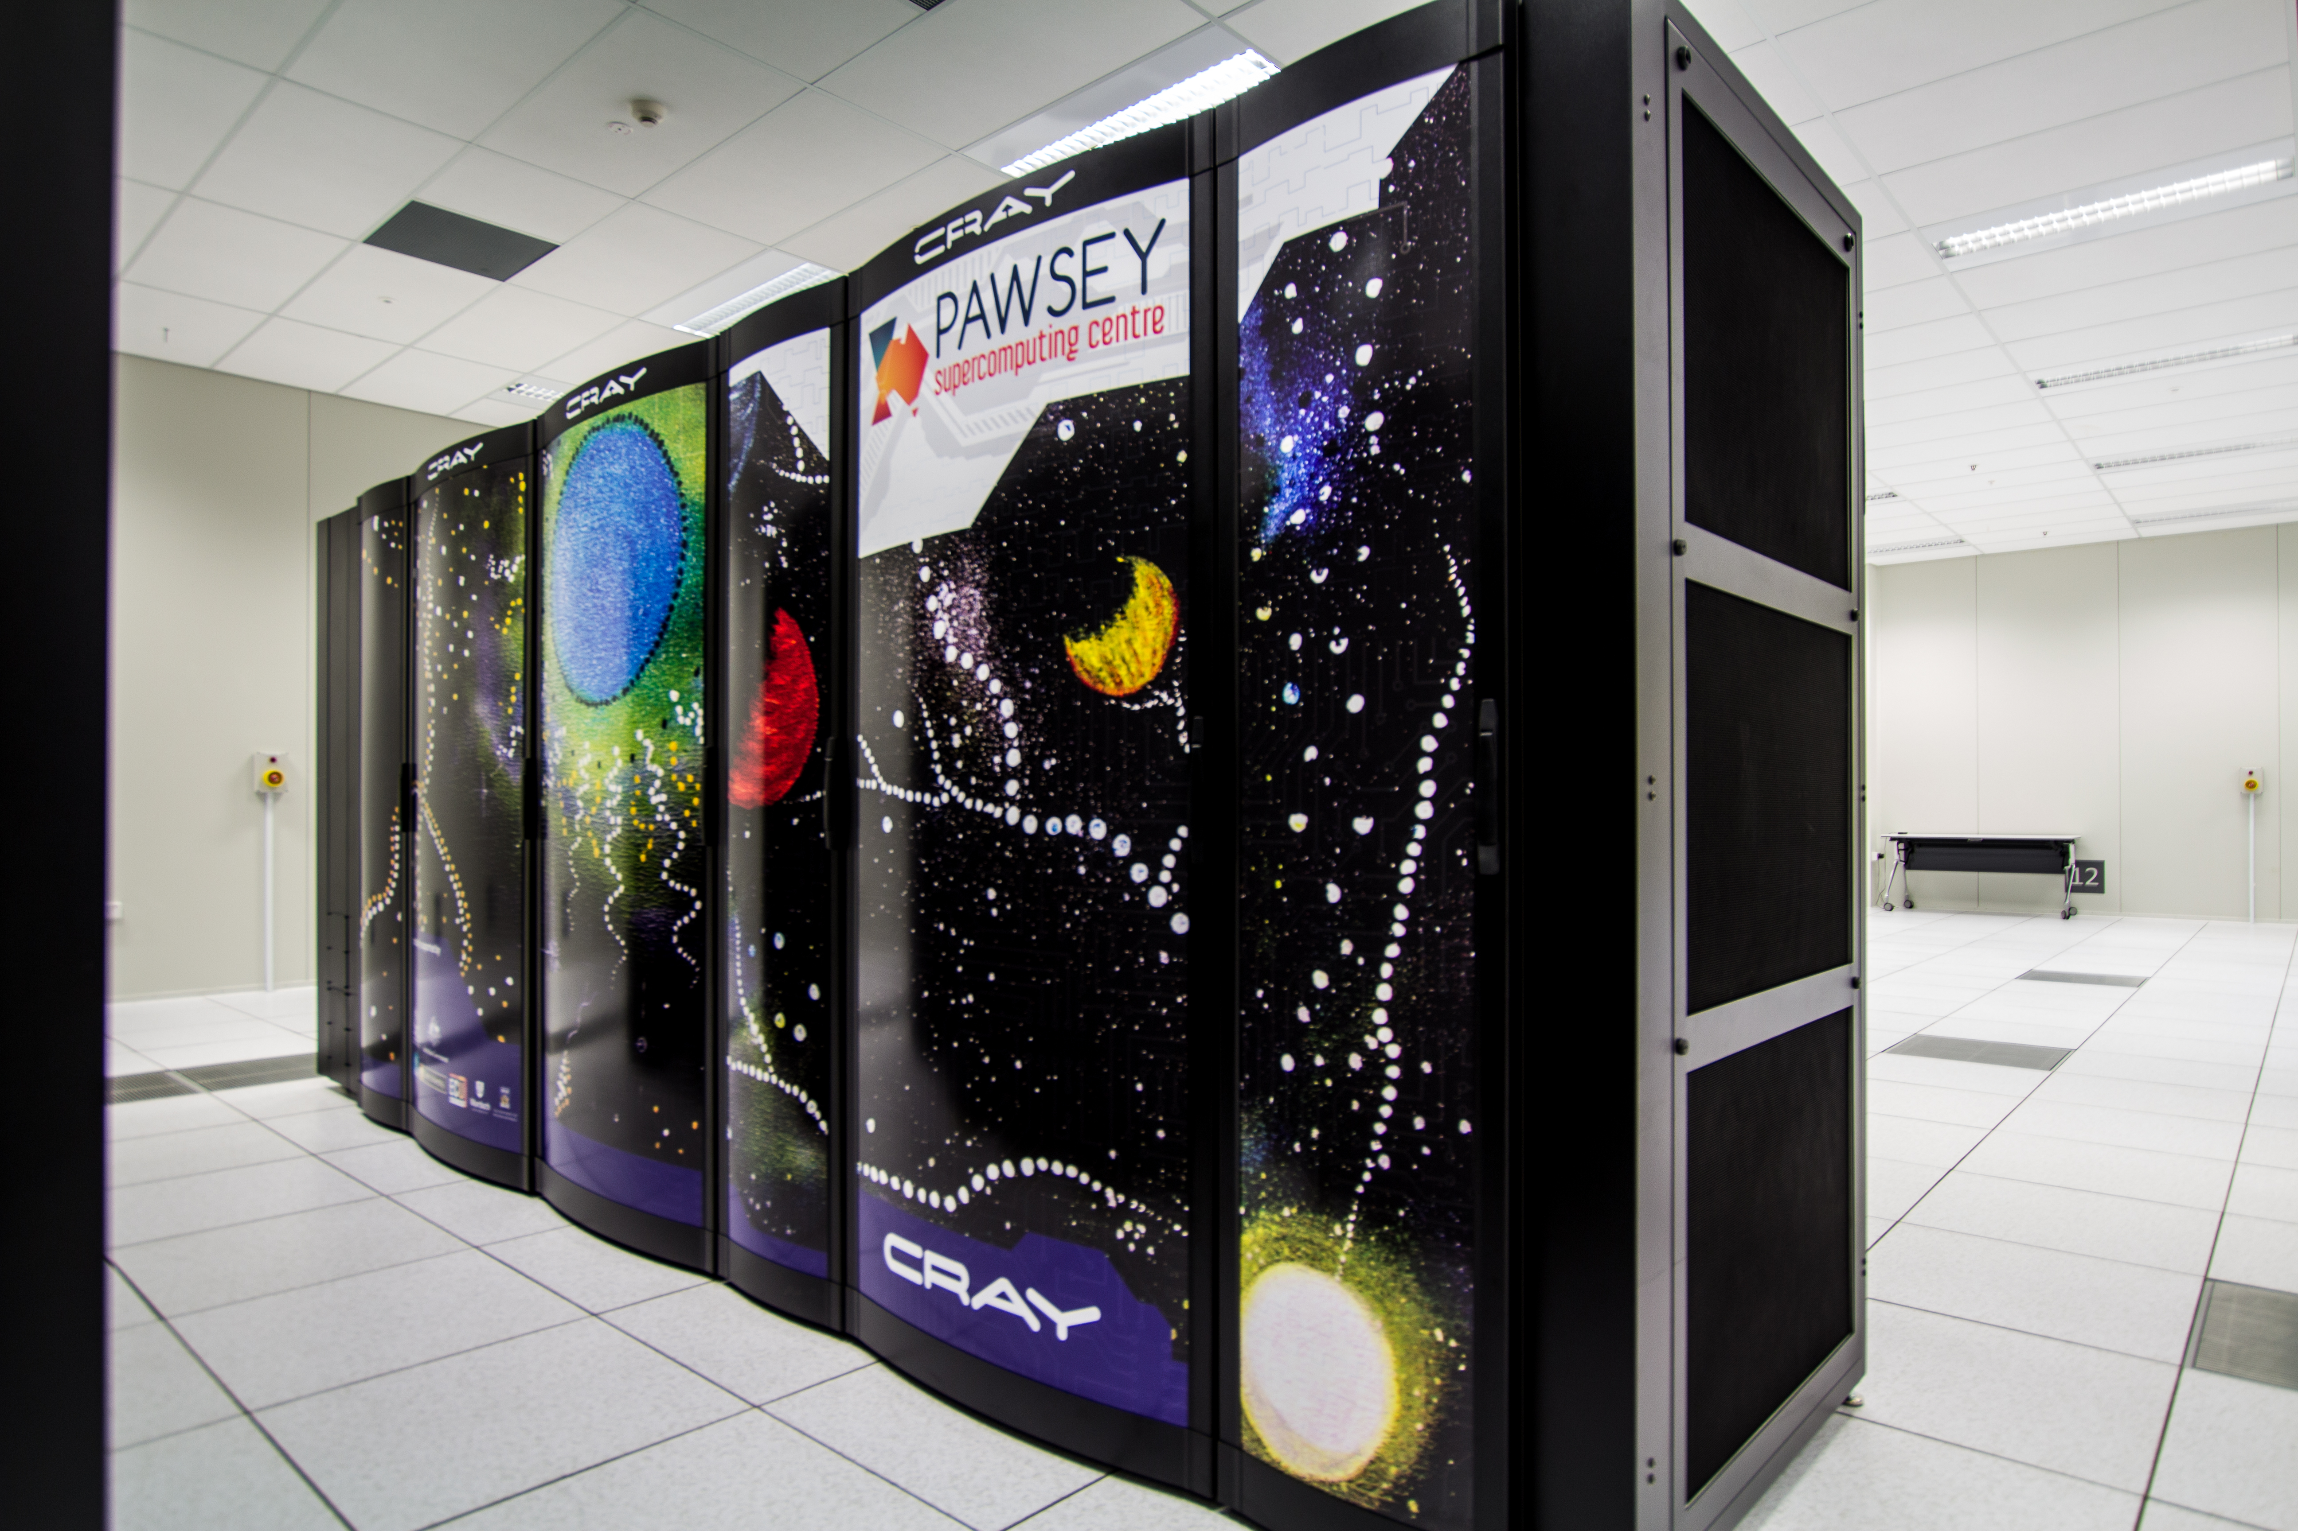
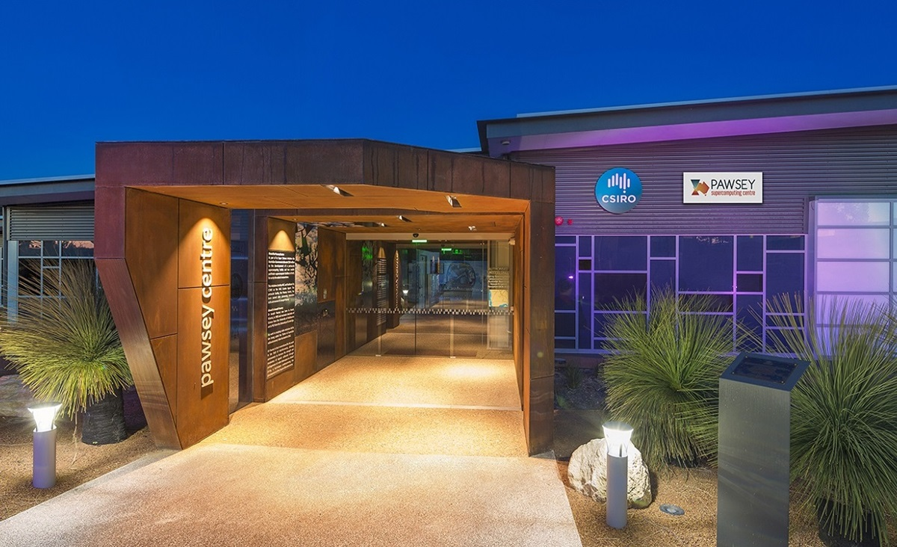
Phase 1 (2012 – 2016): Director – Tingay
128 tiles, receivers (Poseidon, Jesse Searls), correlator;
Pawsey Centre (GFC) established as data storage and data processing partner.
Phase 2 (2016 – 2021): Directors – Wayth, Johnston-Hollitt
256 tiles, 128 correlated at a time (”compact” and “extended” configurations);
ARC LIEF ($1M + $1M from MWA partners).

Slide 9
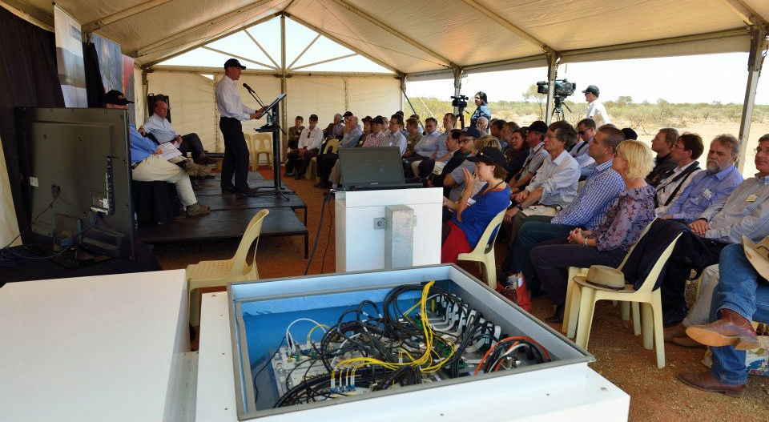
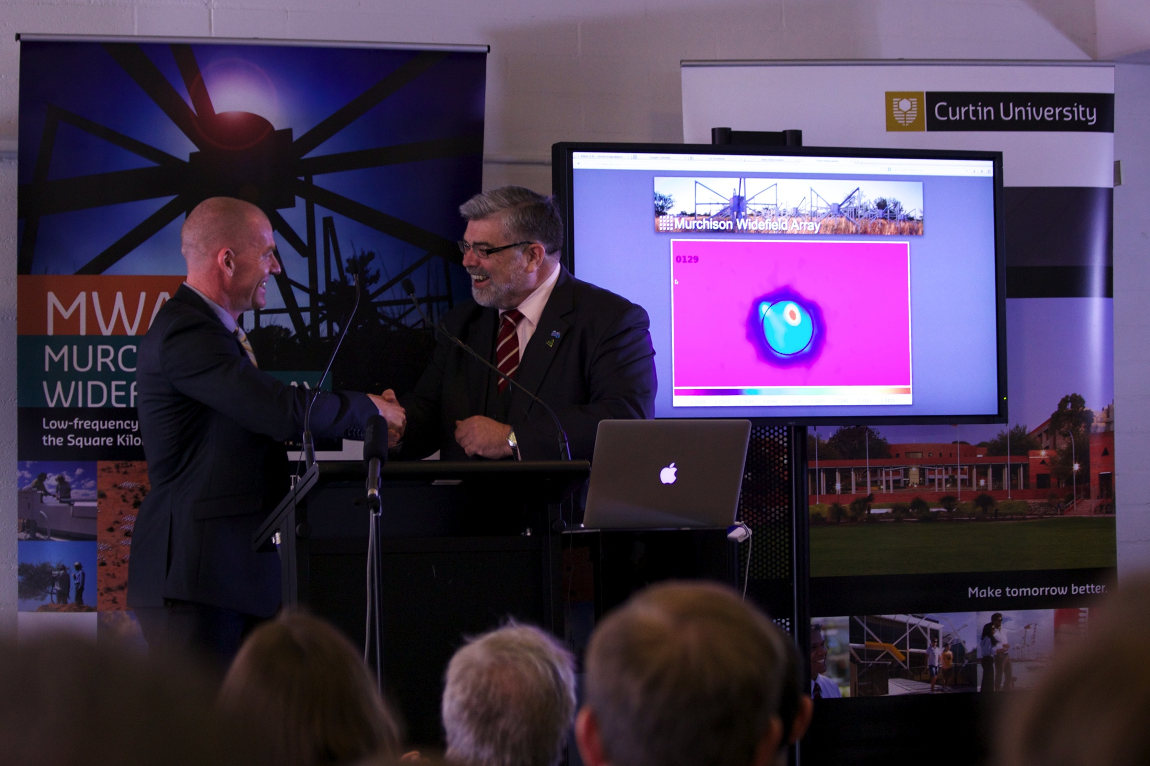

Slide 10
Approved projects for 2013B
1 | Epoch of Reionisation | Webster et al.
2 | A Galactic and Extragalactic All-sky MWA Survey | Staveley-Smith et al.
3 | Unbiased Solar Observations for Burst, Calibration, and Quiet Sun Studies | Cairns et al.
4 | Search for Variable and Transient Sources in the EoR fields with the MWA | Kudryavtseva et al.
5 | Exploring the MWA field of view to study scintillation and the structure of turbulence in the Milky Way | Hancock et al.
6 | Monitoring the Galaxy with the MWA | Kaplan et al.
7 | Constraining X-ray and Dark Matter heating before the Epoch of Reionisation: Preliminary observations at low radio frequencies with the MWA | Ewall-Wice et al.
8 | The MWA long-term radio sky monitor | Bell et al.
9 | Spectral details of extragalactic point sources | Offringa et al.

Slide 11
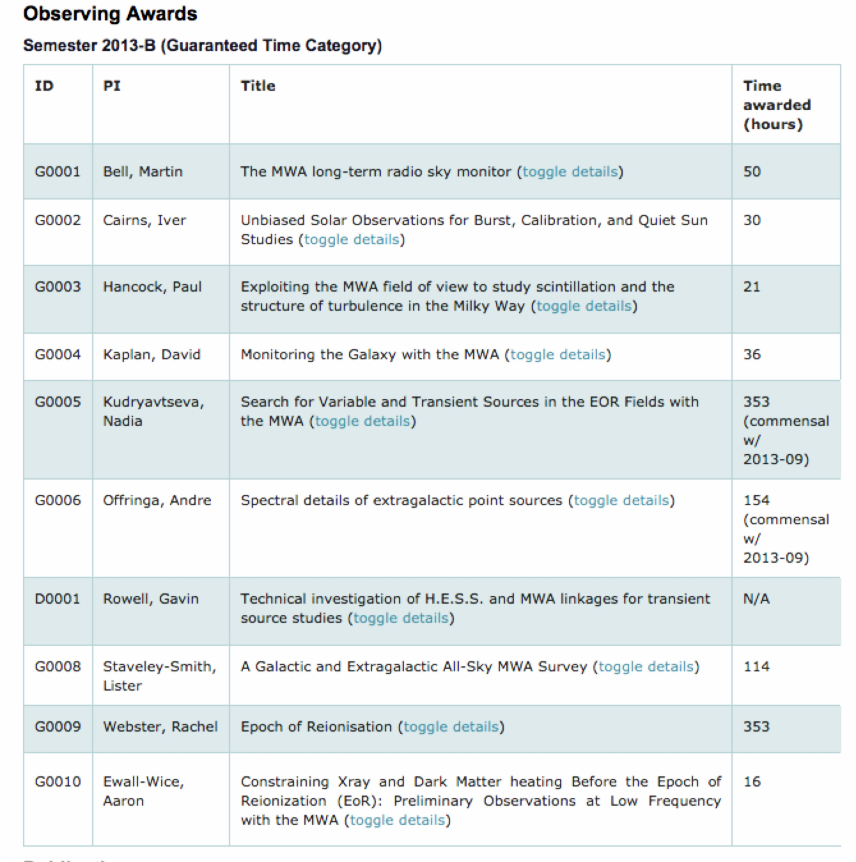
MWA Time Allocation
Committee
Geoff Bower (U.C. Berkeley)
Tzu-Ching Chang (ASIAA)
Dick Hunstead (Sydney)
Deputy Chair
Namir Kassim (NRL)
Chair
Anthony Lasenby (Cambridge)
Monique Pick (Obs. Paris)
DONE!!!
>600 hours observing
~1.5 PB of data collected

Slide 12
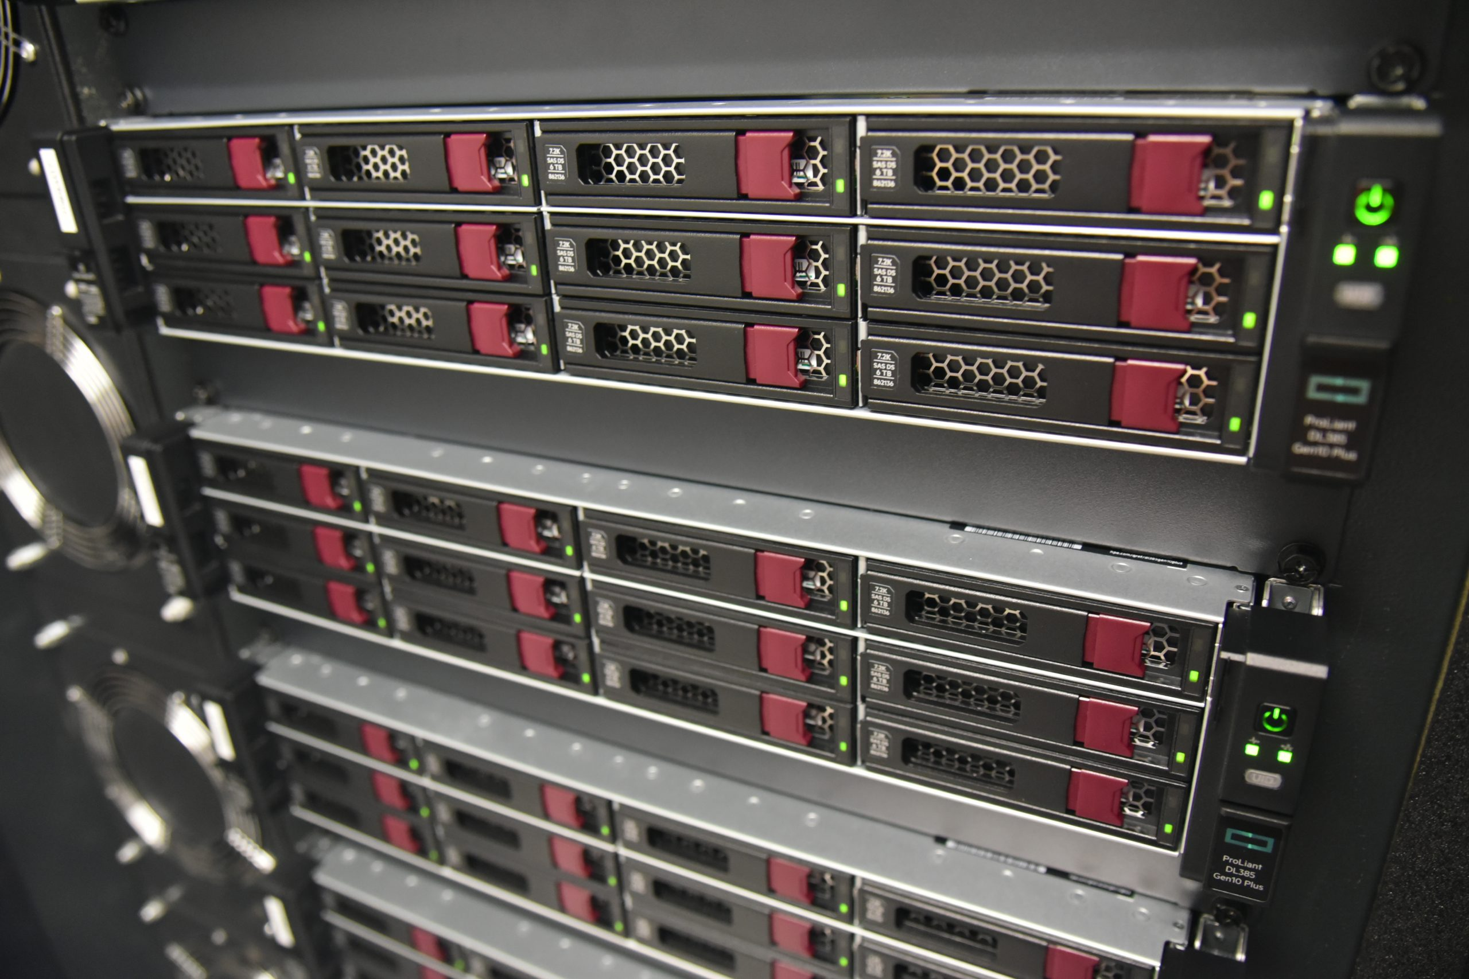





Where are we now?
Phase 3 (2021 - ): Directors – Johnston-Hollitt, Tingay
New MWAX correlator deployed and operational. Morrison, Sleap, Williams, Crosse, Wayth;
256 tiles, all correlated, supported by new receivers (SHAO, in progress; and NI receivers, Jones, Wayth);
$7.7M of NCRIS operations announced this year (expecting more good news). Plus $4M from MWA partners for Phase III.
And a Swiss consortium as a new partner, led by École Polytechnique Fédérale de Lausanne (EPFL) and including FHNW, ISSI-Bern, ETHZ, and CSCS (and others in the future).

Slide 13
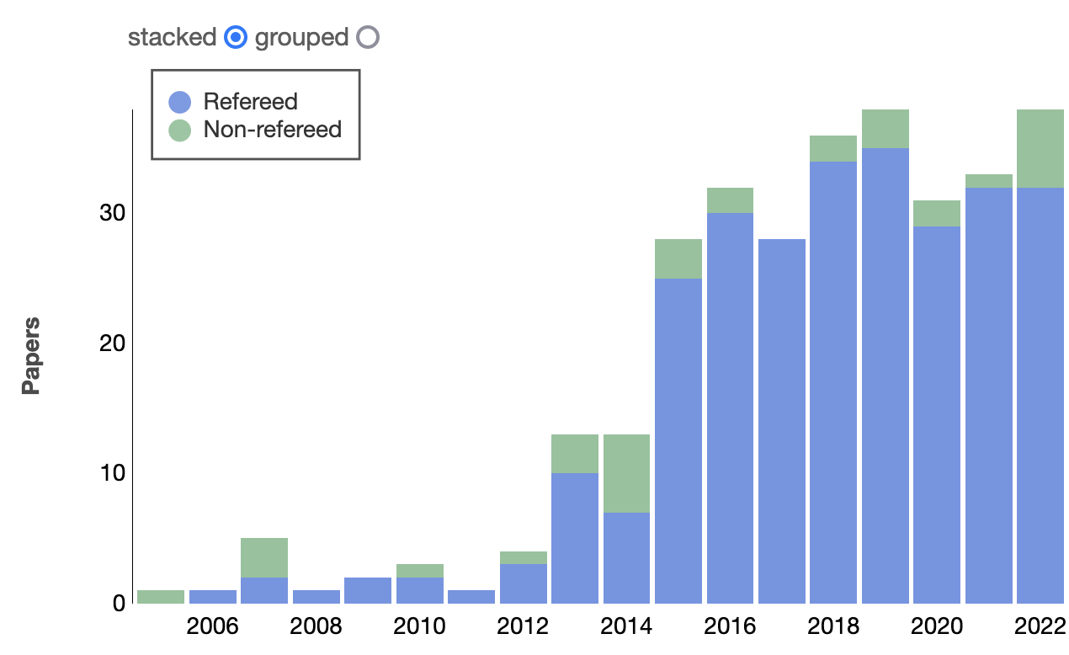
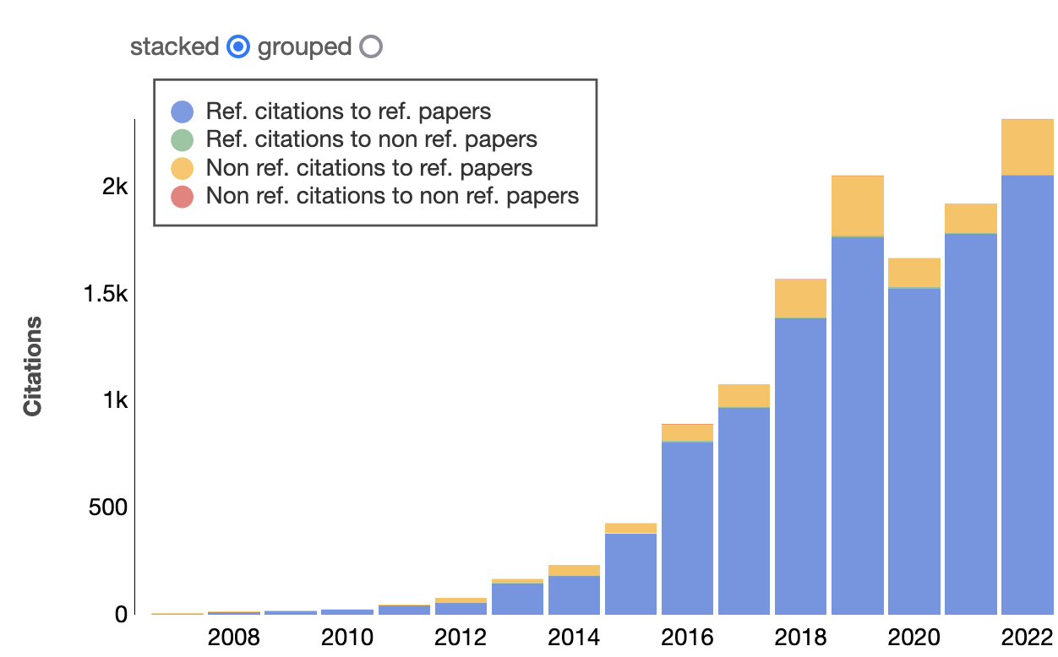

Slide 14
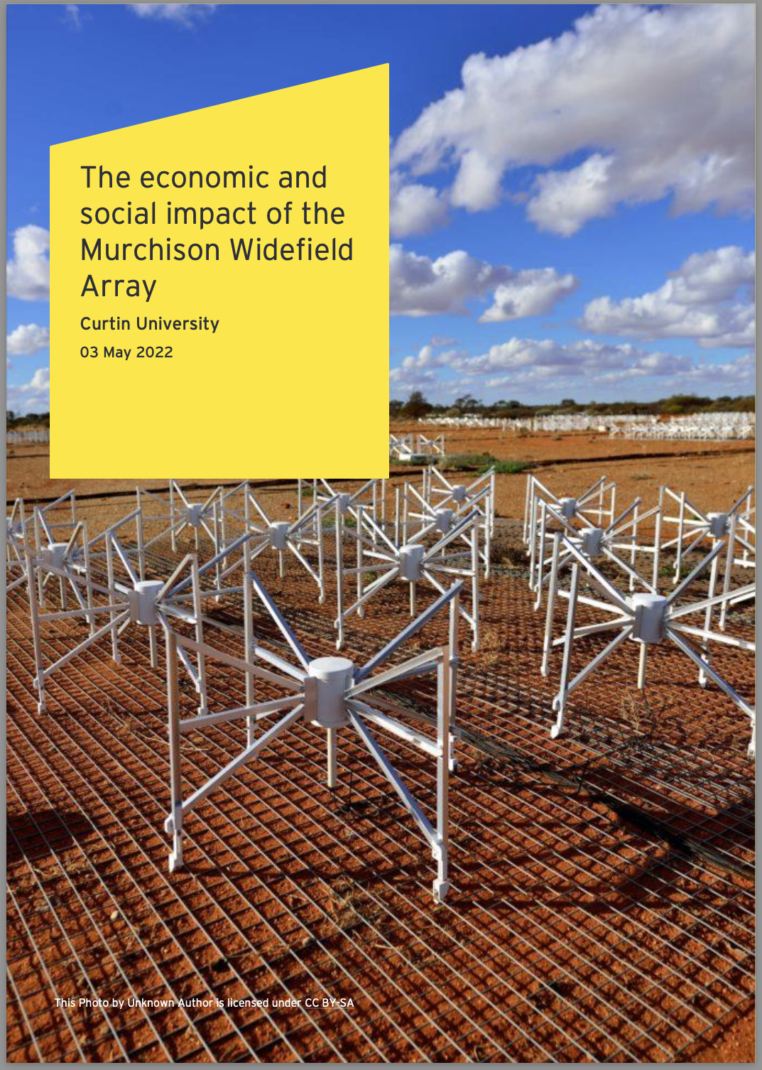
The Economic and Social Impact of the MWA
Report commissioned from Ernst & Young;
https://www.mwatelescope.org/ (front page);
For every $1 spent on the MWA in Australia, $2.3 of GDP has been generated. Compares favourably to investments in many different types of infrastructure;
Case studies show that the MWA has an outsize impact. Same impact as comparable facilities, but with half the operations FTE and one fifth the operations budget!
Plays a crucial role for the SKA. Supporting the next generations of radio astronomers;
Supports industry and translation to industry;
Excellent prospects for greater returns from continued investment.

Slide 15

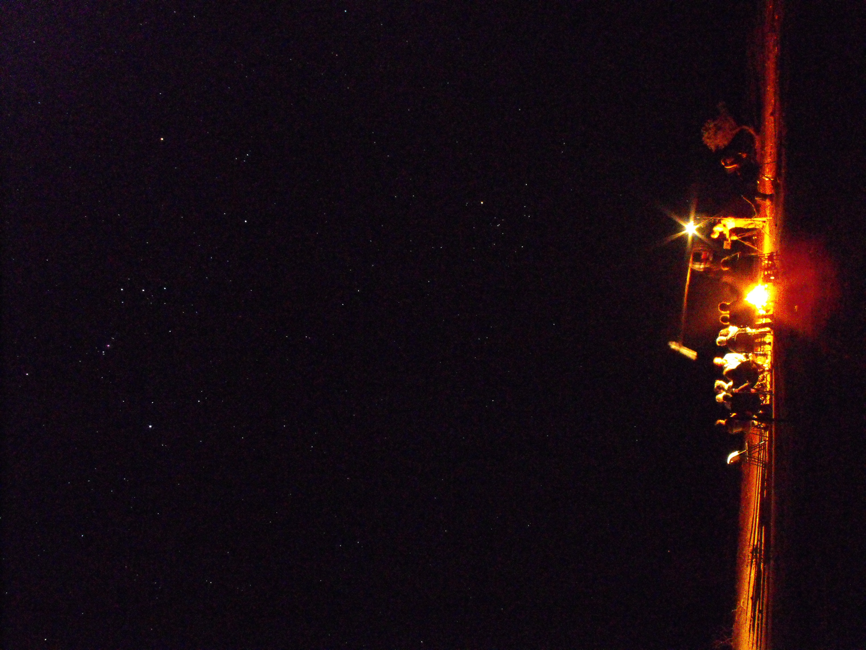

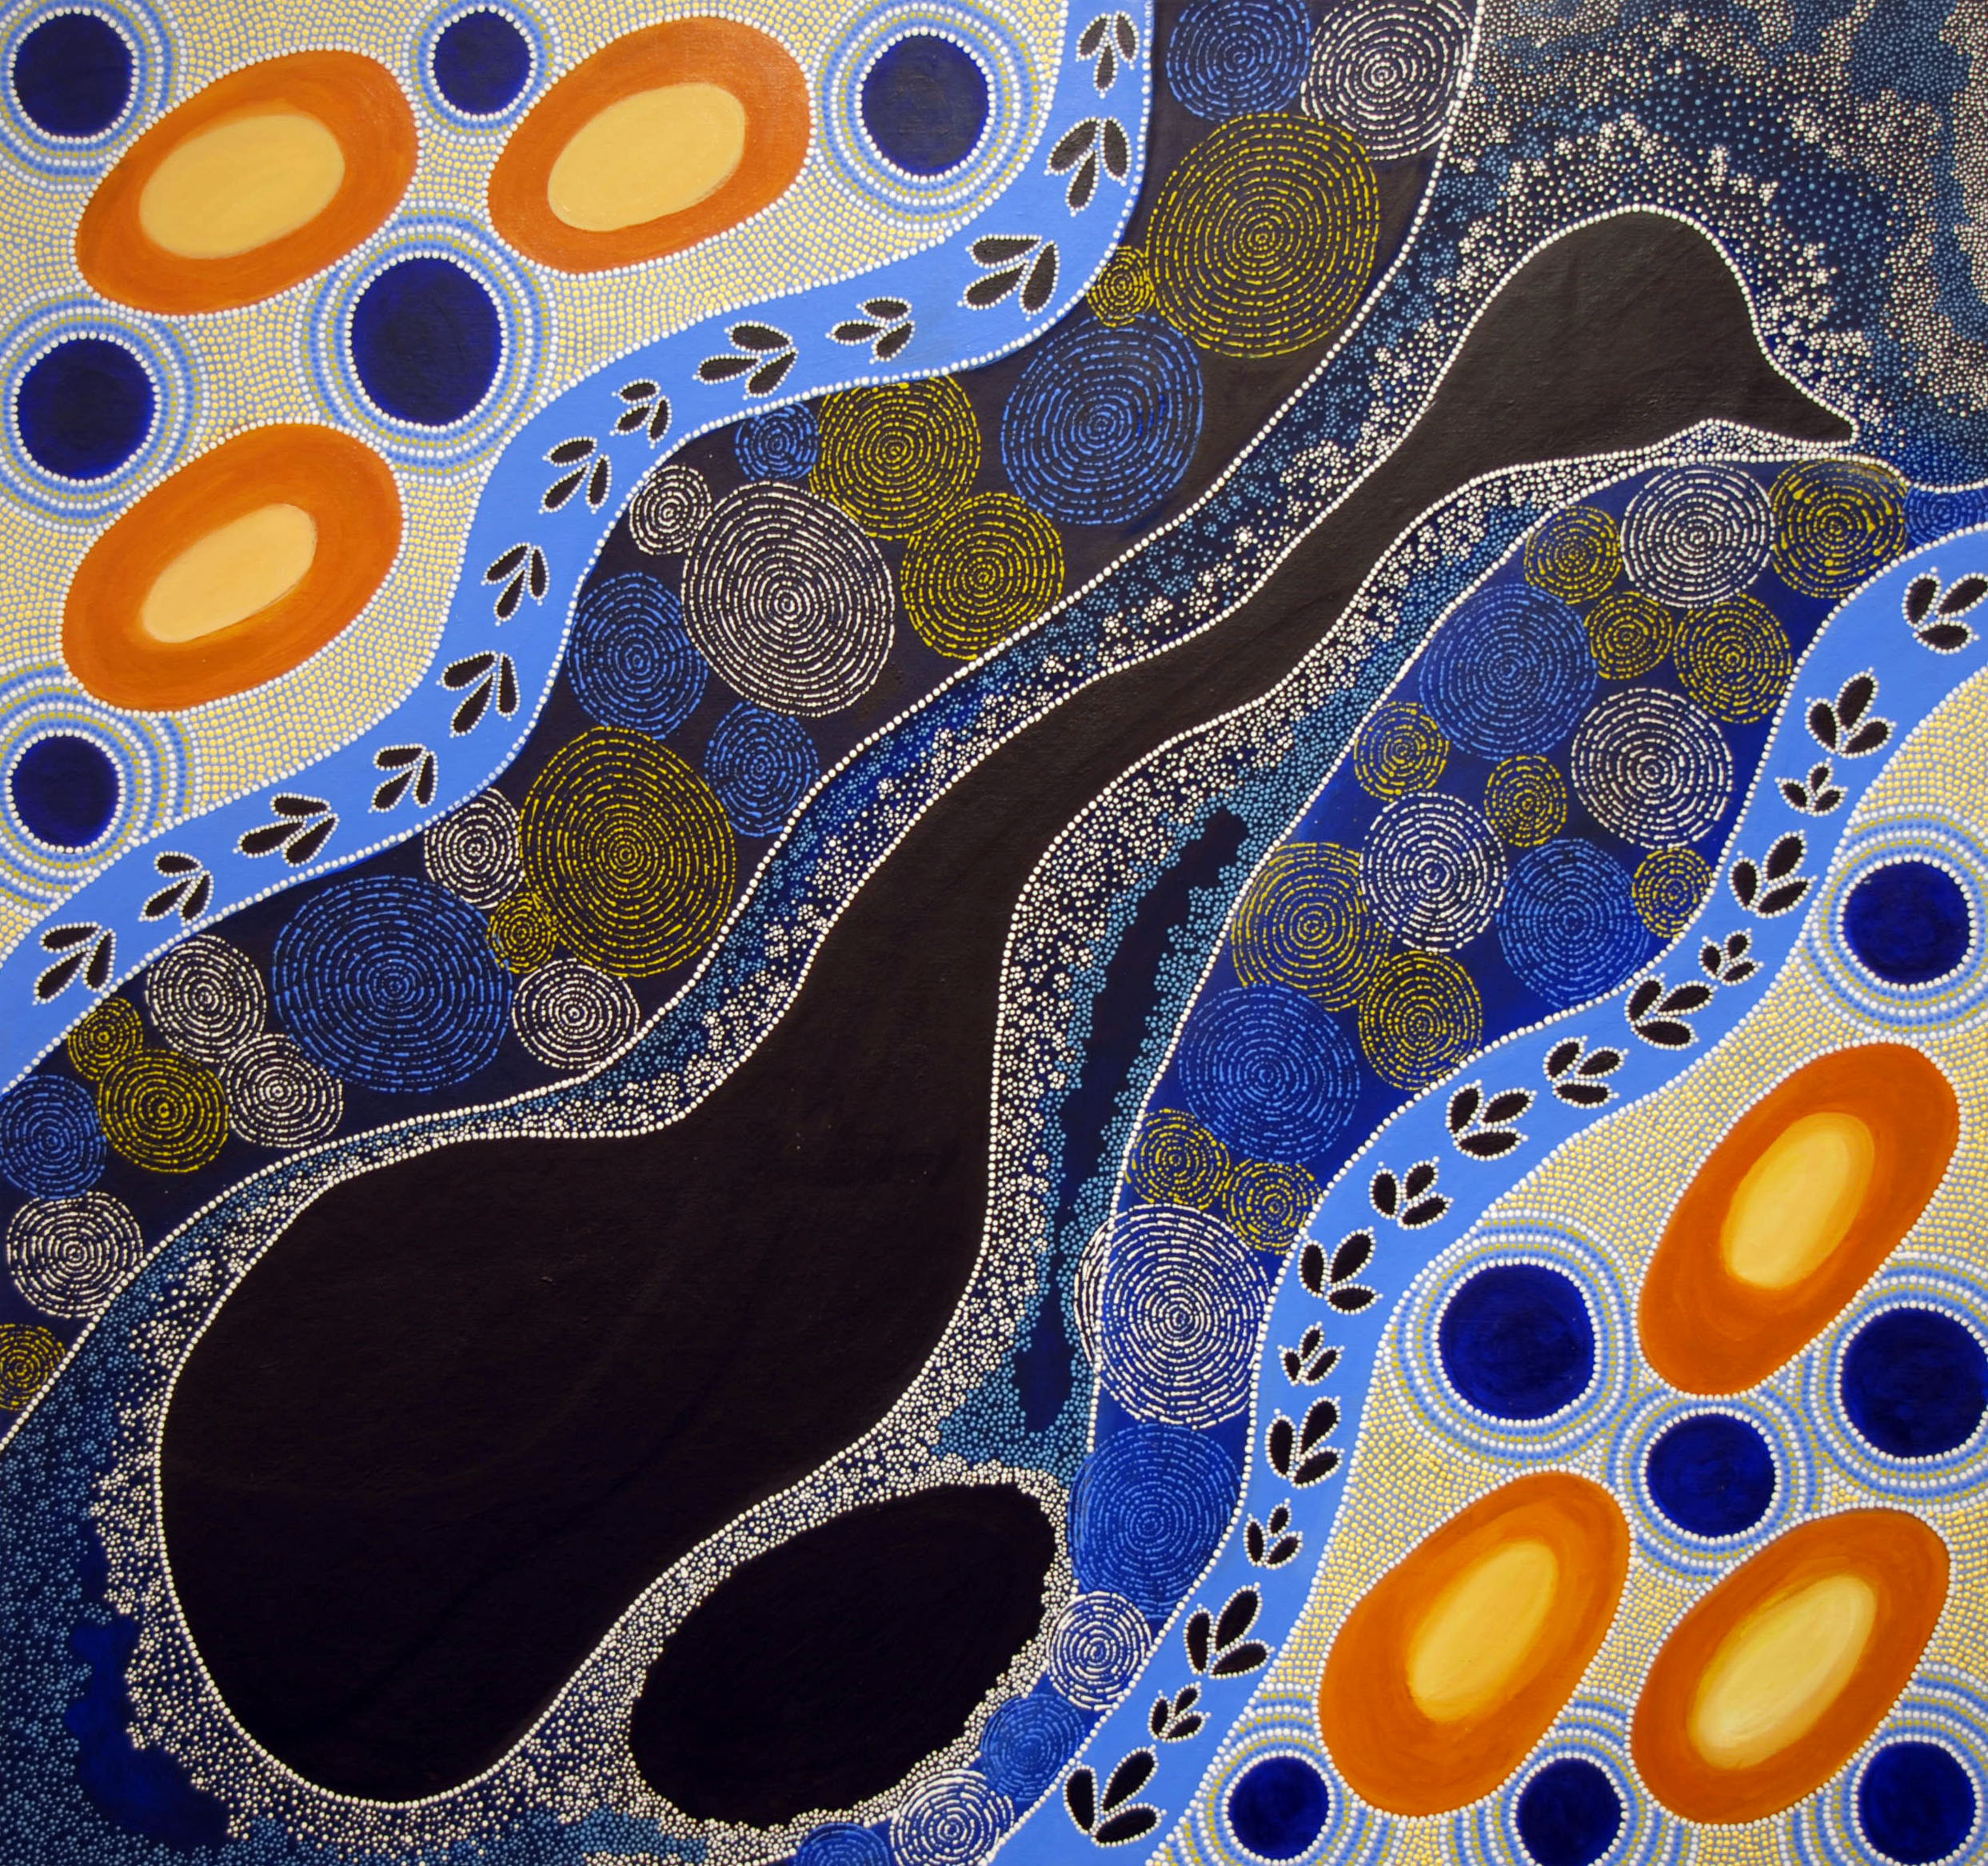
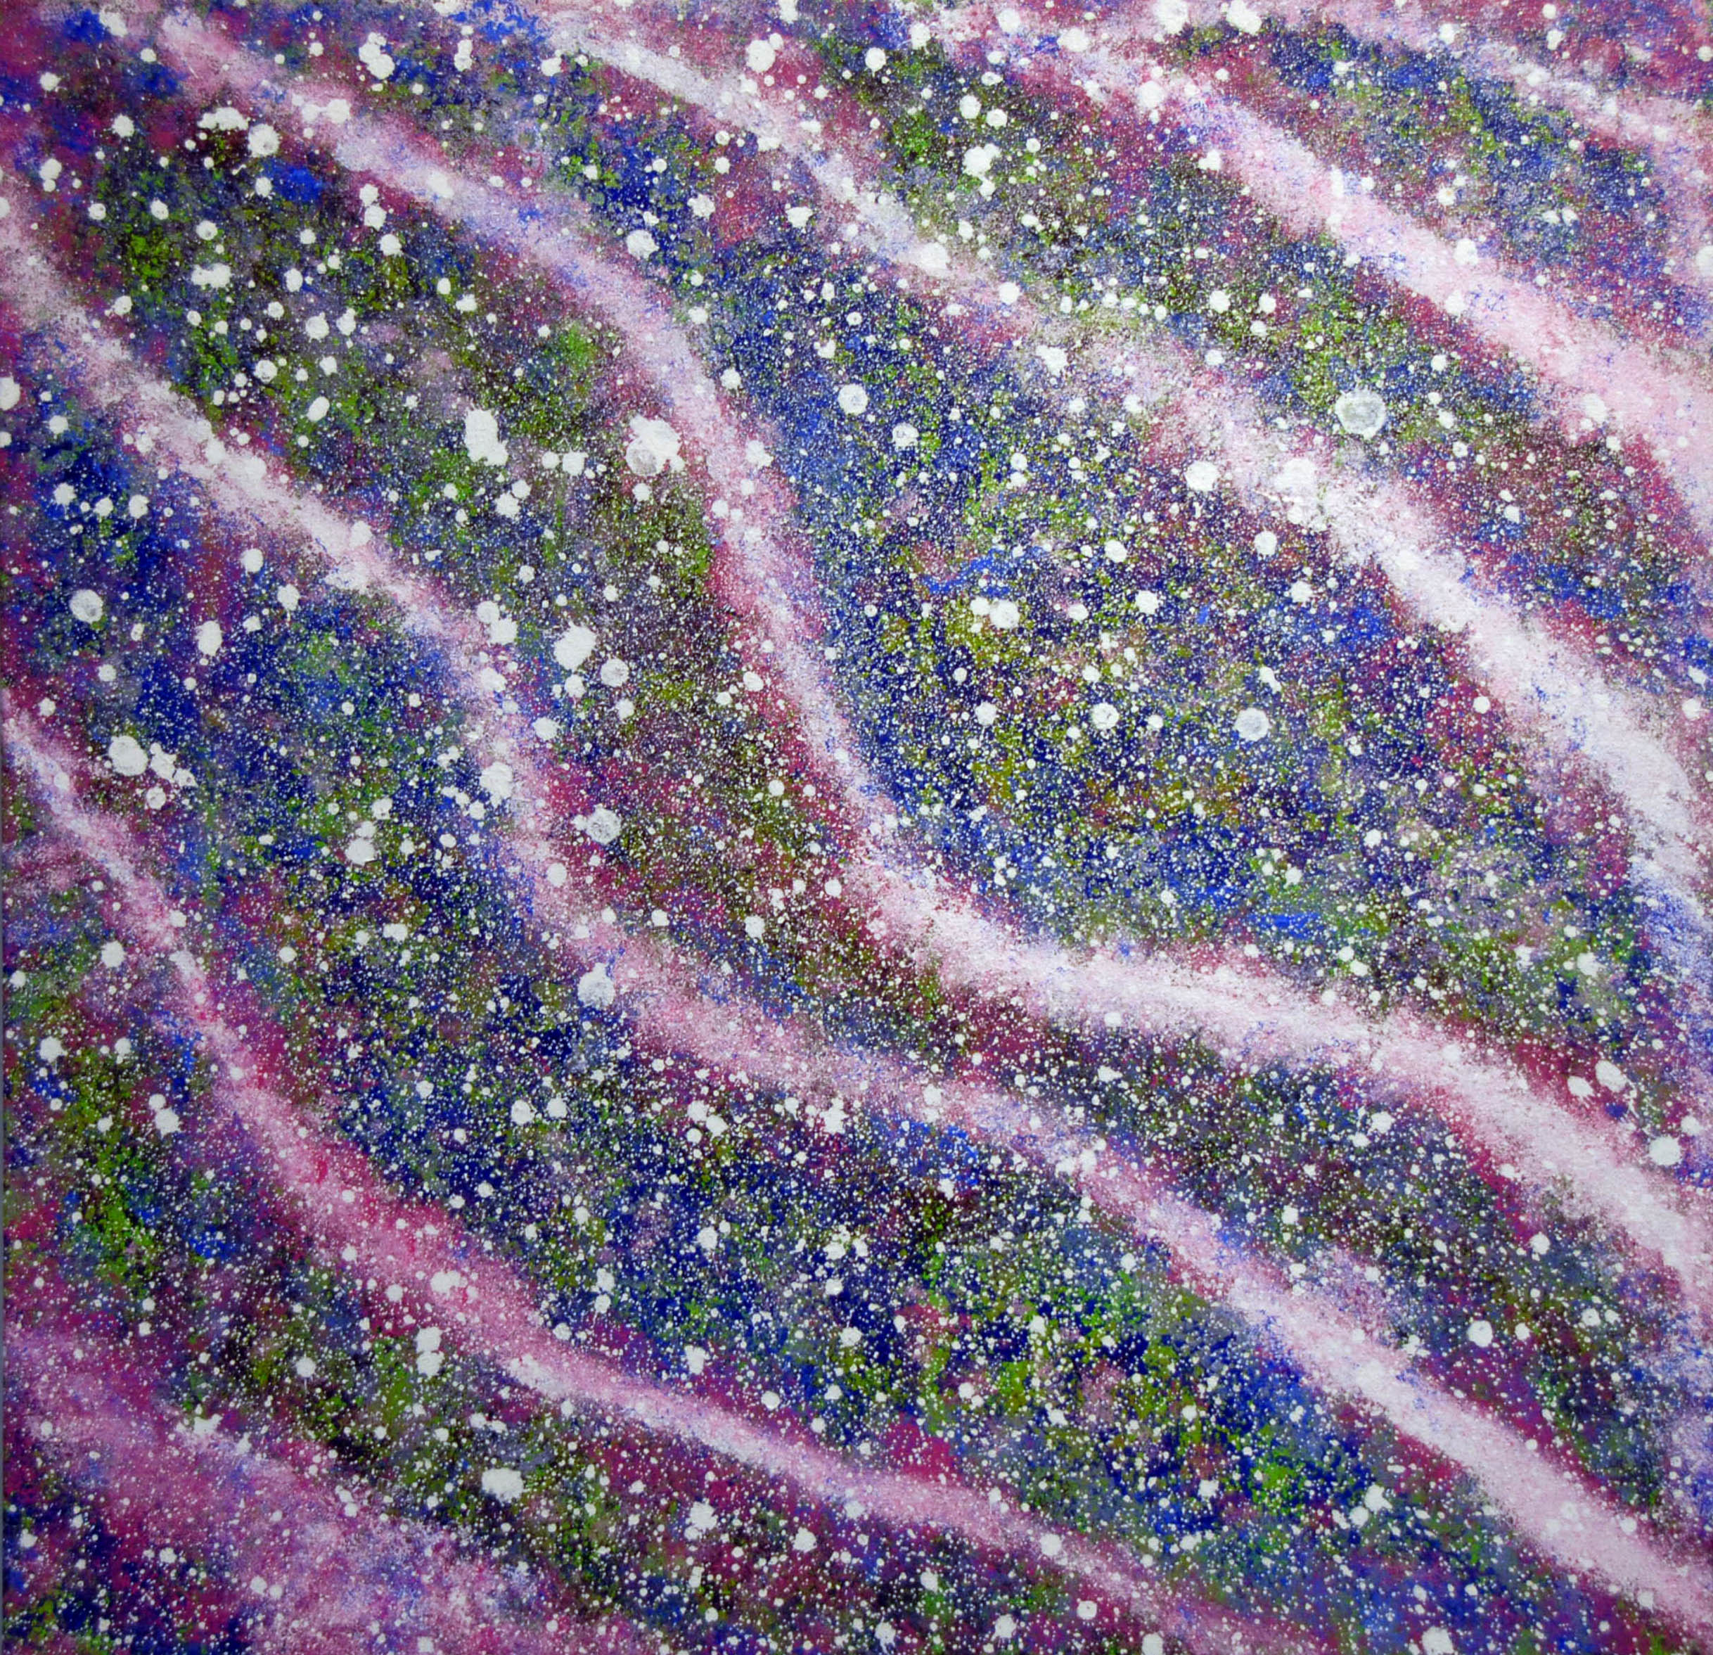
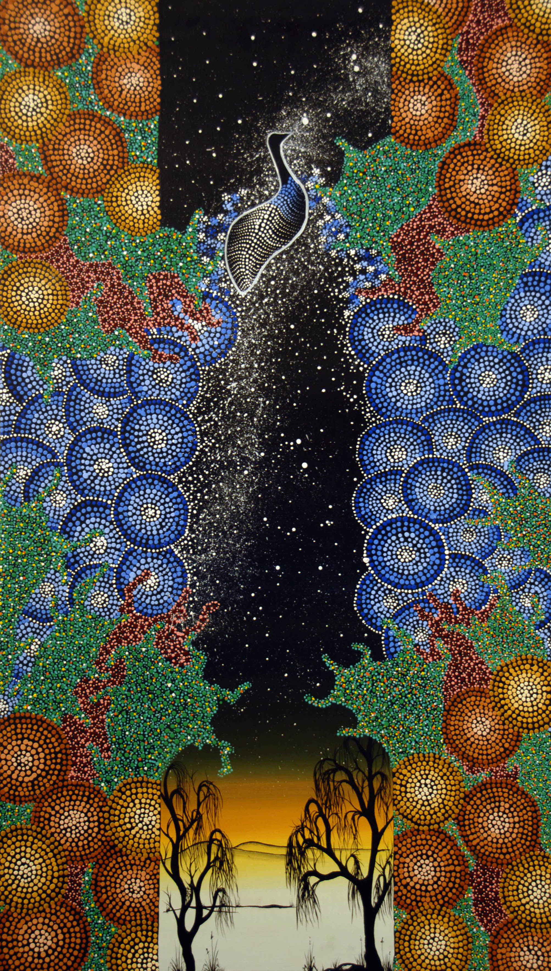
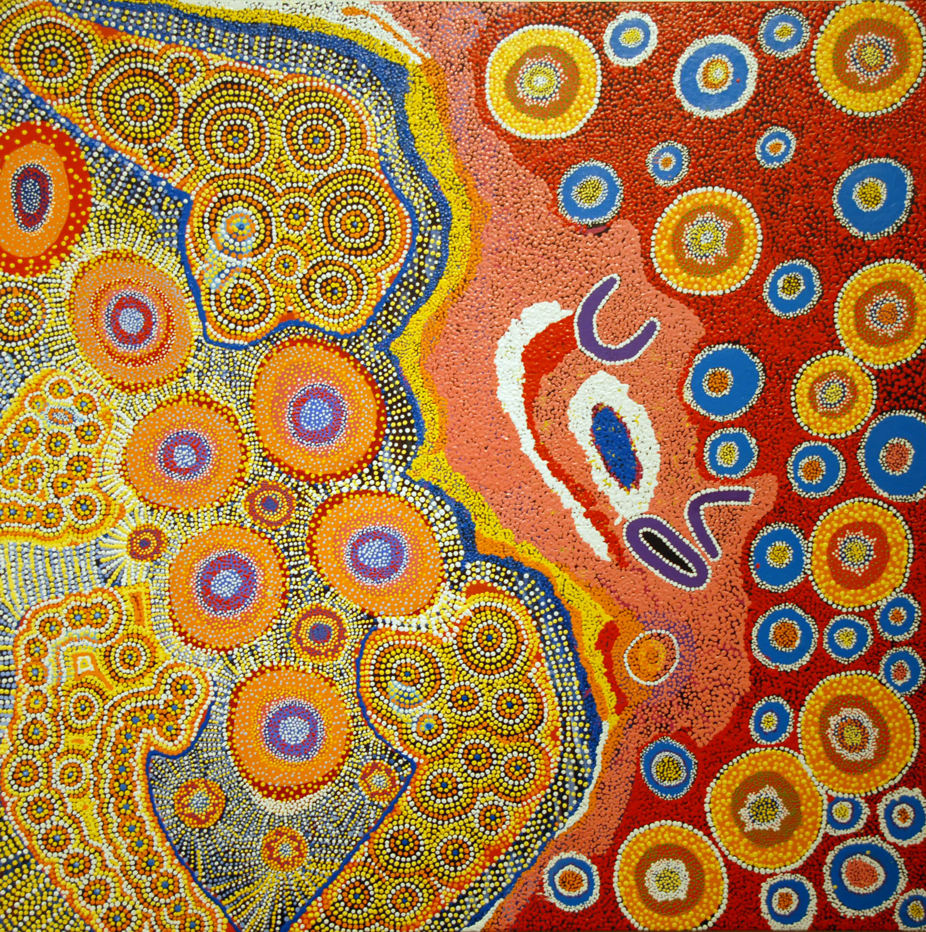
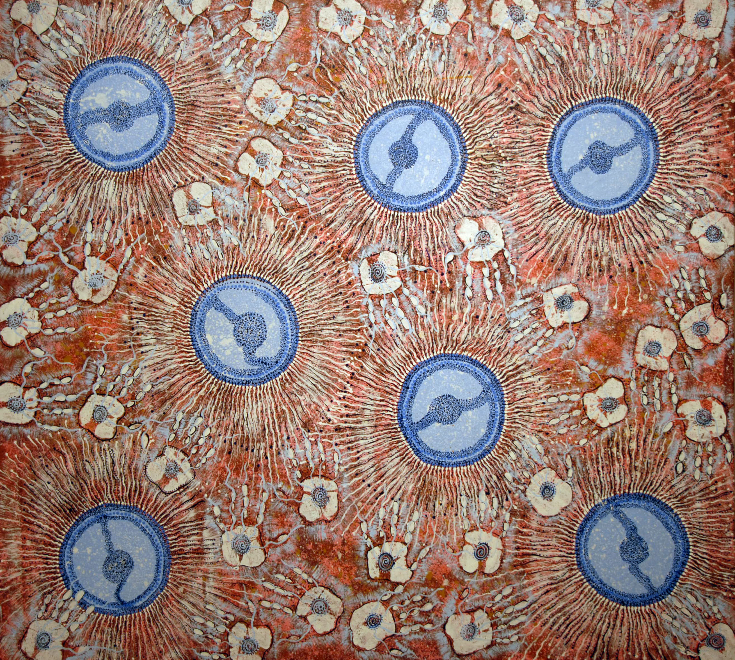
Christine Collard Charmaine Green Gemma Merritt
Barbara Merritt Gemma Merritt Sonya Edney

Slide 16
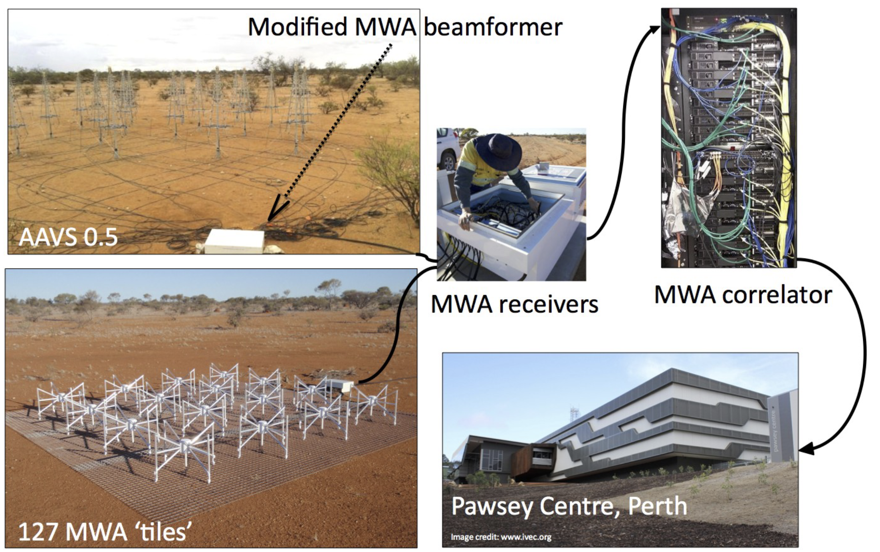
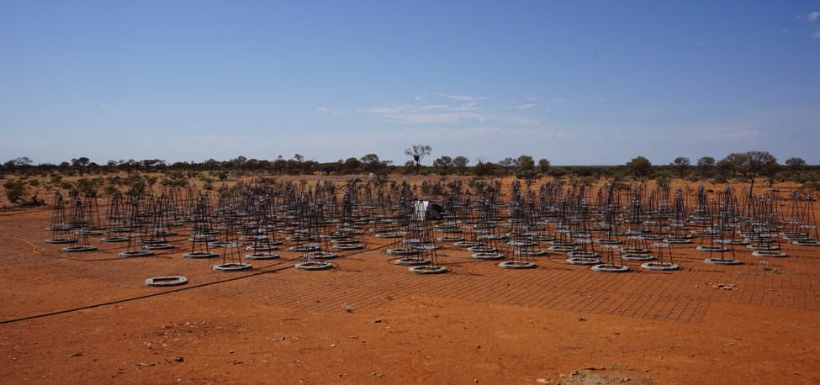
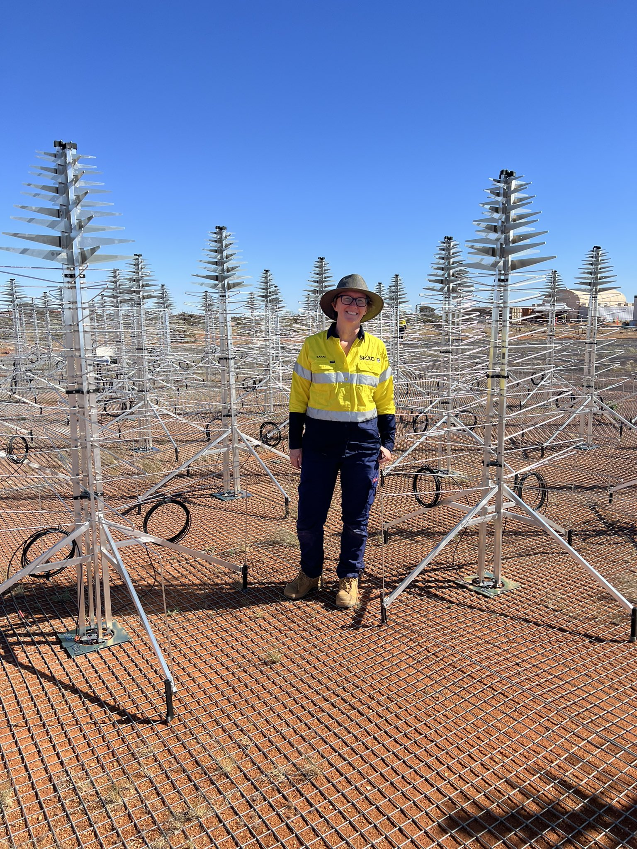
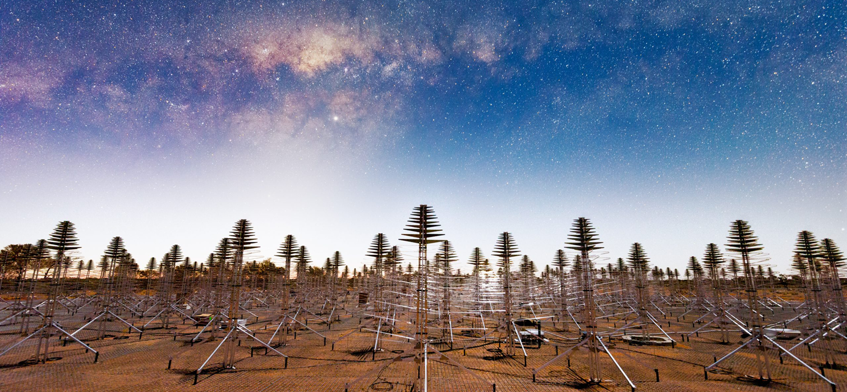
AAVS1
Randall Wayth.
AAVS2
AAVS3

Slide 17
What’s next?
Phase III ambition:
Now till end of the decade, at which point the MWA mission will be complete(??);
256 tiles (32 receivers), all correlated:
  Twice the sensitivity;
  Four times the data!
  Even better uv coverage;
  More flexible modes and parallel paths for signal processing as MWAX evolves.
“Design features” of existing receivers fixed:
  Much better for the EoR.
Host the final SKA preparatory push:
  AAVS3;
  Continue to inform the path to SKA-Low operations and science data processing;
  MWA is the target for the first five years of the $63M Australian SKA Regional Centre.

Slide 18
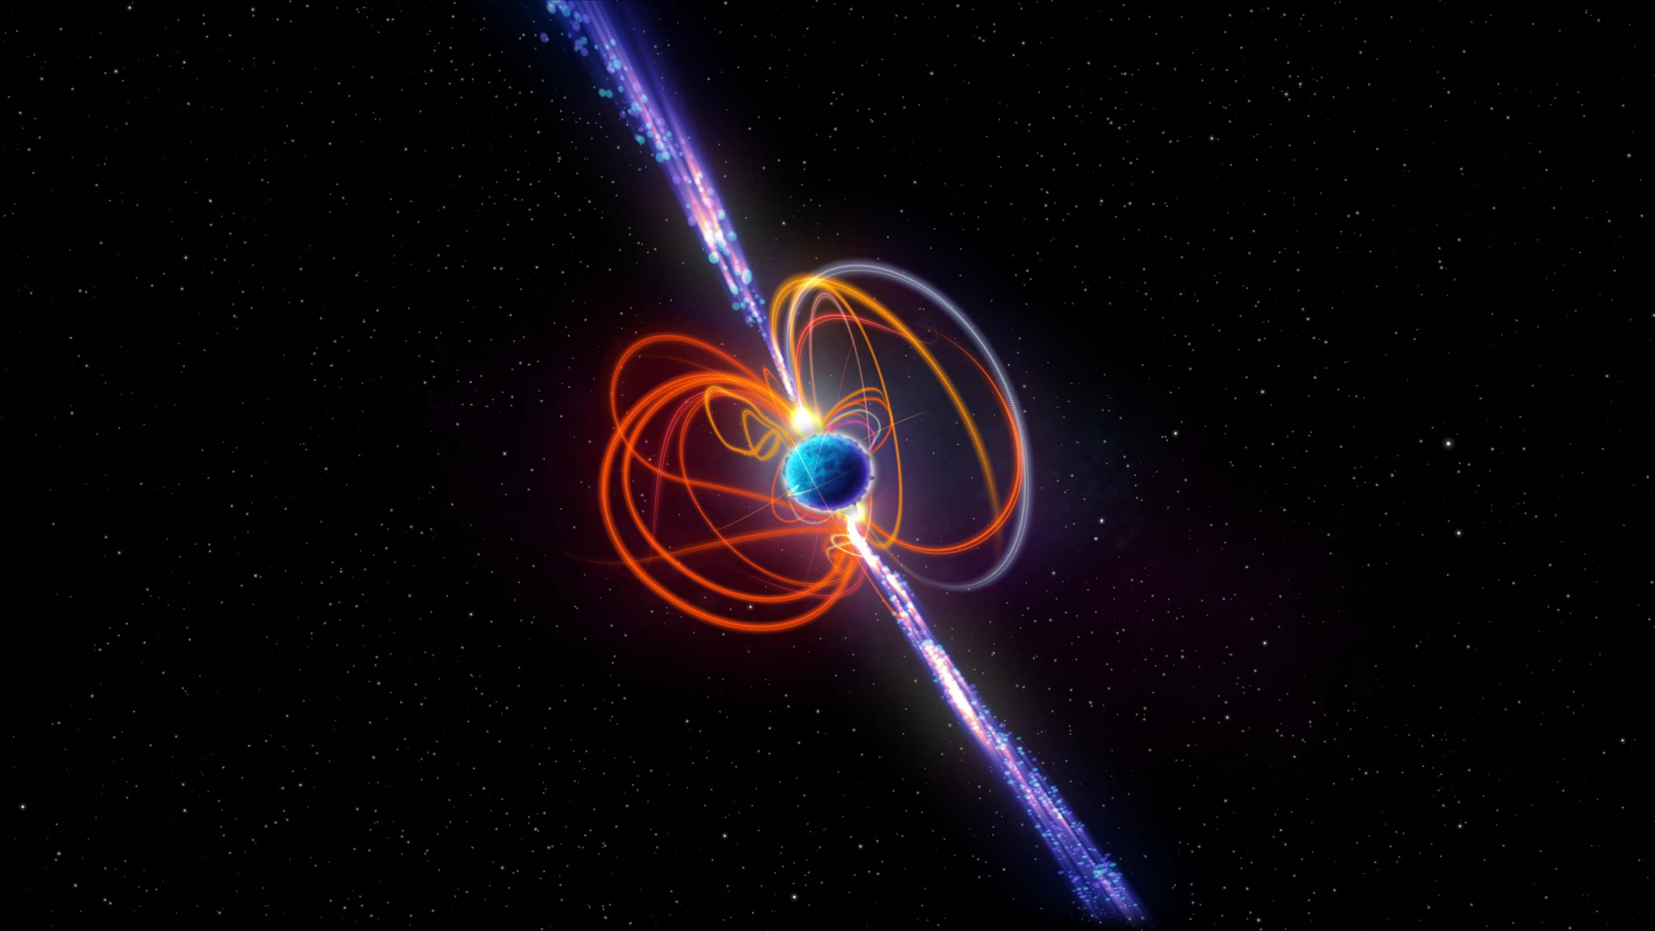
Hurley-Walker et al.

Slide 19
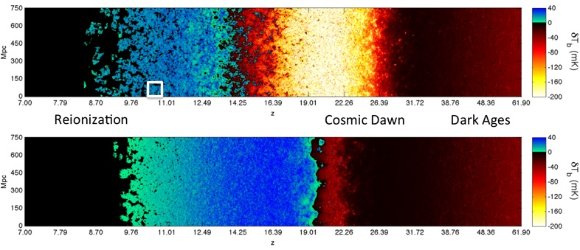
Messinger

Slide 20

THANK YOU ALL, FOR YOUR CONTRIBUTIONS
TO THE SUCCESS OF THE MWA.
ENJOY THE MEETING!

