Slide 1
Science meets Industry!
Notes:
I would like to acknowledge the Wadjuck Noongar elders past present and emerging as the traditional owners of the land on which we meet today and also acknowledge the Wajarri Yamaji elders past present and emerging as the traditional owners of the land on which the project has been built.
To share who we are……… GCo Australia was founded in 2000 by myself and is an Electrical contractor based in Geraldton in the Midwest of WA………… for context we are a short 3.5 hour drive away from the MWA Site at Boolardy Station
Many thanks to Curtin for the invitation to join the 10 year celebration of ops at the MWA and to allow me to share the journey that GCo has been on in the last 15 years with Curtin. I would like to particularly thank Steven Tingay and Tom Booler and their site teams for their continued support during that time. The collaboration between our organizations at all levels has created a relationship based on trust and respect, a successful project on those outcomes alone. Just like to take everyone back for some context.

Slide 2
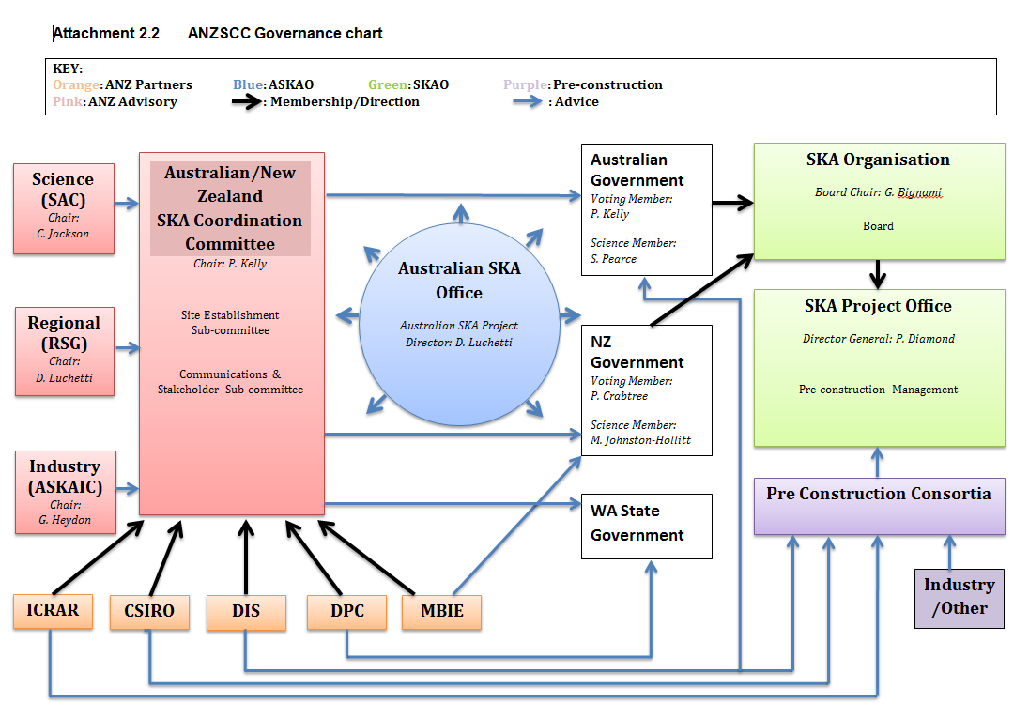
Moving parts…….
Notes:
An old org chart
What I am highlighting here, is the number of moving parts there has been and stakeholders etc in the wider Boolardy site and what the org chart looked like when we first started working with Curtin and the SKA in general…………. it looked unlike any other construction or operations project that I have been involved

Slide 3
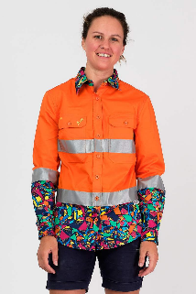
Getting to know you
Notes:
Getting to know you Slide 3 (Einstein)
As we got to engage and understand the project on a closer basis, it became clear that many of the prime stakeholders………. were scientists…… the GCo team had spent its life working with miners, engineers, architects, but never with scientist’s …………whilst sometimes the science project language was challenging……….. the anchor of a common purpose………..essentially a desire to succeed by putting our minds to any challenge came through……….construction IP……….. meets science innovation.

Slide 4
Early Days Oct 2008
Notes:
Early days Slide 04
I recall our first works on site were connecting generators.
Experience of the Projects technical requirements however came to GCo when we came across the term….. radio silence……. and we set about understanding what this meant. The first experience in regards to radio silence was at the onsite facilities, there was no real design or scope………just a requirement… and as you can see it turns out that what seemed a high tech problem had a solution that was based on simple electrical principals, we needed a Faraday cage. Electrical construction met a science project requirement.

Slide 5
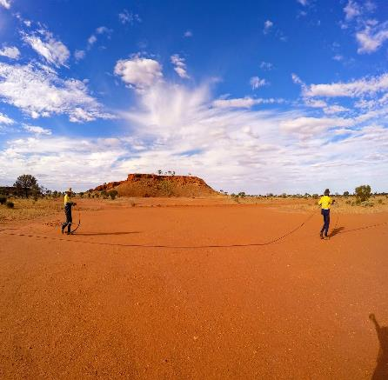
Notes:
Site Conditions and Challenges Slide 05
Whilst at Boolardy Station we have an ideal site to build a radio telescope i.e., radio quietness and nil light pollution…………. it is hardly the ideal site for construction activity. Spectacular in its remoteness and with extremes of weather conditions and seasonal lack of access…….. it is a harsh environment for human habitation………. And equally as harsh as the many remote projects that GCO has delivered in the last 23 years………. full marks need to be awarded to the quality of the camp and its services, provided for our workforce over this time………… the new camp being proposed has big boots to fill.

Slide 6
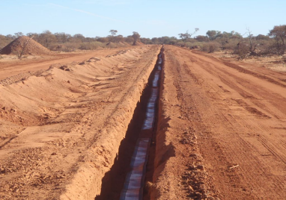
Notes:
Site Conditions and Project challenges Slide 06
Our first significant infrastructure project at the MWA included scope to trench some of the most adverse terrain I have encountered in my 40 year construction career.
In some areas the excavation required was employment of rock saws and engagement of the highest capacity machinery of the day.
As with all construction projects…………. time and budget are of priority, the key to our success was open and honest conversation around time and budget with our client, this was always a 2 way street and in place from the day we submitted the bid for the work…………. to practical completion.
The close collaboration has been the basis of the GCo and Curtin partnership, with numerous scopes of work being delivered in the last 15 years.

Slide 7
Notes:
Project people Slide 07
Projects are only as good as the people that deliver them……… with a can do attitude and applying onsite innovations, safely…………… a solution can be found!

Slide 8
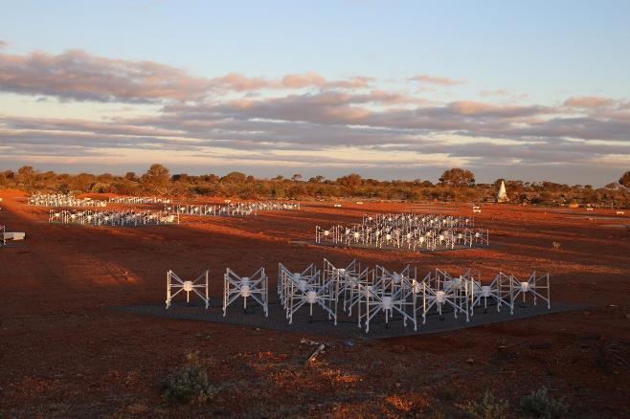
Notes:
LFAA Deployment Study Slide 08
Curtin in 2016 commissioned GCo to provide the SKA Low frequency aperture array deployment study ……..aside from our experience with MWA…….. what did GCo know about delivering a large scale radio telescope… ……… this had never been done before…..as it turns out probably as much if not more than anyone else on the planet………… GCo brought 2 significant pieces of IP to the table to enable a successful completion of this task……………..ONE ….IP from the MWA and our site/ local experience and …two….we had delivered electrical infrastructure on utility scale farms in the past……..principles of which are the same for the LFAA……….only a hand full of construction elements…………..just a lot of them
The study included logistics, materials control/procurement, site facilities, labour force required and a full estimate costing. The study has had several updates as scope and costing and is now with the SKAO.
The IP that GCo has retained from this activity is invaluable to GCo as a local contractor and to the SKA project.

Slide 9
Notes:
ASKAP Slide 9
Being on site at Boolardy has led us to several unique opportunities, you may recognise the ASKAP here which is hosted at Boolardy. Whilst the ASKAP constructor had completed construction scope there was some final pieces with the CSIRO team to ensure the facility was 100% operational. When I become aware of this the approach was simple…….. we don’t know what you need to achieve from an operational or science perspective …….. but how can we help? With our workshops and warehouse facility in Geraldton and onsite experience we completed the installation with Brett and his CSIRO teams………… this was a very satisfying experience for all involved and a piece of IP that a Midwest Business has retained

Slide 10
Notes:
The Future Slide 10
As the saying goes there is only 2 certainties in life….. death and taxes….I do know for certain however that whatever Curtin does on or off site…….. that GCO can a be relied on as a trusted, project enabled partner.
In regard to the SKA project we have forged close ties with the SKAO team….. that has been assembled in Geraldton…………. performing some initial site works to date and hope to be of assistance to SKAO with their deployment of the LFAA. Whilst there is significant infrastructure works about to commence on site there is no guarantee of our involvement, however…… we are on standby.
The long game for GCo is the maintaining of the infrastructure and delivering sustaining capital works to the site into the next 20 years and beyond, as part of our long term aspirations and social license to operate we are progressing with a JV with the Wajarri who are the traditional owners in the region.
Science, traditional owner enablement and our construction expertise stand to make a substantive difference to our local community. The GCo team and I look forward to this next chapter

Slide 11
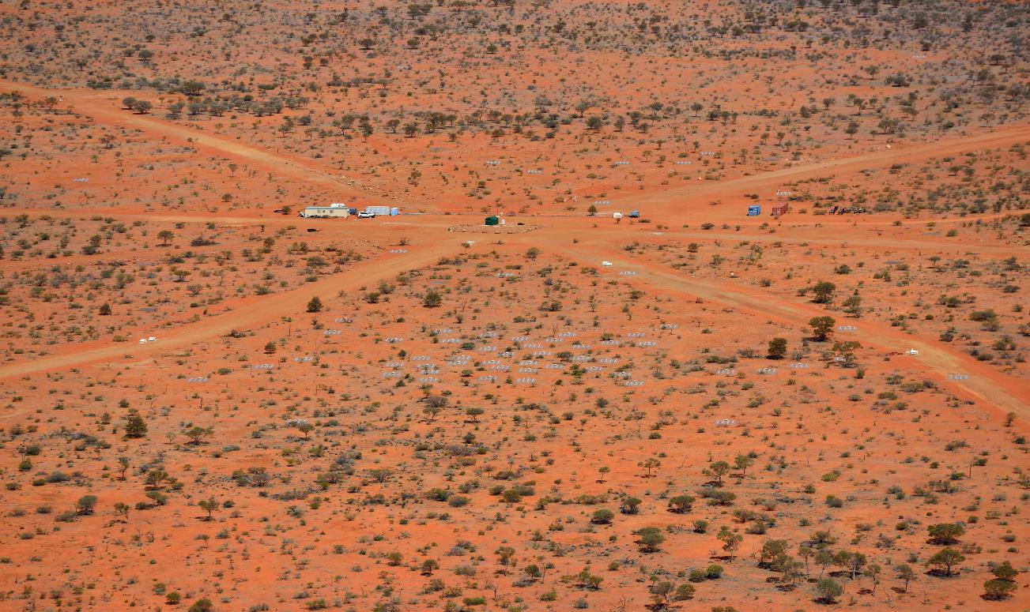
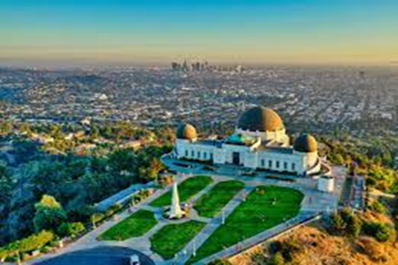
An International Connection
Notes:
International Connection Slide 11
Before closing would like to share a personal experience
In 2019 I was on holidays in the US and found myself in Los Angeles, we had done all the usual sightseeing and I were looking for something a little different when I came across the architecturally impressive decommissioned Griffith observatory, now a tourist attraction
Comment on the photos of the observatory and MWA ie lack of radio silence and isolation for light pollution at the LA site.
I was taking in a display when a guide struck up a discussion………… it turns out the young lady was an astronomy student, I mentioned the MWA and the wider SKA project and the involvement I had with the project infrastructure over the preceeding 12 years……………. she could barely contain her excitement when she thanked me for the amazing data she had been working with that came from the project.
It was then that the reality came home for me that we were indeed a part of a significant international effort.
Thanks for listening.

