Slide 1
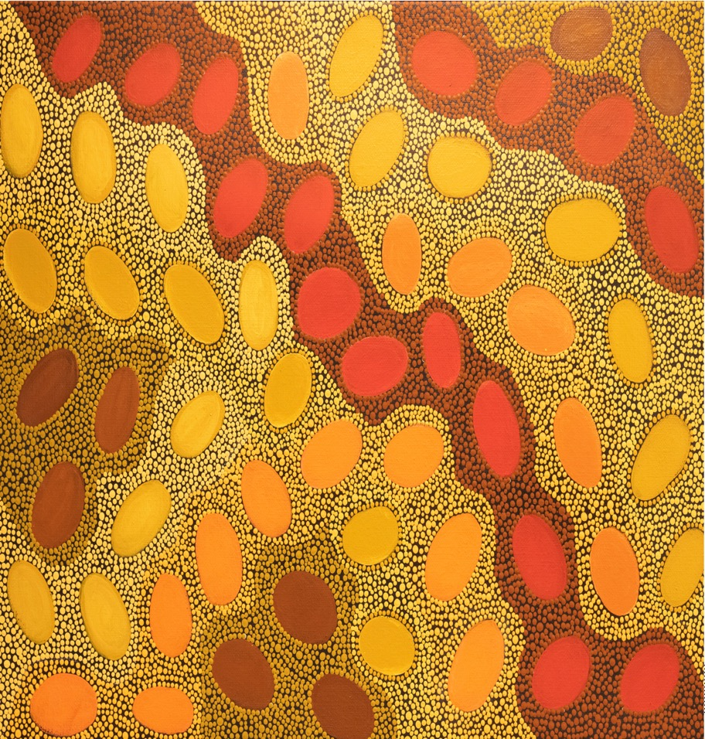
MWA and Pawsey: together for 47 petabytes and counting
Mark Gray and Ugo Varetto

Slide 2
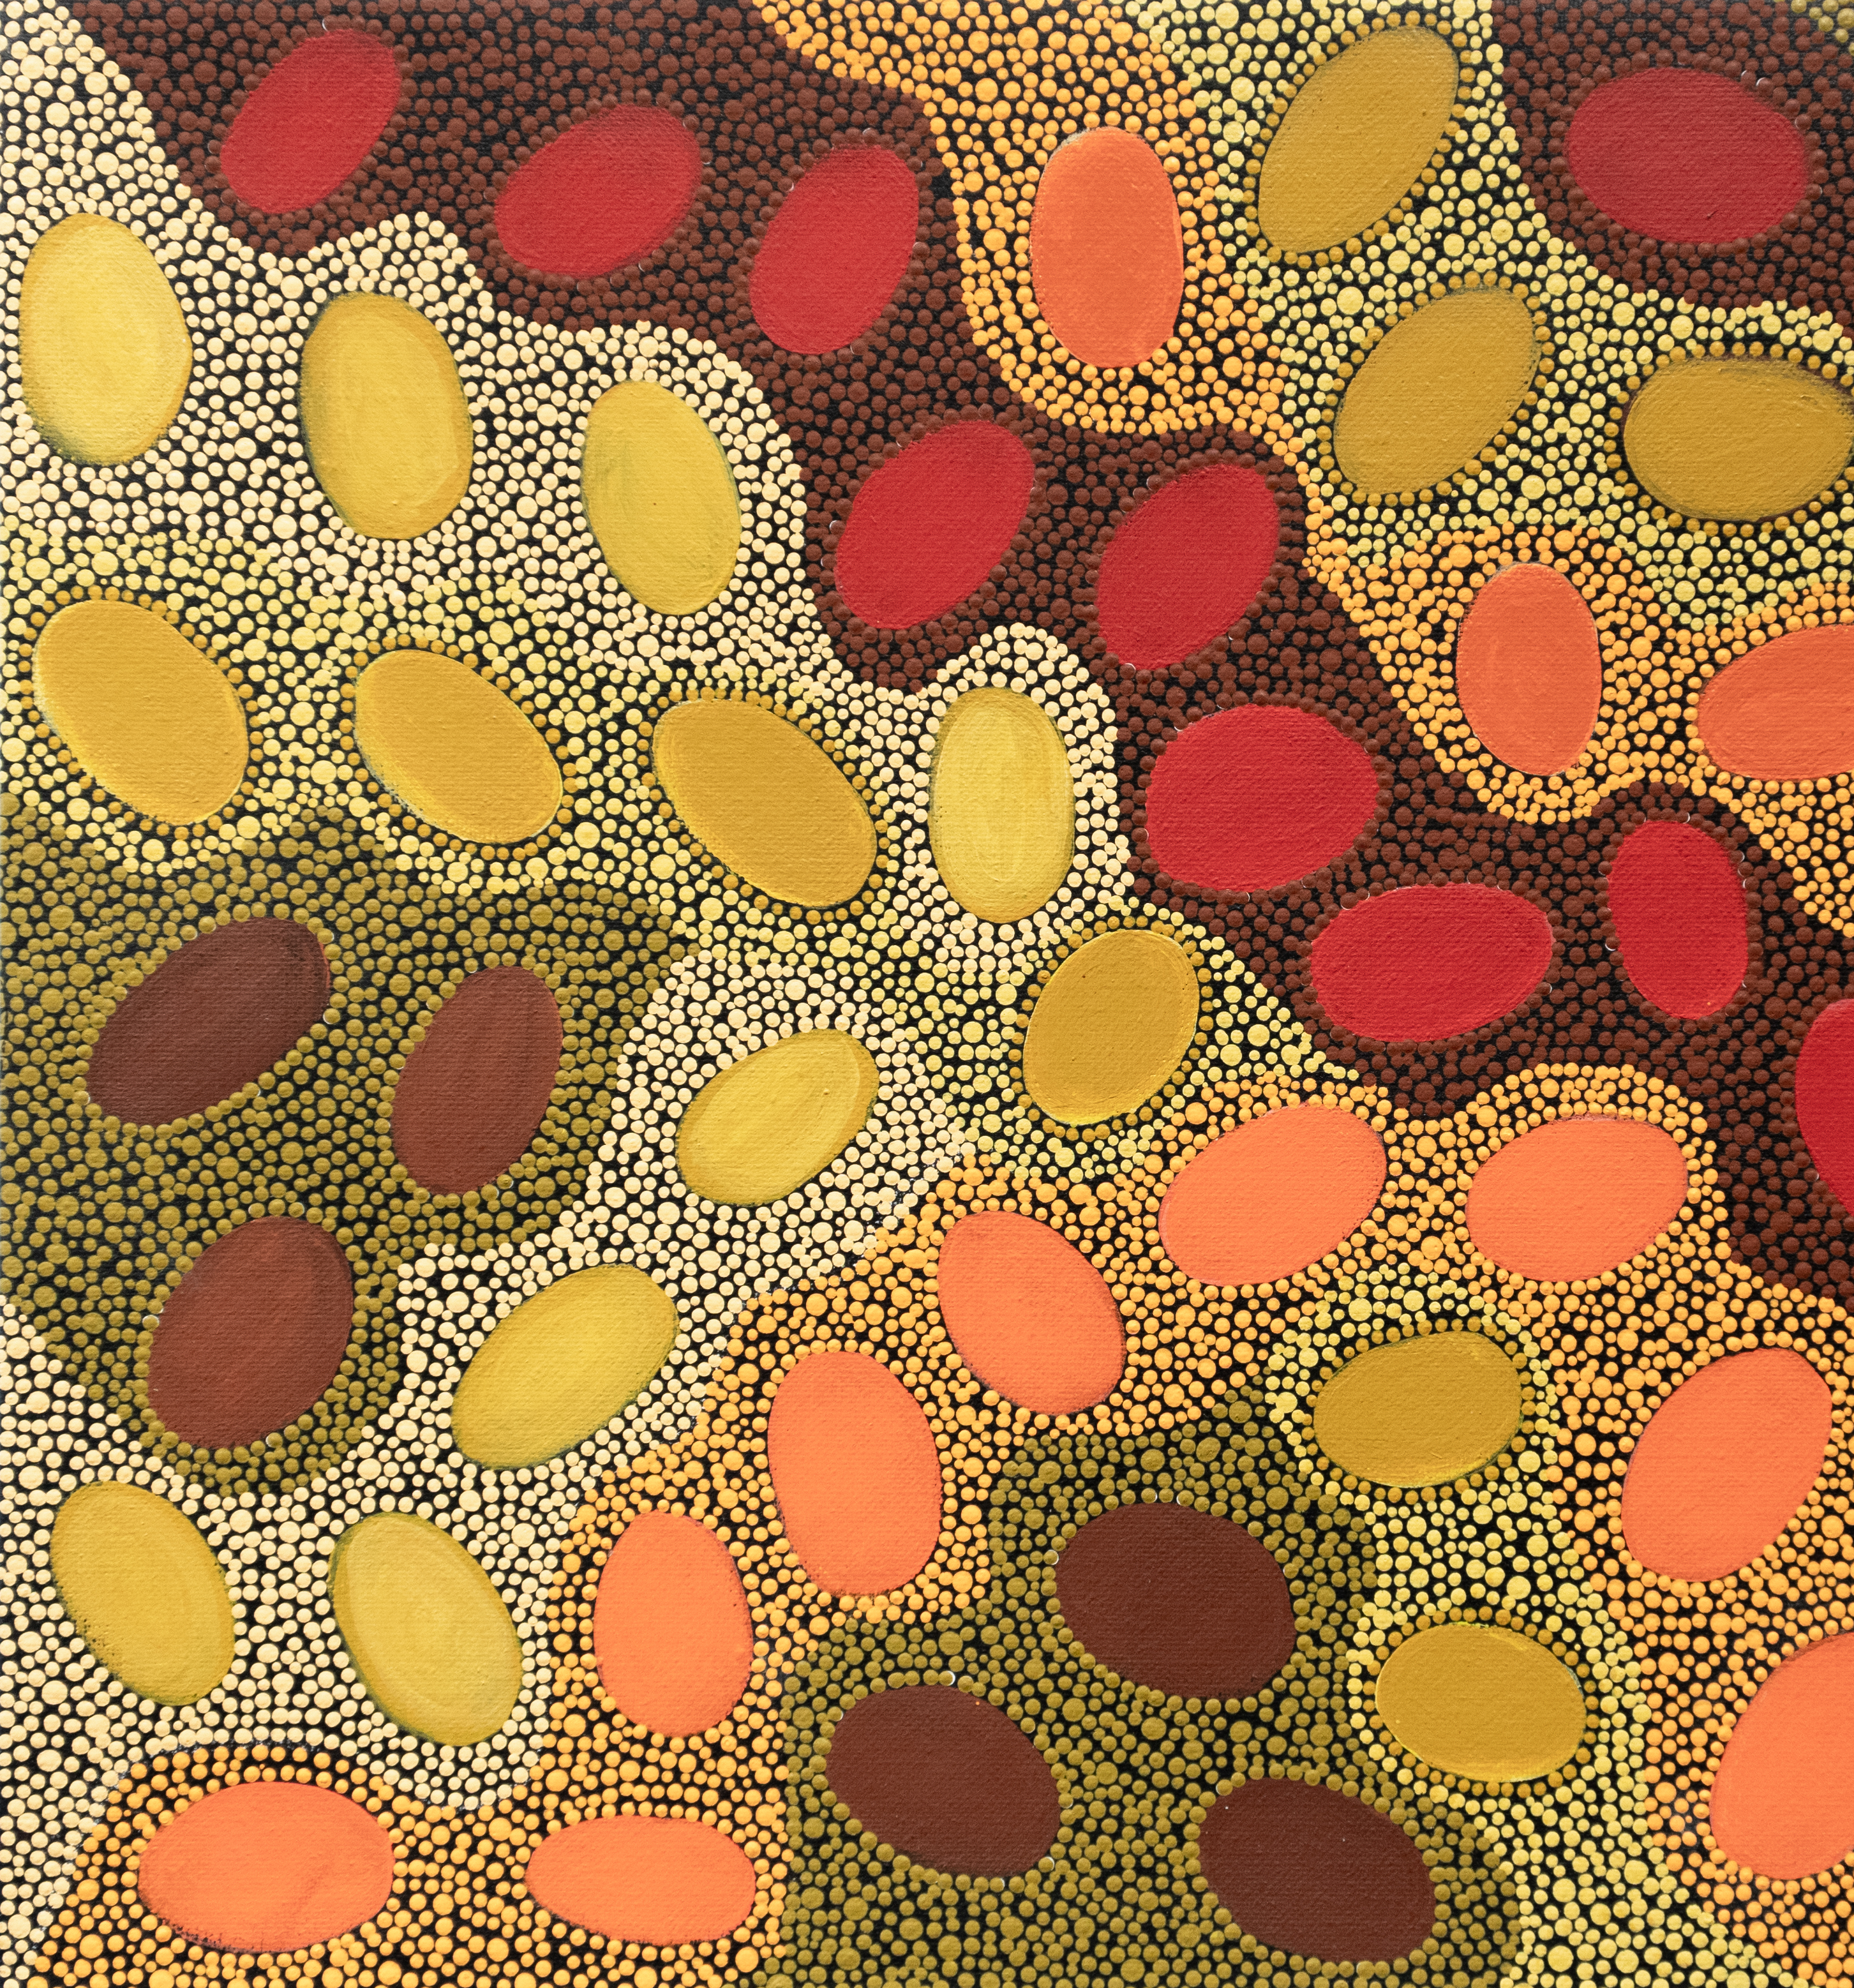


Acknowledgment of Country
Meteorites by Wajarri Yamatji artist Margaret Whitehurst
Ngaala Kaaditji Noongar moort keyen kaadak nidja boodja
I acknowledge the traditional owners of this land, the Noongar Whadjuk People– their ancestors and elders, past, and present – as the original custodians of this land.
Notes:
Acknowledgement of Country – the Whadjuk Noongar people and indeed the First Nations people across Australia on whose lands we are privileged to live and work.
We proud to celebrate not only the world’s oldest living culture but the 60,000-year-old unbroken tradition of human endeavour and scientific discovery.

Slide 3
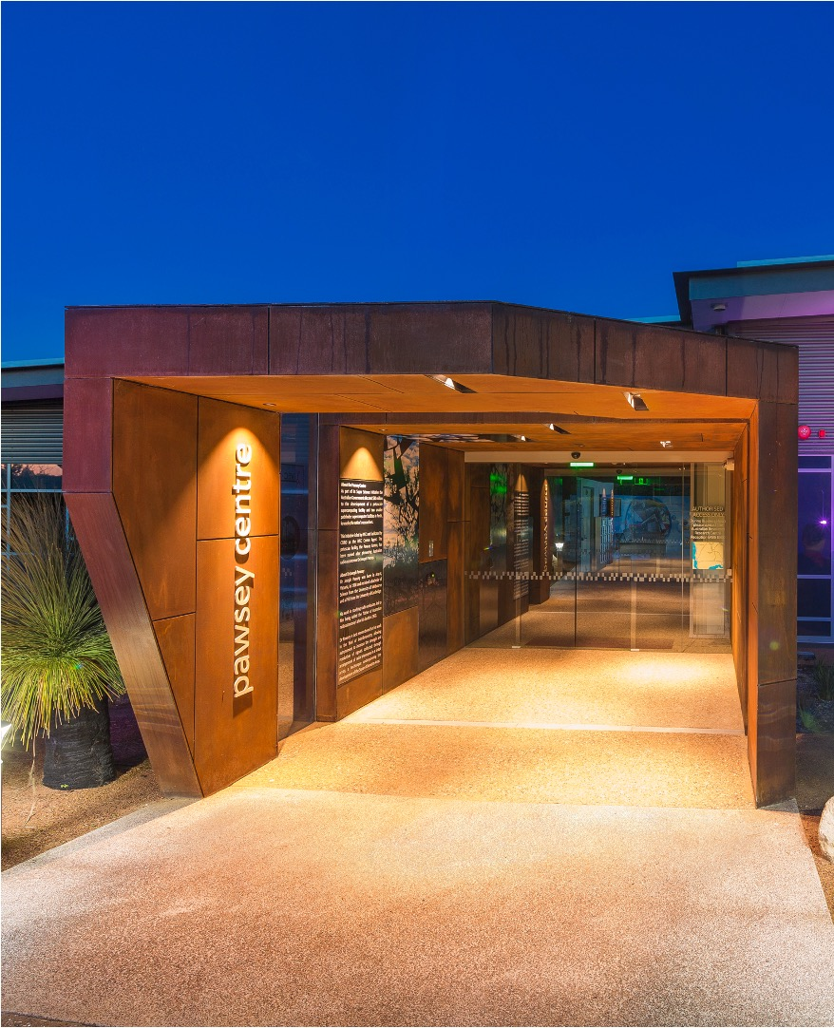
A Partnership for HPC
An Australian National Tier-1 Facility
Headquartered in Perth, Western Australia on Whadjuk country
Launched as Pawsey in 2014, UJV foundations back to 2000
Critical infrastructure for Square Kilometre Array (SKA) in WA on Wajarri Yamatji country, 800km north of Perth (Prime Minister’s April 2021 $387m announcement )
AU$70m capital refresh by Australian Government
60+ Staff employed via CSIRO, national science agency
MWA and Pawsey
Notes:
Welcome to the Pawsey Supercomputing Research Centre.
We pay our respect to the traditional owners of this land, the Whadjuk people and their culture, and to elders both past and present.
We’ve come a long way since 2014, lets start by talking about storage.

Slide 4
The Storage journey at Pawsey
2011 Initial Procurement | SGI Systems; robots libraries and 20PB tape | $8.4m
2016 Tape uplift | 64 TS1150 Drives and 20PB tape | $2.4M
2017 Tape purchase | JD Tape Media | $1m
2018 Tape purchase | JD Tape Media | $1m
2018 MWA Expansion | 1.68 PB CXFS, Servers, 4.2PB Zero Watt | $1m
2020 Capital Refresh Tape | 26 PB JD Tape Media | $1m
2020 Additional Tape | 14 PB JD Media | $.4m
 | 140 PB (Raw) | $15.2m
…next stop: The Capital Refresh
MWA and Pawsey
Notes:
In the later stages of the operation of this architecture, the seams were realty starting to show. Throughput, latency and especially reliability were great concerns,

Slide 5
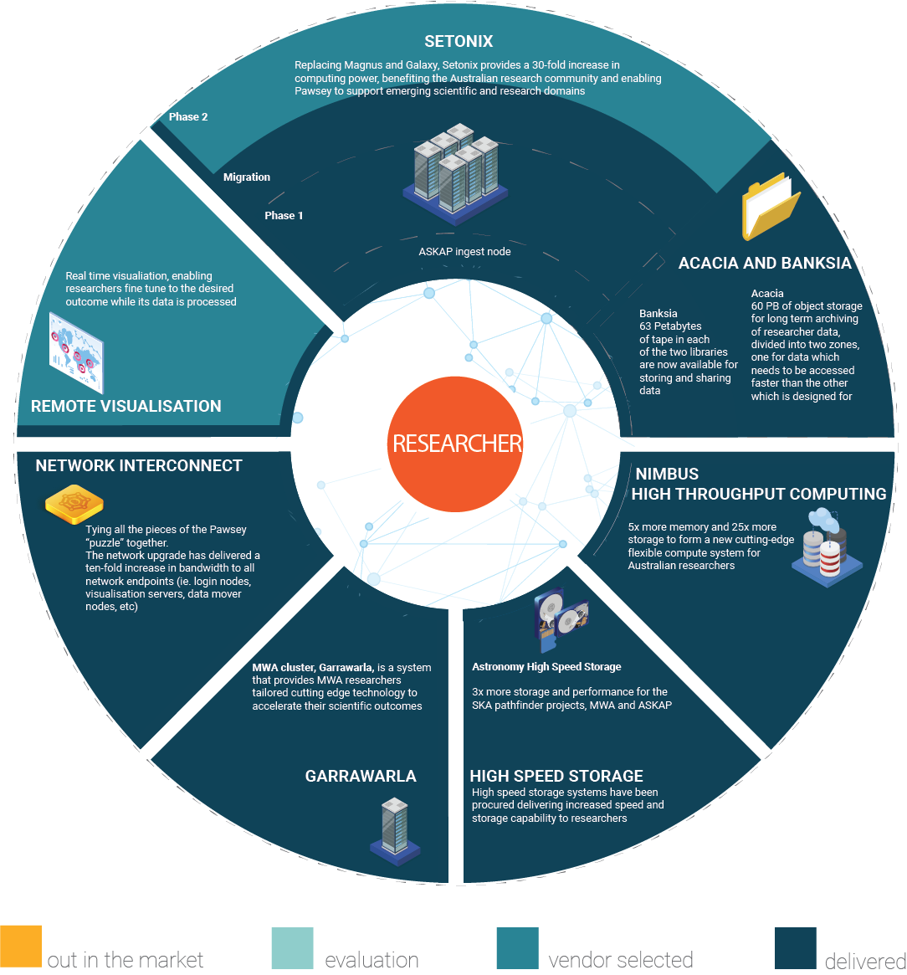
The Capital Refresh and The Process
Technical Reference
User Reference
Contract and Finance Reference
Change Management Reference
MWA and Pawsey

Slide 6
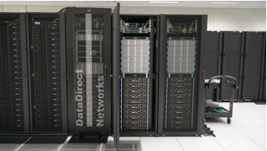
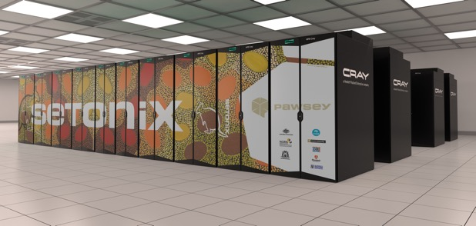
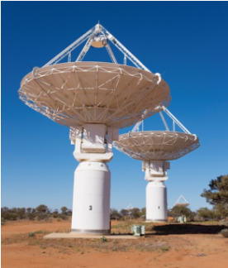
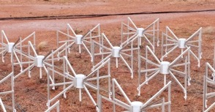
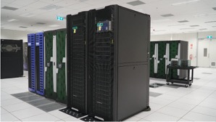
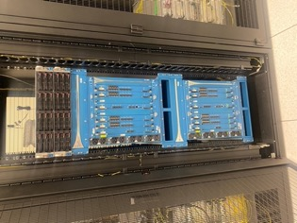
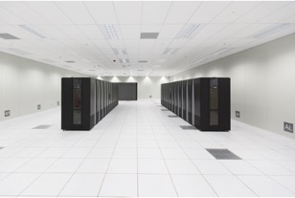
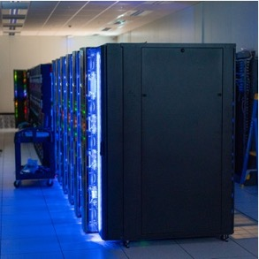
9PB Ceph storage
3000+ vCores
200,000+ Cores, 700+ GPUs, 100Gbps
MWA and Pawsey
Nimbus (Cloud)
Setonix Supercomputer
ASKAP Ingest
Garrawarla
100 Gbps
100 Gbps
10 Gbps
10 Gbps
100 Gbps
S3 Interface
100 Gbps
External Firewall
Fibre Channel
100Gbps
70 PB tape system
60+ PB Ceph Object Store
Advanced
architecture
Notes:
Setonix is also the centrepiece of our refreshed architecture, which has been designed to accommodate the growth we see now and into the future.
Other elements of our system include the Acacia storage system which offers 130 petabytes of online and offline storage.
Pawsey is also moving from a monolithic single-core router to a spine-leaf architecture with a 400Gbps backbone and 100 Gbps links to host endpoints.
The network has been designed to be expandable to support the Ceph-based object storage platform as well as integration with Setonix.
Importantly, this will enable a ten-fold increase in bandwidth from moving from 10 Gbps to 100 Gbps ethernet.

Slide 7

PACER: extreme scale computing
Strategic 3-year Partnership Program
$3m program providing early access to tools and infrastructure, co-funded postdoctoral and PhD roles plus Pawsey expertise
10+ projects, 18 institutions, 60+ researchers, national and international collaborations
Knowledge sharing at Pcon 2021 - https://pawsey.org.au/pacer-changing-the-science-and-research-landscape/
MWA and Pawsey
Notes:
BLINK and you’ll miss it: blazingly-fast all-sky radio astronomy pipelinesDr Marcin Sokolowski
HiVIS: Delivery of a next-generation data storage approach to unlock deep SKA and pathfinder observationsDr Martin Meyer
PIGI: Parallel interferometric GPU imagingProfessor Melanie Johnston-Hollitt

Slide 8
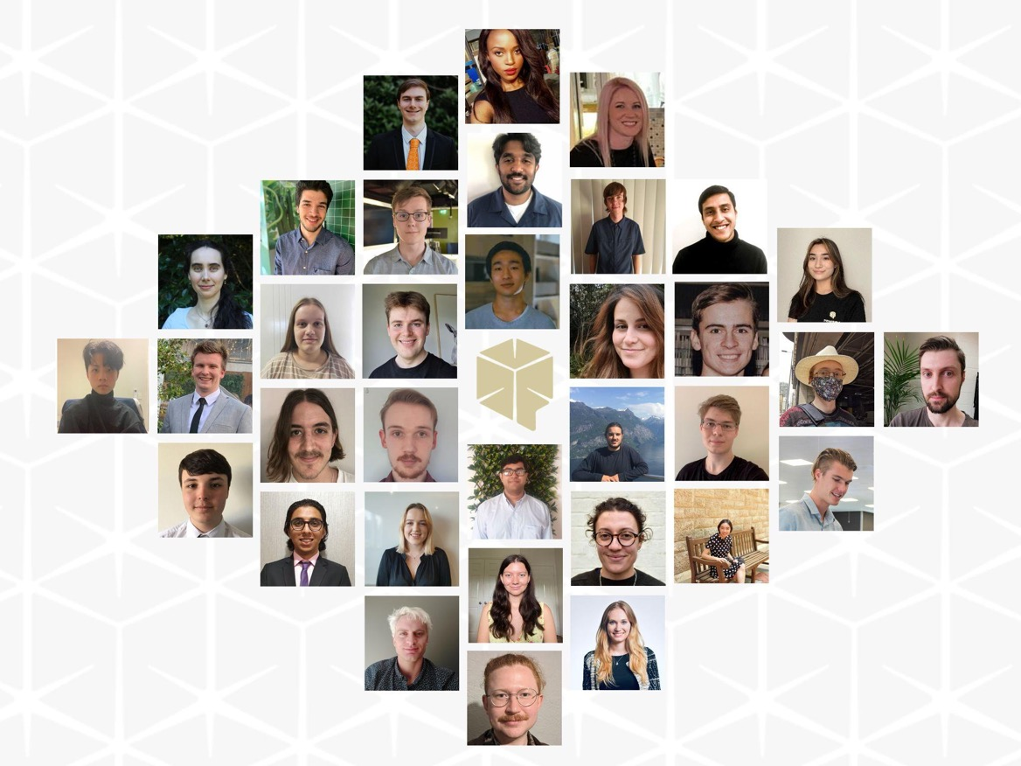

Supporting our Future Leaders
Education and Training Update
Pawsey Internship Program success stories
Launch of Learn@Pawsey – data science education
Launch of DResSA - Digital Research Skills Australasia https://dresa.org.au/
MWA and Pawsey

Slide 9
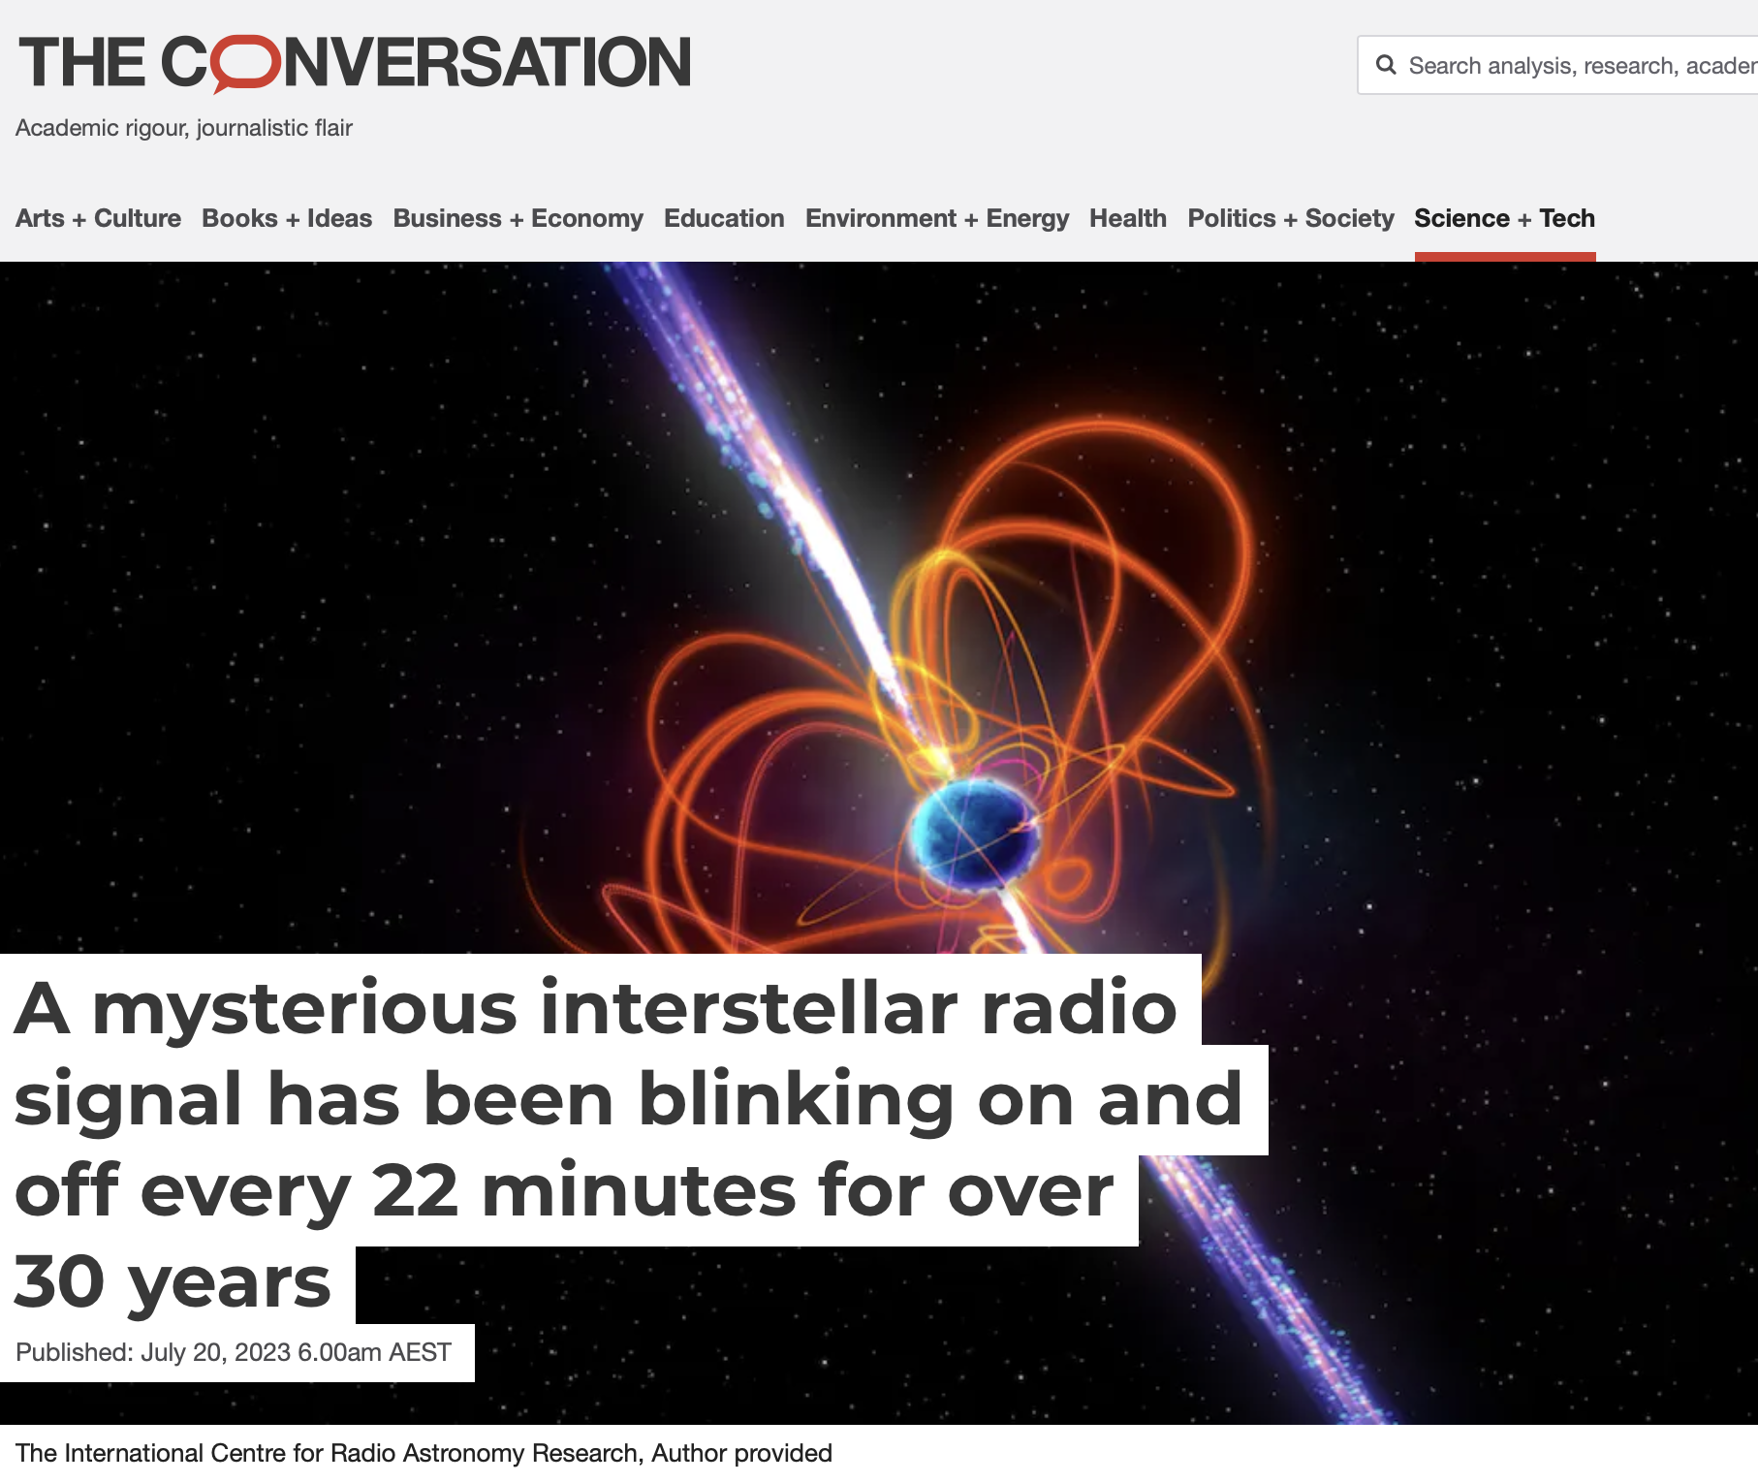
Outcomes: World Leading Science
MWA and Pawsey

Slide 10
Outcomes: Leading science culture in Australia
Lin and Francis, AERO Forum 2023
MWA and Pawsey

Slide 11
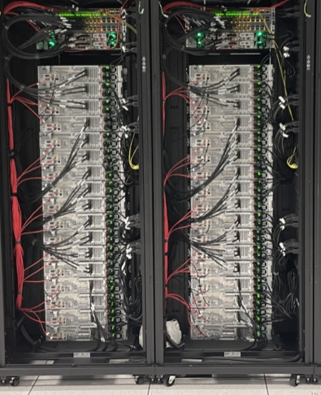
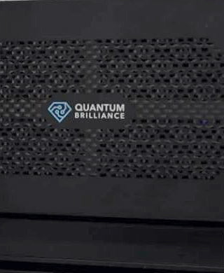
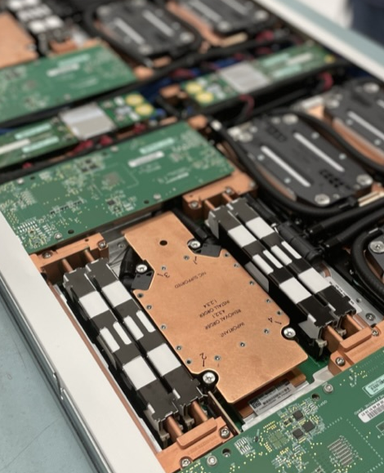
The Foreseeable Future
Expanded Storage
Quantum Technologies
The Next Chapter
More object storage for research datasets. Partially funded through ARDC/AAL/MWA
We’re investing in new technologies and working with novel Australian companies
SKA and future national digital investment; growth in storage and compute.
MWA and Pawsey

Slide 12
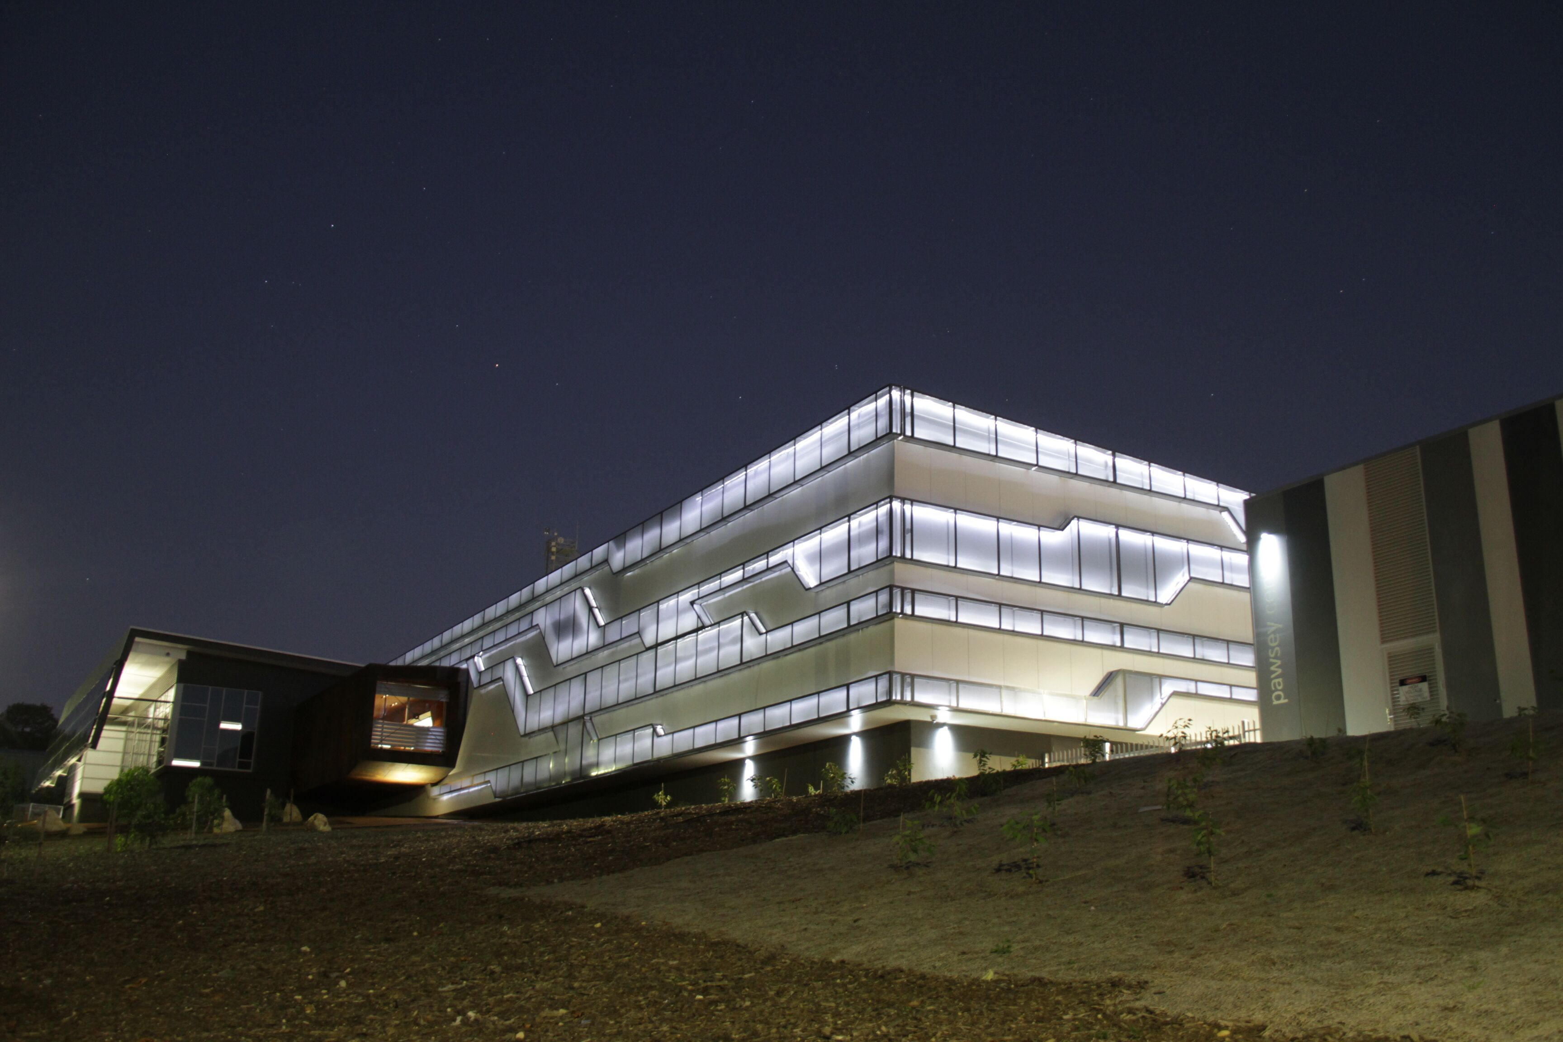

Q&A

