Slide 1
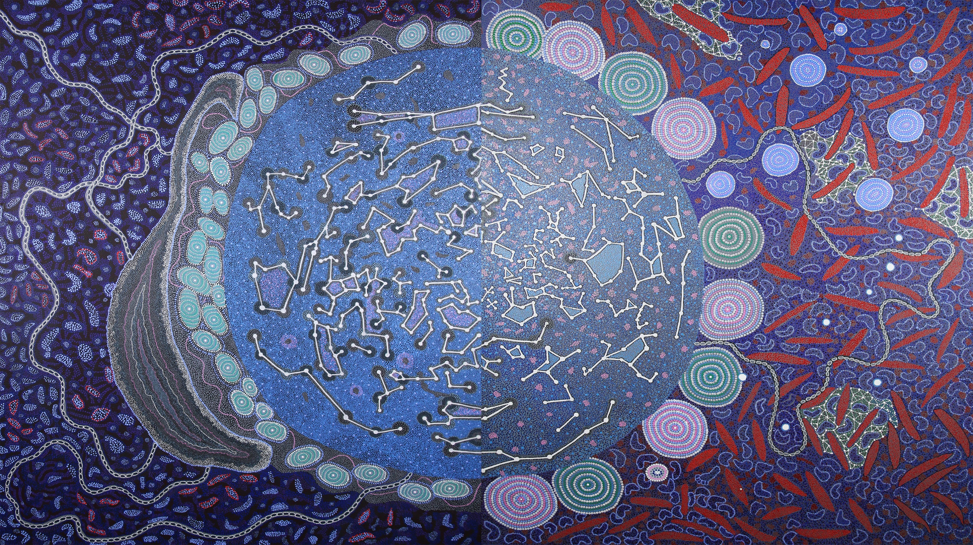
YAMAJI ART – A Journey of Cultural Astronomy

Slide 2
Yamaji art – reaching for the stars
Longest Running Aboriginal Art Centre the lower Midwest
Unique placement – Indian Ocean to the outback
Artist representing most major Language groups
Notes:
History of YA
History of Yamaji country & language groups of which Wajarri is where the MRO is located

Slide 3
Yamaji art and curtin university – a relationship of time and space
2008 networking opportunity between artists and visiting scientists in Geraldton;
Working along side Traditional Owners – Wajarri Yamaji
Field visit -Mullewa and Murchison Radio astronomy Observatory (MRO) Boolardy Station
Navigating cultural politics to ensure protocols not breached
Notes:
Two vastly different groups of people artist (emotive/subjective) vs scientist (facts and figures) – common thread – night sky
Sustainable collaborative project between astronomers of International Centre for Radio Astronomy Research (ICRAR), Yamaji Art Centre , CSIRO and MWDC exploring Aboriginal art and astronomy as part of the 2009 International Year of Astronomy.
Collaborative cross cultural exchange of knowledge – developed concurrently with Aust bid for the SKA
Meeting Steven
Included visits to the site with TO and artists
Shared stories of the night sky – Emu in the Sky and Seven sisters
Artist first time looking through the lens of a telescope and listening to the sounds of the universe

Slide 4
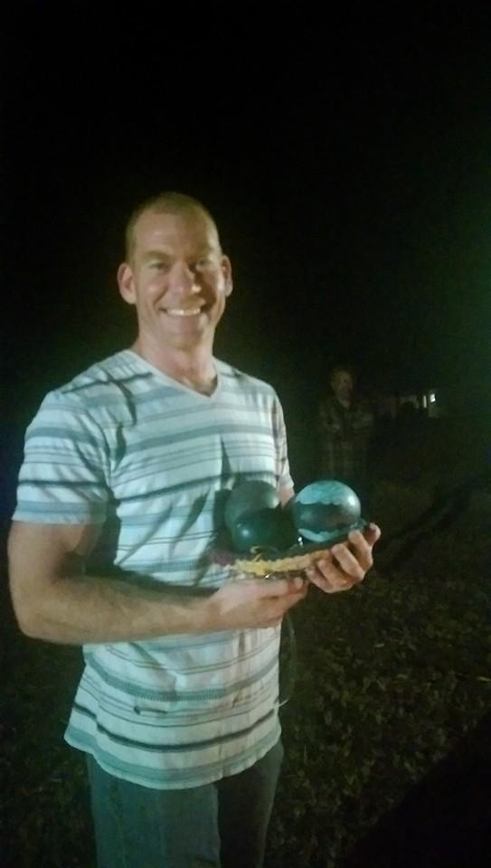
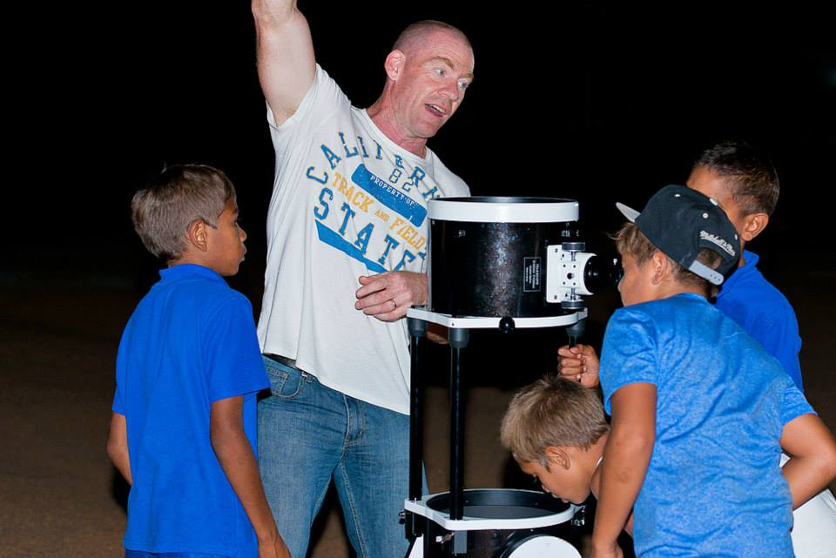
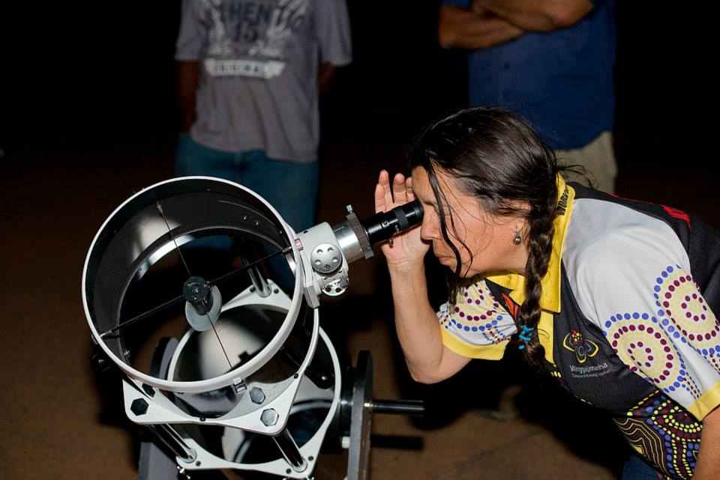
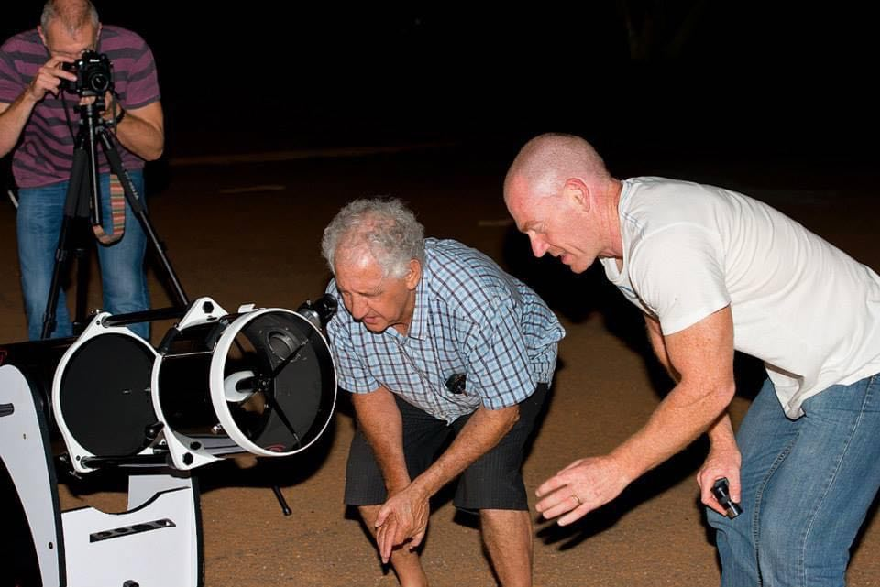
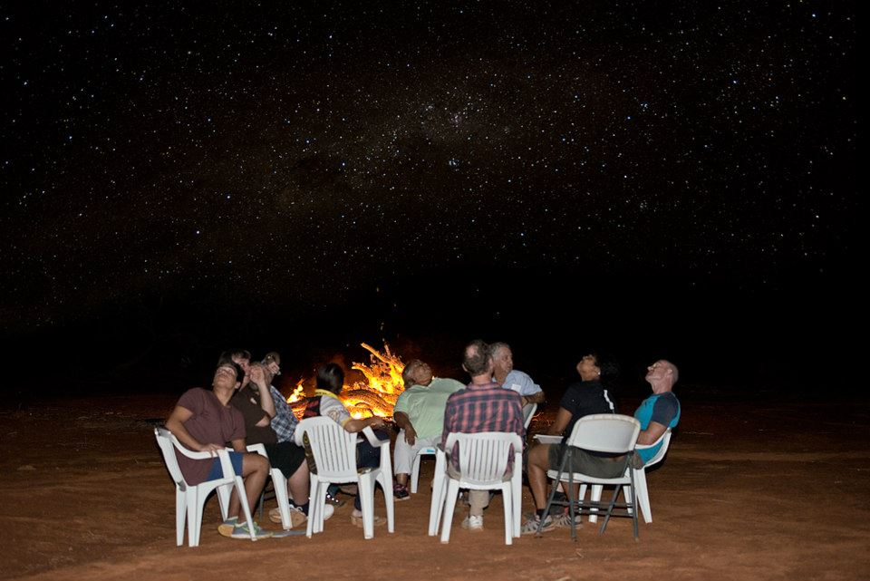

Slide 5
Exhibitions: Shared sky and ilgarijiri – creative journey
International Collaboration and Cross Cultural Learnings
Over 200 artworks of various sizes produced to date
Approximately 20 artist involved across the two collections
National and International touring agenda
SKA Acquisition of collection
Project nominated for a WA Science Award – Science Outreach Program of the Year
Project featured in International Astronomical Union General Assembly in Brazil – Federal Department of Industry , Innovation, Science and Outreach.
ABC Message Stick documentary
SBS Living Black
Notes:
Shared sky: YA and South Africa
Exhibition history (local, Canberra, Berlin in Germany, Eurpean parliament brussels Belgium, the Hague Netherlands, Manchester, spain
Manchester visit – collaborative - use of antennas

Slide 6
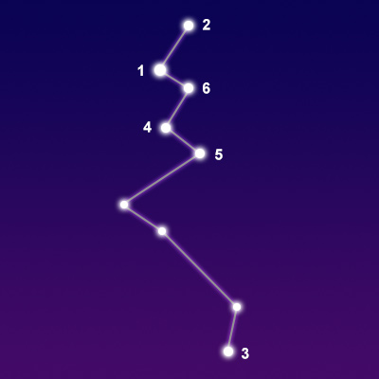
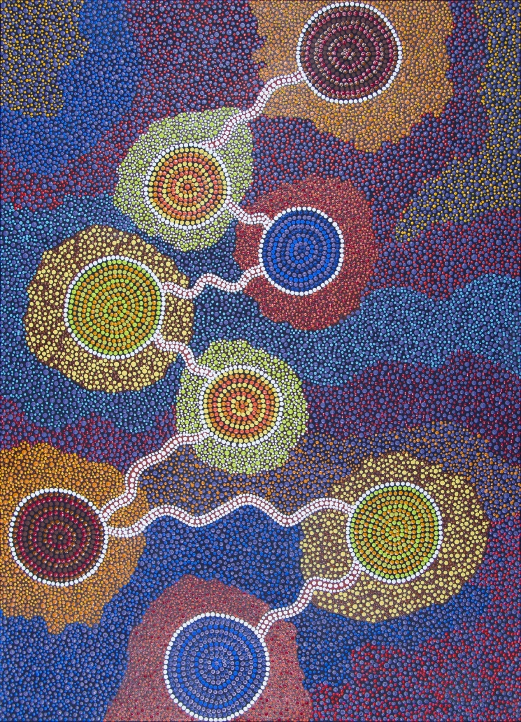
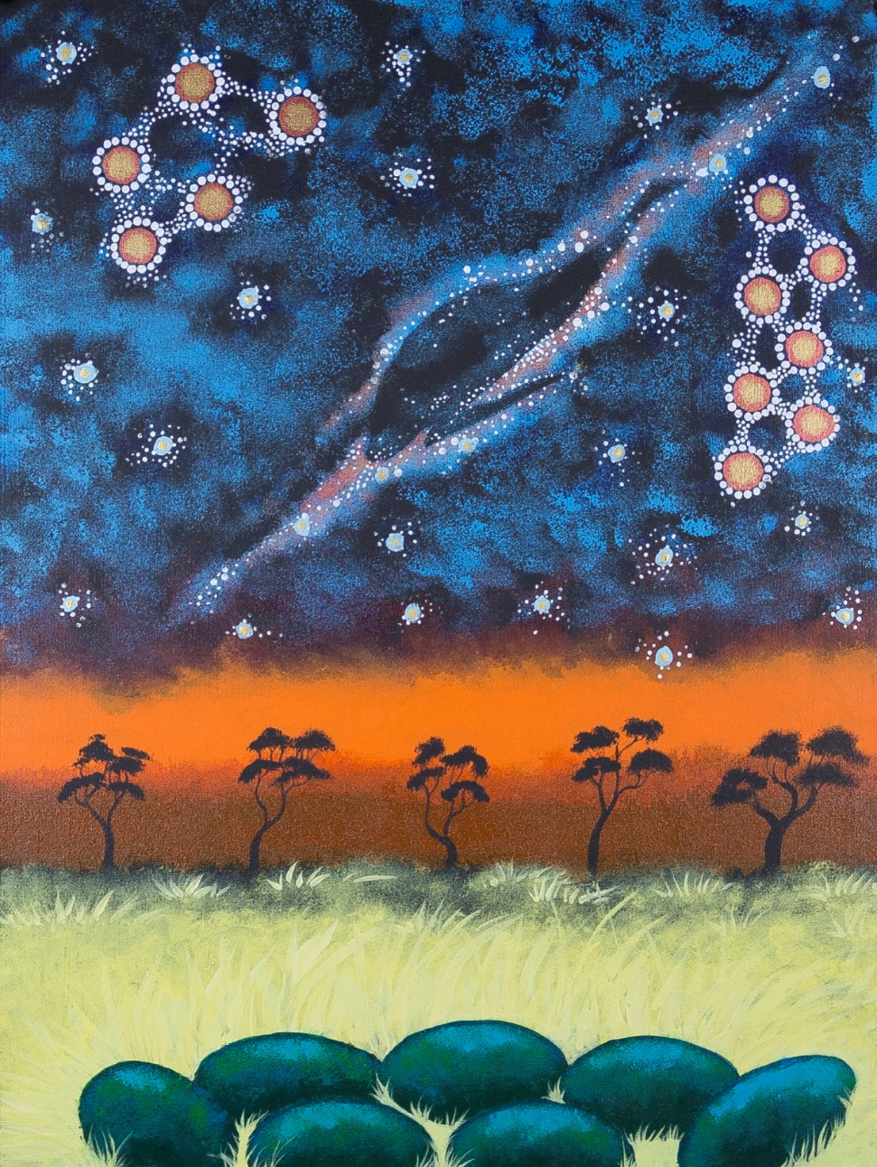
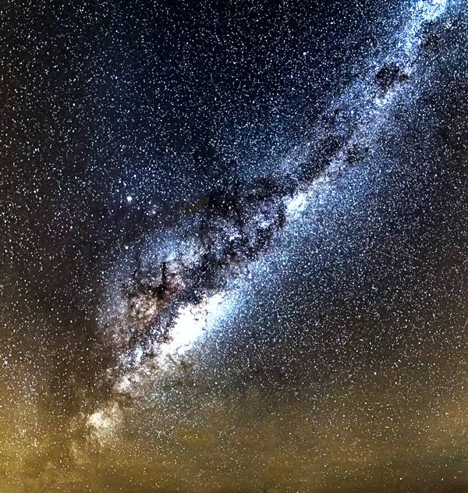
Notes:
Examples of sky works……
Artist interpretation of night sky and cultural stories – emu season
Lacerta – Margaret Whitehurst – story of listening to static sounds of the universe
Emu in the sky – Craig ‘chook’ Pickett

Slide 7
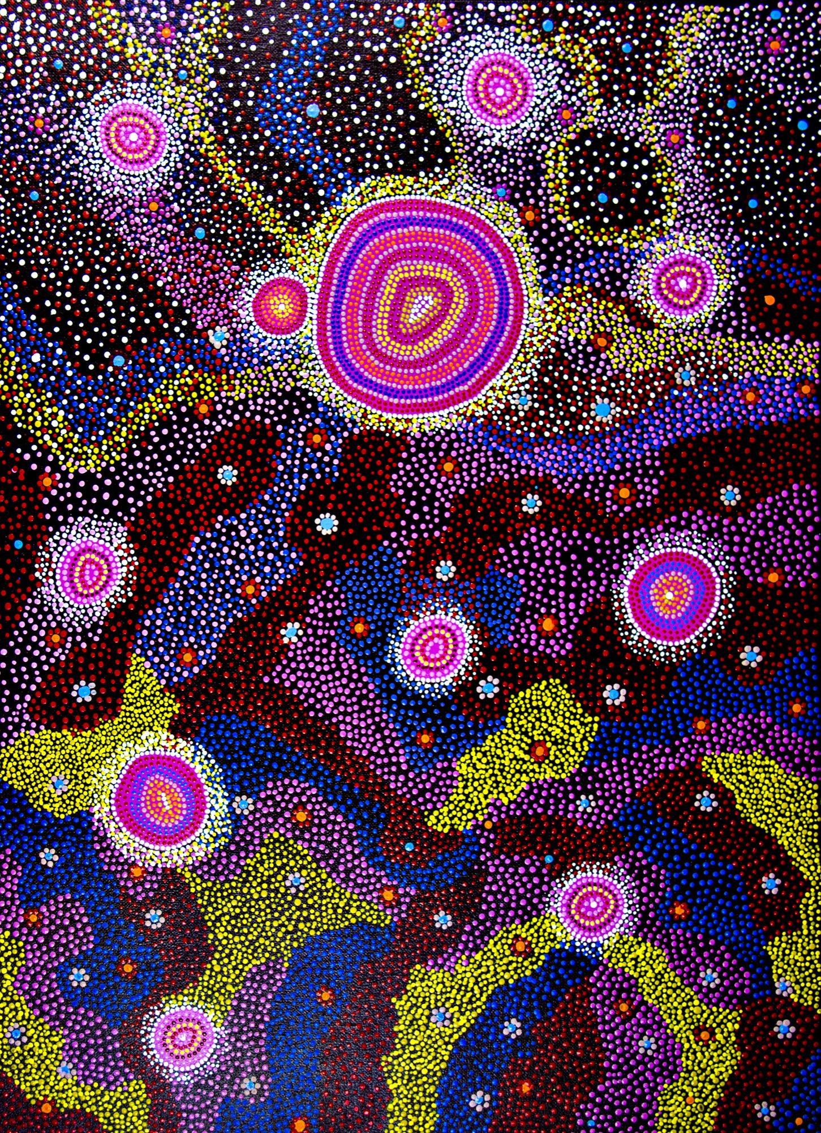
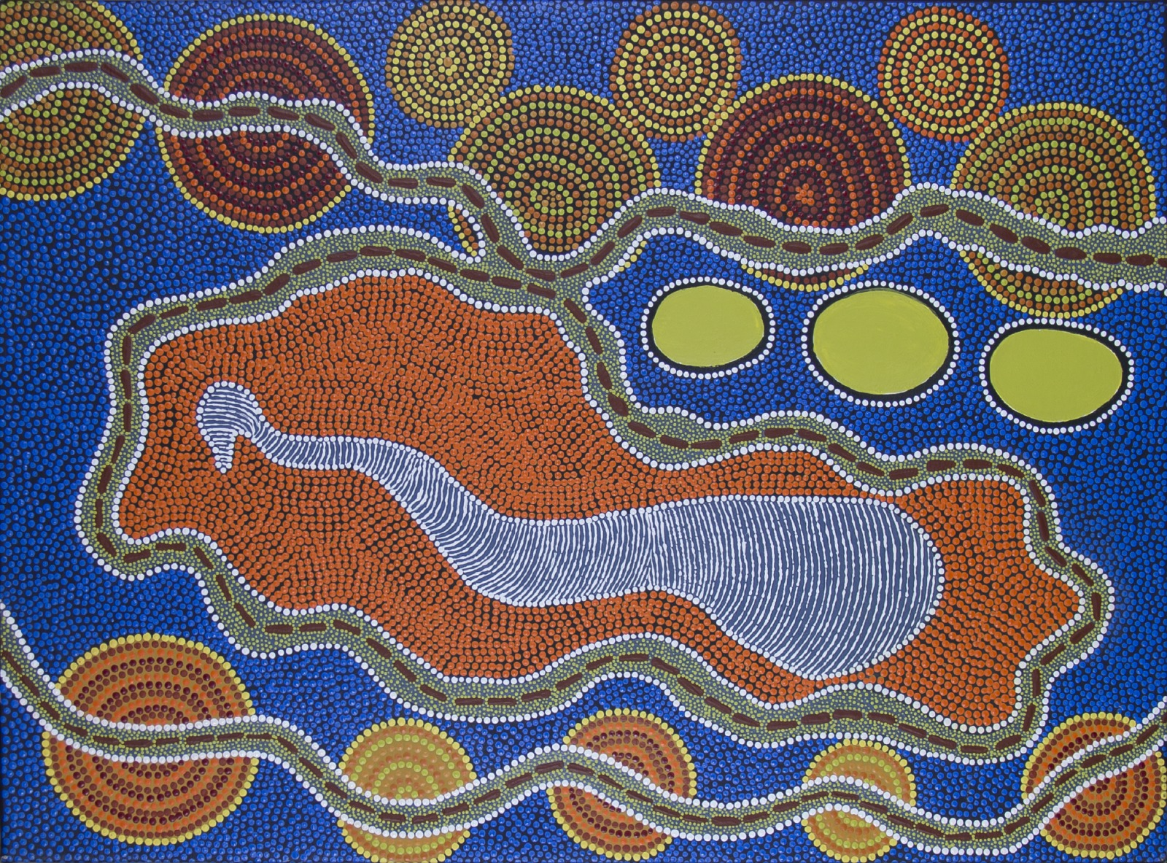
Notes:
Jupiter and the 10 moons – Barbara merritt
Emu in the Sky – Margaret Whitehurst

Slide 8
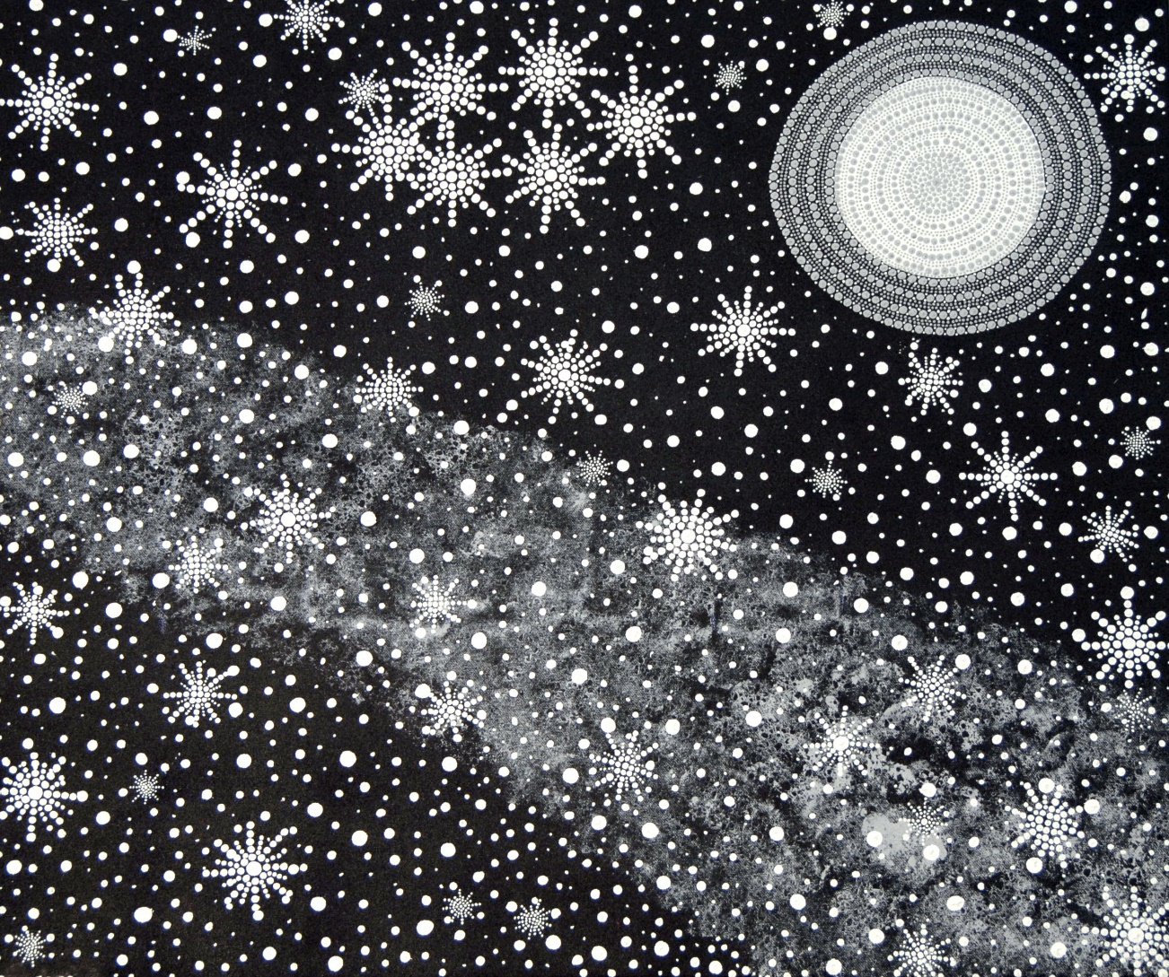
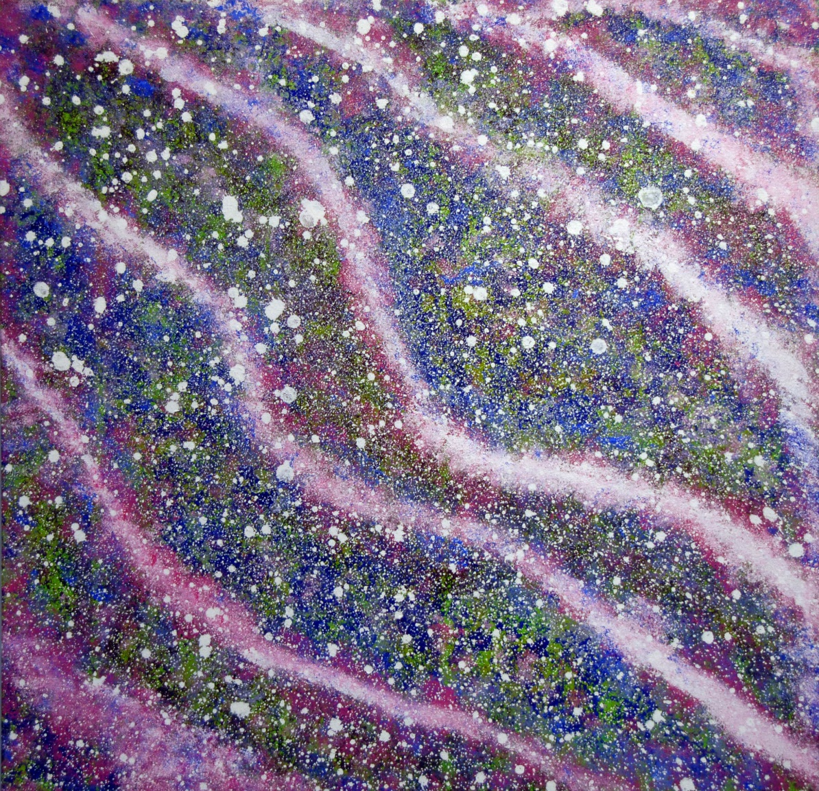
Notes:
Title unkown.....Karen Comeagain
Sound waves – Gemma Merritt

Slide 9

Notes:
Cant be here today but Voice of the artist important….

Slide 10
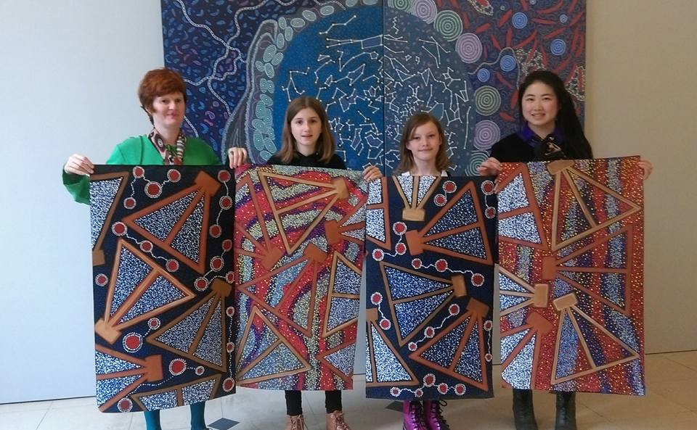
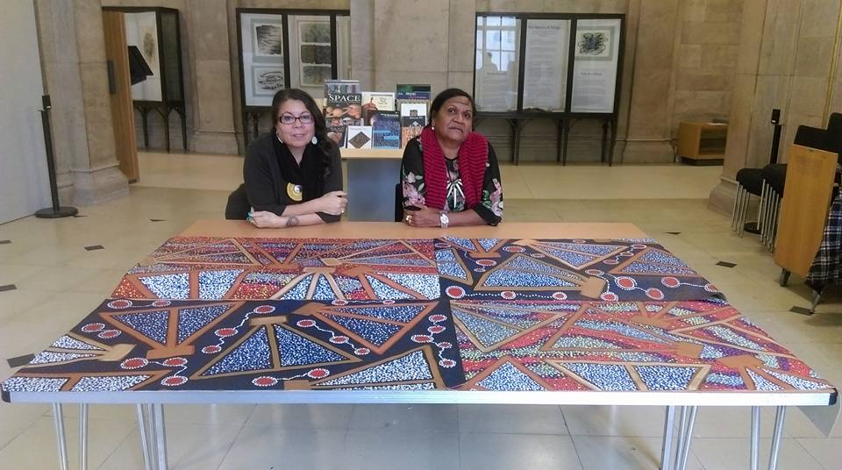
Notes:
Public collaborative works – Manchester 2018(?) opening of shared sky
Ask – recognize the design? – show next slide

Slide 11
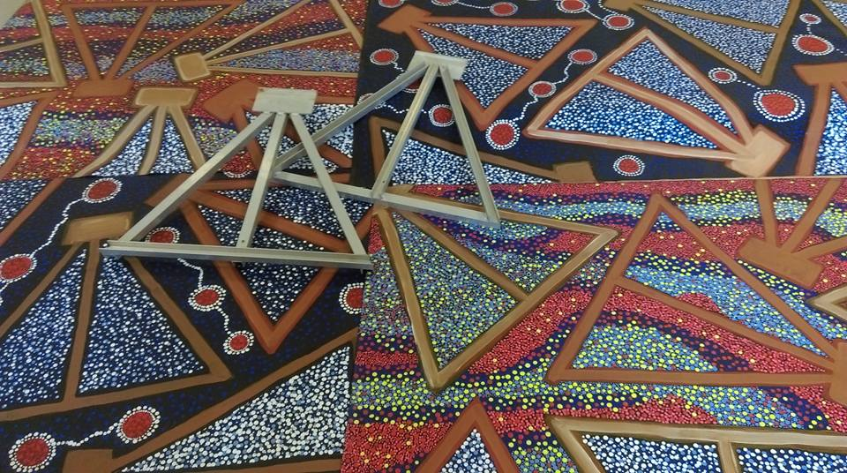

Slide 12
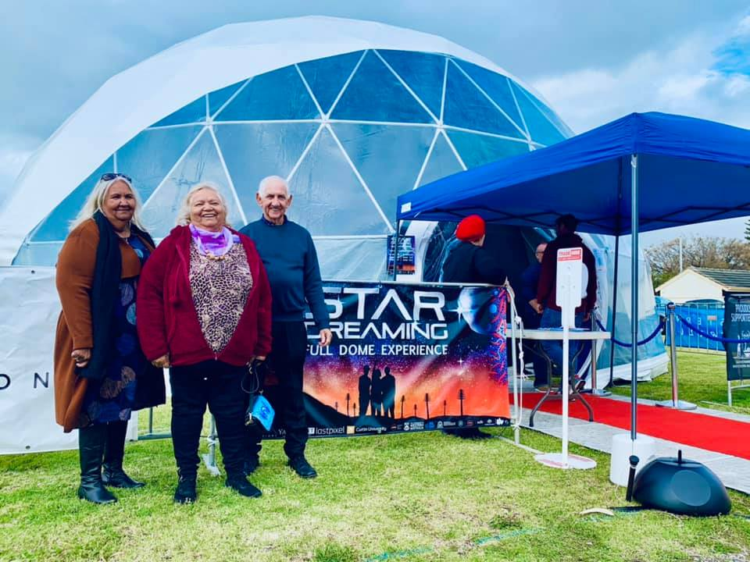
Star dreaming film – 180 immersive experience
Partnerships with Prospero Production and Curtin University
2 years filming
5 Artworks animated to represent and share cultural view
Immersive experience - 180 degree dome
Touring agenda, nominations and awards
Notes:
Winner dome fest Best educational award
Finalist WA premier The Premier's Science Awards in the 'Chevron Science Engagement Initiative of the Year' category
LA, Canada,

Slide 13
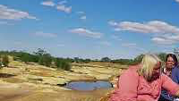

Slide 14
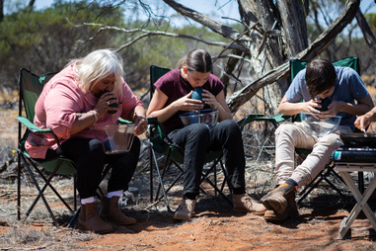
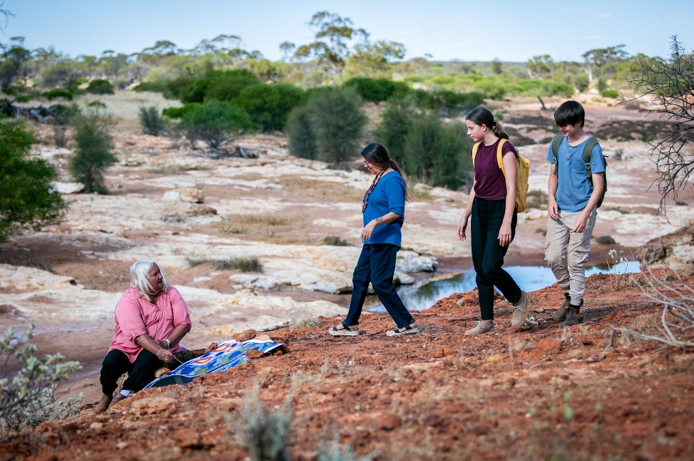
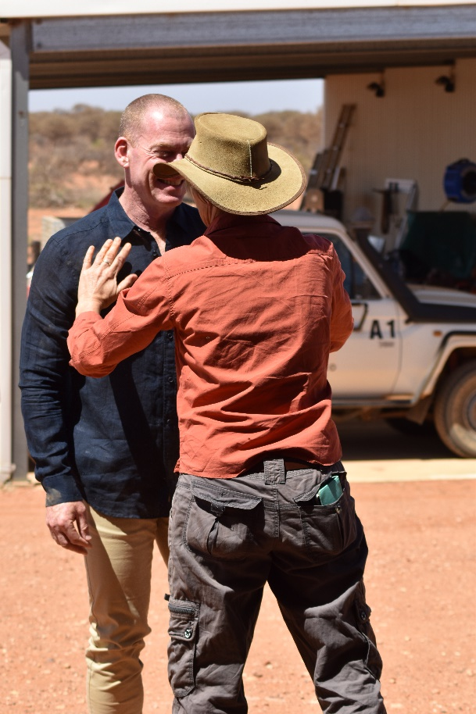
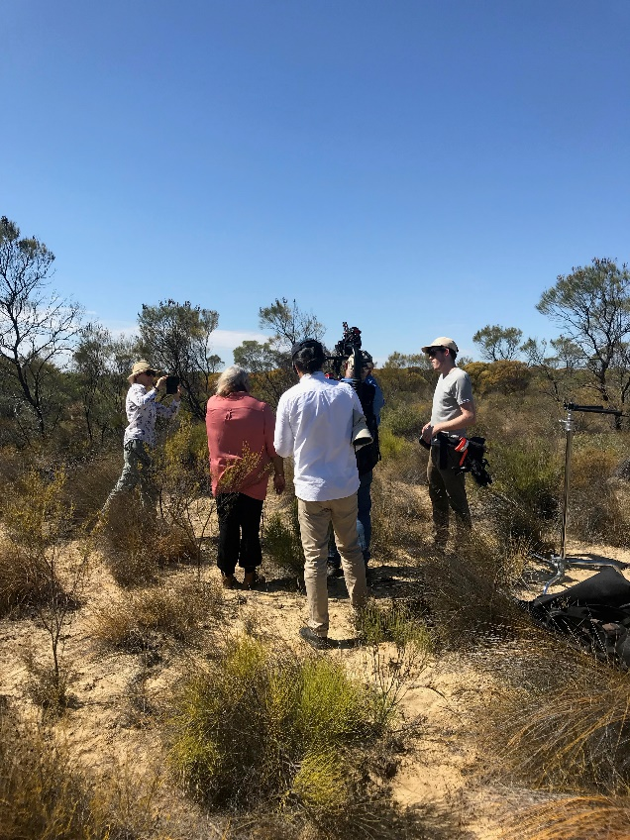
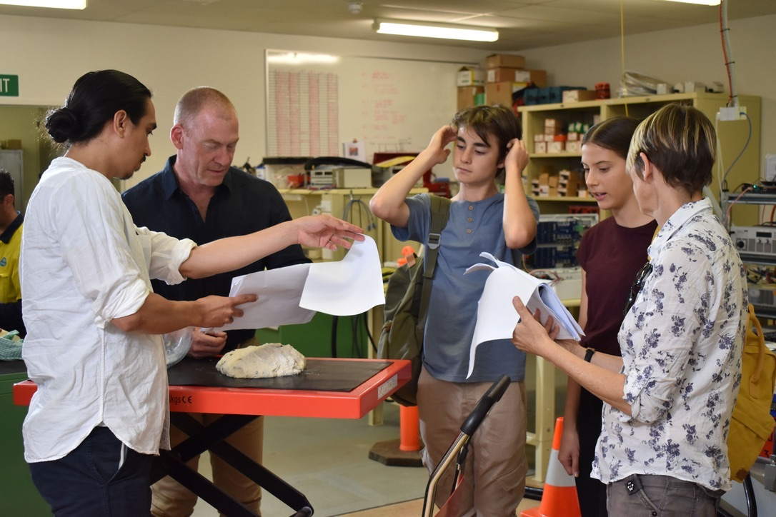
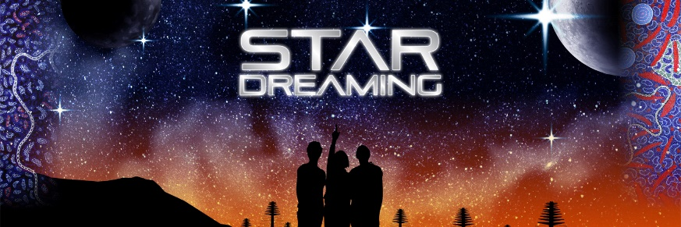

Slide 15
Other projects
Public Art - ‘Eggs on the Foreshore’ – Seven Sisters
Antipodium – fashion – Seven Sisters – Barbara Merritt
History of the world in 100 objects – British Museum
Pawzy Super Computer
Royal Australian Mint

Slide 16

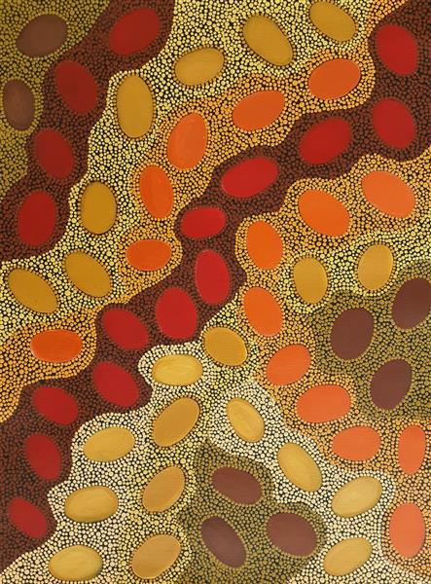
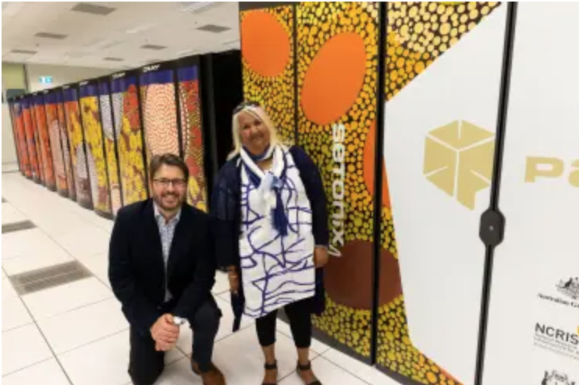
Notes:
Pawzy super computer

Slide 17
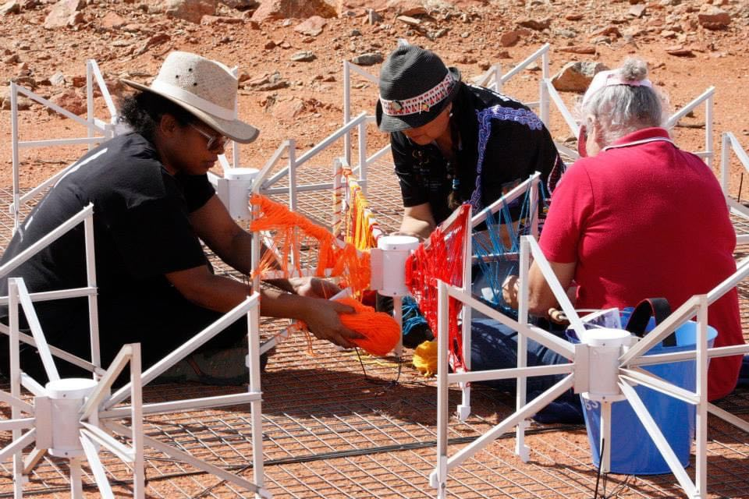
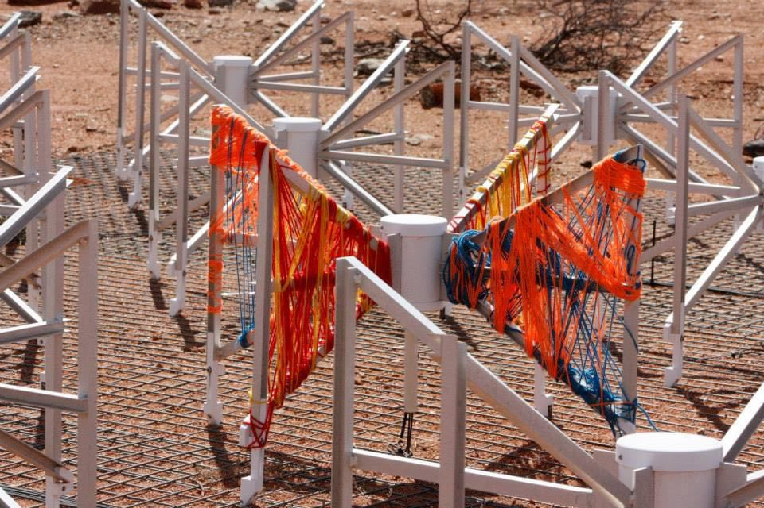
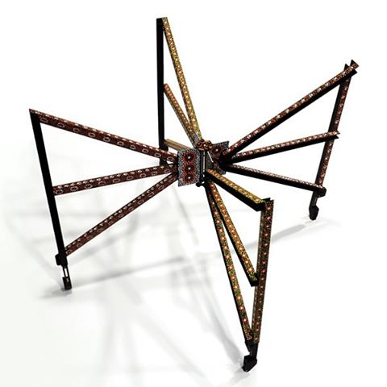

Slide 18
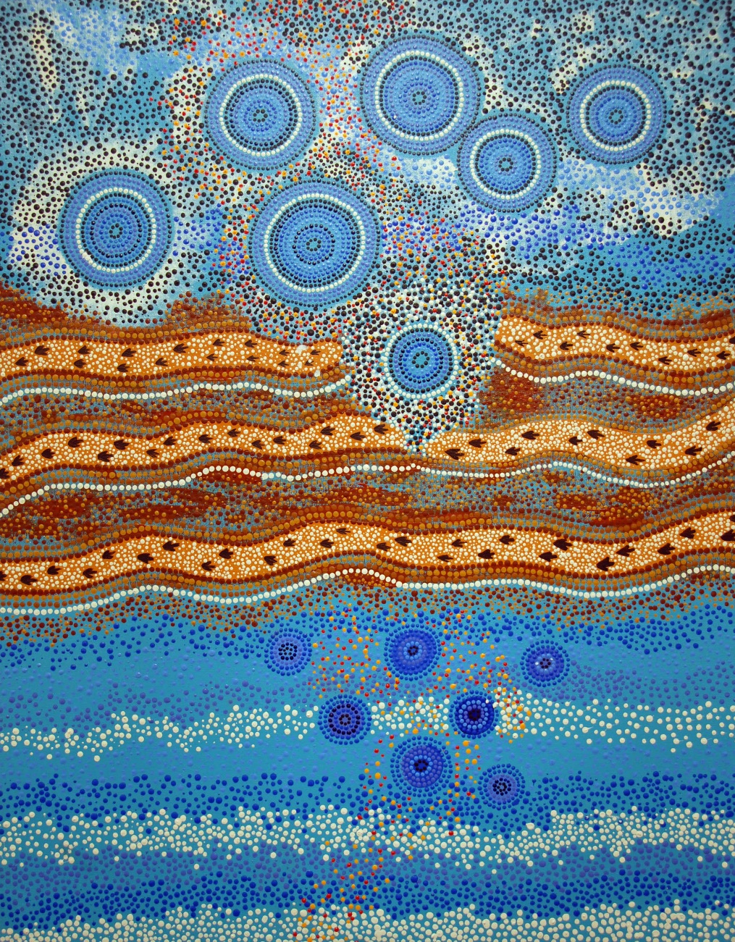
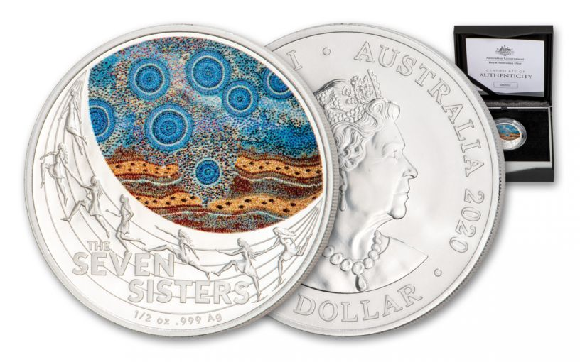

Slide 19
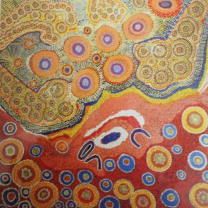
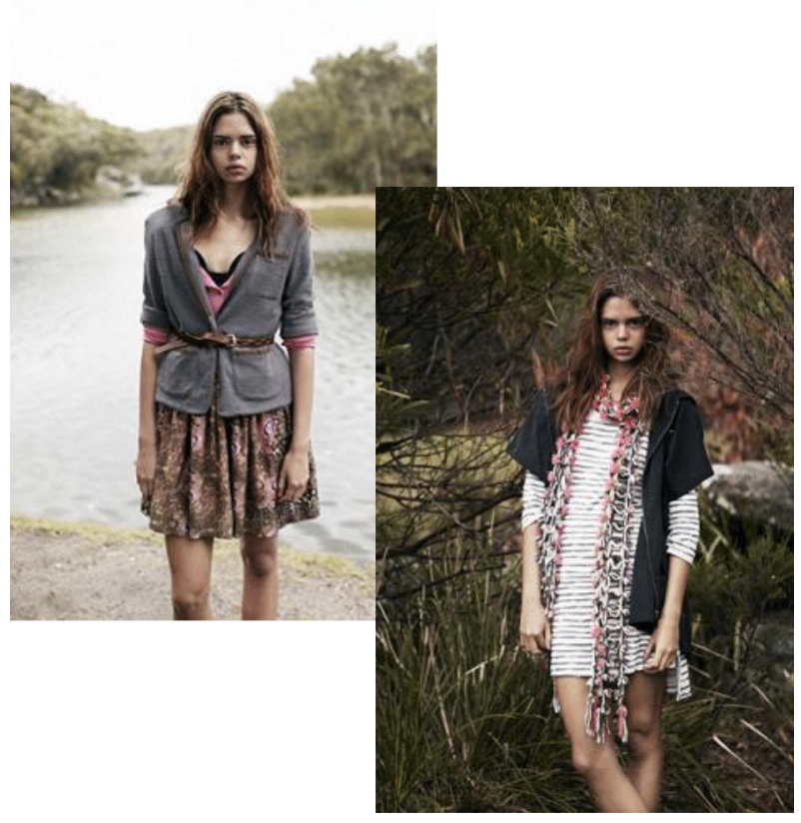

Slide 20
WHATS NEXT
Yamaji Calisto – collaborative Opera
Local Exhibition in November 2023
Collaborative Exhibition – Space Junk
Working towards National Telstra Award – Sky theme
Notes:
Yamaji Calisto – immersion of two cultural storylines Italian Ursula Major – Bear Constellation and newly formed contemporary song lyric sequence of ‘Yamaji Calisto’ and his ascent to earth and meeting the Yamaji peoples.
Exhibition revisiting the night sky in November
Commenced discussions with Singaporian based artist Isabella Ong and how we could work with her collaboratively on the Lucy in the Sky with Debris
Work towards a Telstra awards entry – show 3D printed item….

Slide 21
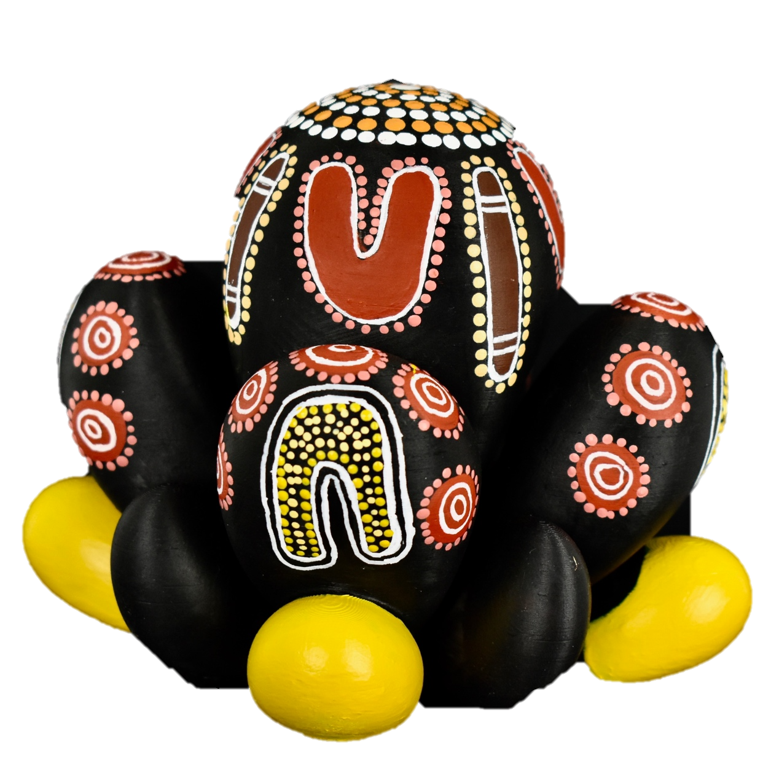
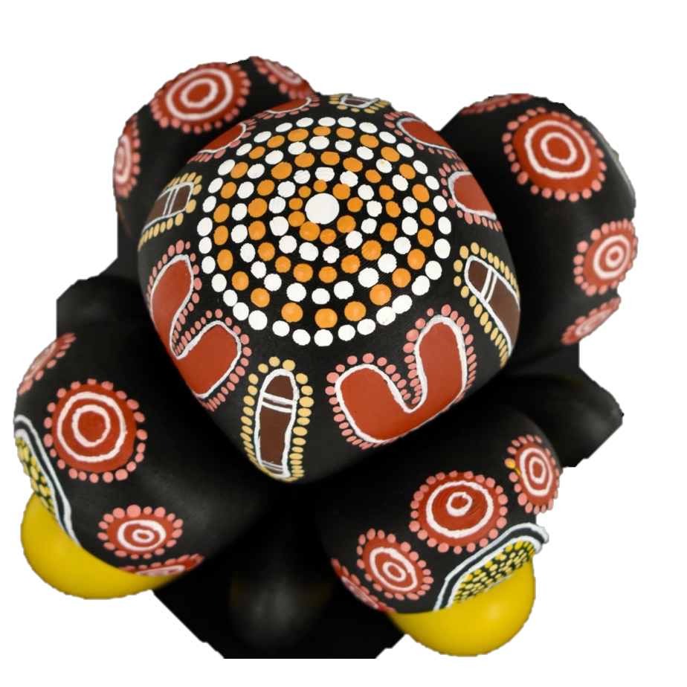

Slide 22
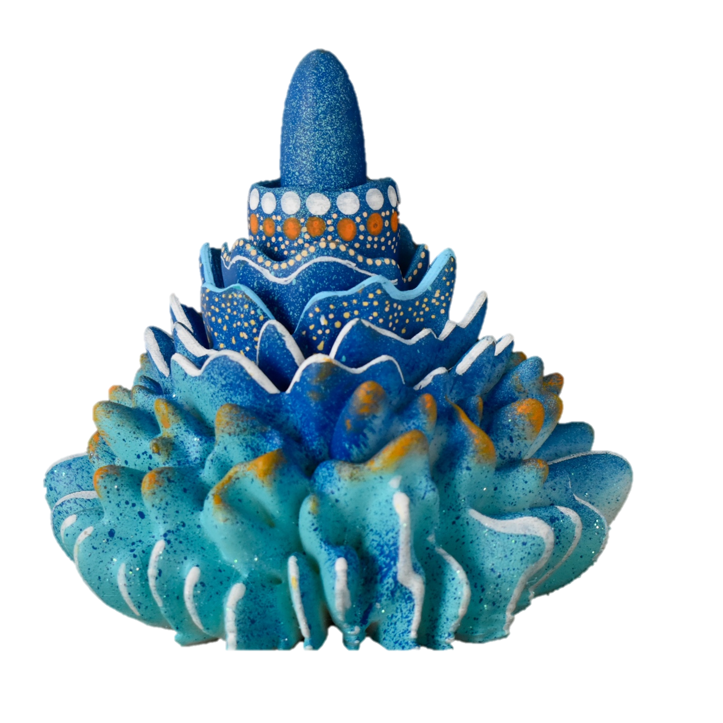


Slide 23
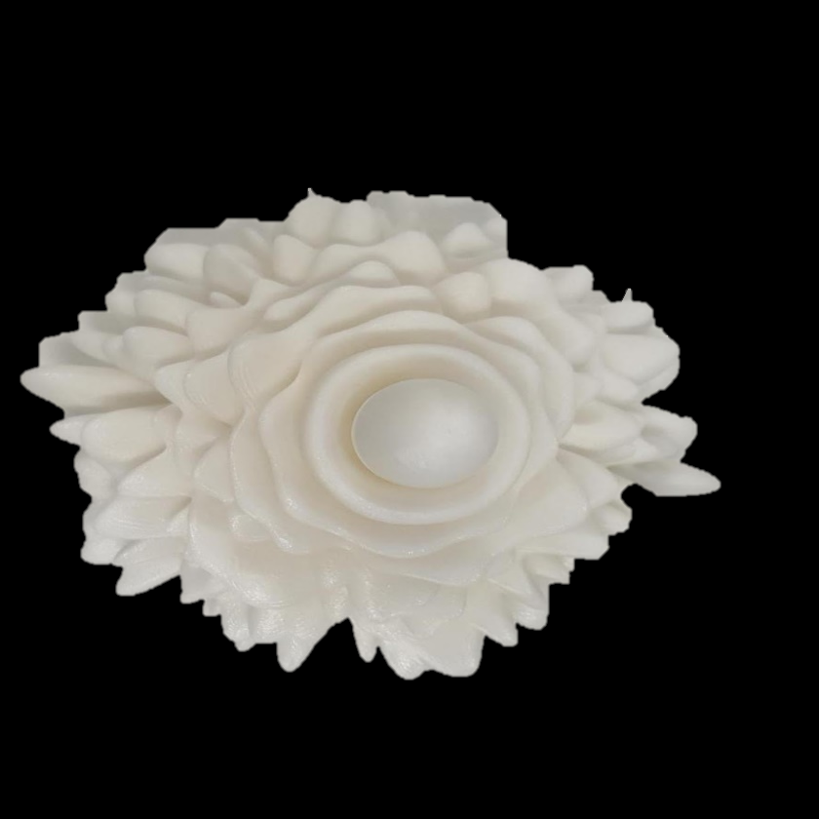

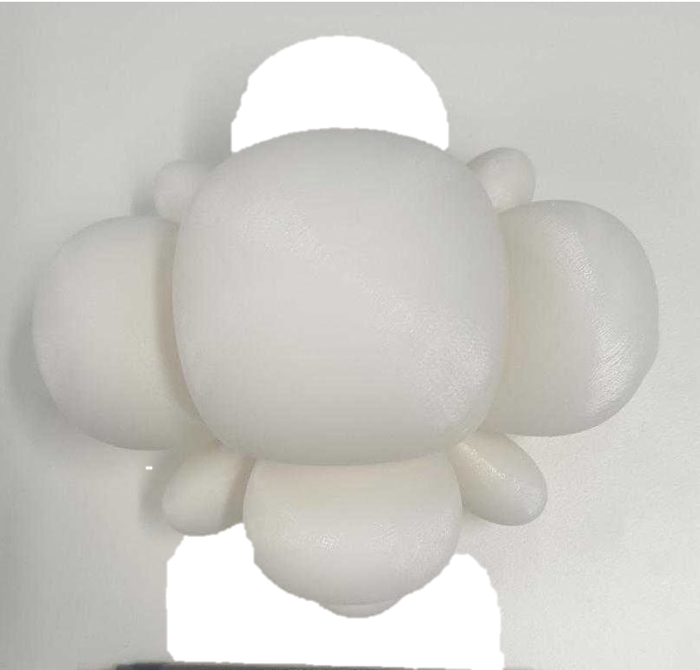
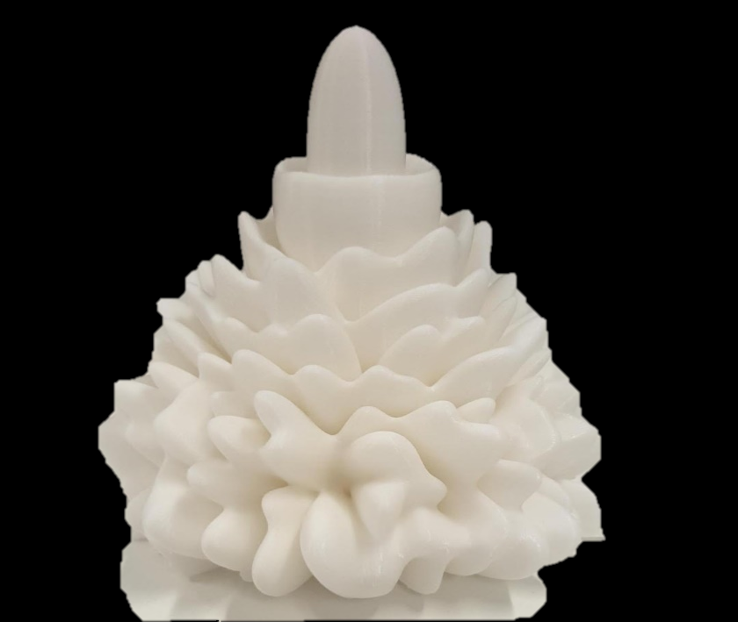
MWA & SKA 3D printed sound waves

Slide 24
Thank you
Questions?

