Slide 1
Probing the ISM towards the Gum Nebula using Pulsar Measurements
Mengyao Xue
25 July 2023, Perth

Slide 2
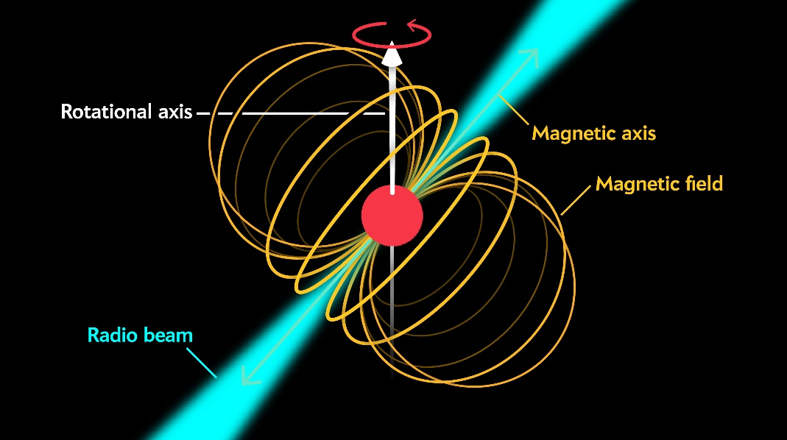
Pulsars
Highly magnetised
(~10⁸ - 10¹⁴ G)
Highly polarised radio emission
Linear:
Average ~20%, highest ~100%
Tends to ↓ with frequency ↑
Circular :
Average ~10%
Total intensity
(I profile)
Linear polarisation (L profile)
J0630-2834
MWA
Circular polarisation (V profile)

Slide 3
Propagation effects due to ISM
Inhomogeneous ISM
-> Scattering screen
Magnetic field
-> Faraday rotation
$$\vec{B}$$
ionised ISM
-> Dispersion
All these effects are frequency dependent!

Slide 4
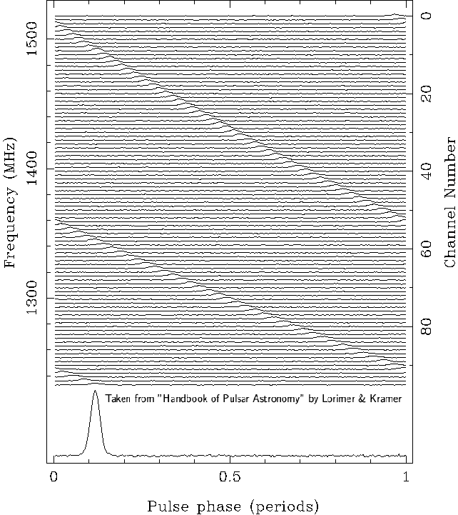
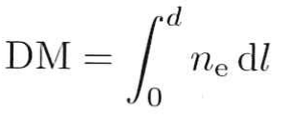
Propagation effects due to ISM
Dispersion
Different group velocity for different frequency wave in the ionised ISM
Low frequency signals will arrive later than higher ones
Dispersion Measure (DM)

Slide 5
Propagation effects due to ISM
Inhomogeneous ISM
-> Scattering screen
Magnetic field
-> Faraday rotation
$$\vec{B}$$
ionised ISM
-> Dispersion
All these effects are frequency dependent!

Slide 6
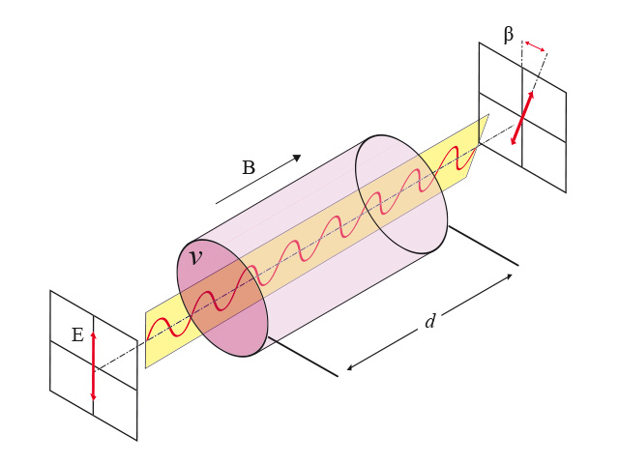
Propagation effects due to ISM
Faraday Rotation Measurements (RM)
Credit: wikipedia.org
Can be used to probe the magnetic field strength parallel to our LoS

Slide 7
Propagation effects due to ISM
Inhomogeneous ISM
-> Scattering screen
Magnetic field
-> Faraday rotation
$$\vec{B}$$
ionised ISM
-> Dispersion
All these effects are frequency dependent!

Slide 8
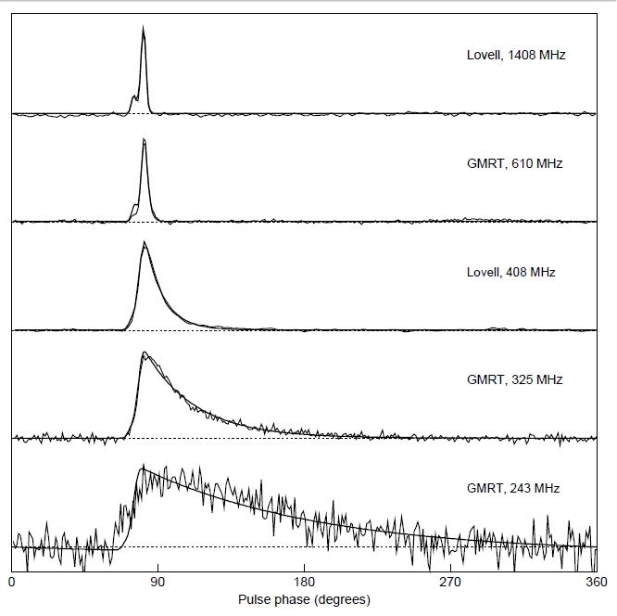
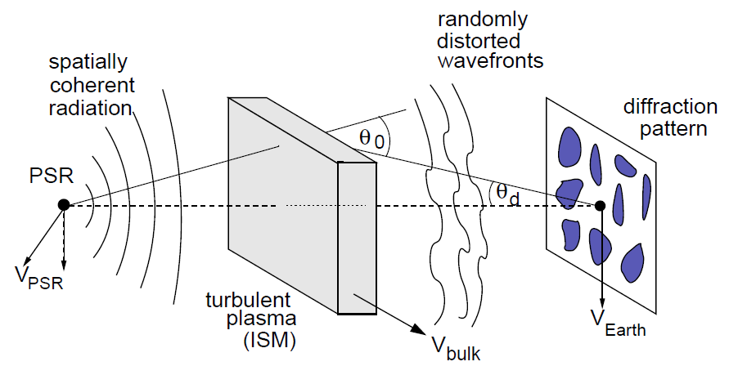
Propagation effects due to ISM
Scattering
A thin-screen model

Slide 9
Low frequency pulsar observations
— sensitive to ISM propagation effects
Dispersion: ∝$f^{−2}$
Faraday rotation: ∝$f^{−2}$
Scattering: ∝$f^{−4}$
MWA, as a low frequency radio telescope, is able to get precise DM, RM, scattering broadening of pulsars
-> and use them to probe the ISM properties

Slide 10
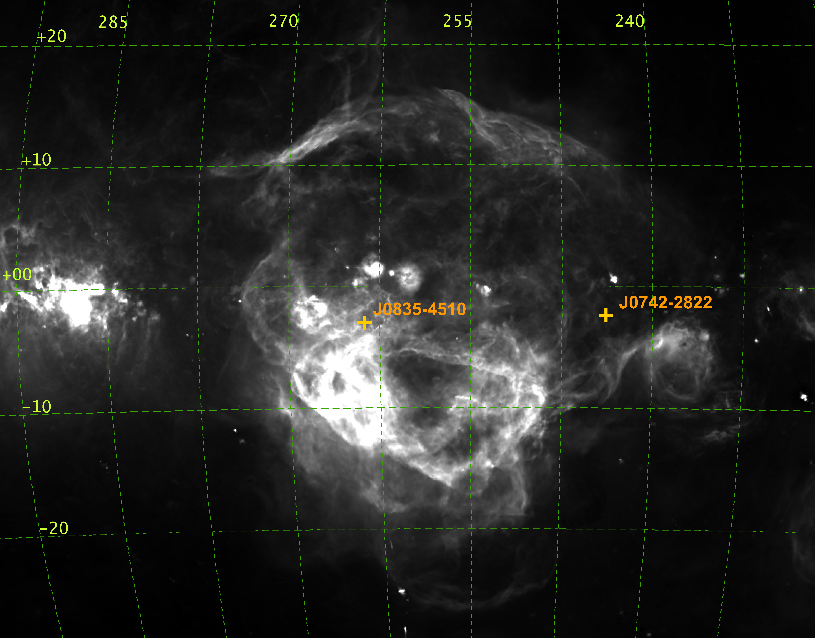
The Vela pulsar (PSR J0835-4510)
Young pulsar, SN exploded ~10⁴ yr ago
Bright, it is the pulsar with highest flux density in the sky, ~5 Jy at 400 MHz, ~1 Jy at 1.4 GHz
ISM environment: Vela SNR & the Gum Nebula
ROSAT image of the Vela SNR in 0.44−2.04 keV
H-alpha map of the Gum Nebula
Dec
b
RA
l
Finkbeiner (2003)
Powered with Aladin
García et al. (2018)

Slide 11
Polarimetric pulse profiles of the Vela pulsar at different frequencies

Slide 12
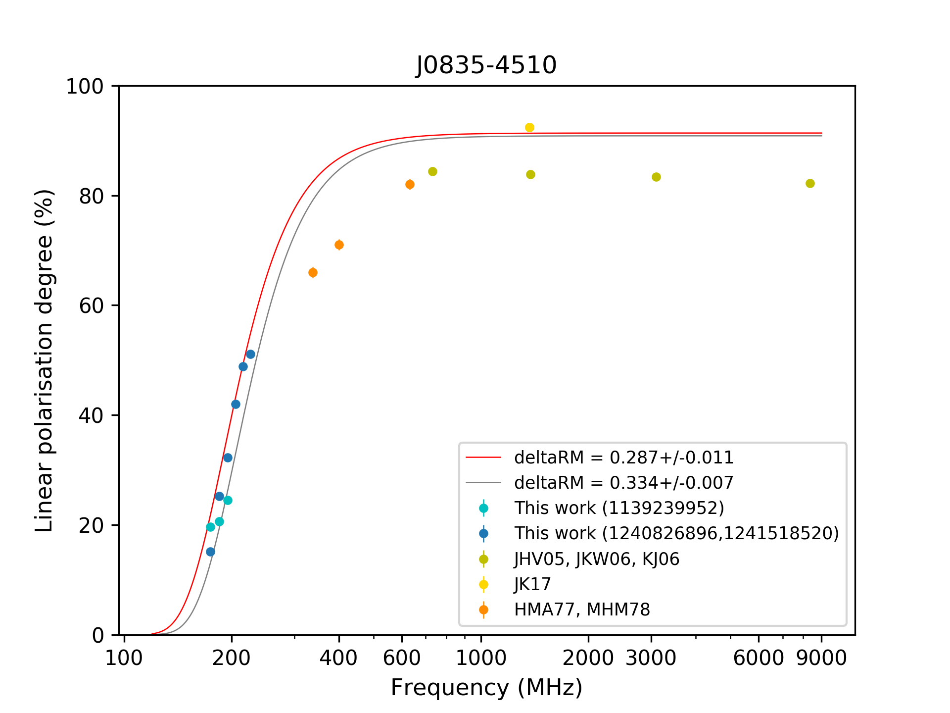
L/I vs. frequency for the Vela pulsar
Rapid depolarisation at low radio frequency for the Vela pulsar, which in contrast with the common trend

Slide 13
Polarimetric profiles for PSRs J0742-2822 and J1752-2806
Xue et al. (2019)

Slide 14
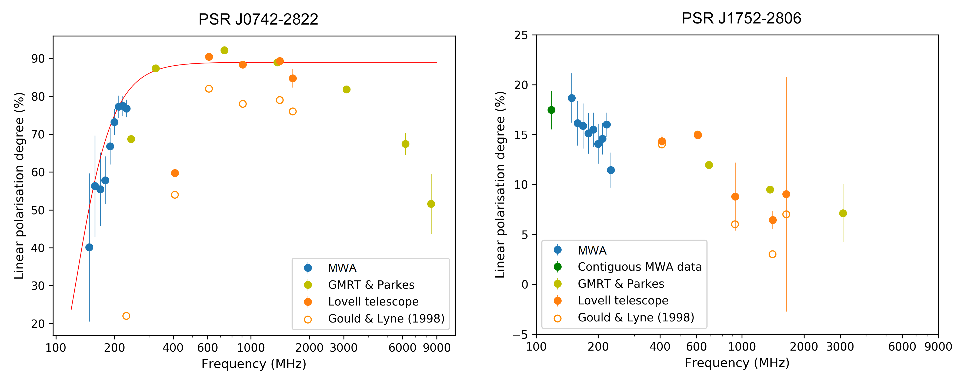
Fraction of linear polarisation as a function of frequency
Xue et al. (2019)
%L
Rapid depolarisation at low radio frequency for PSR J0742-2822

Slide 15
Depolarisation for J0742 & the Vela pulsar
%L
Possible explanation depolarisation:
stochastic Faraday rotation caused by the magneto-ionic turbulent ISM in the Gum nebula
%L ∝ exp(-2λ⁴ δRM²)
<- Macquart & Melrose (2000)
J0742 fitted δRM=0.111~0.128
J0835 fitted δRM=0.287~0.334

Slide 16
There are some more interesting things about the Vela pulsar…
Hamilton et al. (1985)
Its RM & DM have HUGE variation with observing time
from 1970 to 1985:
RM rise from 34 to 46
DM drop from 69.1 to 68.2
Hamilton et al pointed out the RM and DM shows a linear variation with observing epoch, and they are negatively correlate with each other.

Slide 17
The explanation given by Hamilton et al.
$$\overset{⃑}{v}$$
77 ± 2 km/s

Slide 18
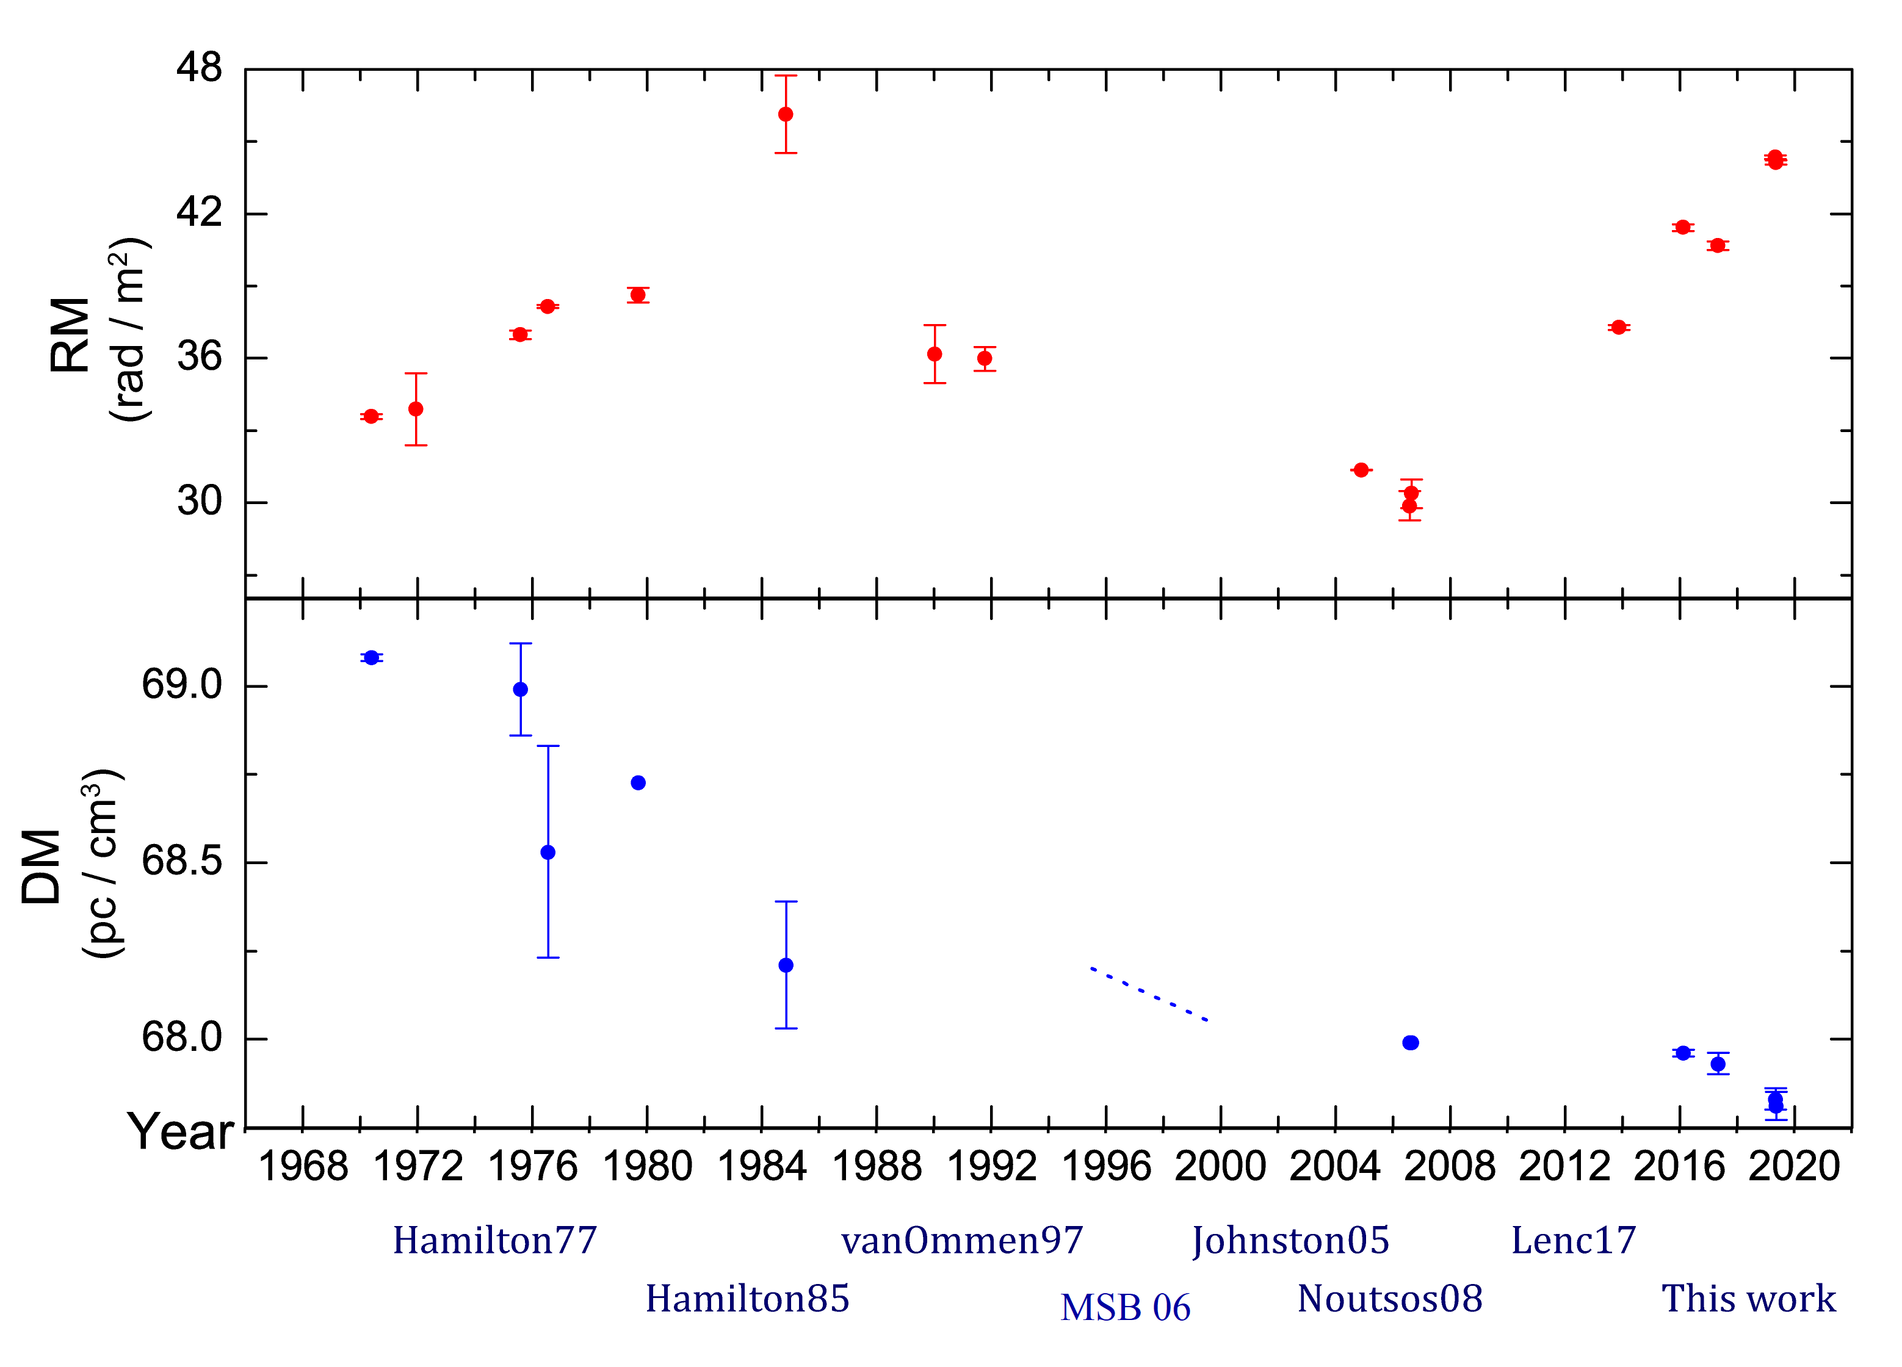
By adding some new measurements…

Slide 19
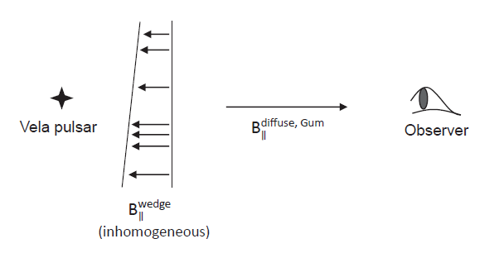
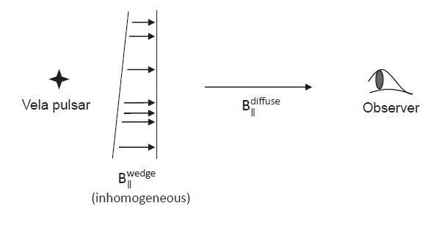
$$\overset{⃑}{v}$$
77 ± 2 km/s
$$\overset{⃑}{v}$$
77 ± 2 km/s

Slide 20
The variation of the Vela’s scattering tail obtained by the MWA
τ_{sc} = 43.63 ms
τ_{sc} = 42.59 ms
variation of the scattering tail
↓
temporal/spacial variation of the ISM
& its small scale structure (which probably responsible for the depolarisation at low-freq)
↑
variation of the DM and RM
τ_{sc} = 30.59 ms

Slide 21
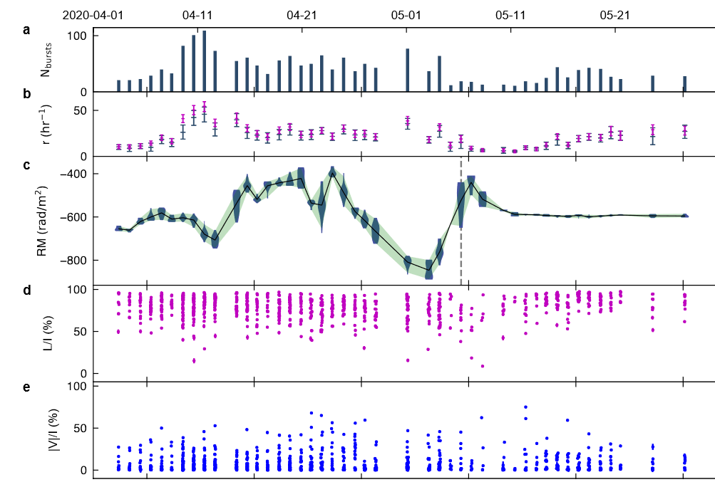
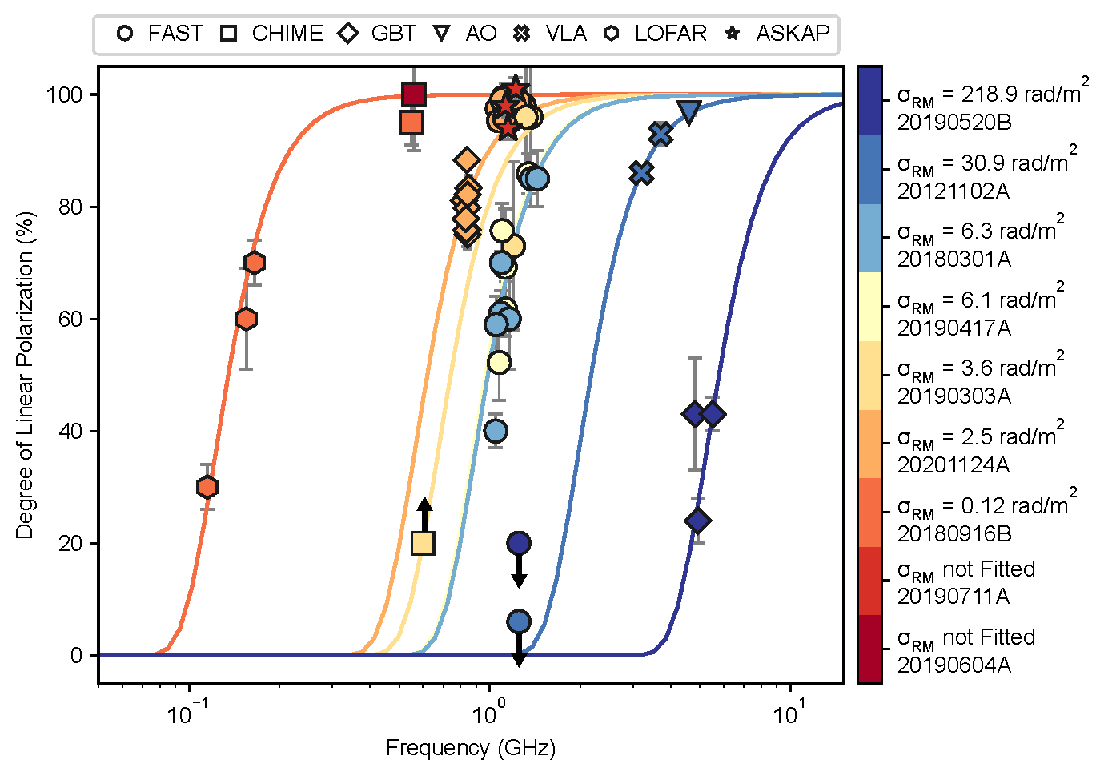
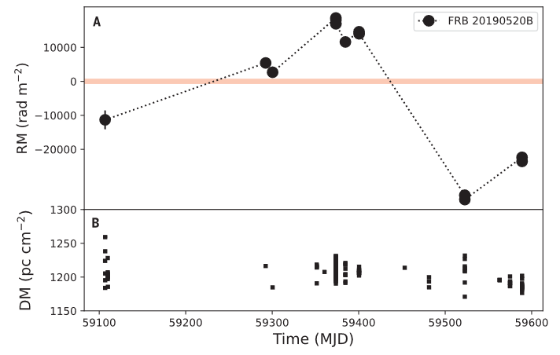
Similar phenomenon in FRBs
RM variation changing direction
depolarisation possibly due to stochastic RM
FRB201124A
Xu, Niu, Chen et al. (2022)
Feng, Li, Yang et al. (2022)
FRB190520
Anna-Thomas, Connor, Dai et al et al. (2023)

Slide 22
Summary
DM and RM variation of the Vela pulsar over fifty years:
DM:
monotonic decreasing trend from 69.1 to 67.8 pc cm⁻³
RM:
increased from 33.6 to 46.2 rad m⁻² (1975 –1984),
then dropped to a low of 29.9 rad m⁻² in 2006,
and started to increase again, reaching 44.4 rad m⁻² in 2019
Vela show different scatter broadening properties at MWA 185MHz:
11 Feb 2016: τ_{sc} = 43.63 ms; 04 May 2017: τ_{sc} = 42.59 ms
02 May 2019: τ_{sc} = 30.59 ms
Depolarisation toward the Gum Nebula:
Towards the direction of the Gum Nebula, both PSR J0742-2822 & the Vela pulsar shows a rapid depolarisation at low radio frequency
might be attributed to the stochastic Faraday rotation caused by the magneto-ionic turbulent ISM in the Gum nebula.

