Slide 1
GLEAM-X DRII: What’s available and what’s next!
Kat Ross, Natasha Hurley-Walker (Curtin / ICRAR) Tao An, Stefan Duchesne, Tom Franzen, Tim Galvin, Paul Hancock, George Heald, Silvia Mantovanini, John Morgan, Ben Quici, Chris Riseley, Brandon Venville, Tessa Vernstrom, Xiang Zhang

Slide 2
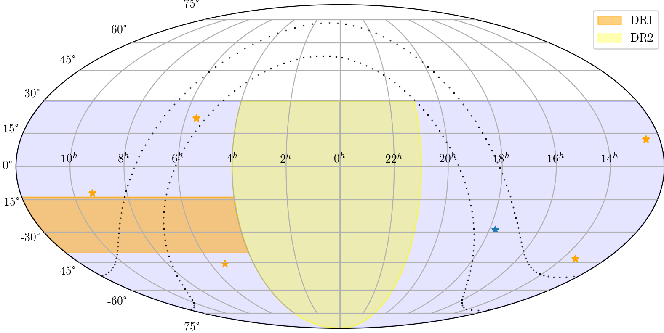
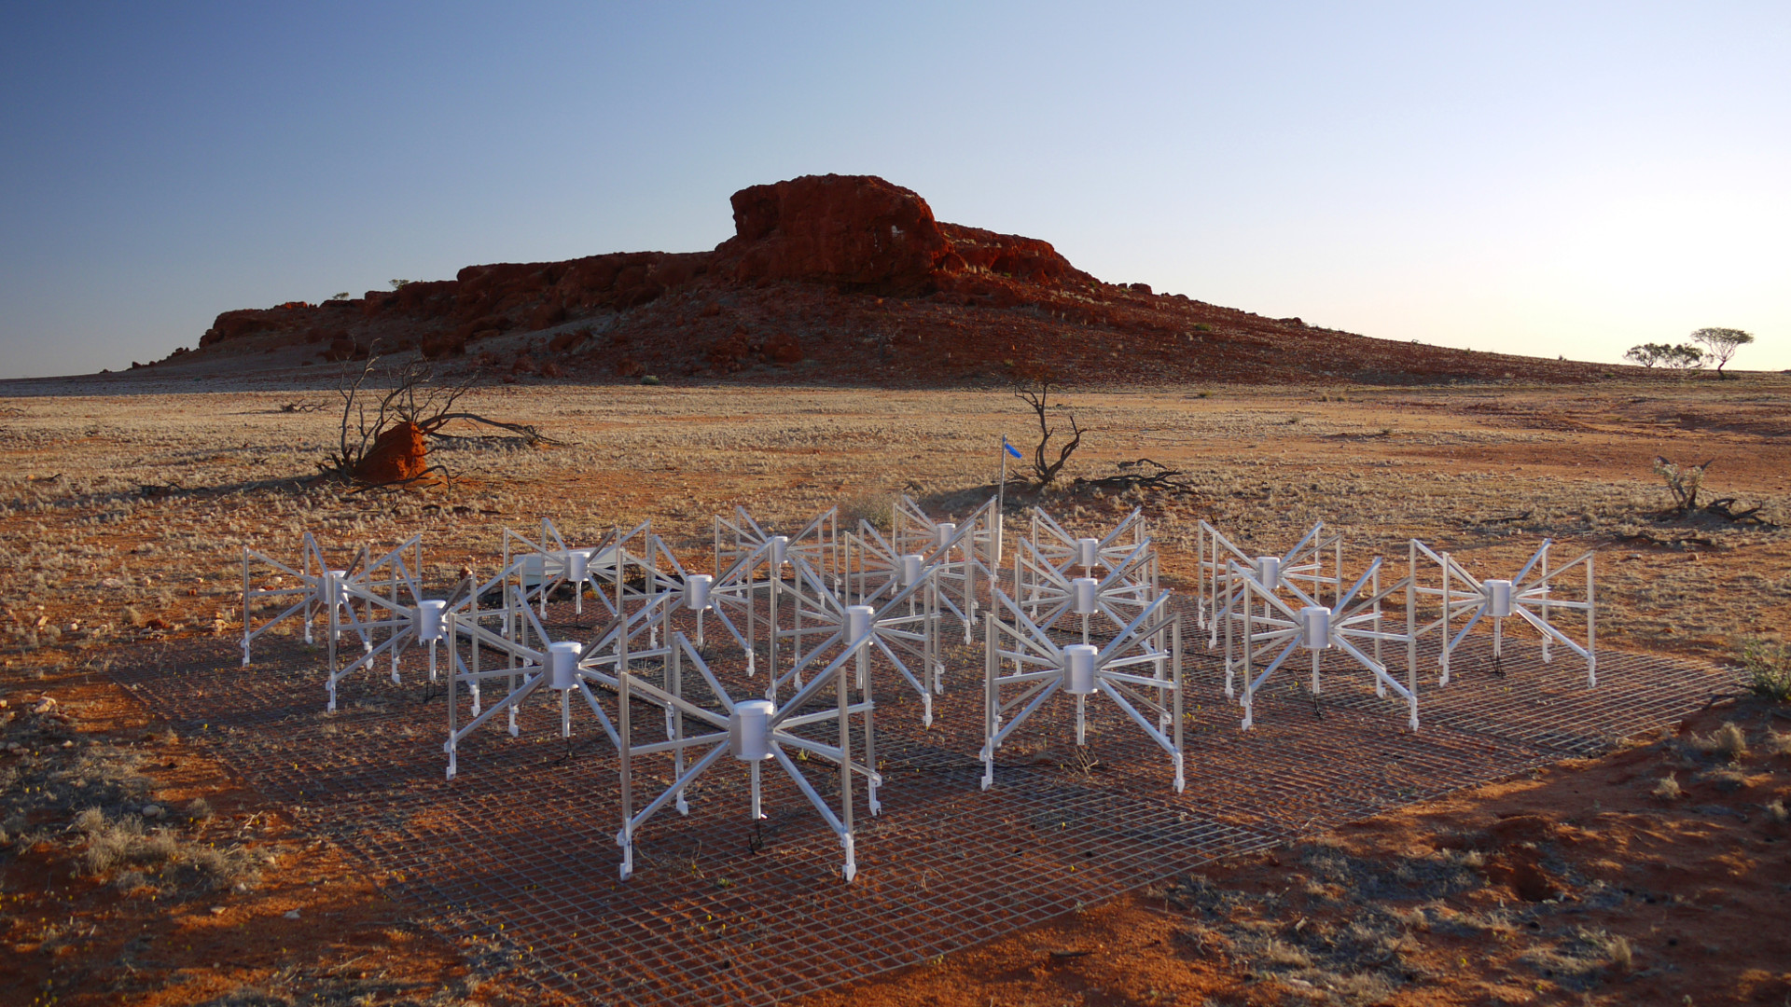
Survey description
Three tranches of observing spanning 2018 — 2020
HA -1h, 0h, +1h drift scans at Decs +18°, +2°, -13°, -27°, -40°, -55°, -72°
= 84 nights + make-up
72 — 231 MHz over 5 x 30.72MHz bands
2 PB of raw visibilities
Instrumental Stokes → Full polarisation & RM Synthesis
Murchison Widefield Array Phase II extended (Wayth et al. 2018)

Slide 3
DRII
Dec: <+30
RA: ~20hr - ~6hr
72 - 231 MHz
Observing times:
Sept 2020 - Oct 2020
One drift per night
28 nights
Week between observations of same drift

Slide 4
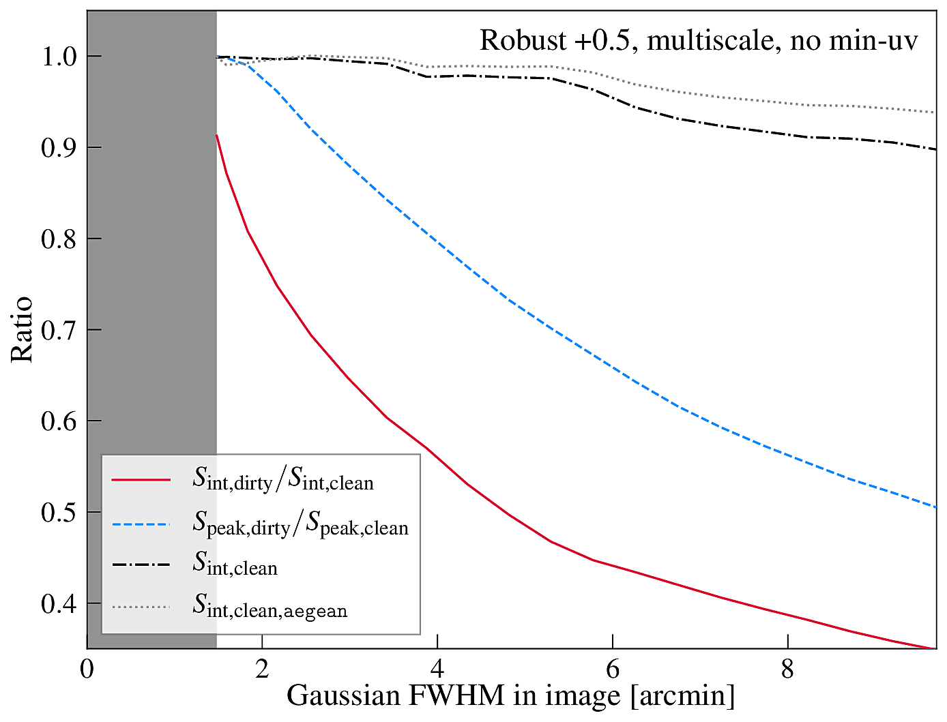
Continuum Pipeline Overview
Using GLEAM-X pipeline: https://github.com/GLEAM-X/GLEAM-X-pipeline
Major updates since GLEAM:
In-field calibration using global sky model (based on GLEAM)
Automated (u,v)-subtraction of sidelobe sources
Multi-scale clean and Briggs +0.5 weighting (Duchesne et al. 2021)
10’ = 95% recovery
40’ = reduced recovery

Slide 5
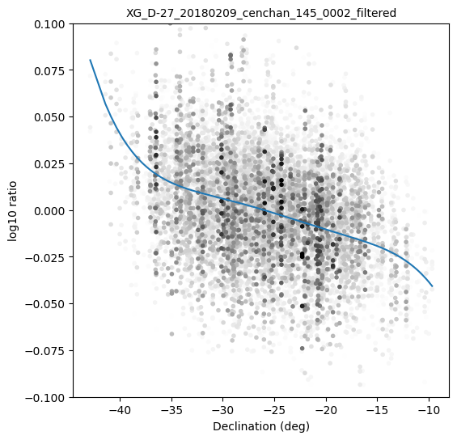
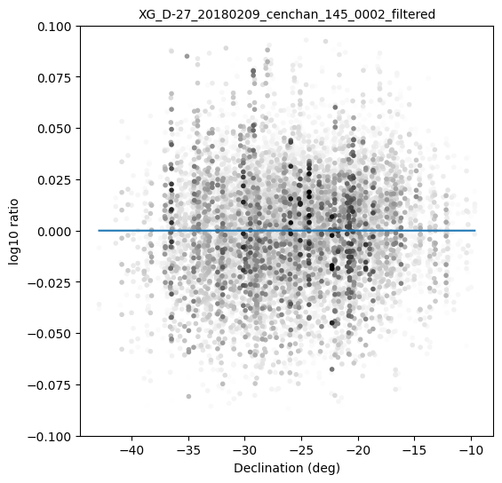
Continuum Pipeline Overview
Using GLEAM-X pipeline: https://github.com/GLEAM-X/GLEAM-X-pipeline
Major updates since GLEAM:
In-field calibration using global sky model (based on GLEAM)
Automated (u,v)-subtraction of sidelobe sources
Multi-scale clean and Briggs +0.5 weighting (Duchesne et al. 2021)
Full-Embedded-Element primary beam model (Sutinjo + 2015)
Primary beam correction via accumulation of snapshot measurements c/f GLEAM
Flux density calibration RMS ~ 2% c/f GLEAM

Slide 6
Continuum Pipeline Overview
Using GLEAM-X pipeline: https://github.com/GLEAM-X/GLEAM-X-pipeline
Major updates since GLEAM:
In-field calibration using global sky model (based on GLEAM)
Automated (u,v)-subtraction of sidelobe sources
Multi-scale clean and Briggs +0.5 weighting (Duchesne et al. 2021)
Full-Embedded-Element primary beam model (Sutinjo + 2015)
Primary beam correction via accumulation of snapshot measurements c/f GLEAM
Self-cal and sidelobe subtraction (when needed…)

Slide 7
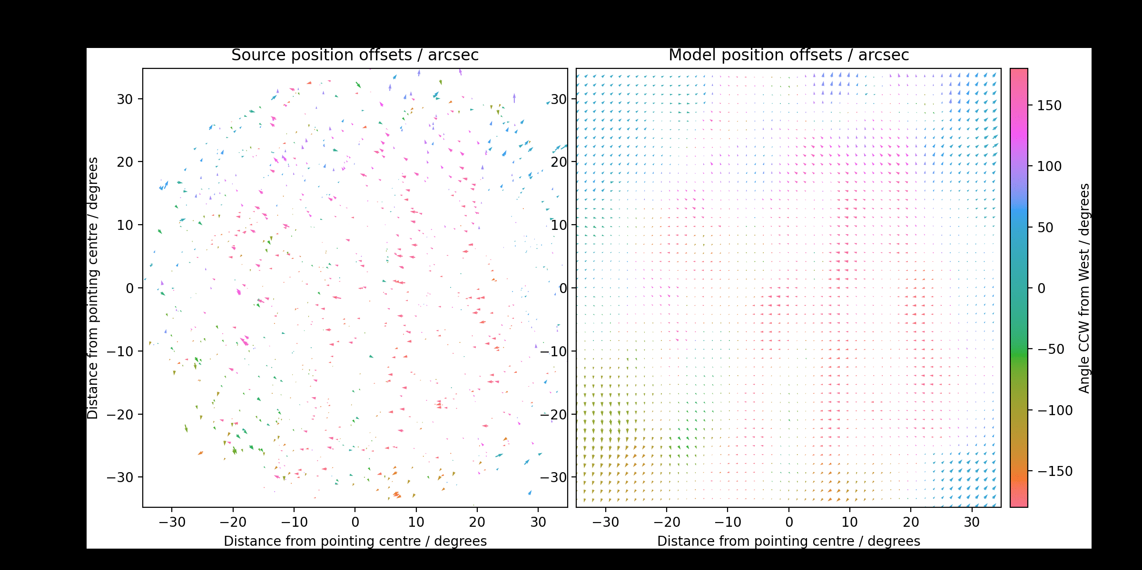
Ionospheric Behaviour: per-snapshot
Use fits_warp (Hurley-Walker & Hancock 2018) to correct source positions to NVSS/SUMSS
Also perform binocular imaging to measure altitude of distortions
Working with NRL (USA) for detailed analysis c/f Helmboldt & Hurley-Walker (2021)

Slide 8
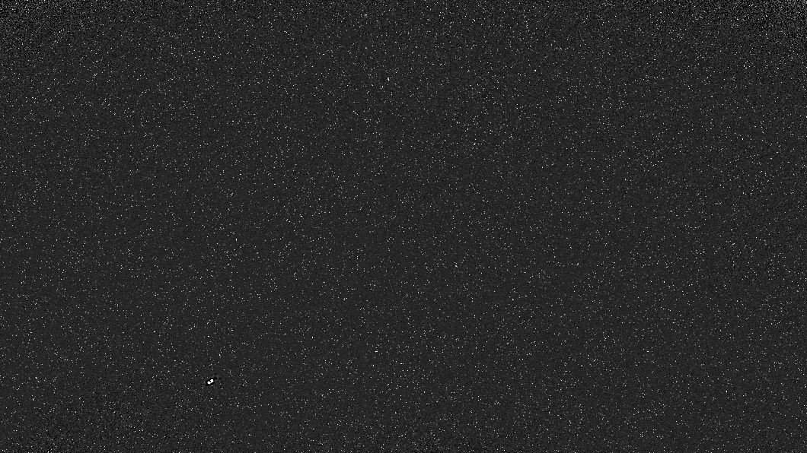
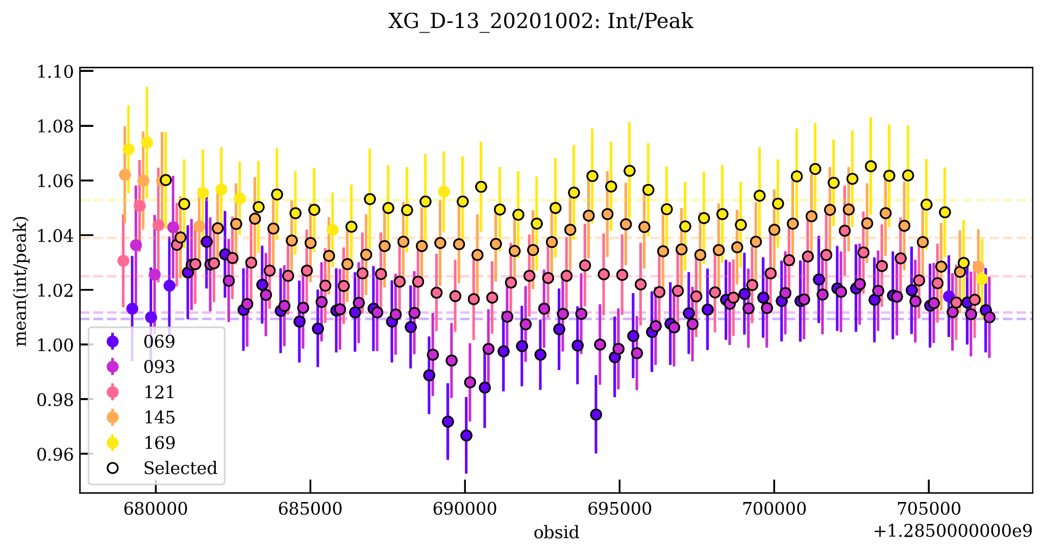

Slide 9
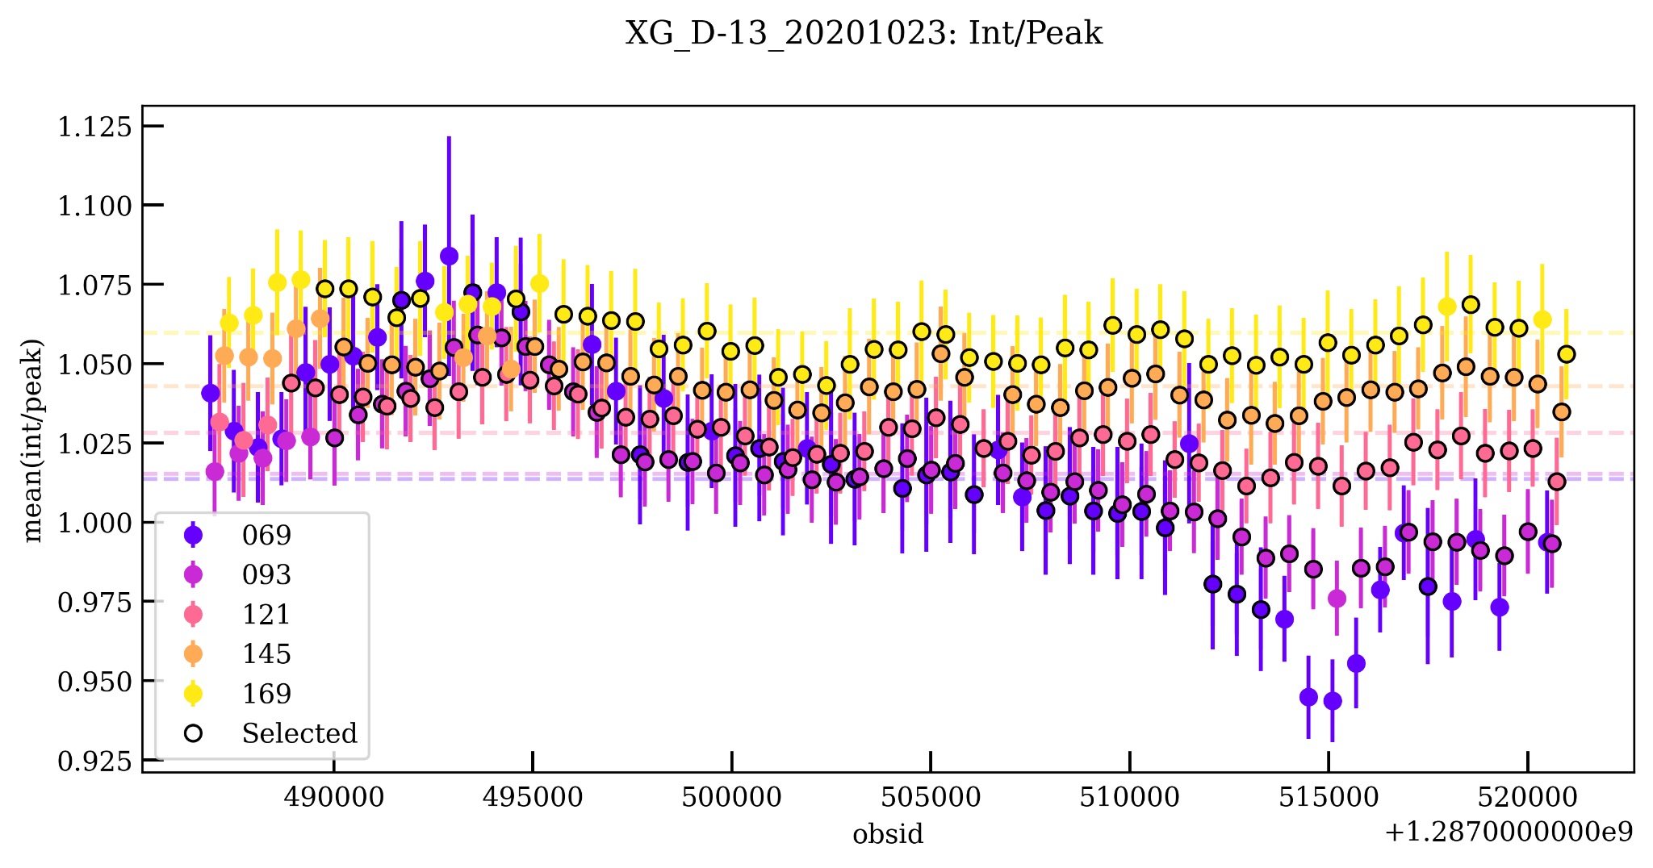

Slide 10
Mosaicking
Images S_{i}
(Scaled and de-warped)
Weights W_{i}
(primary beam/RMS²)
Mosaics Σ S_{i} W_{i}
Σ W_{i}
For each of 84 nights…
For every 7.68 MHz channel and every 30.72 MHz MFS...
Per night: images, weights, intermediate data = 400 GB
Per night: mosaics = 50 GB

Slide 11
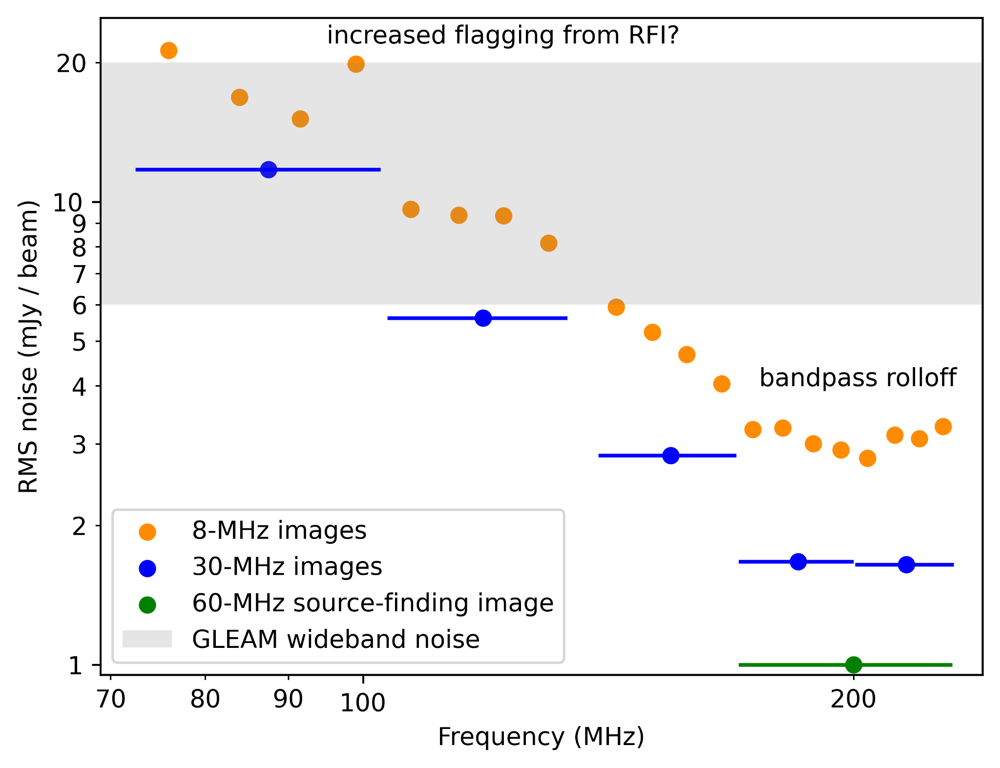
Mosaic properties: noise
Example 8-MHz coadded-mosaic cutouts covering 72 — 231 MHz

Slide 12
Data release 2 status
All nights processed
Quality assurance finished
Final mosaicking and source finding!

Slide 13
What will be available with DRII
Source catalogue:
~750,000 sources
(some) spectral information*

Slide 14
What will be available with DRII
Source catalogue:
~750,000 sources
(some) spectral information*
Image cutouts:
Hosted on Data Central
Cutouts for all frequencies in final DRII mosaics
Per night mosaics?*

Slide 15
What will be available with DRII
Source catalogue:
~750,000 sources
(some) spectral information*
Image cutouts:
Hosted on Data Central
Cutouts for all frequencies in final DRII mosaics
Per night mosaics?*
Intermediate products?
Transient imaging
Weekly variability
Binocular imaging
??

Slide 16
What’s to come
Peaked spectrum catalogue:
PSS in GLEAM = ~1,500 (Callingham+ 2017)
PSS in GLEAM-X = tens of thousands? Fainter PSS!
Long term variability
Days-Weeks:
Changes in absorption? (Ross+2022)
Extreme scattering?
Galactic Plane!
New PhD student, Silvia Mantovanini:

Slide 17
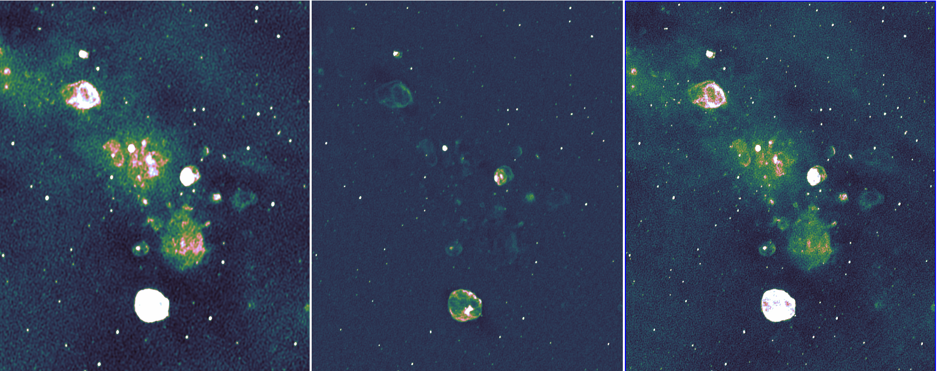
Just two obsids! 139-170 MHz
GLEAM (Phase I)
GLEAM-X (Phase II)
GLEAM + GLEAM-X: Joint deconvolution

Slide 18
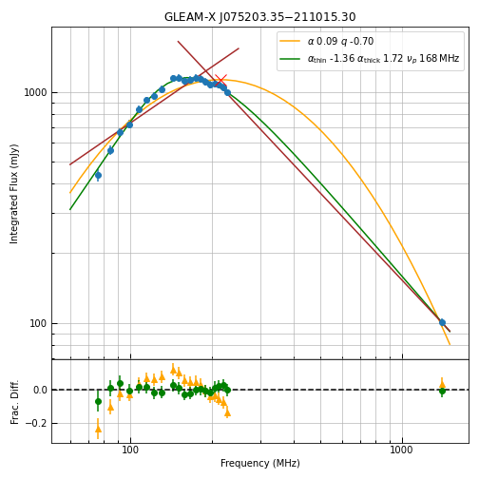
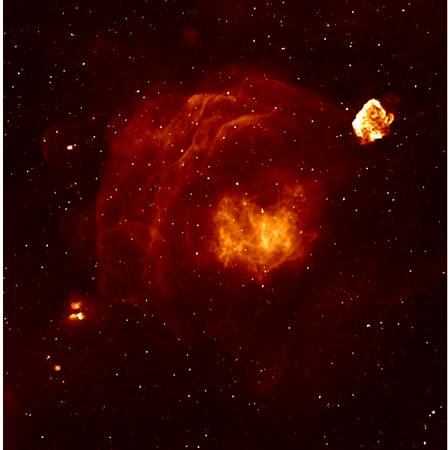
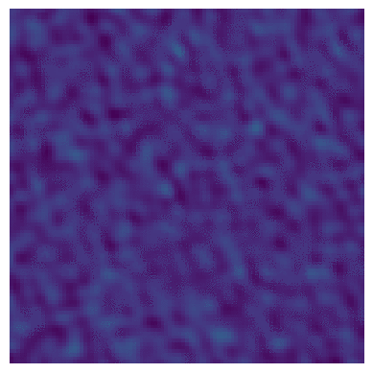
Science prospects
Peaked and curved -spectrum sources:
High-redshift radio galaxies (Drouart et al. 2020, 2021)
Spectral variability (Ross et al. 2021)
Absorption mechanism insights (Callingham et al. 2017)
Galactic astrophysics
New supernova remnants (Hurley-Walker et al. 2019)
Absorption as a 3D probe (e.g. Arias et al. 2019)
Cosmic ray tomography (Su et al. 2017,2018)
Transients and variables
Comparisons with other surveys (Murphy et al. 2018)
New transients (Hurley-Walker et al. 2022a)
Long-term variability (Bell et al. 2020)
Flare stars (Lynch et al. 2017)
Radio galaxies
Magellanic Clouds (For et al. 2018)
Star-forming galaxies (Galvin et al. 2018, Kapinska et al. 2017)
Radio galaxy lifecycles (Quici et al. 2021)
Polarised AGN (Riseley et al. 2020, 2021)
RLFs at low frequencies (Franzen et al. 2021)
& potential for further galaxy cluster studies (Duchesne et al. 2020, 2021), and new discoveries!

Slide 19
Conclusions
Data Release 1 available now (Hurley-Walker et al. 2022b)
Data Release 2 to arrive 2023 (Ross et al. in prep)
72 — 231 MHz = key southern sky survey before the advent of SKA_LOW
Wide range of scientific possibilities
Contact me for more details and to get involved!
RMS = 5 mJy/beam
RMS = 1 mJy/beam

