Slide 1
MWA rapid follow-up of GWs: prospects for detecting prompt radio counterparts
Jun Tian

Slide 2
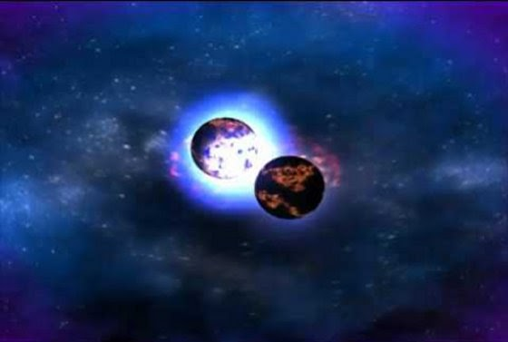
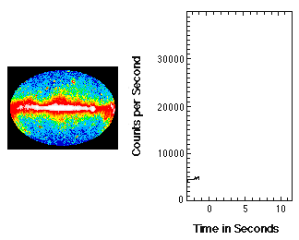
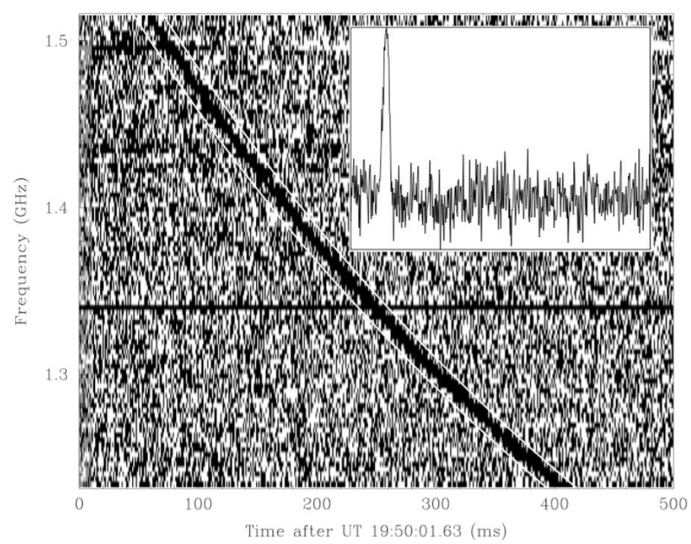
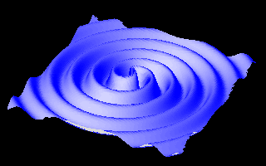
Radio Transients from Compact Binary Merger
NS-NS merger
?
GW
Short GRB
FRB like
Animation by William Folkner, LISA project, JPL
science.hq.nasa.gov
Lorimer et al. 2007

Slide 3
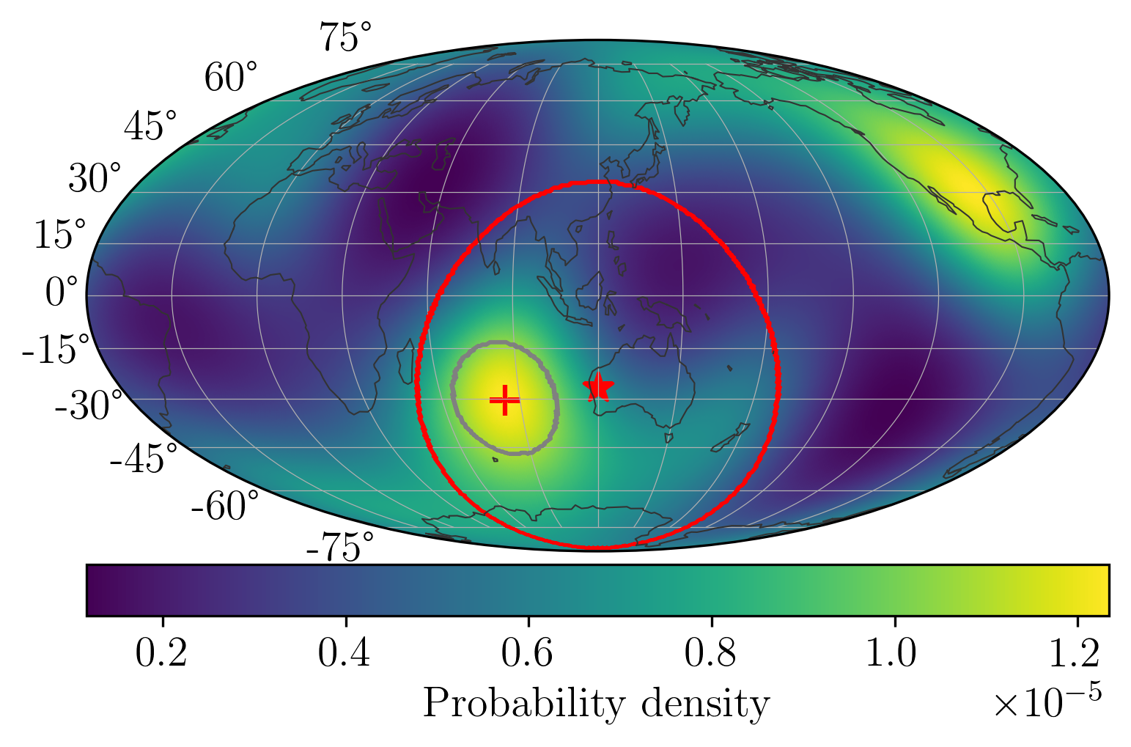
GW detections during O4
A unique opportunity as MWA is well placed to target the highest sensitivity zone of the GW detector network over the Indian Ocean
MWA
Horizon
Probability density map predicted for GW detections in O4

Slide 4
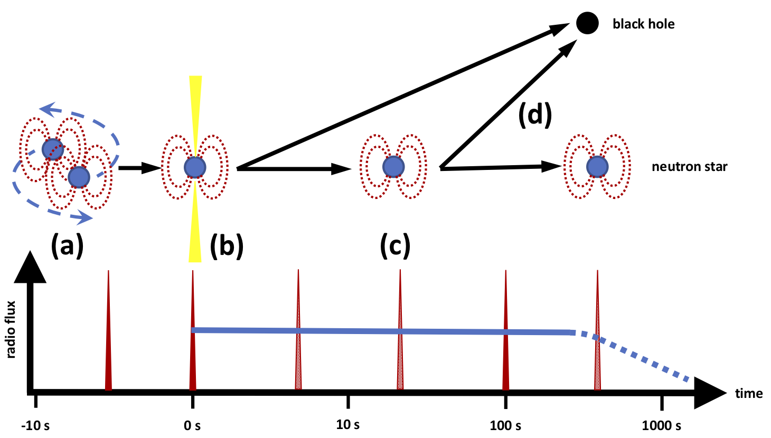
Coherent Radio Emission
Coherent radio emission predictions:
Prompt (FRB-like)
Persistent (dipole radiation)
Merger products (magnetar?) - EoS of nuclear matter
a) B field interactions
b) GRB jet-ISM interactions
c) Remnant dipole radiation
d) Collapse to BH
Rowlinson & Anderson 2019
Notes:
Collapse is not guaranteed, so use ‘if’ instead of ‘when’

Slide 5
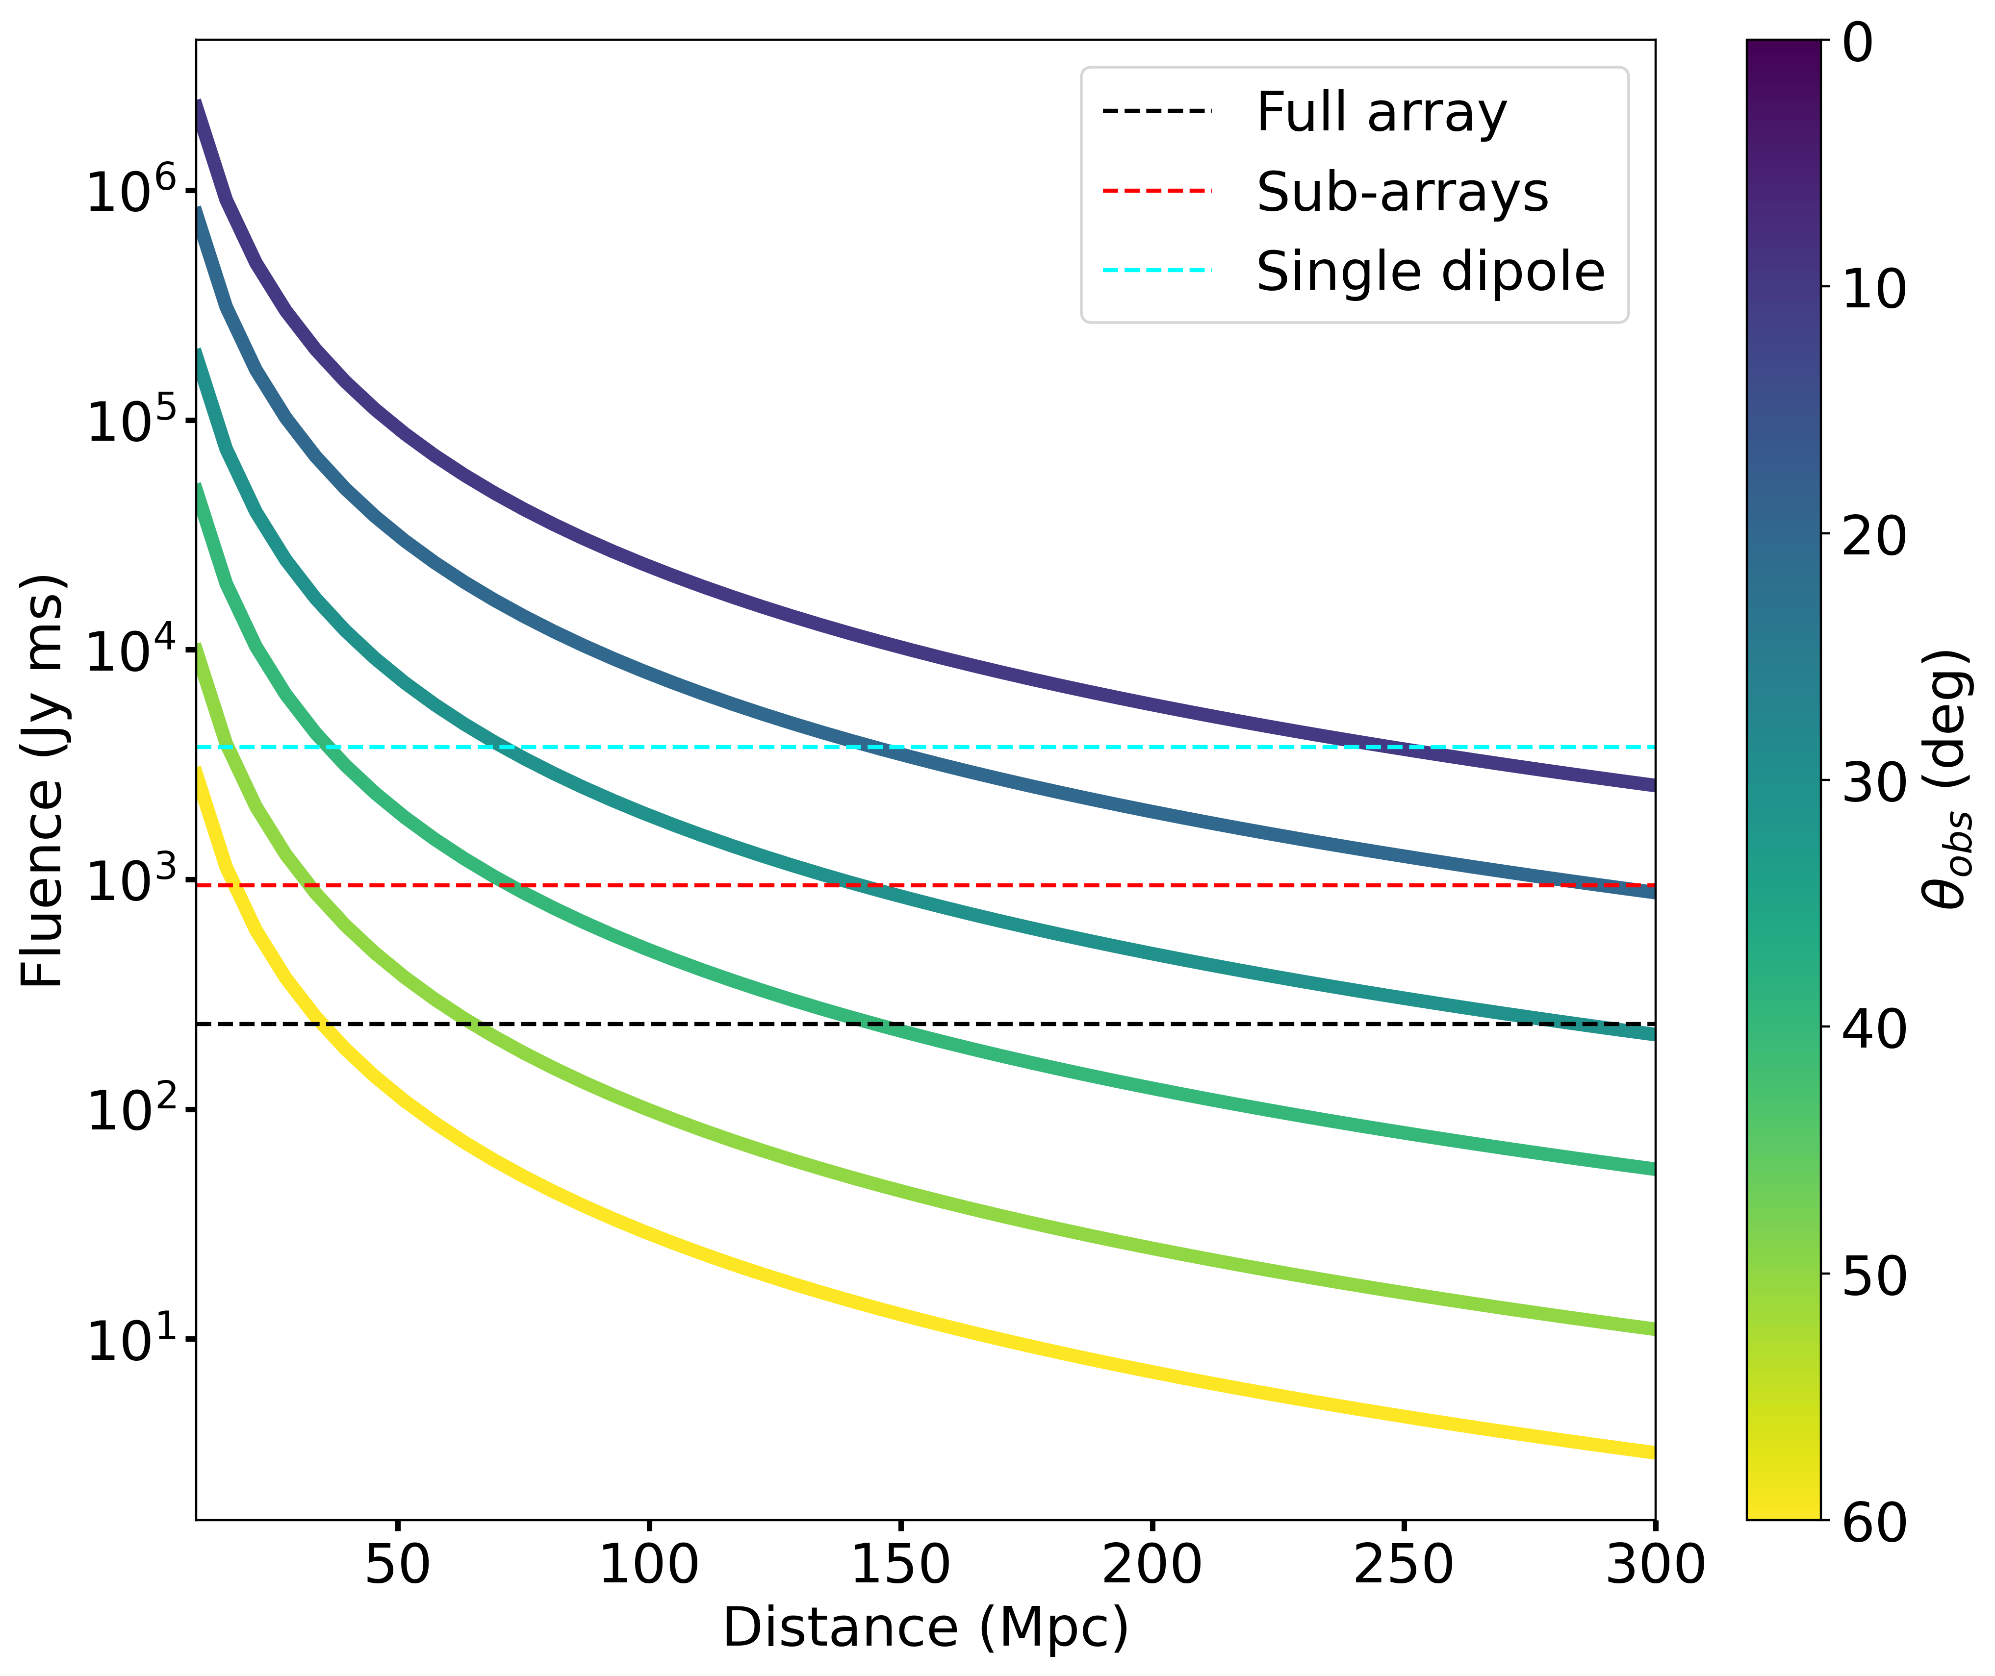
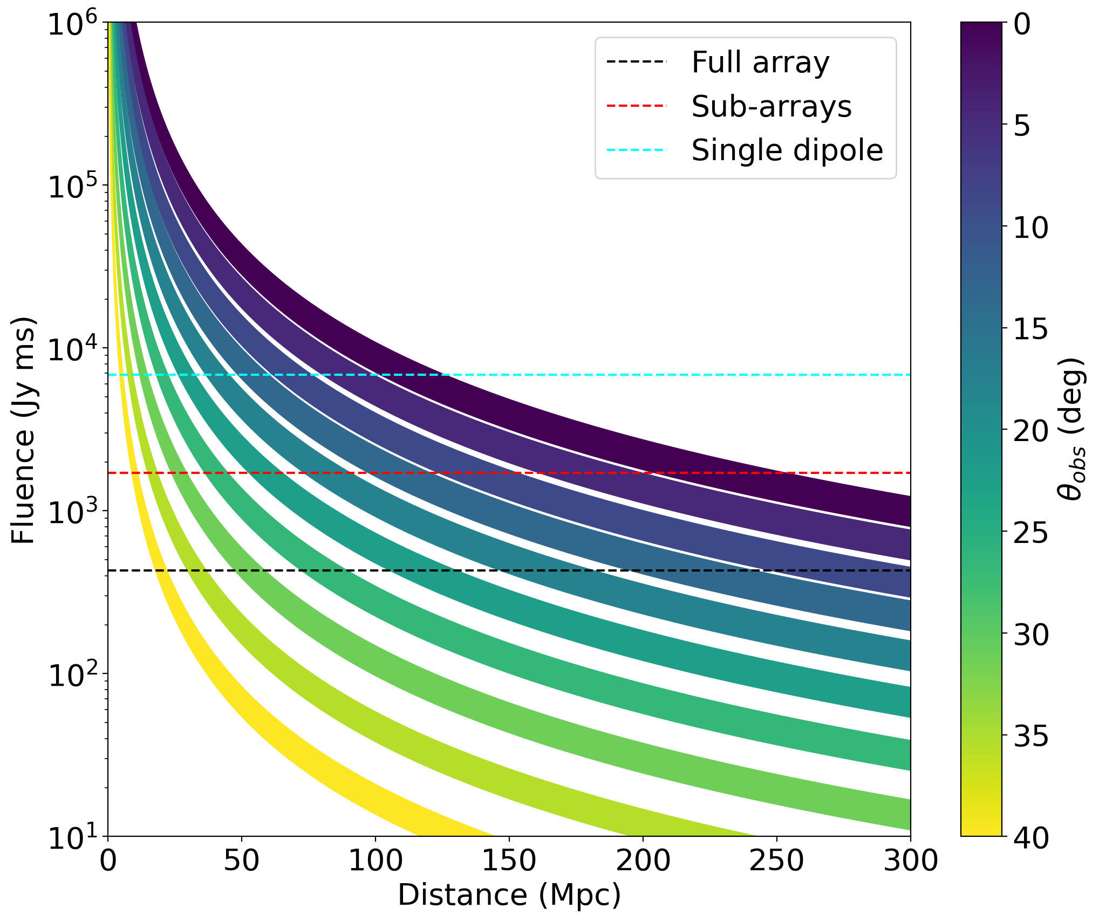
Detectability of the model emission
NS interaction
Jet – ISM interaction
The total fluence of the radio emission predicted to be produced during the last 3ms of the BNS inspiral at 120MHz. The solid lines represent the observable emission with the color corresponding to different viewing angles with respect to the binary merger axis based on the color bar. The three horizontal dashed lines in black, red, and cyan represent the expected sensitivity on ∼ms timescales of the MWA full array, four sub-arrays, and a single dipole per tile, respectively
The fluence of the prompt radio signal predicted to be produced by the relativistic jet and ISM interaction at 120MHz. The regions in different colors show the radio fluence predictions corresponding to different viewing angles from 0deg (on-axis) to 40deg (off-axis)

Slide 6
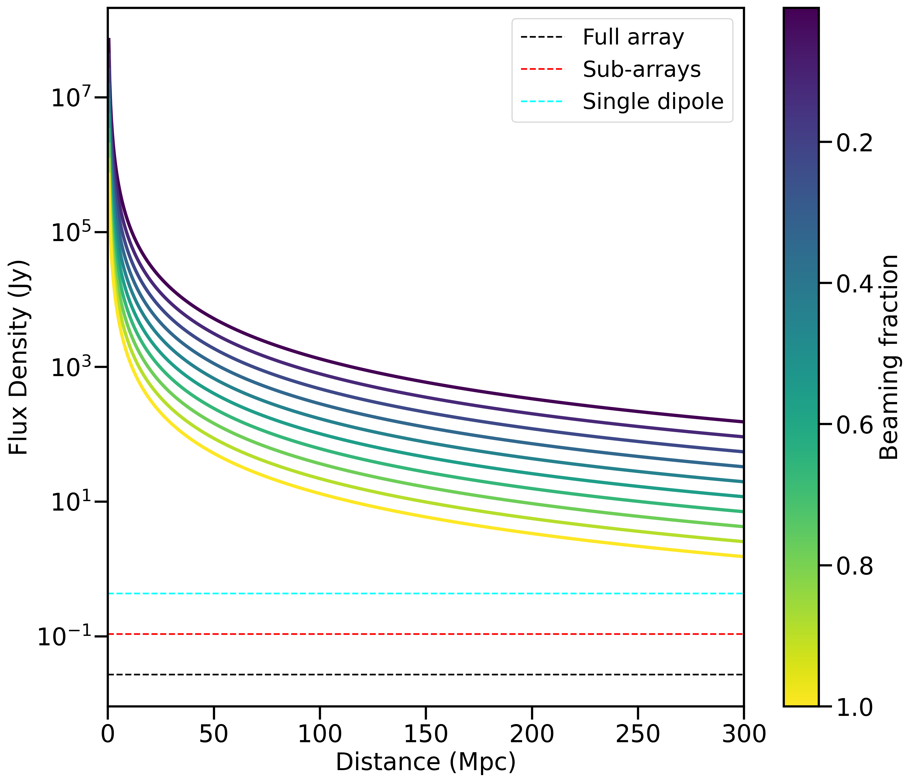
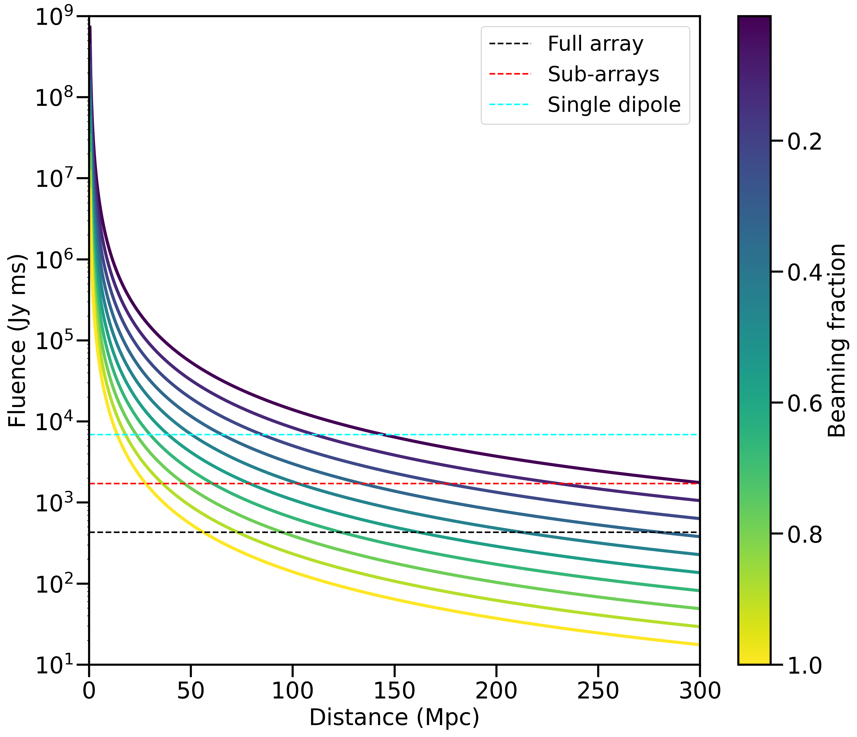
Detectability of the model emission
Pulsar emission
Magnetar collapse
The predicted flux density for the persistent radio emission from the dipole radiation of a magnetar remnant at 120MHz. The solid lines in different colors represent the observable emission from a typical magnetar remnant for different beaming fractions.
The predicted fluence for the radio burst produced during the collapse of the magnetar remnant at 120MHz. The solid lines in different colors represent the observable emission resulting from the collapse of a typical magnetar remnant for different beaming
fractions.

Slide 7
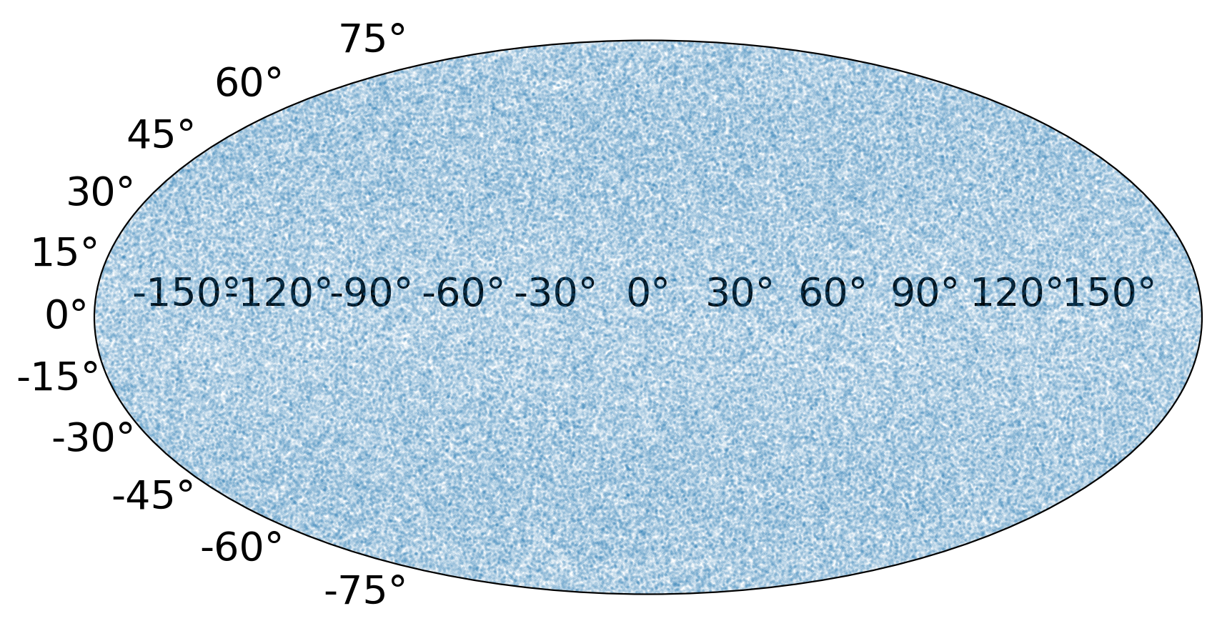
Radio detectable fraction of GW events
Dec
RA
Population synthesis of GW sources
Essential properties of each GW source:
Distance
Binary inclination angle
Intrinsic radio emission
Assuming the same intrinsic emission, the observable radio emission from each GW source varies with distance and binary inclination angle

Slide 8
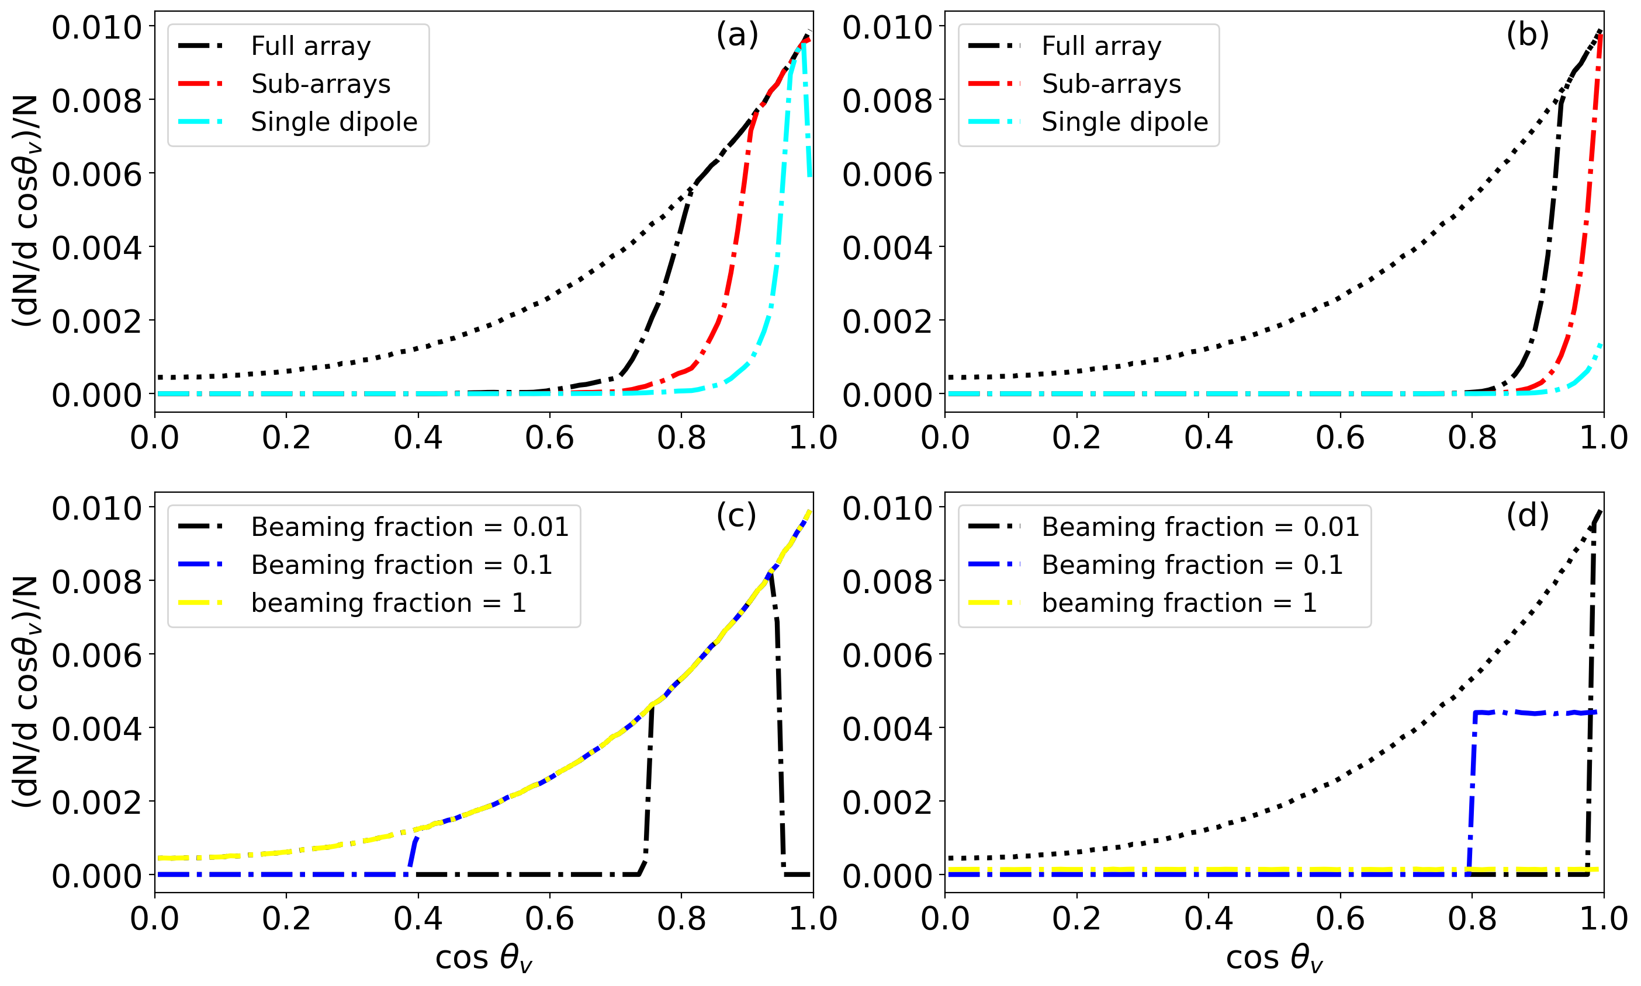
Radio detectable fraction of GW events
Differential distributions as a function of inclination angle of GW detected events in the simulated BNS population (black dotted line) and GW-radio jointly detectable events (dashdot lines) for the four coherent emission models. (a) The interaction of NS magnetospheres. The dashdot lines represent those events with radio emission predicted by the NS interaction model to be detectable by the MWA with the black, red, and cyan corresponding to detections by the full array, sub-arrays and single dipole. (b) The jet - ISM interaction. Here we show the distribution of GW events with radio fluence predicted by the jet-ISM interaction model to be above the MWA sensitivities. (c) The persistent pulsar emission from the magnetar remnant. Given the predicted emission is so bright that its detectability is only dependent on the viewing angle, here we show the distribution of radio detectable events for the three beaming fractions, with the dashdot lines in black, blue, and yellow representing those events with a pulsar beaming fraction of 0.01, 0.1, and 1, respectively. Note that the black dotted line representing the GW detected population overlaps with the yellow dashdot line. (d) The magnetar collapse. Here we show the distribution of GW events with radio emission predicted by the magnetar collapse model to be detectable by the MWA full array.

Slide 9
MWA observing modes: balance between sky coverage and sensitivity
A summary of three observing modes of MWA, including the sensitivity for 1ms and 30min integrations and the field of view (down to 20% of the primary beam) for 120MHz and 200MHz.

Slide 10
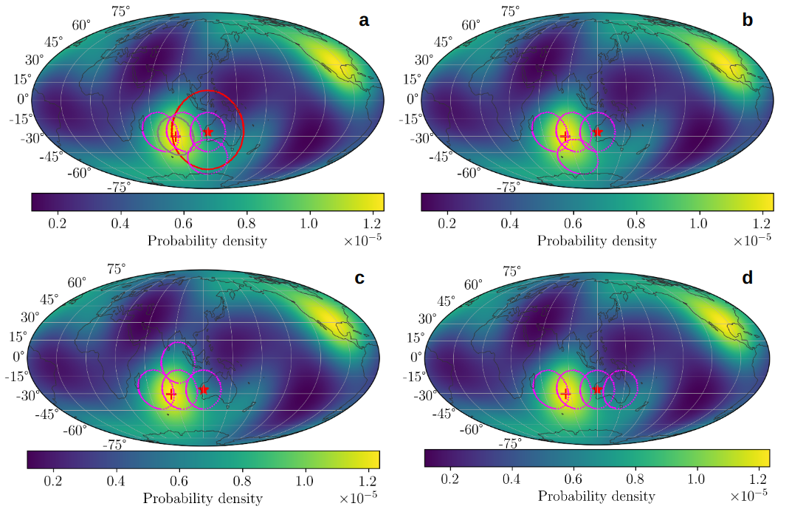
MWA observing modes
Different observing modes over the GW probability density map. In Panel (a), the lines in different colors show the MWA FoV for different observing modes, with the red line corresponding to a single dipole per tile with maximum sensitivity at zenith, the gray line to the full array pointing to the most likely location of GW detections (red cross), and the magenta line to the four sub-arrays. The four pointings of the sub-array observing mode overlap at 50% of the primary beam response, and one of them (the rightmost close to the equator) is towards the zenith. The red, gray, and magenta contours cover 12.4%, 4.9%, and 12.6% of GW detections, respectively. Panels (b), (c), and (d) show different sub-array configurations in aid of determining the optimal pointings of the sub-array observing mode.

Slide 11
Prospects of detecting the model emission
Detectable fraction of the four model emissions at 120MHz among all GW detections in O4 by the three MWA observing modes. The Sub-arrays a, b, c and d correspond to the four sub-array configurations displayed in the previous slide.
Conclusion: sub-arrays b is the optimal observing strategy for searching for radio counterparts to GW events when GW alerts contains no or poor positional information.

Slide 12
MWA observing strategy
Shadow the LVK network's highest sensitivity region over the Indian Ocean, maximising our sky coverage by pointing MWA using the 4 beam sub-array configuration
On receiving an Early Warning Alert or a Preliminary Alert of a BNS or BH-NS merger, we will trigger the buffering mode, obtaining up to 240s of negative latency data on a significant portion of the sky
Continue recording with the VCS for up to 3 hours
Automatically repoint the array when subsequent alerts (Preliminary Alerts and Initial Alerts) with better positions and/or positional errors become available
Cancel the observation in the case of a Retraction Alert or if the GW event is outside the MWA sky for up to 3 hours into the future

Slide 13
Summary
The 4 beam sub-arrays of MWA pointed at the LVK network’s highest sensitivity region can cover 12.6% of GW BNS detections during O4.
The MWA could potentially capture the earliest radio emission from BNS mergers, with the probability of detecting the NS interaction and jet-ISM interaction model being 4.6% and 1.2%, respectively.
We expect MWA to trigger on 5 - 22 BNS merger events during O4, of which 2 might have Early Warning Alerts, which could potentially result in the detection of the predicted coherent emission or place significant constraints on the emission models.

