Slide 1
I acknowledging the Traditional Owners of the lands that we host our facilities on across Australia.
I pay my respect to their Elders past and present, and recognise their continuing connection and custodianship of the lands, seas, and waters throughout Australia.
Notes:
In particular…

Slide 2
I acknowledging the Whadjuk People of the Noongar nation as the Traditional Owners of the land that we’re meeting on today.
Notes:
In particular…

Slide 3
We acknowledge the Wajarri Yamaji as the Traditional Owners and native title holders of
Inyarrimanha Ilgari Bundara, our Murchison Radio-astronomy Observatory site
where the Murchison Widefield Array is located.
Robin Boddington
Galactic ASKAP - Neutral Hydrogen
2022, detail
Notes:
I do not expect you to read out painting details.
I would like to take a moment to acknowledge the Wajarri Yamaji as the traditional owners and native title holders of the observatory. Paying particular respects to the partnership we share with them as we work towards the successful operation of the Observatory.

Slide 4
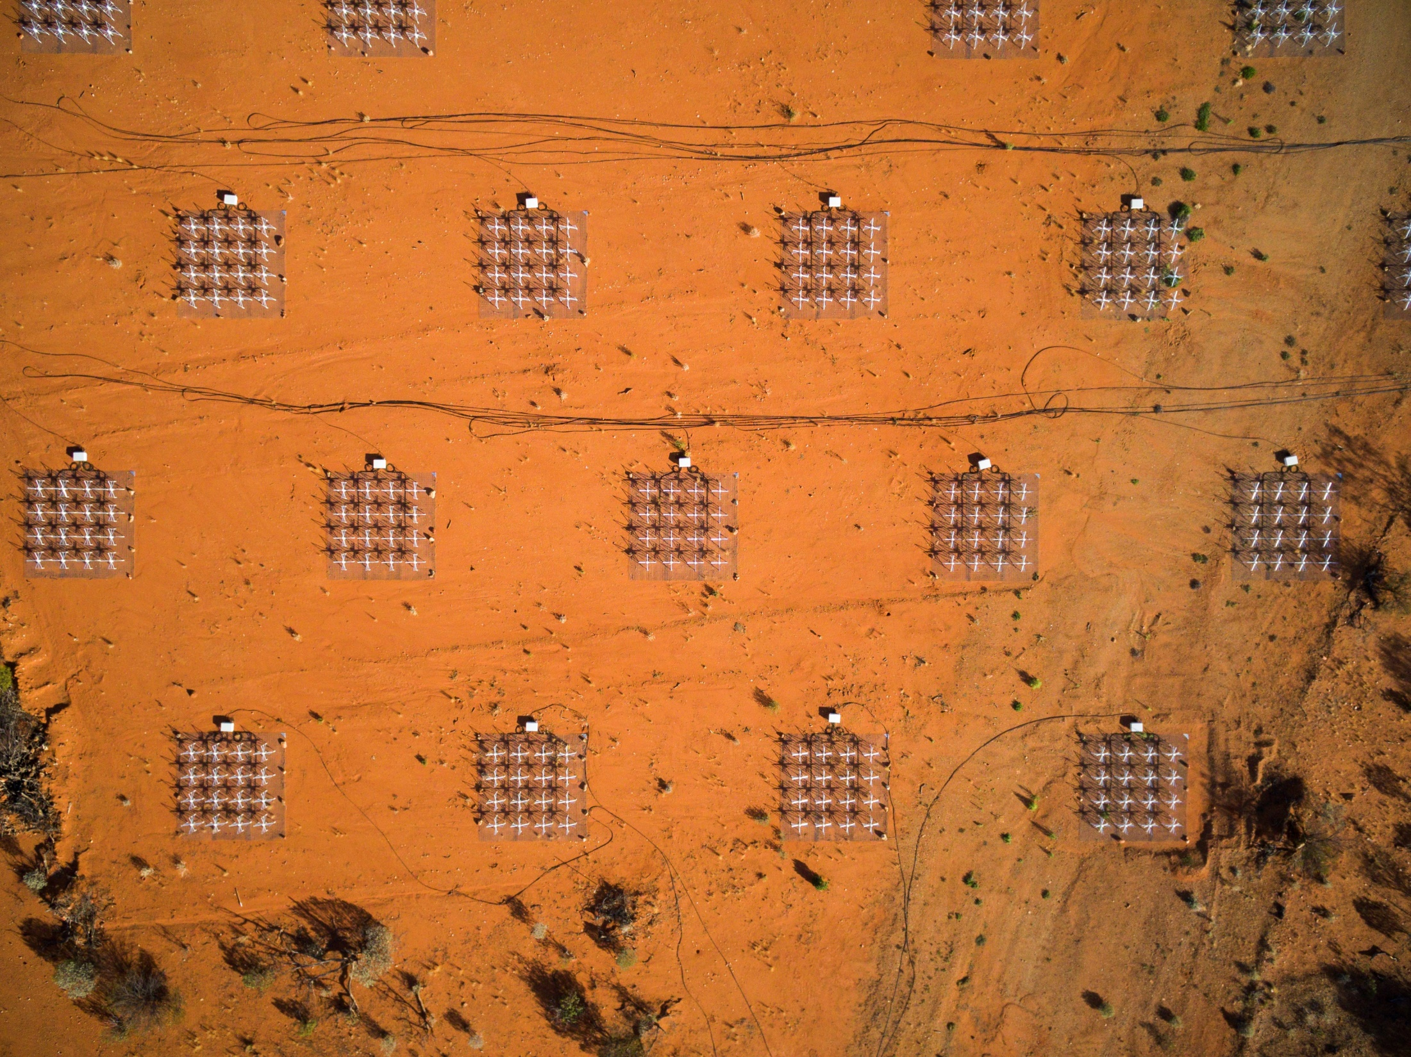
Notes:
House Keeping
In the event where an evacuation is required an alarm will sound, two tones, the first being an alert tone, the second being an evacuate tone
Muster Point – located in the car park outside, the large grassed area near the base of the stairs
First Aid – if for whatever reason you are fill unwell, or require first aid, please see reception
Also for anyone on Twitter or whatever it is called today… CSIRO ATNF has given the MWA a shout out in celebration of MWA’s 10th anniversary.

Slide 5
Inyarrimanha Ilgari Bundara, the CSIRO Murchison Radio-astronomy Observatory
Margaret Whitehurst
Rapid ASKAP Continuum Survey (RACS)
2019, detail
Notes:
Here follows a brief overview of the observatory and its radio astronomy projects.

Slide 6
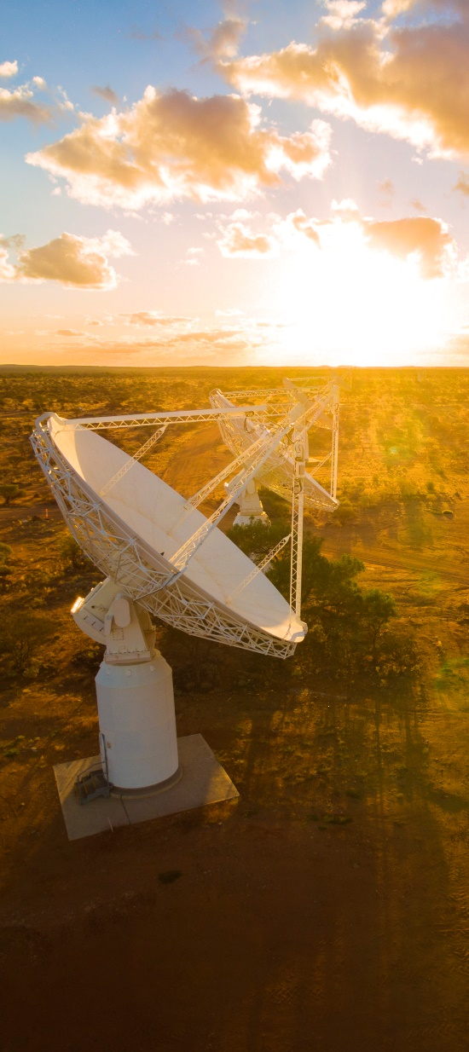
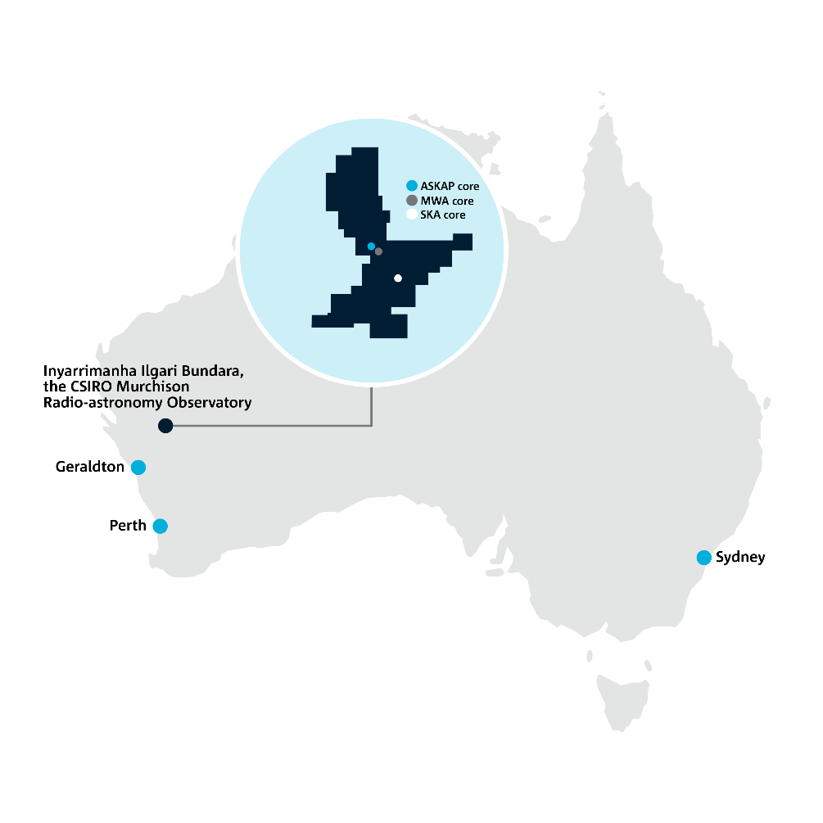
Observatory site
Notes:
Observatory is now 27 times larger than the previous Murchison Radio-astronomy Observatory, at 345,748 hectares.
Location - About 370km from Geraldton to roughly what I would call the centre of the observatory, or 700km from Perth
If I were to drive from the southern most point of the Observatory, to the northern most point, it would take me about an hour and a half… so definitely a big place
Image: MWA tiles

Slide 7
Wajarri Yamaji
Traditional Owners and native title holders of our radio observatory on Wajarri Yamaji Country in Western Australia
New Indigenous Land Use Agreement (ILUA) with the Wajarri Yamaji, signed last year
Provides intergenerational benefits to Wajarri Yamaji as it is in place for 50 years
First action of the ILUA was a new name for the expanded observatory
Announcement of the new name and celebration of the ILUA signing was held on Country, 5 November 2022
Notes:
The Wajarri Yamaji community and its forebears have lived with, cared for, and been occupiers and custodians of this land for thousands of years. Their living culture and unique role in the life of the region is acknowledged and the key to the success of the Observatory is our relationship with the Traditional Owners, the Wajarri Yamaji. Without their partnership we would not be able to successfully deliver on the ambitions for the future of the Observatory.
Protection of Wajarri heritage on site is one of our major priorities, we have promised to protect and preserve their heritage and cultural places during the operation of Observatory and during construction of the SKA-Low
A new ILUA was negotiated for whole station to become the much larger observatory and this will help establish opportunities for the Wajarri that will be spread across multiple generations with the life span of the Observatory being 50 years
Last year we concluded negotiations for an Indigenous Land Use Agreement, one of the first of its’ kind in Australia… which lead us to being gifted with a new name for the Observatory…

Slide 8
Inyarrimanha ilgari bundara
The Wajarri component of the dual name for our radio observatory means ‘sharing the sky and stars’
Inyarri-manha
Share-ing
Ilgari
Sky
Bundara
Star
Full name:
Inyarrimanha Ilgari Bundara, the CSIRO Murchison Radio-astronomy Observatory
Notes:
It is important for us to acknowledge that the Observatory has a dual name, this is a key departure from how we used to refer to the observatory
The name was selected by the Wajarri Yamaji Aboriginal Corporation, from a pool of entries submitted by the local community.
The observatory name is both the Wajarri part, and the English component.

Slide 9
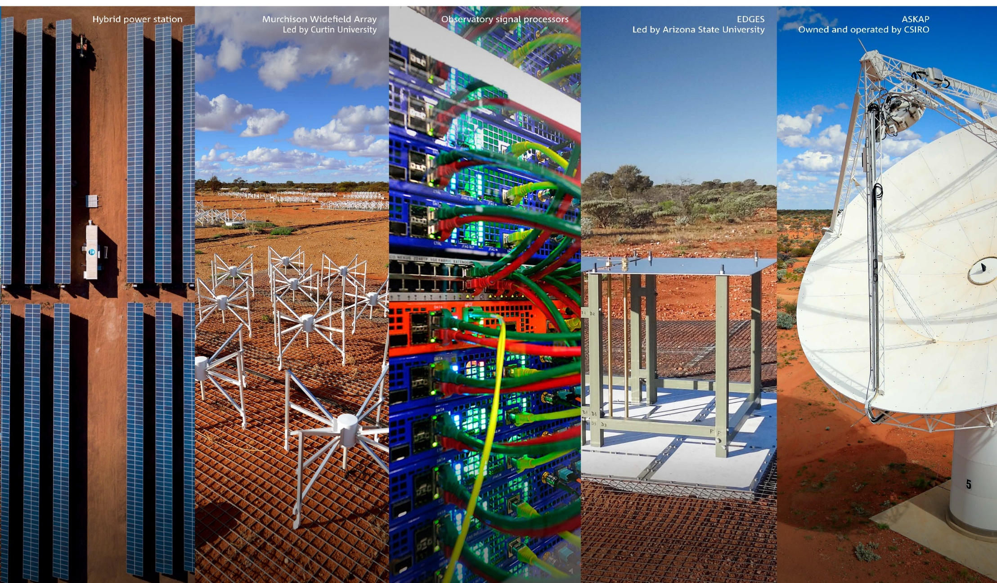
Notes:
Infrastructure and telescopes
Power station
MWA
Control building and signal processing
EDGES
ASKAP radio telescope
ASKAP
It is a high sensitivity, wide field of view survey telescope able to ‘look’ at large areas of the sky at once.
It has 36, 12-m wide dishes spread over six kilometres
It also features CSIRO’s multi-award winning phased array feed receivers – which are like high resolution cameras, only in radio frequencies.
MWA
8000 low frequency antennas in 128 ‘tiles’
Covers an area 3 km across
International consortium, managed by Curtin University
EDGES
Experiment to Detect the Epoch of Re-ionisation
Lead by Arizona State University
SKA-Low
The SKA-Low will be comprised of over 131,000 “Christmas-tree” antennas.

Slide 10
History of the observatory
2009 – First ILUA signed with Wajarri Yamaji
2009 – Establishment of CSIRO’s Murchison Radio-astronomy Observatory
2011 – EDGES established on site
2012 – Official opening of the observatory and our ASKAP radio telescope
2012 – SKAO makes site decision for hosting the SKA telescopes: 2 countries
2013 – Murchison Widefield Array launched at the observatory
2020 – CSIRO establishes the Site Entity to manage an extended observatory
2022 – New ILUA for expanded observatory site; dual name introduced
2022 – Official start of SKA-Low construction
Agnes Boddington
FLASH
2022, details
Notes:
2009 – First ILUA signed with Wajarri Yamaji
2009 – Establishment of CSIRO’s Murchison Radio-astronomy Observatory
2011 – EDGES established on site
2012 – Official opening of the observatory and our ASKAP radio telescope
2012 – SKAO makes site decision for hosting the SKA telescopes: 2 countries
2013 – Murchison Widefield Array launched at the observatory
2020 – CSIRO establishes the Site Entity to manage an extended observatory
2022 – New ILUA for expanded observatory site; dual name introduced
2022 – Official start of SKA-Low construction

Slide 11
Thank you
Site Entity
Chris Brayton Deputy Site Entity Lead
+61 8 6436 8667
chris.brayton@csiro.au
csiro.au/MRO
Notes:
Gosh darn it, I can’t remember how these slides are meant to look

