Slide 1
Principal Engineer’s Update
Randall Wayth - July 2023 project meeting

Slide 2
Outline
Early MWA engineering
MWA Development
The Phase II era
The MWAX era Part 1: signal (un)chained
The MWAX era Part 2: towards real-time beamforming
The future

Slide 3
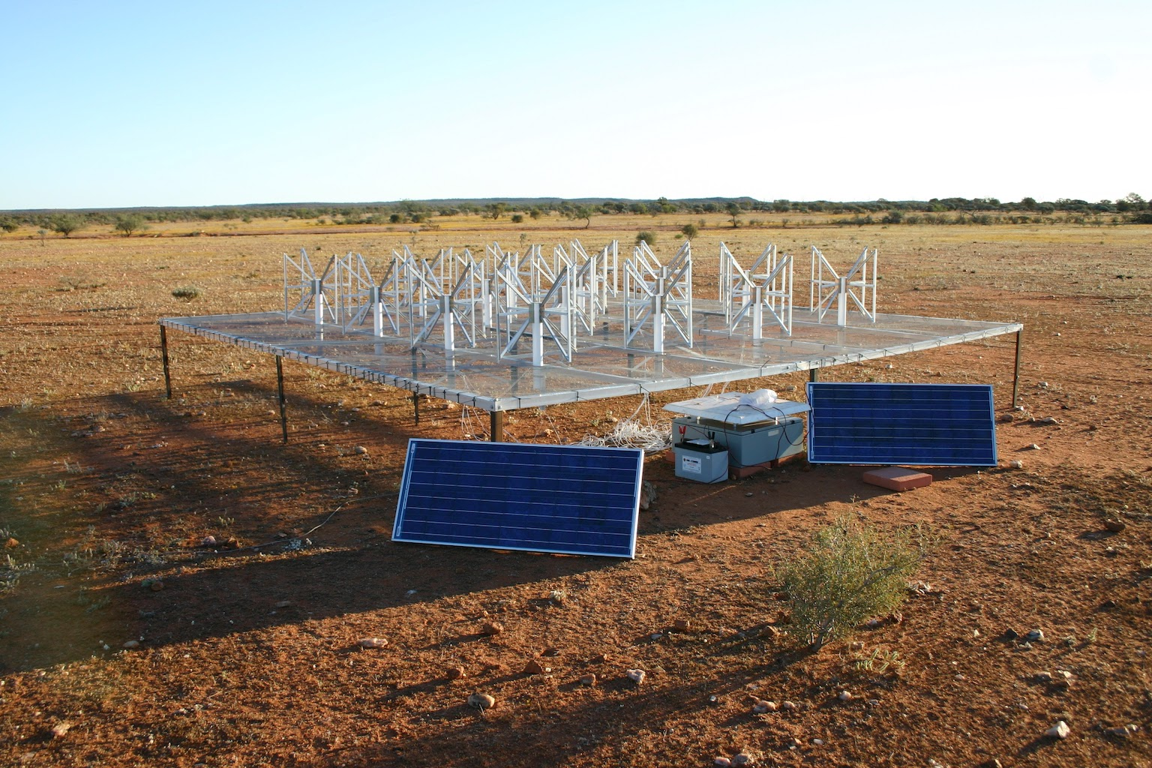
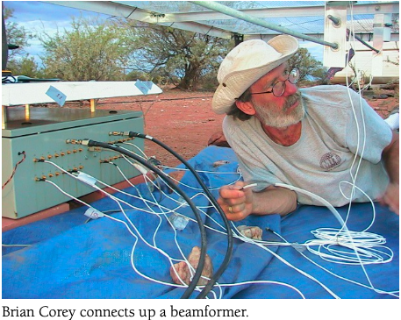
Early MWA Engineering
Sep 2005
MIT Haystack: (PE: Roger Cappallo, Guru: Alan Rogers + team)
Antenna/LNA, beamformer - Eric Kratzenberg & Brian Corey
Clock
FinePFB/correlator – CSIRO + Haystack
RRI: (Prabu T, Vani, G-K + team)
Digital systems (ADFB, AgFo)
ANU (Guru: Frank Briggs, Mark Waterson + team)
Analogue Signal Conditioner + Rx
Melbourne, Curtin: Technical, logistical support
March 2005. Image: D. Herne

Slide 4
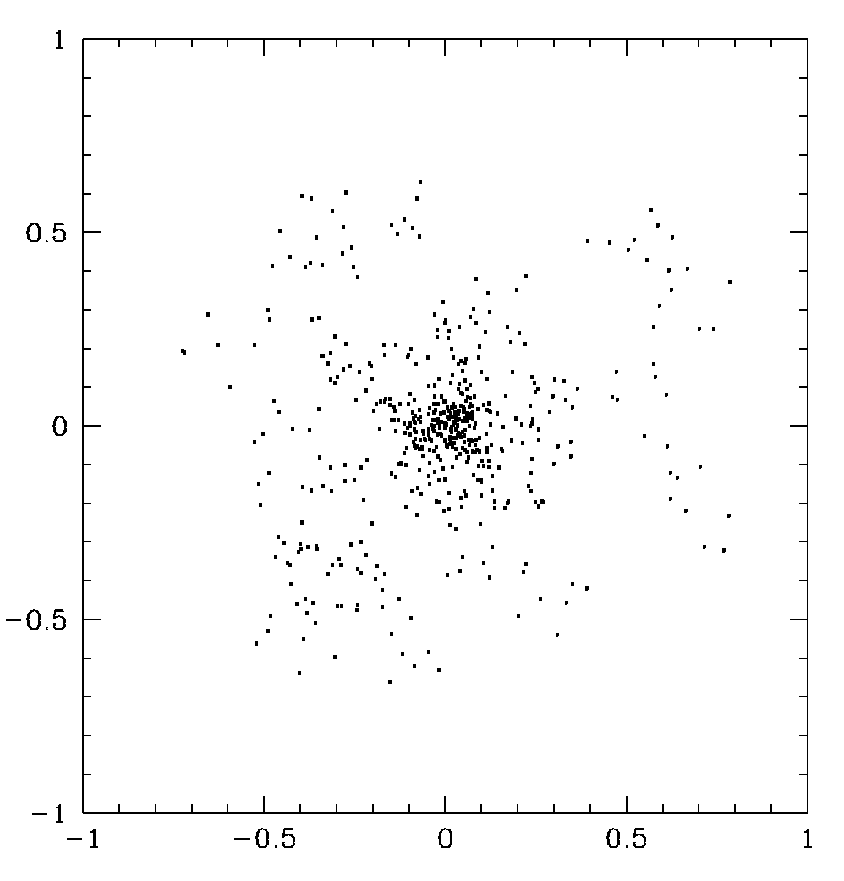
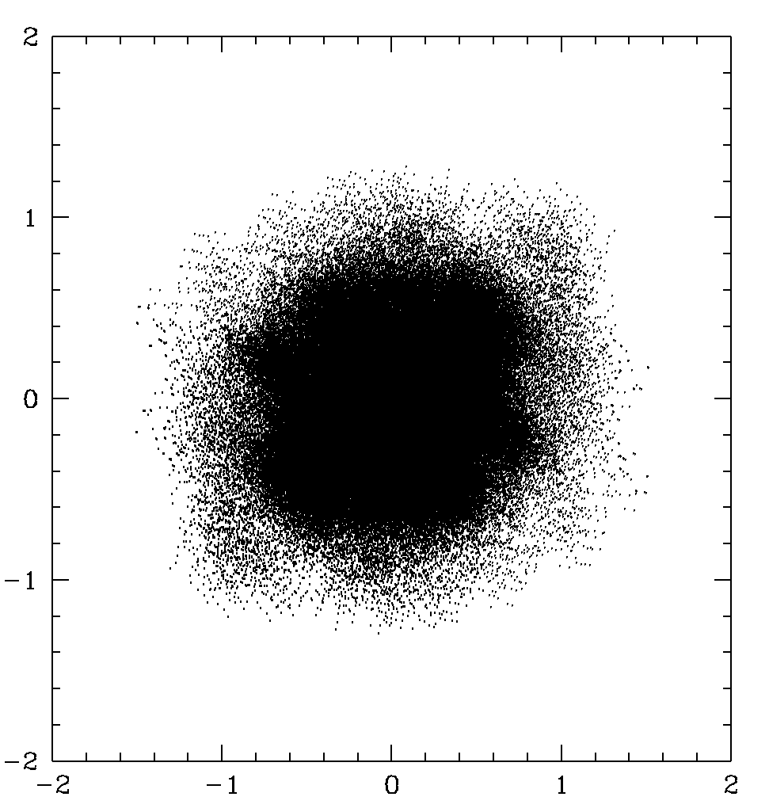
Development – Original Concept
From a 2007 slide…
Originally the “Low Frequency Demonstrator”: MWA-LFD
512 tiles, HW correlator, real-time cal & imaging (FTW!)
Aperture plane
u,v plane

Slide 5
Phase 1 era: 128T
Industry partnerships for hardware and infrastructure
Wandering guru: Bob Goeke
Large student/staff cohort part of construction
Hybrid FPGA/GPU correlator, with very limited parameters, but does the job.

Slide 6
MWA digital signal path
From June 2016 meeting
Software correlator (could run on 6 boxes with current GPU, network)
Bespoke protocol
10G ethernet
Bespoke protocol
From Tremblay et al, 2015.

Slide 7
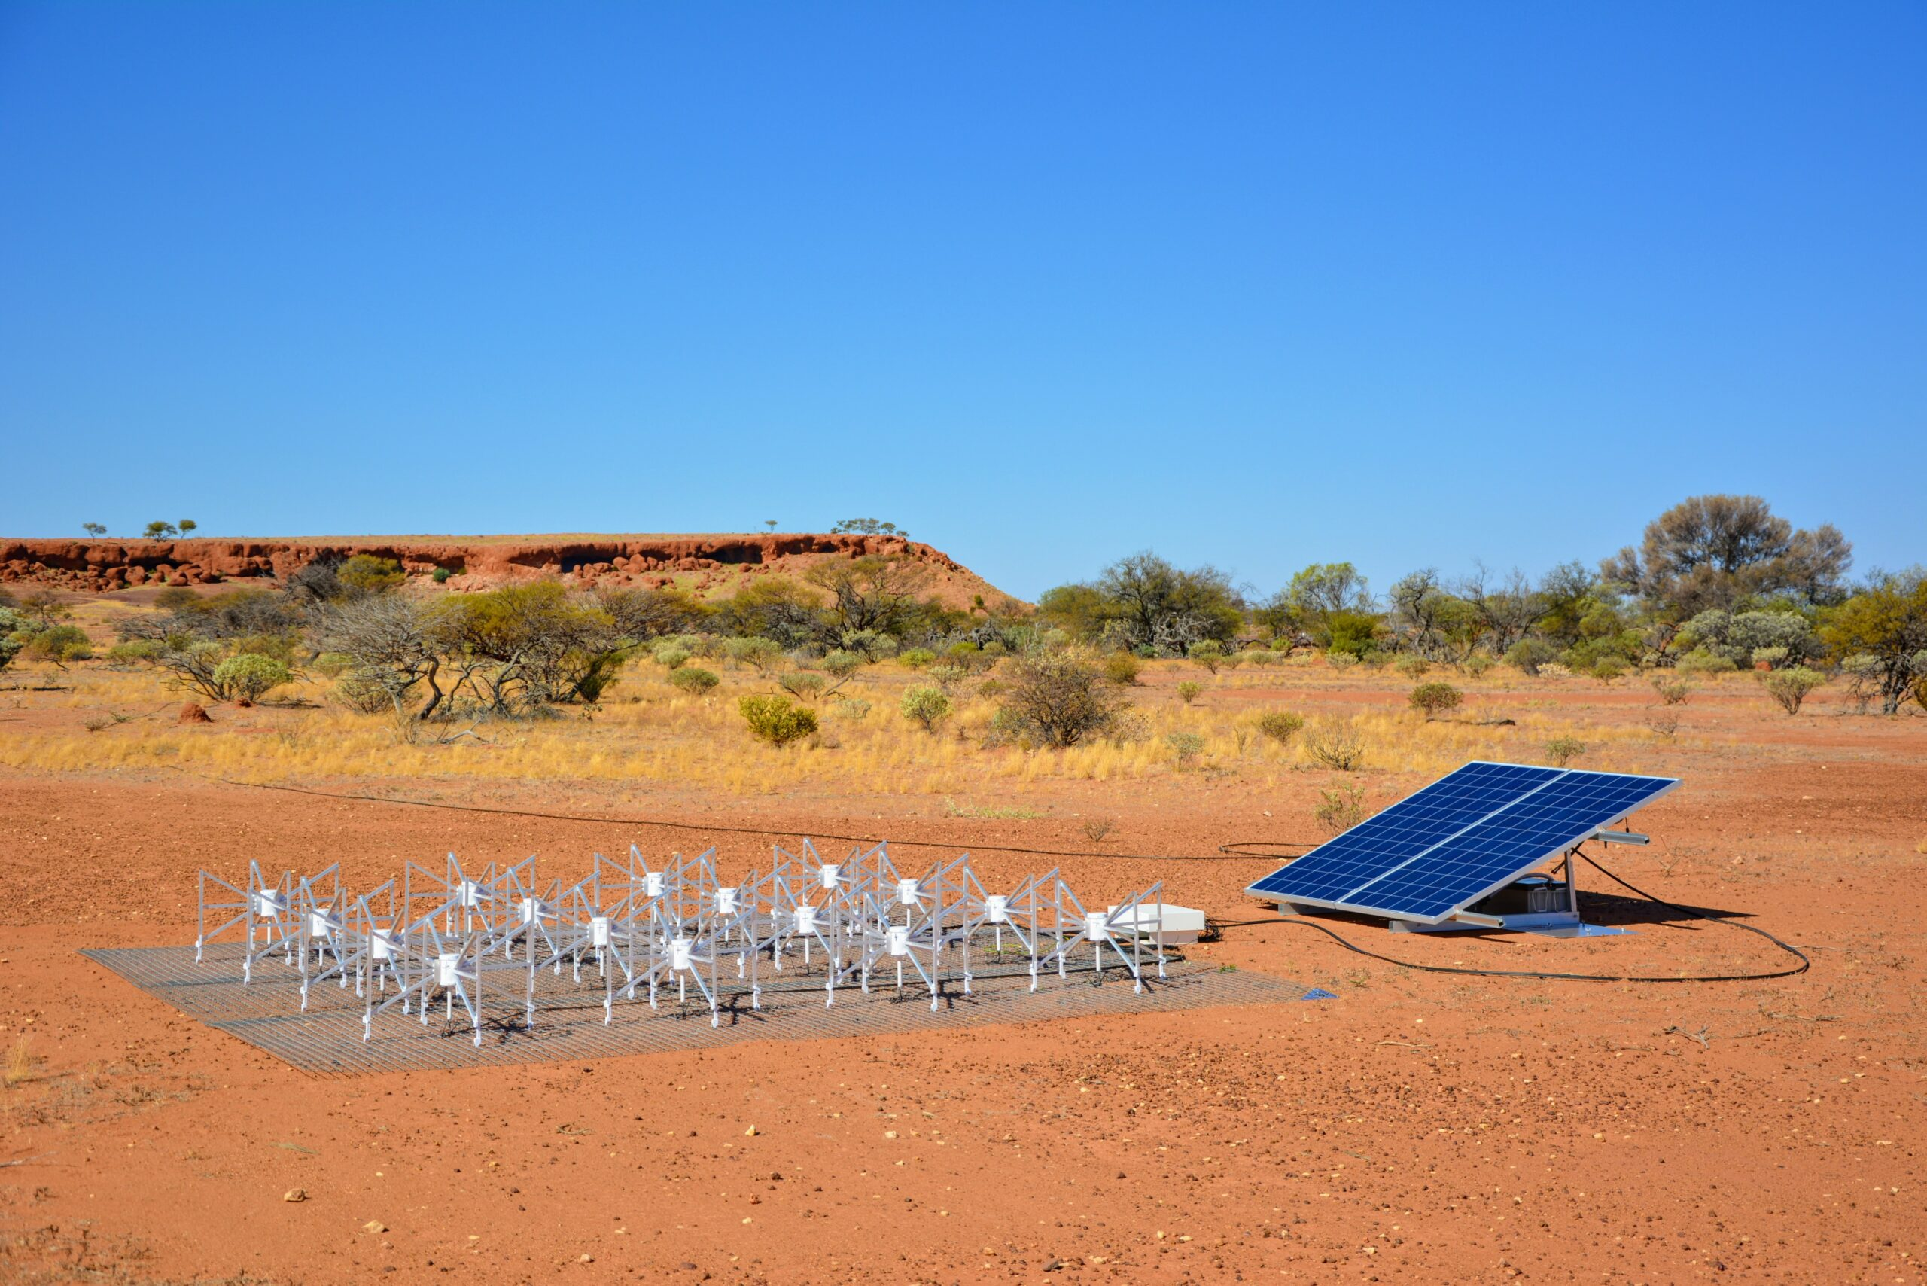
The Phase 2 era
128 New Tiles!
56 new long baselines -> x2 diameter!
Redundant arrays – back in fashion!
Same Rx and signal path: 2 configurations with manual reconfig (time, risk)

Slide 8
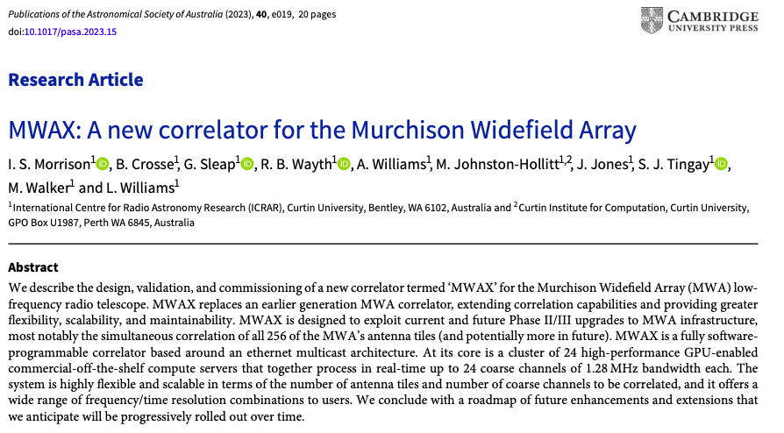
The MWAX era
Paper published – please cite where appropriate!
Current/recent activities:
Coarse channel bandshape correction
Correct vis weights (e.g. missing or flagged data)
Static delay corrections
Fringe tracking available
Working towards real-time beamforming – many subtle details

Slide 9
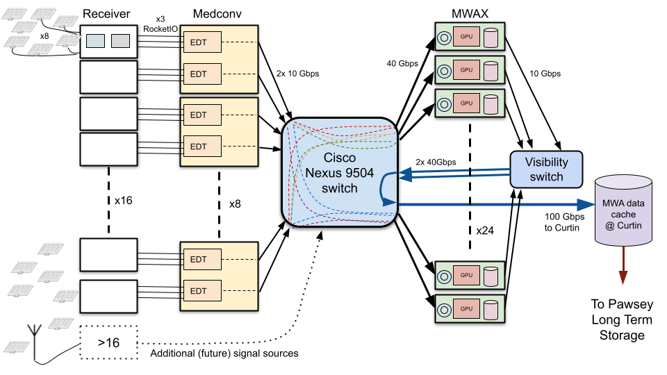
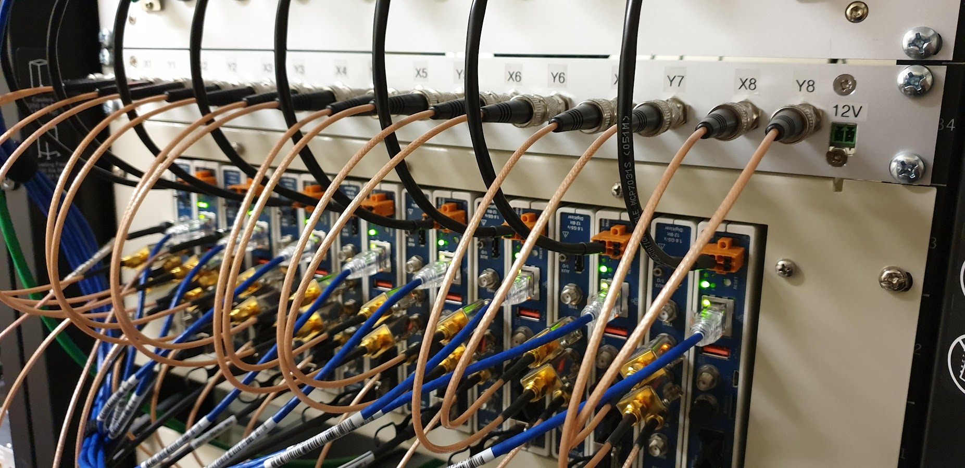
New MWA signal path
Rx 17
Rx 18

Slide 10
New Receivers: NI receiver
RRI-compatible digital PFB created for these units.
Units do not have ASCs (no gain, no filtering)
However, the output power levels from MWA RFoF tiles (after the RFoF link) are fortunately at the right level such that gain is not required
Only a lowpass anti-aliasing filter
These units output true 8-bit samples, so have more intrinsic dynamic range than RRI units
Jake Jones + MWA ops
Prototype 8-tile receiver using NI FlexRIO units
RFoF = Radio frequency over fibre

Slide 11
New Receivers: SHAO Receiver
Full receiver system
Designed for signal levels from coax and RFoF tiles
Data output on standard network interfaces
Compatibility mode replicates PFB of existing receivers
Future mode can generate oversampled coarse channels
Raw voltage capture capability
Extensive lab testing

Slide 12
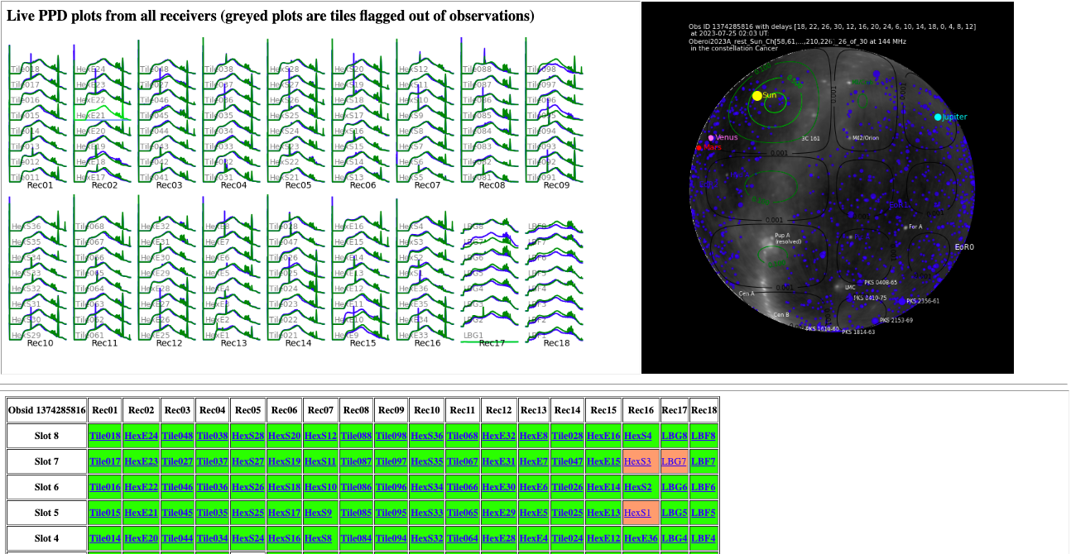
Show live status pages
https://ws.mwatelescope.org/tiles/tilemap/
http://telemetry-static.mwa128t.org/liveplots/

Slide 13
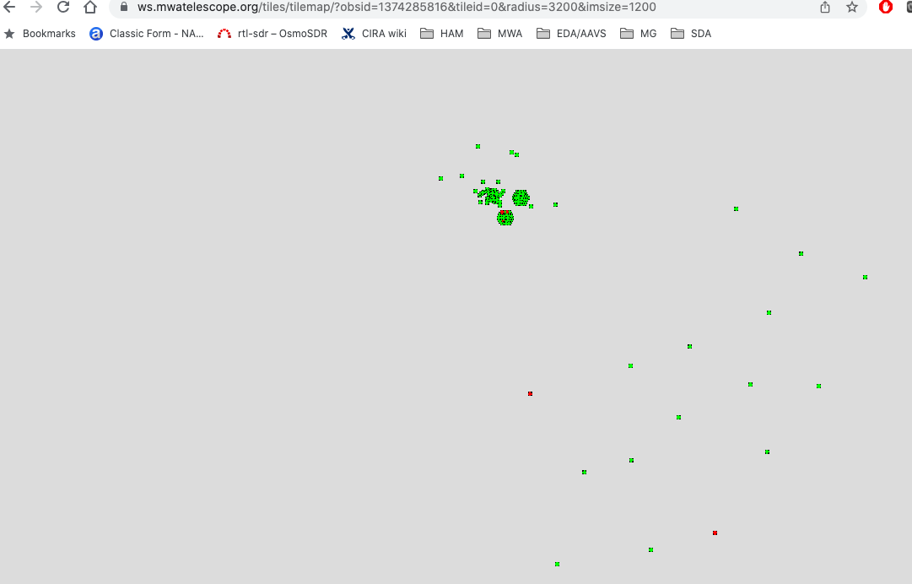
Show live status pages
https://ws.mwatelescope.org/tiles/tilemap/
http://telemetry-static.mwa128t.org/liveplots/
MWA Currently active tiles

Slide 14
The Future: From 144T towards 256T
From a 2016 slide…
With a full complement of receivers:
No array reconfigs! – all antennas available all the time
Consolidation of signal paths, with new power and aggregation points
With 32 new Rx, move to oversampled PFB
A 256T MWA is the same magnitude signal processing as SKA1-Low

Slide 15
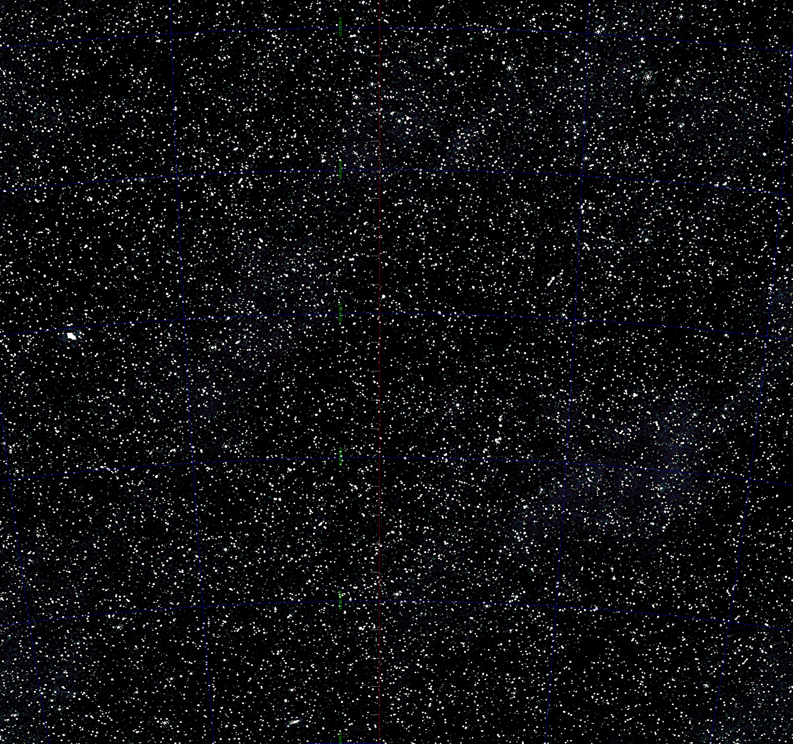
Questions?
Image: Andre Offringa

Slide 16
New Receivers: NI Rx “first light” (May 2022)
Jake’s first light plot – looking good!

Slide 17
What’s new and what’s not?
New
Not New
Farewell old fine (10 kHz) PFBs
1.28 MHz coarse channels are the basic data unit flowing in system
Straightforward to capture raw coarse channels, no inverting fine PFB required
LOTS of new time/freq modes
See wiki: https://wiki.mwatelescope.org/display/MP/New+Correlator+-+MWAX
Same oversampled coarse channels with PFB bandpass edges
Fringe stopping still applied in post-processing (for now)
Time and/or bandwidth decorrelation still need to be considered (for now)

Slide 18
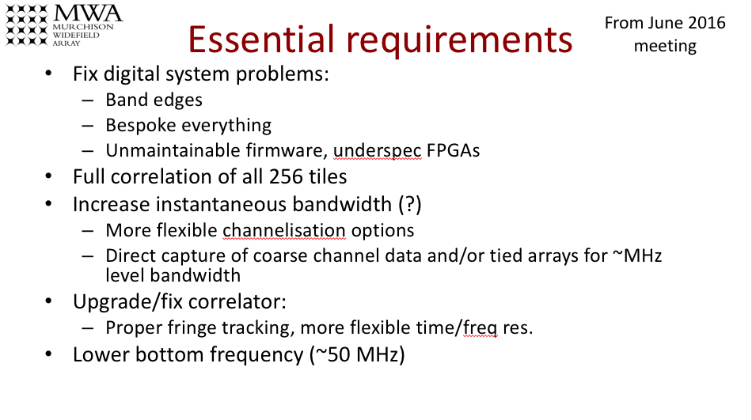
Outline
MWAX update
Brief history
Oct 2014: “Phase II” planning
June 2016: “Phase III” aspirations
Many desired enhancements
Funding secured last year for hardware
Key to unlocking this: un-hardwire the signal chain
Move to standard network-based signal chain like most other low frequency telescopes
Brian Crosse
Ian Morrison
Greg Sleap
+ MWA ops team

Slide 19
Receivers update
For 10 years, the 16 in-field receivers have serviced MWA
With Phase II, relocation of receivers is required to change from compact <-> extended configs
Effectively irreplaceable, it is remarkable that they have survived this long
NI-based units were acquired a few years ago as potential replacements for the digital part, but could not be (easily) integrated with the old correlator
There’s one…

Slide 20
New Receivers: NI receiver
Clock
Early in 2022, the LBGx RFoF fibres were re-routed and the prototype installed on site
Supporting hardware for power, data transport (data networking), and clock deployed
Standard RFoF optical receivers moved from field
The clock distribution is new and serves as a prototype for future expansion
M&C network
Power
RFoF optical-> electrical
NI digital units
Clock distribution
Data transport
Freq synth

