Slide 1
崇祯历书
The Chongzhen Calendar
主创团队：宇宙黎明骑士团
Team: Cosmic Dawn Knights

Slide 2
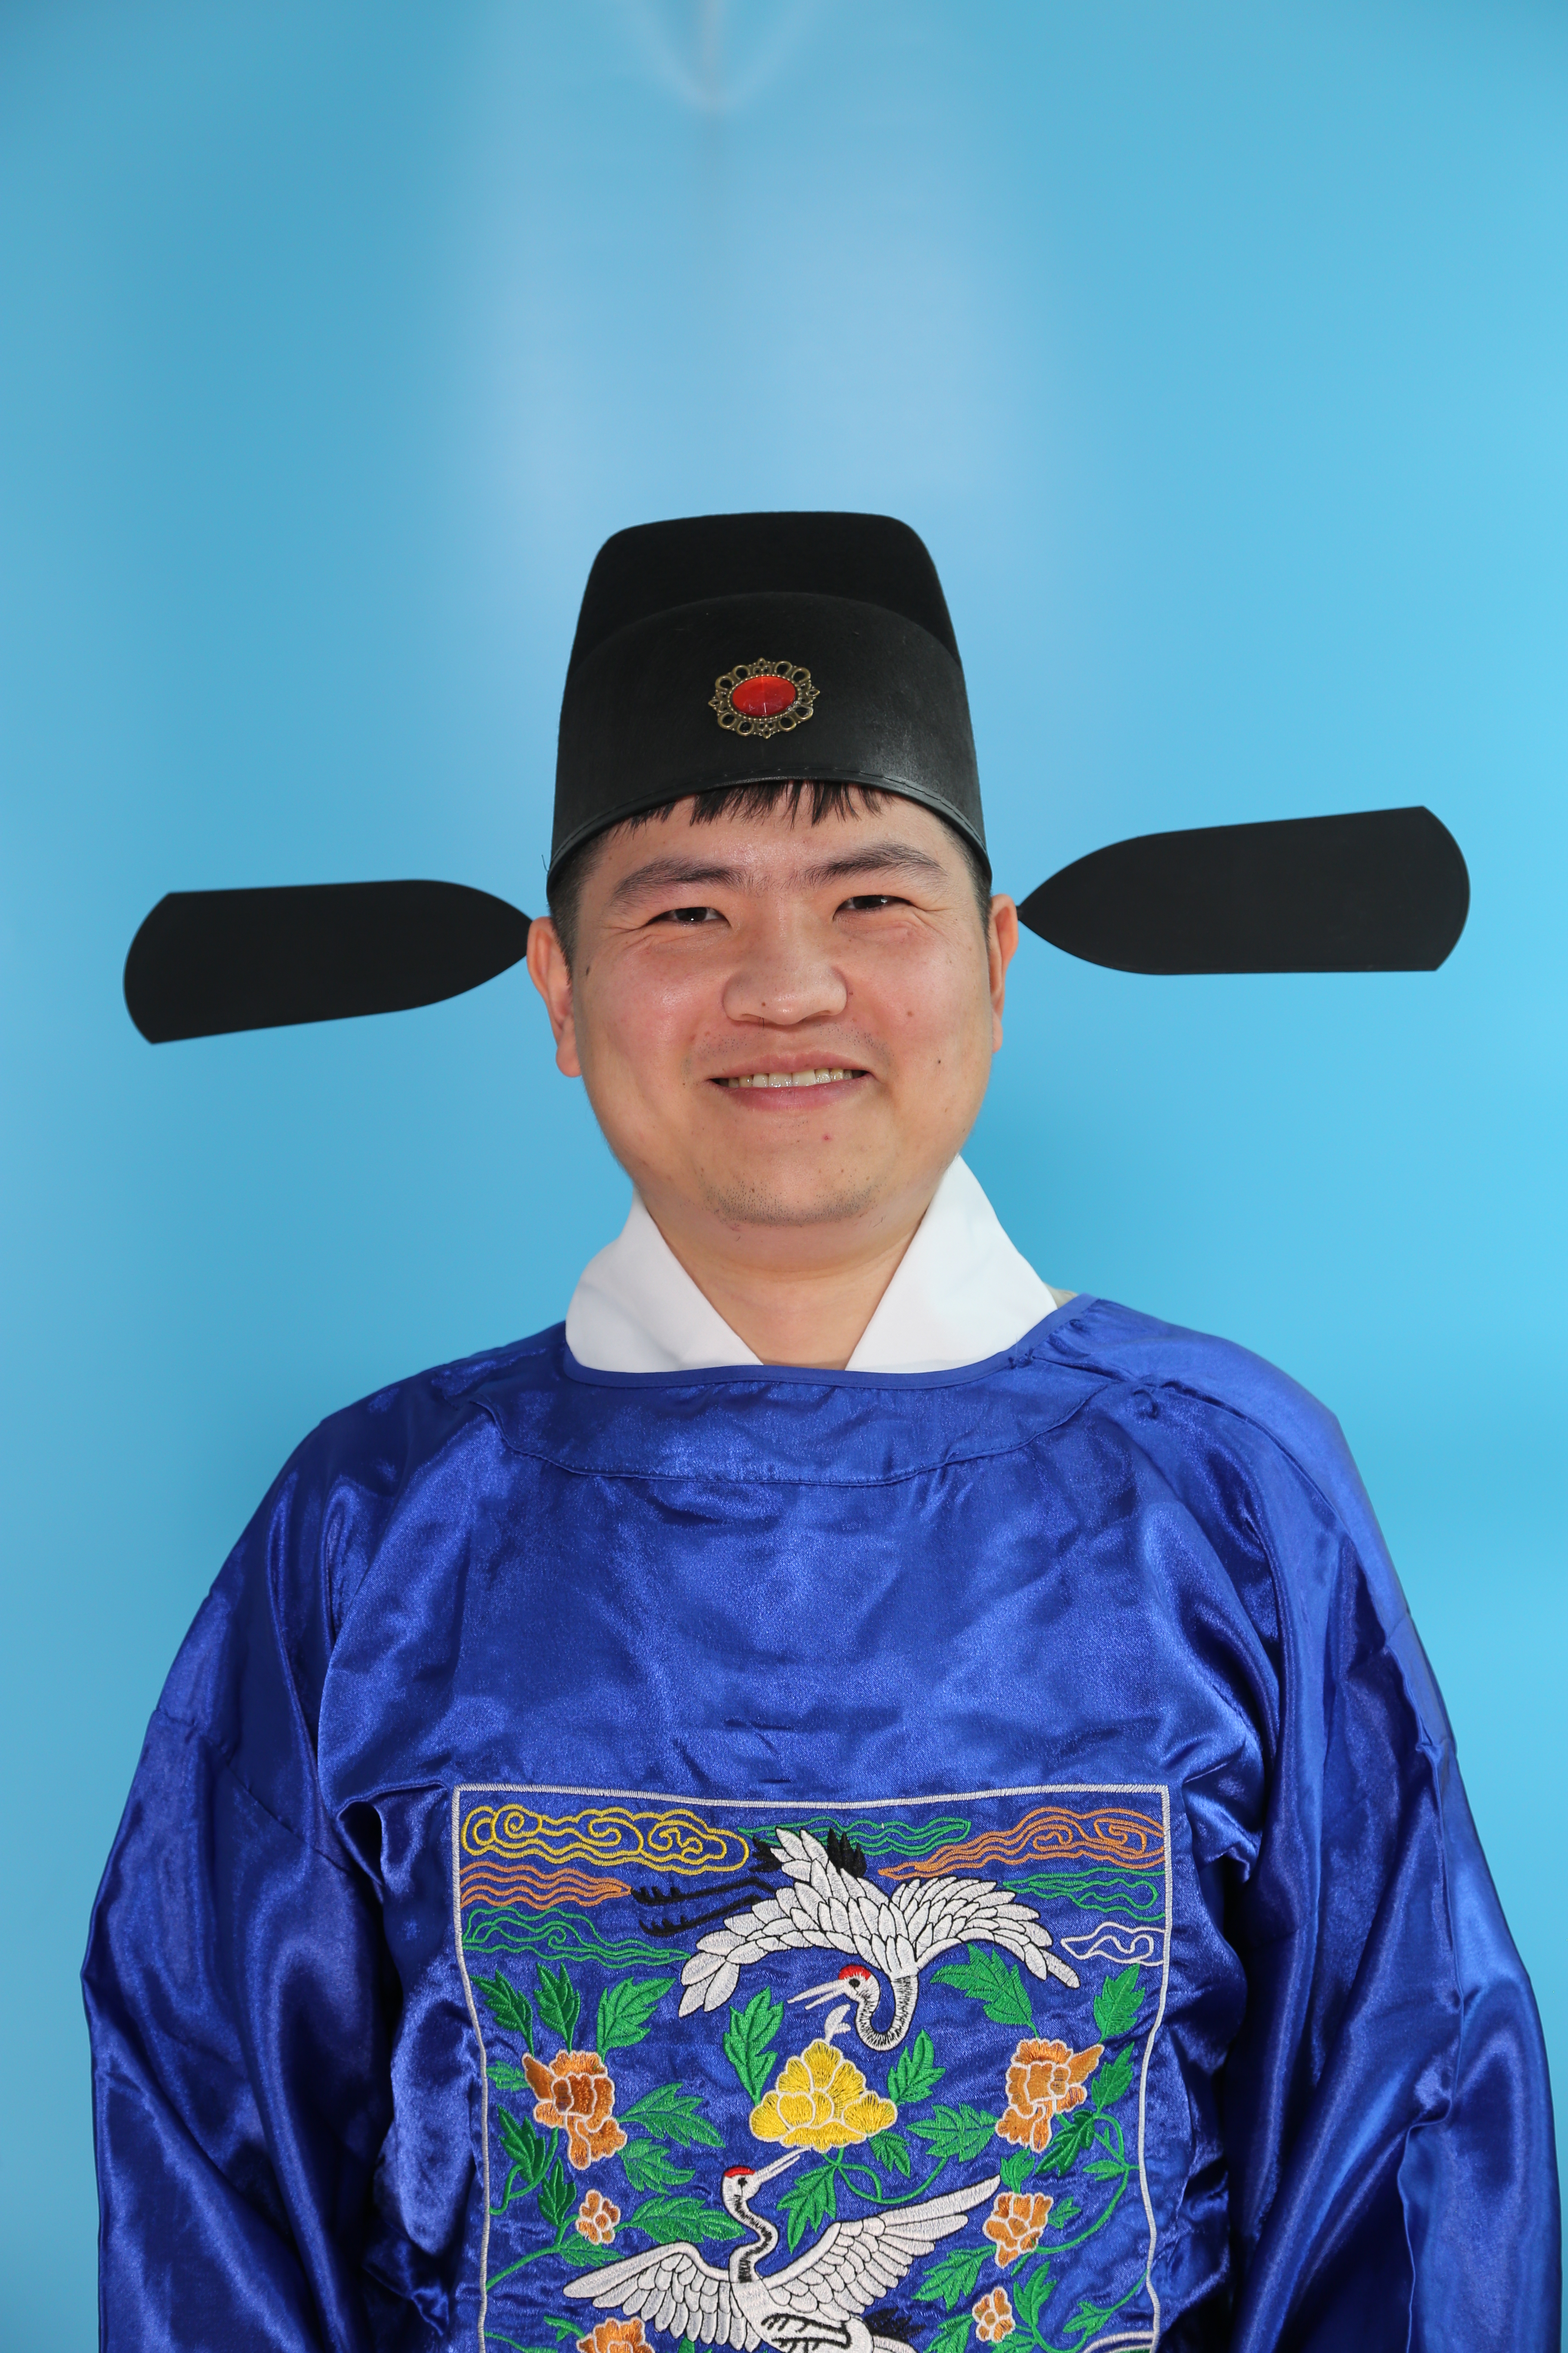
人物
魏文魁 Wenkui Wei： Male, he founded the East Bureau, published <Li Yuan> <Li Ce>, an astronomer who sticked to traditional Chinese methods.
戈丰年 Fengnian Ge：Male, Chief Astrologer of the Imperial
Observatory
徐光启 Guangqi Xu： Male, 67-70 years old in this period. He founded the Calender Bureau. He is an expert in astronomy and algriculture, introduced western science to China.

Slide 3
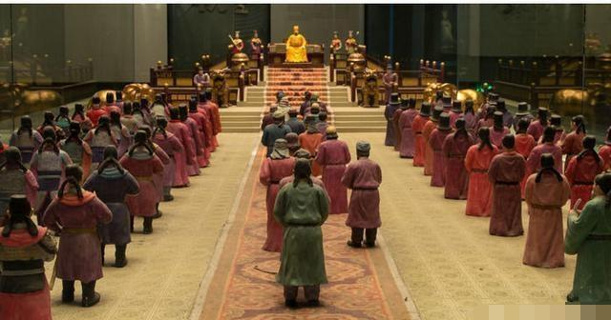
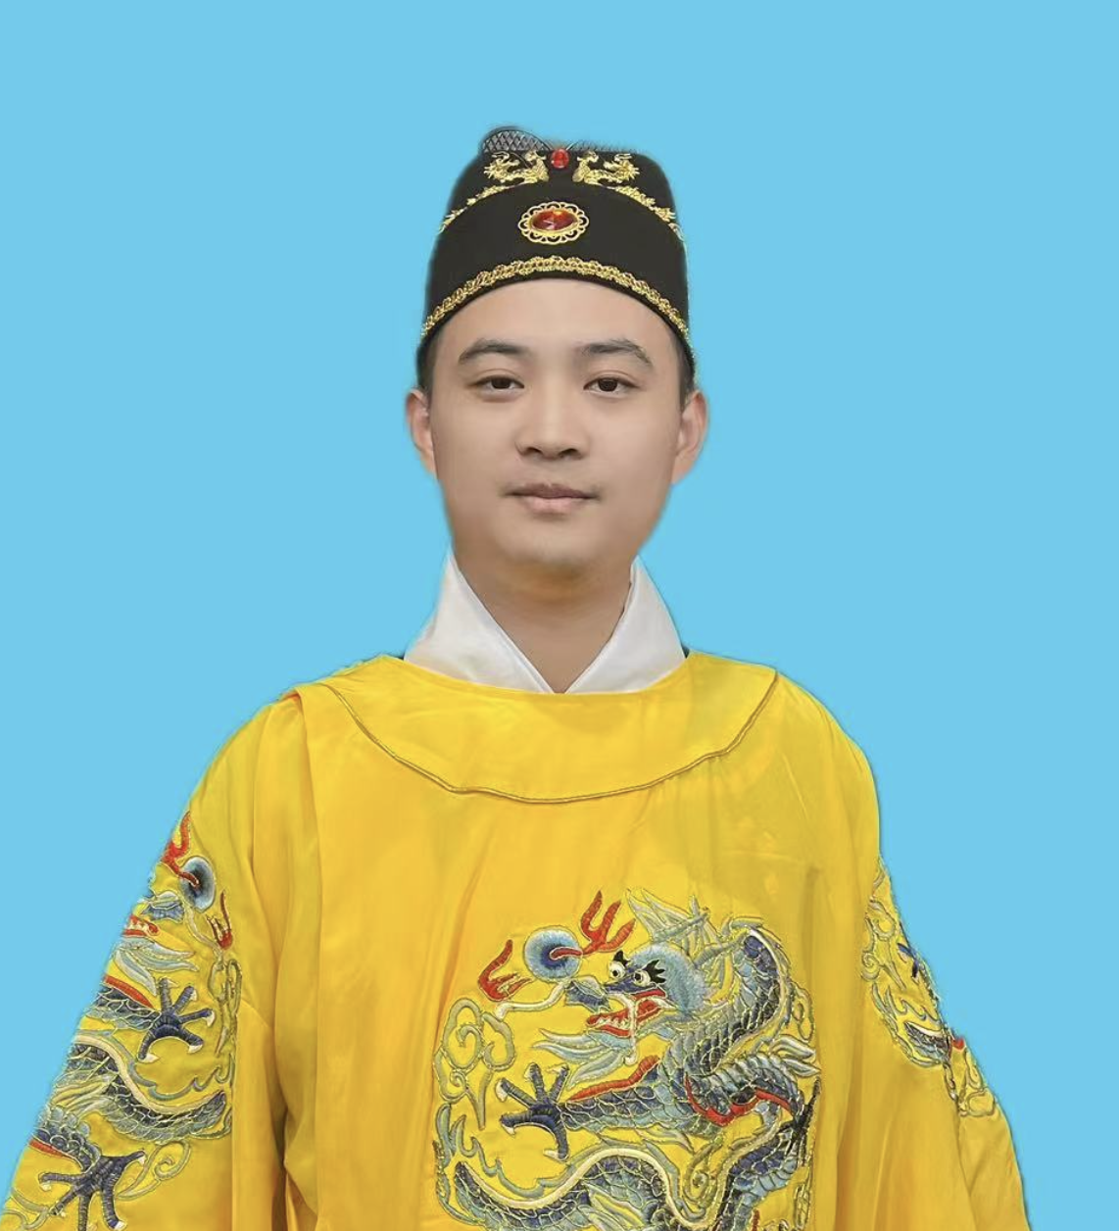
崇祯帝 Emperor Chongzhen： Male, 18 years old. He is the fianl emperor of Ming dynasty. 。

Slide 4
人物
汤若望Johann Adam Schall von Bell： Male. 37 years old. German, Catholic missionary, assisted in completing the "Chongzhen Calendar," becoming the Chief Astrologer of the Imperial
Observatory during the Qing Dynasty.
邓玉函 Johann Schreck：Male. 53 years old. German, Catholic
missionary, colleague and friend of Galileo, member of the Roman
Academy of Lincei. The first person to bring astronomical telescopes to
China. Passed away in 1630.

Slide 7
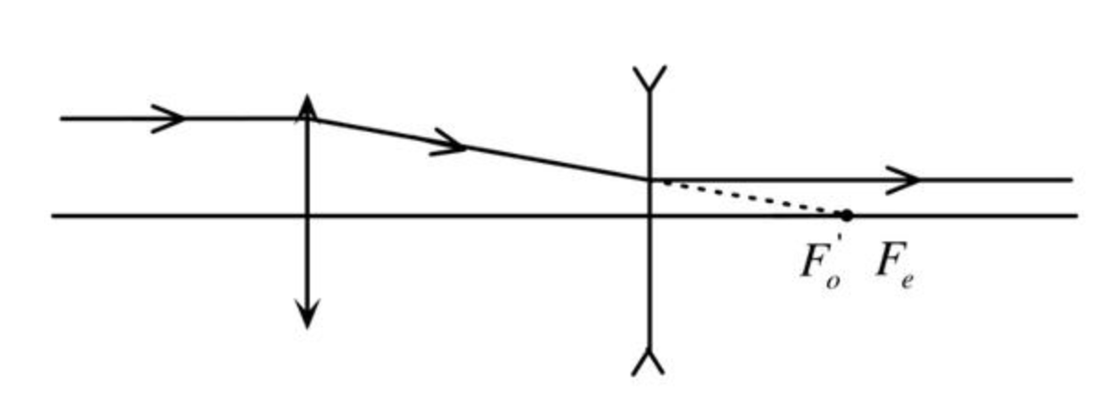
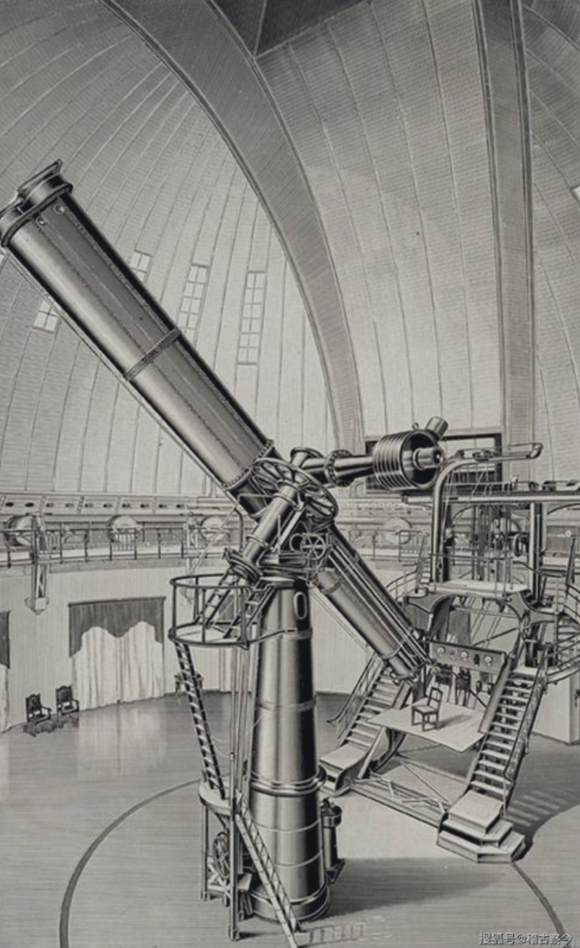
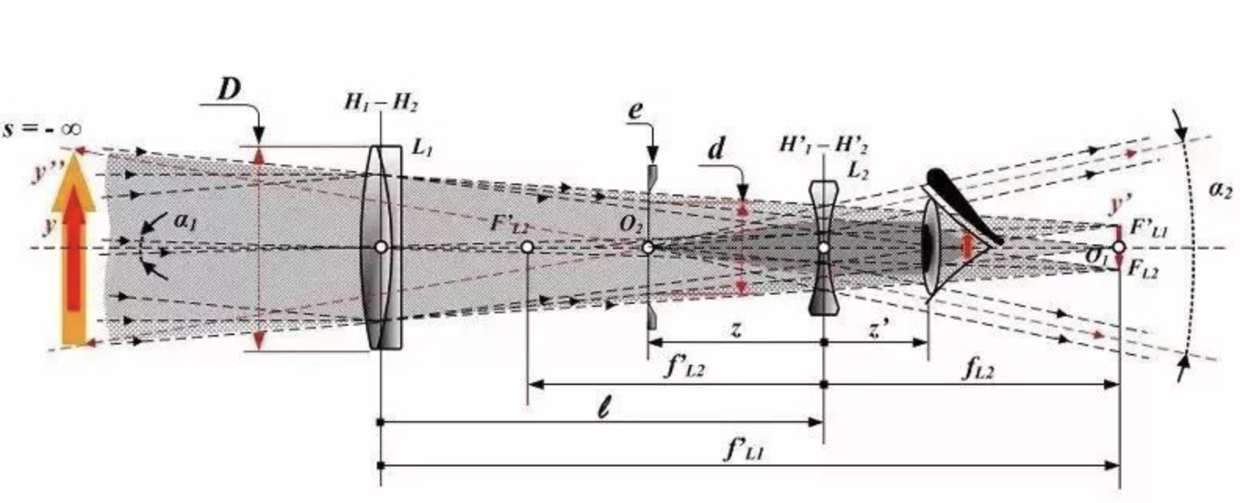

Slide 9
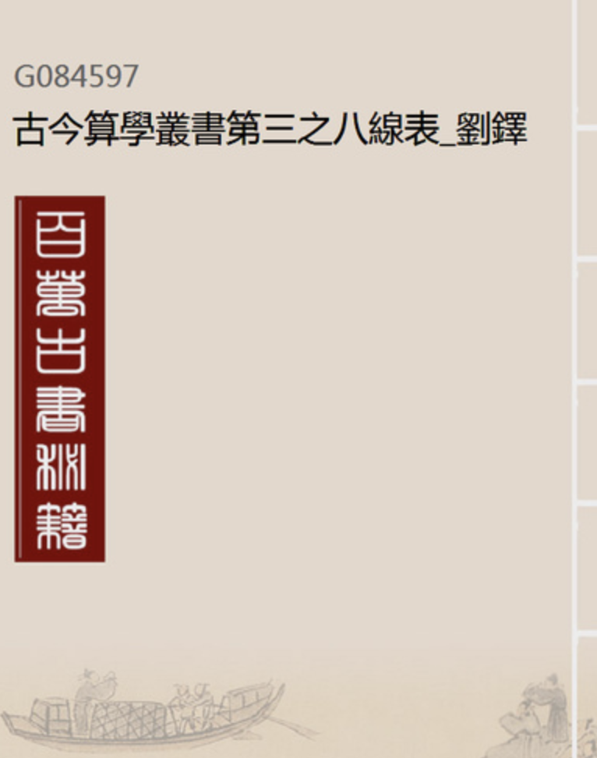
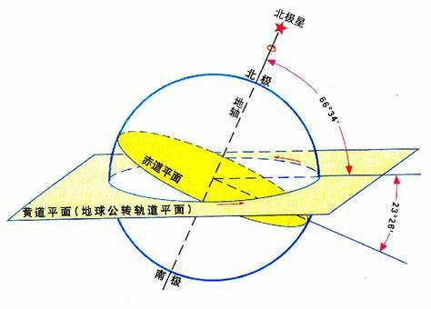

Slide 13
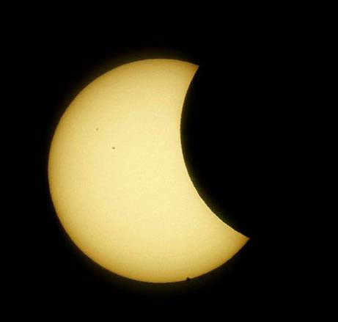

Slide 15
Guangqi Xu passed away soon, the Chongzhen Calender was finished in 1634, applied national wide in 1643, Ming dynasty ended in 1644.
Johann Adam Schall von Bell became the Chief Astrologer of the Imperial
Observatory during the Qing Dynasty.The Chongzhen Calender was updated into Shixian Calender，which becomes the Lunar calendar used in China today.

