Slide 1
MWA Archive Update
December 2020 – MWA Project Meeting
Presented by Greg Sleap, Curtin University/MWA

Slide 2
MWA Archive Update
State of the archive
Data Retention Policy
Rucio Evaluation Update
Phase 3 Data flow
MWA Project Meeting
2
Notes:
2

Slide 3
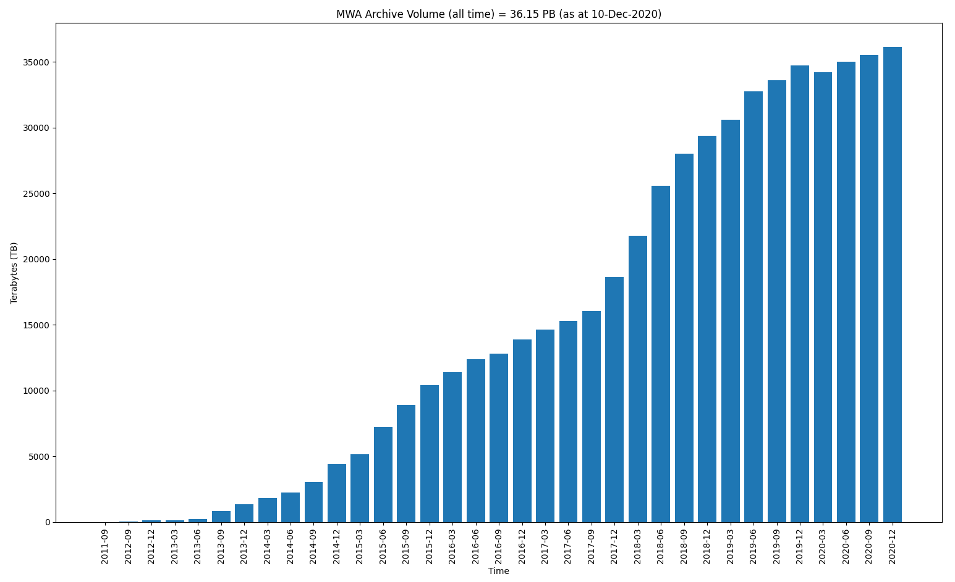
State of the Archive
36.15 / 40.00 PB
MWA Project Meeting
3
Notes:
3

Slide 4
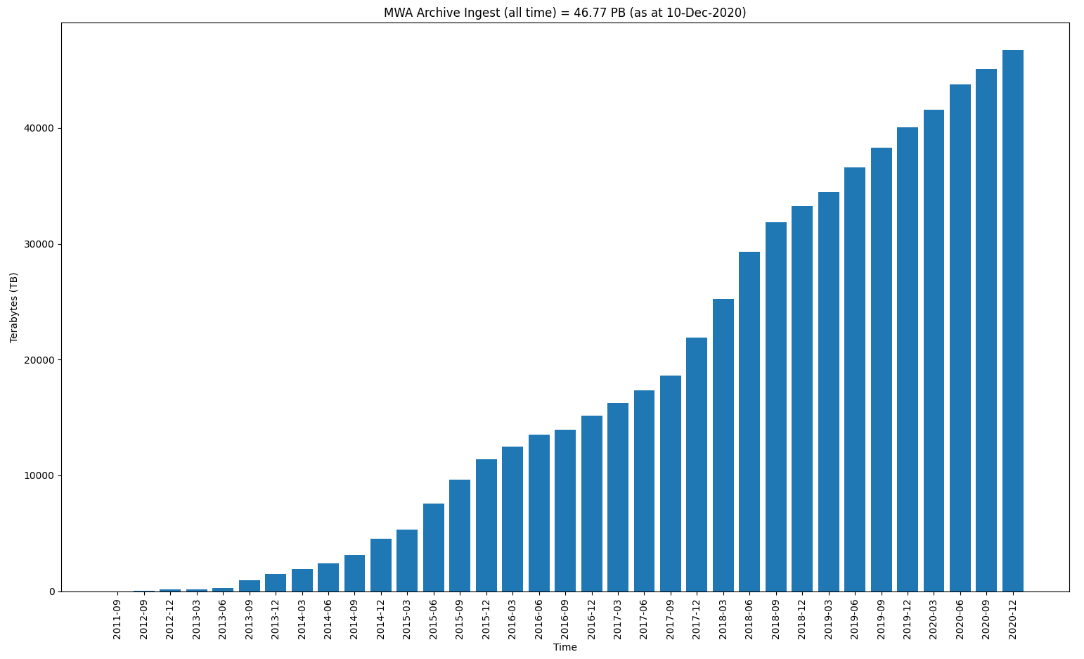
State of the Archive
46.77 PB (without deletes)
MWA Project Meeting
4
Notes:
4

Slide 5
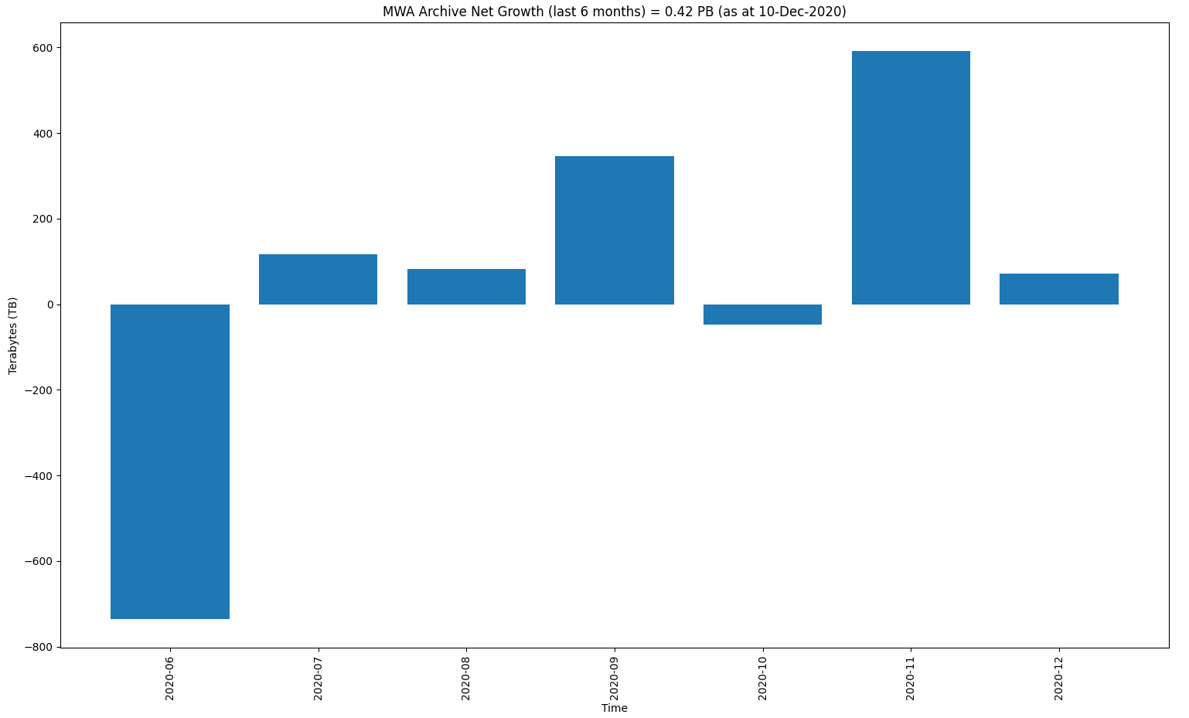
State of the Archive
0.42 PB Net Growth(!)
MWA Project Meeting
5
Notes:
5

Slide 6
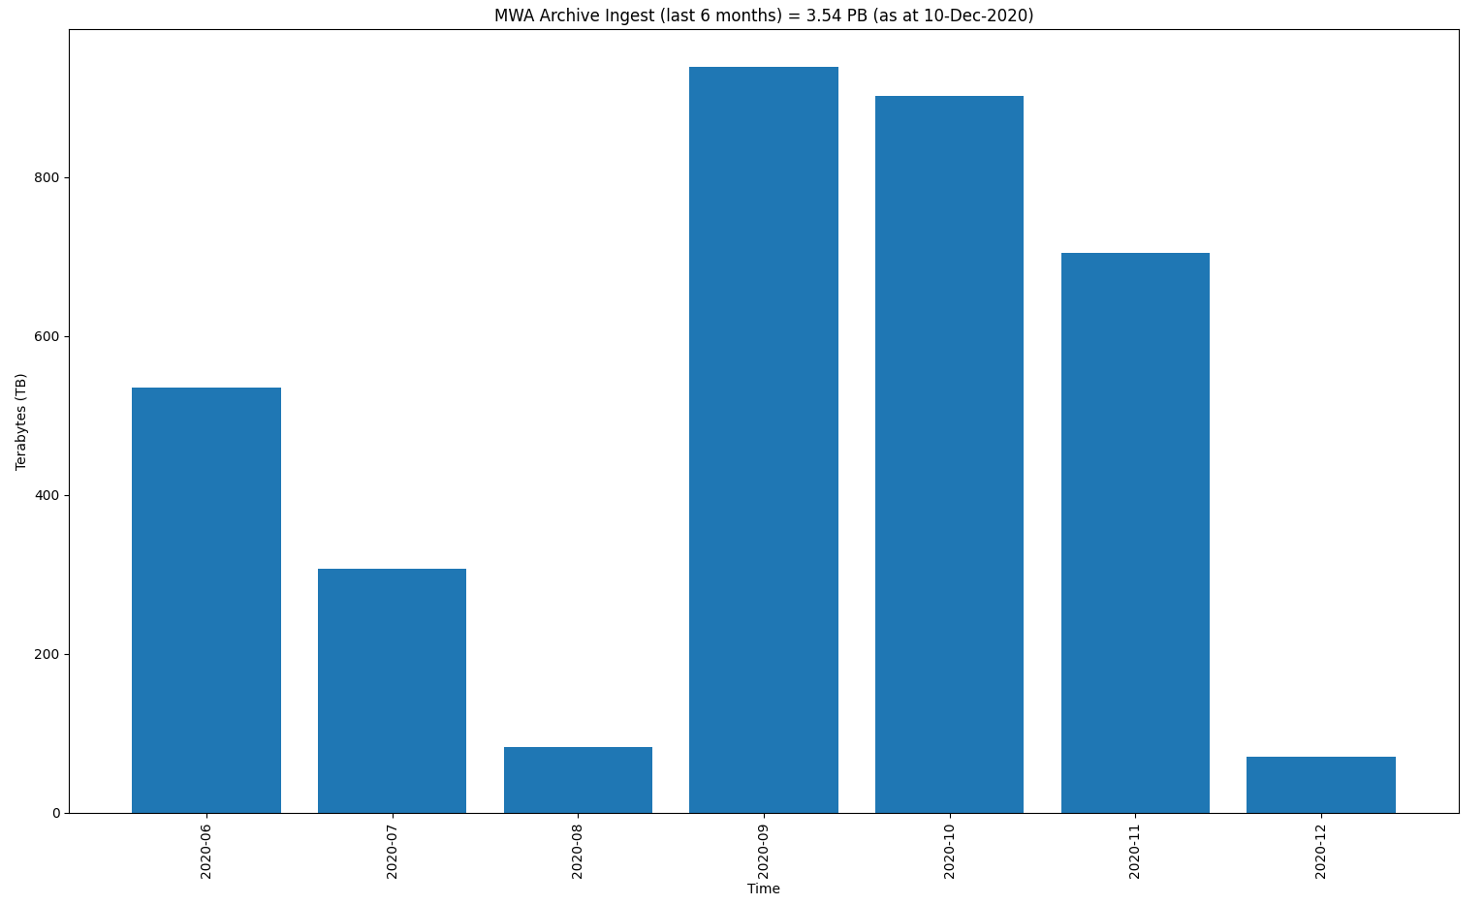
State of the Archive
3.54 PB
(without deletes)
MWA Project Meeting
6
Notes:
6

Slide 7
State of the Archive
Solar
VCS FRBs
ASKAP shadowing
Calibration
GLEAM
Parkes MSP
SMART survey
EoR
Director’s time
Other
IPS
EoR moon
MWA Project Meeting
7
Notes:
7

Slide 8
Data Retention Policy
Data Retention Policy is now published and approved by the MWA Board
https://www.mwatelescope.org/images/documents/2019_policies/20201102_MWA_Data_Retention_Policy.pdf
MWA Project Meeting
8
Notes:
8

Slide 9
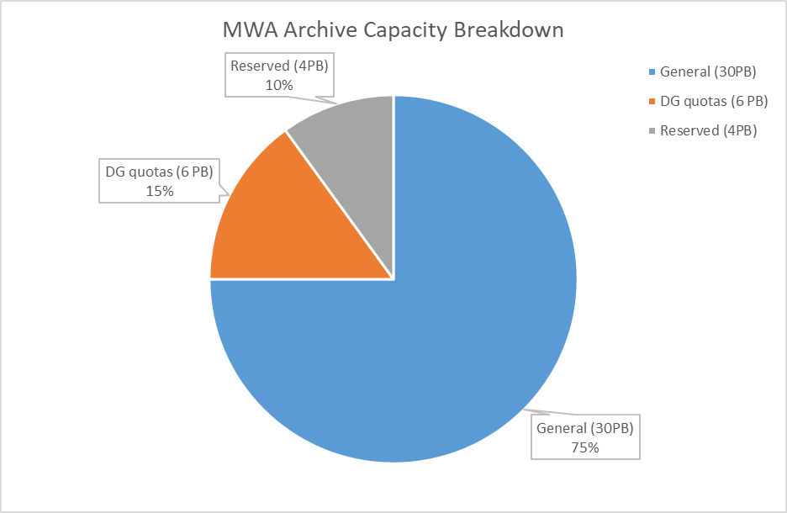
Data Retention Policy
MWA Project Meeting
9
Notes:
9

Slide 10
Data Retention Policy
Data Groups (DG)
EoR, SHI, GEG, Slow Transients, VCS, Ops +
Quotas determined by Director with input from SWG leads + Principal Scientist
Quota changes during Call for Observing Proposals
DG leads manage their quotas
DG leads may protect any observations
Protected observations won’t be removed
Protections expire after 12 months
MWA Project Meeting
10
Notes:
10

Slide 11
Data Retention Policy
Last day of the month
Identify oldest non-protected & email report
DG Quota Protected obs Management
Automated Delete of oldest non-protected
First day of the month
!
☺
General is >90% full
General is <= 90% full
MWA Project Meeting
11
Notes:
11

Slide 12
Data Retention Policy
Initial implementation will start during Q1/2 2021
Harry to present on MWA ASVO UI changes
First cycle will be extended/longer than usual
Plenty of time available before any data is removed
Positions us well for Phase 3 data challenges
MWA Project Meeting
12
Notes:
12

Slide 13
Data Retention Policy
Proposal
Data is Public
Data Removal
Schedule
Observe
Proprietary Period
Science Team backup/ archive
MWA Project Meeting
13
Notes:
13

Slide 14
Rucio Evaluation Update
Pawsey-led Rucio evaluation
Sandbox deployment
Very large technology stack required
Deep sysadmin knowledge vital
Non-Atlas use case not well supported
xrootd for data transfer
Pawsey new Long Term Storage
MWA Project Meeting
14
Notes:
14

Slide 15
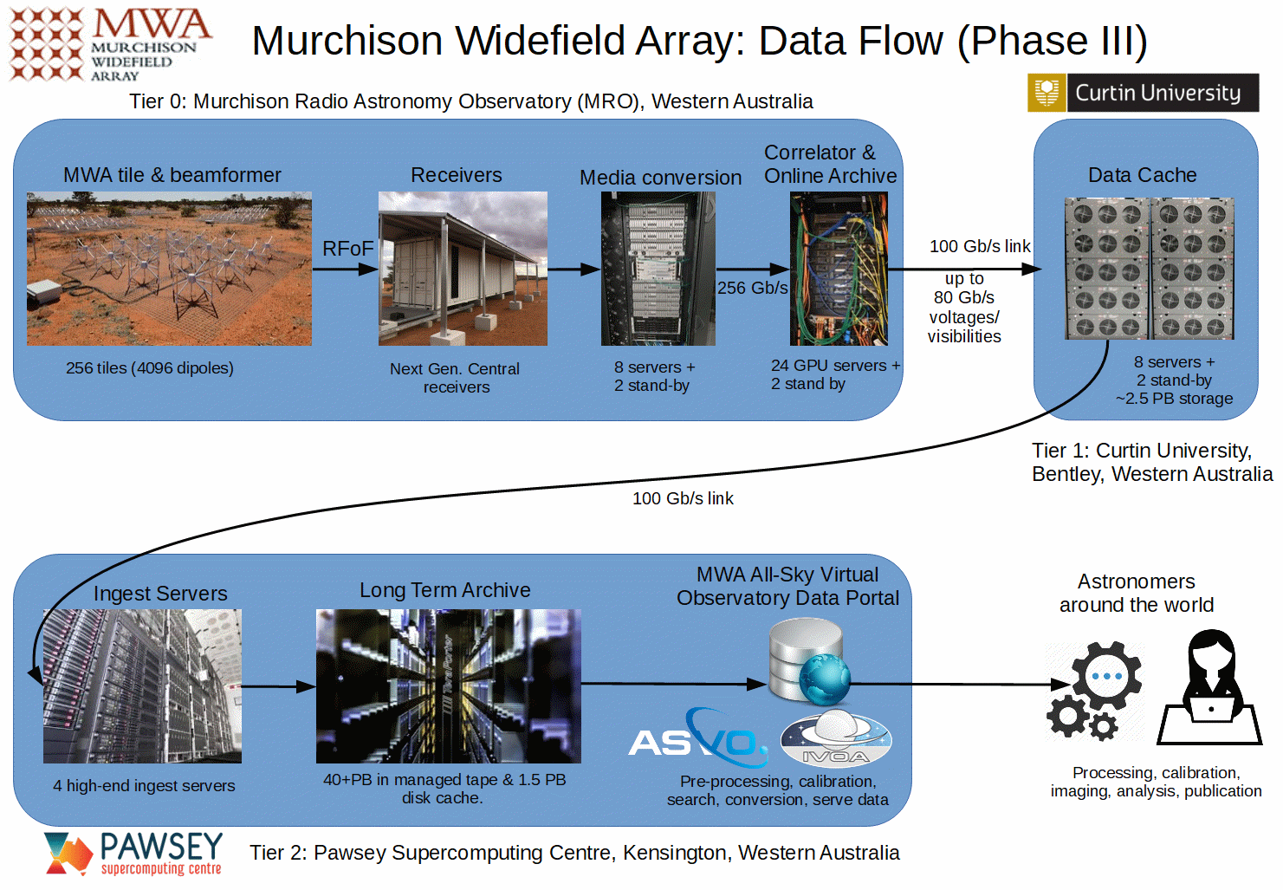
MWA Phase 3 Data Flow

Slide 16
MWA Phase 3 Data Flow
New Pawsey ingest nodes (testing)
xrootd pushing data
Utilise 100G links MRO->Curtin->Pawsey
Intermediate storage on mwacache servers
Integration with Pawsey new Long Term Storage (early testing promising)
MWA Project Meeting
16
Notes:
16

Slide 17
Thank You!
Questions?
Contact:
Greg Sleap (MWA Data Manager) greg.sleap@curtin.edu.au
MWA Project Meeting
17
Notes:
17

